Slide 1

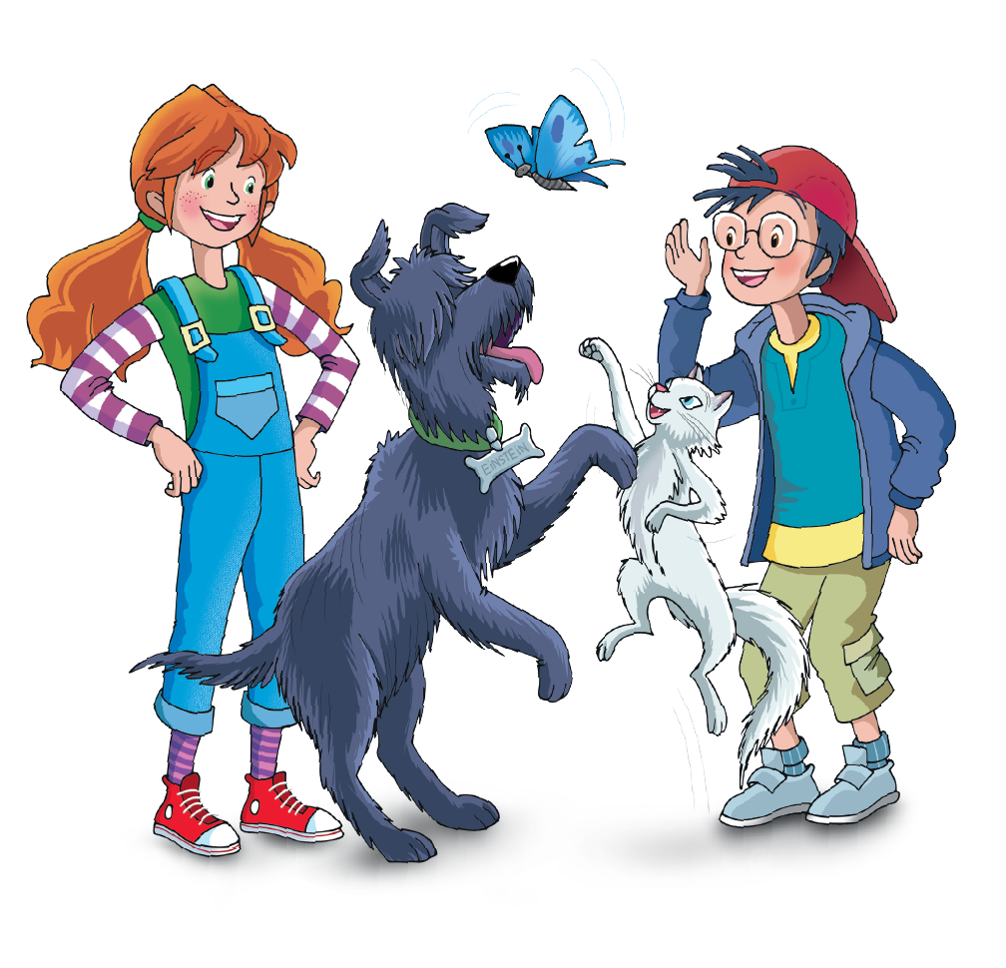
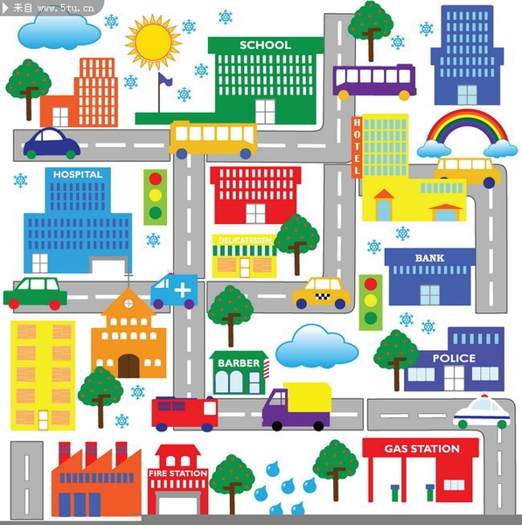
UNIT 10 – AROUND THE TOWN
Lesson 8 – Project

Slide 2

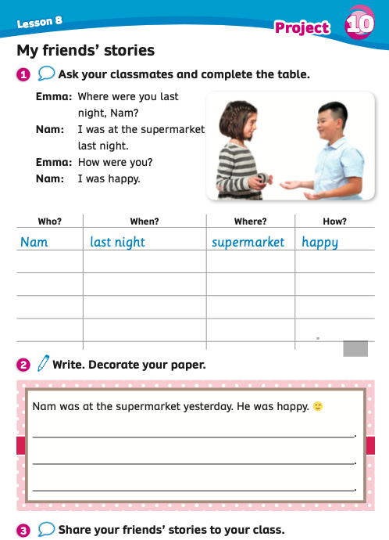
UNIT 10: AROUND THE TOWN
Lesson 8
We’re learning…
Practice talking about past events and feelings
PB p.119
AB p.103

Slide 3



WARM-UP
Look at the video.
Listen, sing and dance along to the song.
Notes:
Link Youtube:

Slide 4
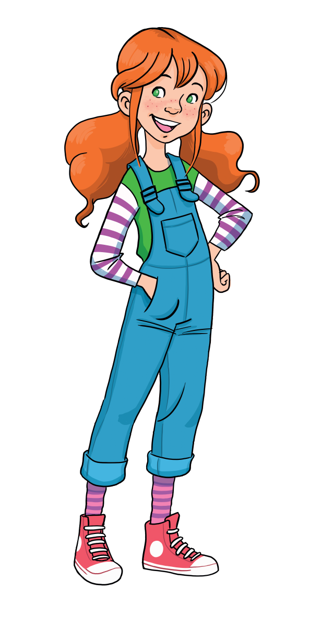
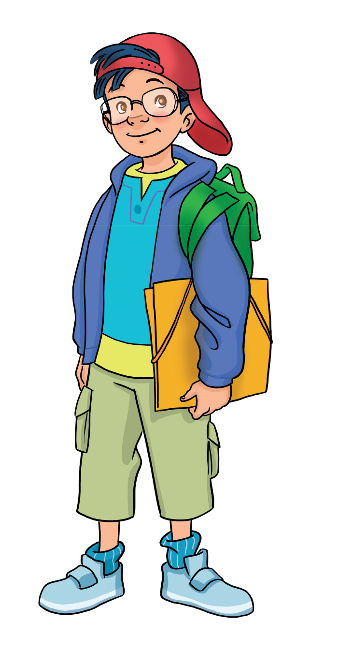
WARM-UP ACTIVITY
Let’s play!
Divide students into groups of four to six students.
Each member of the group stands up and plays the game.
Students look at the question with the picture and raise their hands to get a chance to answer the question.
The first student with the correct answer receives 2 points for the team.
All students repeat the answers.

Slide 5




MsPham-0936082789
START

Slide 6


Next
Where were you yesterday?
Check
MsPham-0936082789
I was at the supermarket.

Slide 7
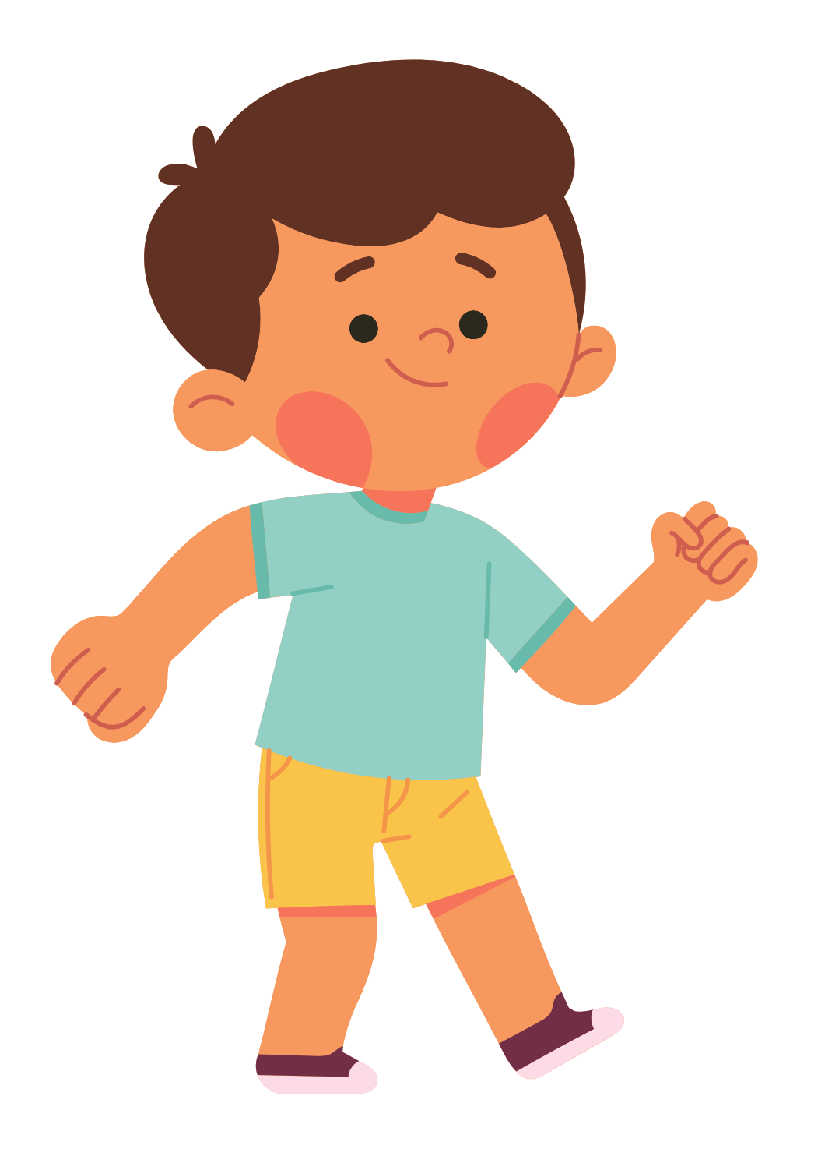
Next
How were you last weekend?
Check
MsPham-0936082789
I was happy.

Slide 8

Next
Where were they last night?
Check
MsPham-0936082789
They were at the restaurant.

Slide 9

How were you last night?
Next
Check
MsPham-0936082789
We were surprised.

Slide 10

Where were you yesterday?
Next
Check
MsPham-0936082789
I was at the post office.

Slide 11
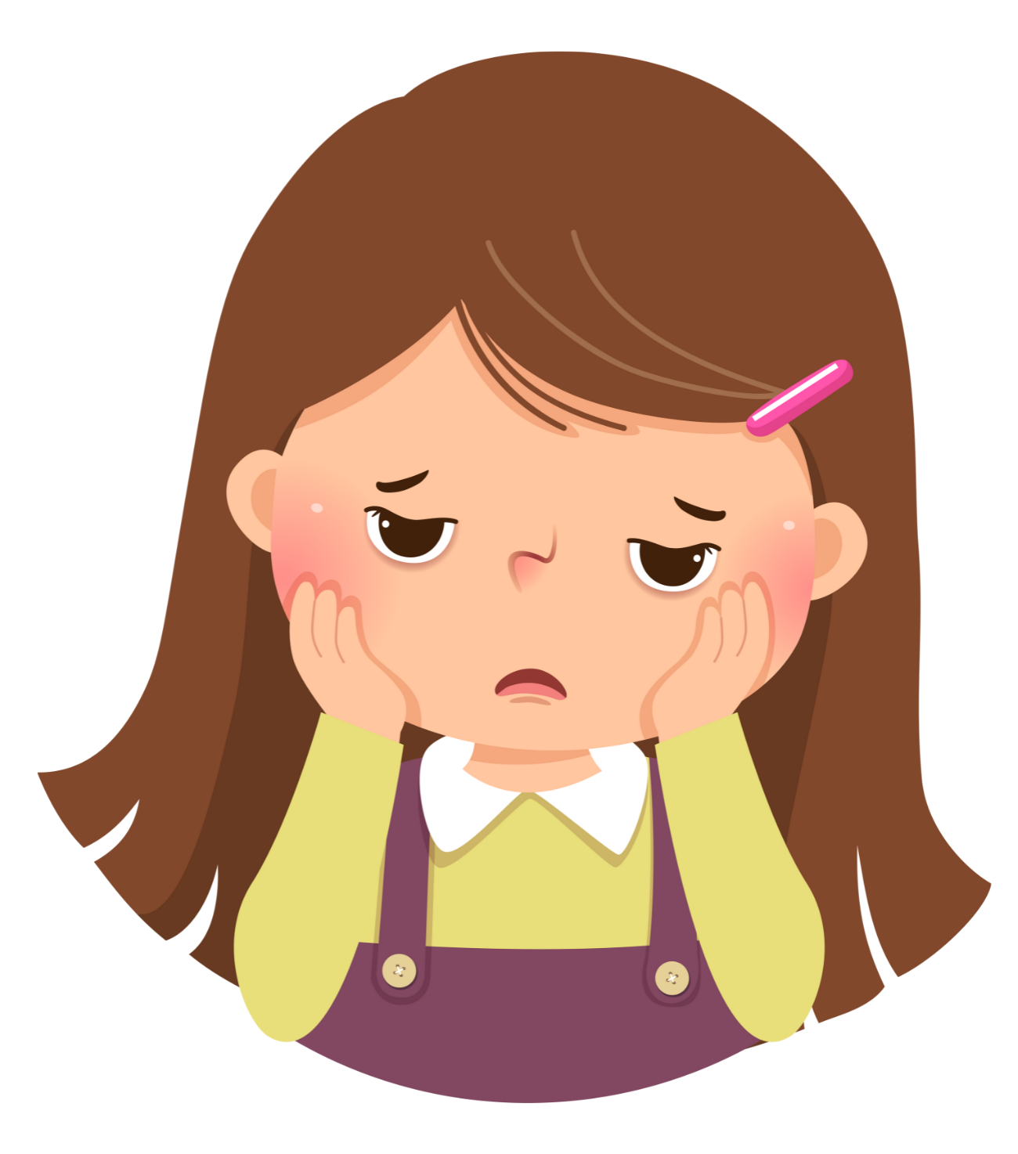
How were you last night?
Next
Check
MsPham-0936082789
I was bored.

Slide 12
MsPham-0936082789
Exit

Slide 13
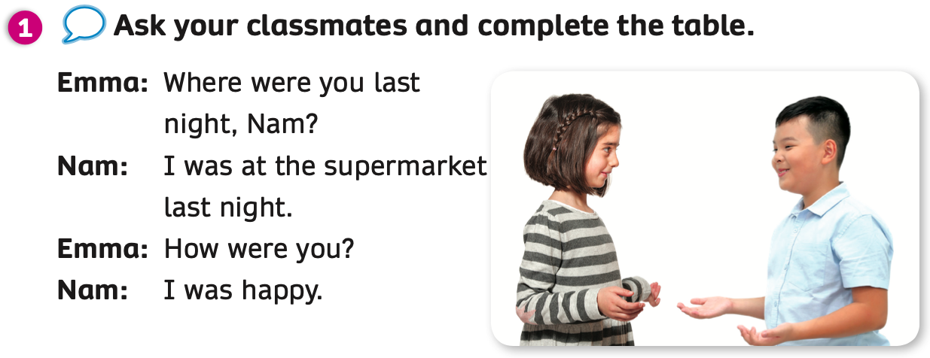
PUPILS’ BOOK p.119
Divide the class into two teams. One team takes on the role of Emma. One team takes on the role of Nam. They role-play the dialogue.
Then students work in pairs. They take on the roles of Emma and Nam and practice.

Slide 14
PUPILS’ BOOK p.119
List out:
Name of your friends in the class in one minute.
Divide the class into groups of four students. Each group takes out a sheet of paper.
Students discuss and write the names of their friends in the class in one minute.
The group with the most names receives 2 points.

Slide 15
PUPILS’ BOOK p.119
ANSWER
When?
last weekend
last night
yesterday
Students work in groups of four. They discuss and write words about the question words.
The first 3 groups who finish the activity receive 2 points.

Slide 16
PUPILS’ BOOK p.119
ANSWER
restaurant
park
post office
bookshop
department store
Where?
chemist
bakery
bank
supermarket
cinema
Students discuss and write words about the question words.
The first 3 groups who finish the activity receive 2 points.

Slide 17
PUPILS’ BOOK p.119
ANSWER
scared
angry
sad
How?
surprised
bored
happy
Students discuss and write words about the question words.
The first 3 groups who finish the activity receive 2 points.

Slide 18
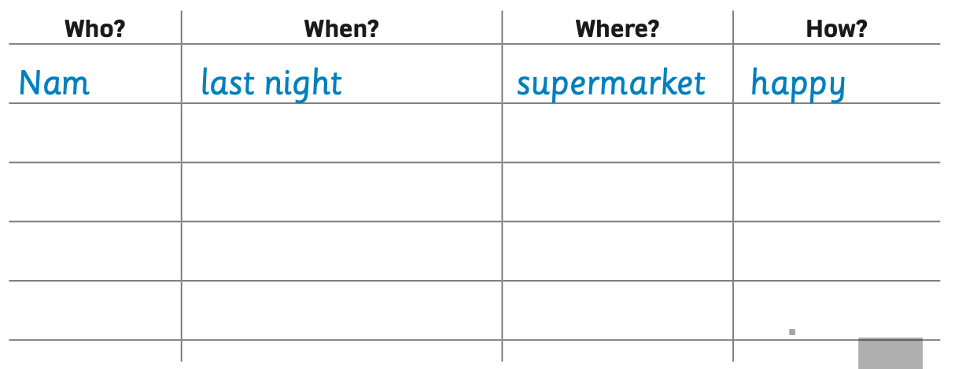
PUPILS’ BOOK p.119
Have students open their books and look at the table. Ask them to focus on 4 question words: Who? When? Where? How? with the example item on the first line.
Look at the example dialogue on the next slide.

Slide 19
PUPILS’ BOOK p.119
EXAMPLE
How were you?
Where were you yesterday, Sam?
I was at the bakery.
I was surprised.
Sam
yesterday
bakery
surprised
Students look at and read the example questions and answers.

Slide 20
PUPILS’ BOOK p.119
Places: chemist, supermarket, bookshop, park, restaurant, bank, post office, department store, bakery, cinema.
Feelings: sad, happy, angry, bored, scared, surprised.
Sam
yesterday
bakery
surprised
Have students go around the room and ask other students what they did in the past.
Students are to fill in the table after talking to their classmates.
Students can choose a place and a feeling on the table to answer.

Slide 21
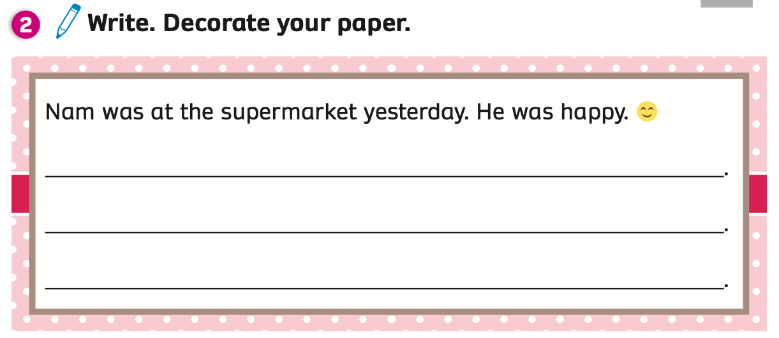



PUPILS’ BOOK p.119
EXAMPLE
Sam was at the bakery yesterday. He was surprised.
Lucy was at the post office last night. She was angry.
Ben was at the restaurant last weekend. He was sad.
Show students the example sentences and ask students to read them aloud.
Explain that they will write sentences based on the information they recorded in the table.
Have students work individually to write 3 sentences on their books.

Slide 22

PRODUCTION
Sam was at the bakery yesterday. He was surprised.
Lucy was at the post office last night. She was angry.
Ben was at the restaurant last weekend. He was sad.
EXAMPLE
Divide students into groups of four to six students. Each student takes turns sharing a few of the sentences they wrote with the others.
Call some students to come to present in front of the class.
Give points to students.

Slide 23

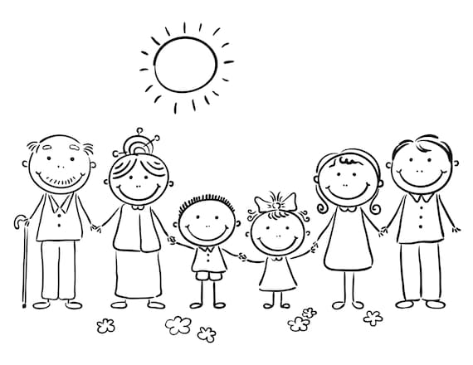
PRODUCTION (OPTIONAL)
EXAMPLE
I was at __________yesterday.
I was _____.
the bookshop
happy
My ____ was at _________. He wasn’t at ________.
He was______.
dad
the bakery
the bank
bored
My ____ was at ____________. She wasn’t at ____________.
She was________.
sister
the supermarket
the post office
surprised
Ask each student to take out a sheet of paper. They will draw about their family and write sentences about their members and what they did in the past.
Students practice speaking at home, record a video and send it to the teacher.

Slide 24

HOMEWORK
Review vocabulary and grammar.
Do exercise 2,3 in the Activity book (page 102).
Check answers in the Teacher’s book (page 216) or Active Teach.

Slide 25
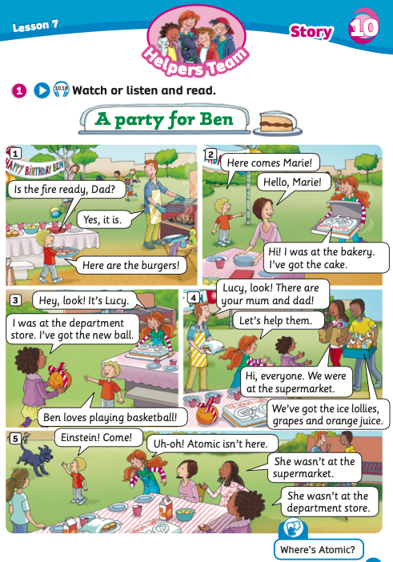
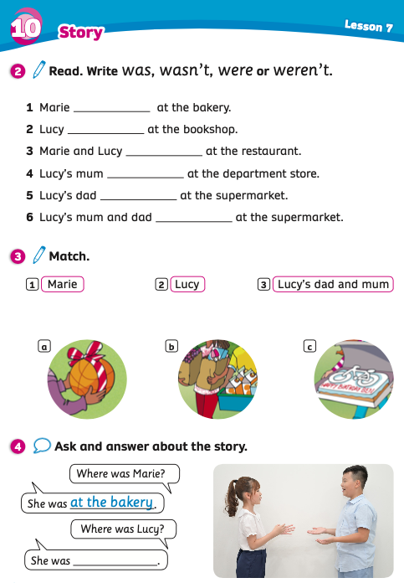

UNIT 10: AROUND THE TOWN
Lesson 7B
We’ve learned…
Understand a simple story:
“A party for Ben”

