Slide 1

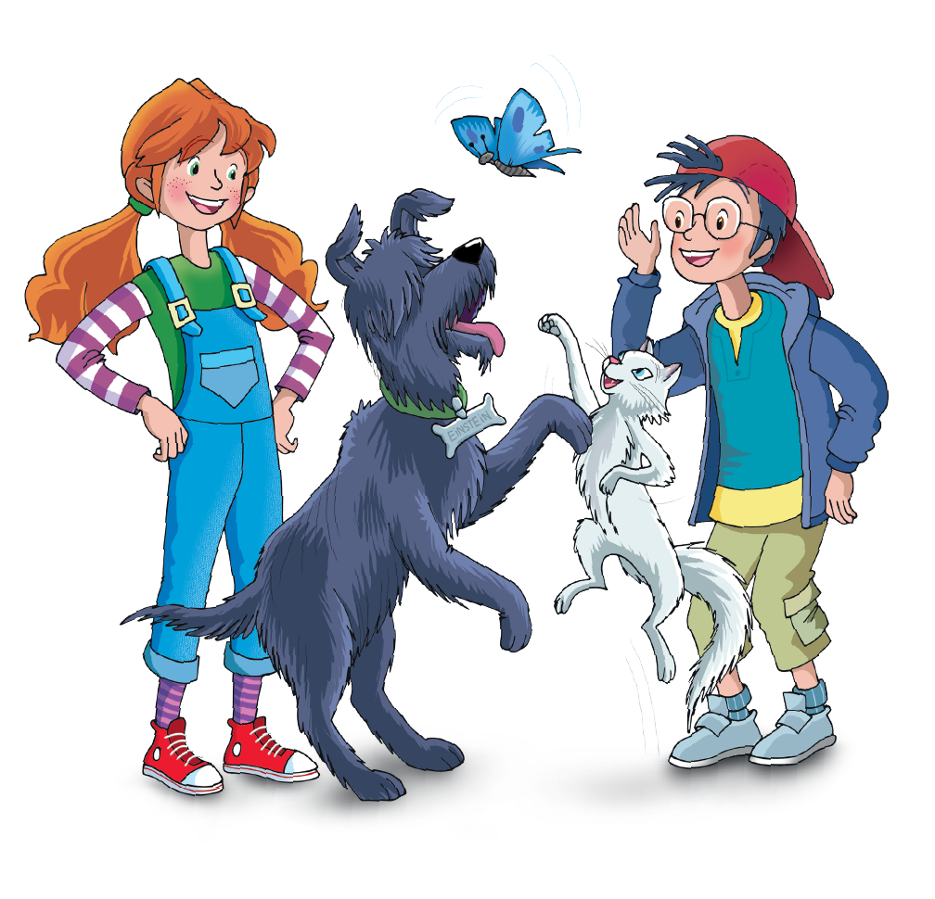
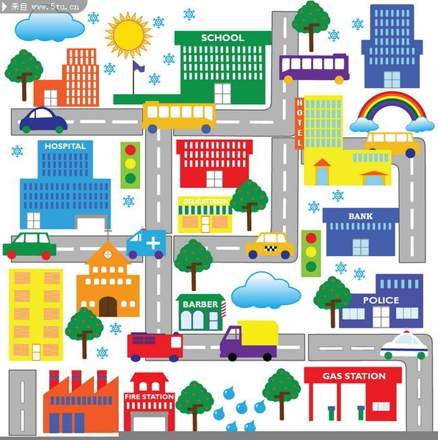
UNIT 10 – AROUND THE TOWN
Lesson 2 – Review

Slide 2

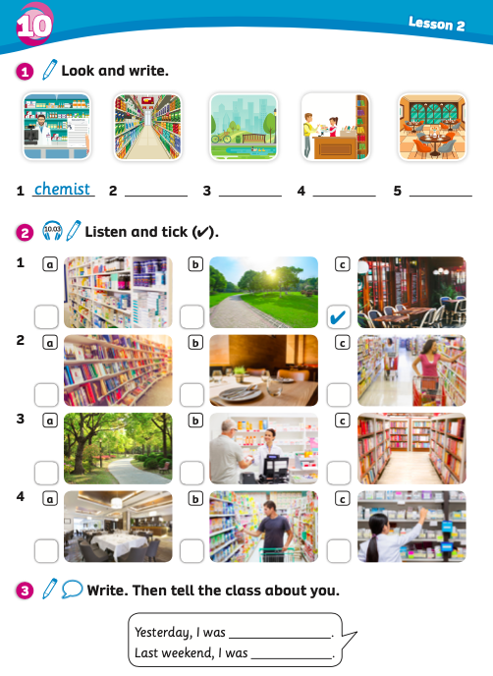
UNIT 10: AROUND THE TOWN
Lesson 2
We’re learning…
Learn the names of shops.
PB p. 112
AB p. 97

Slide 3

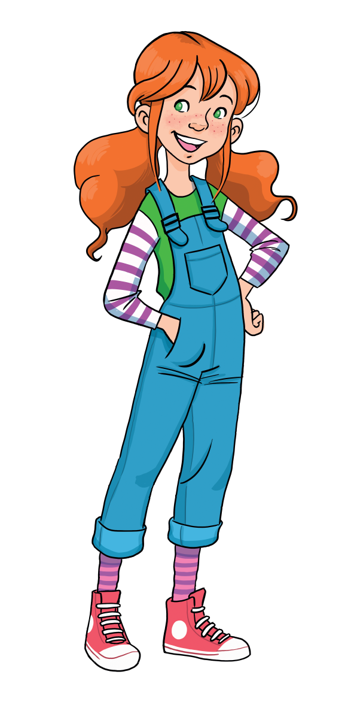
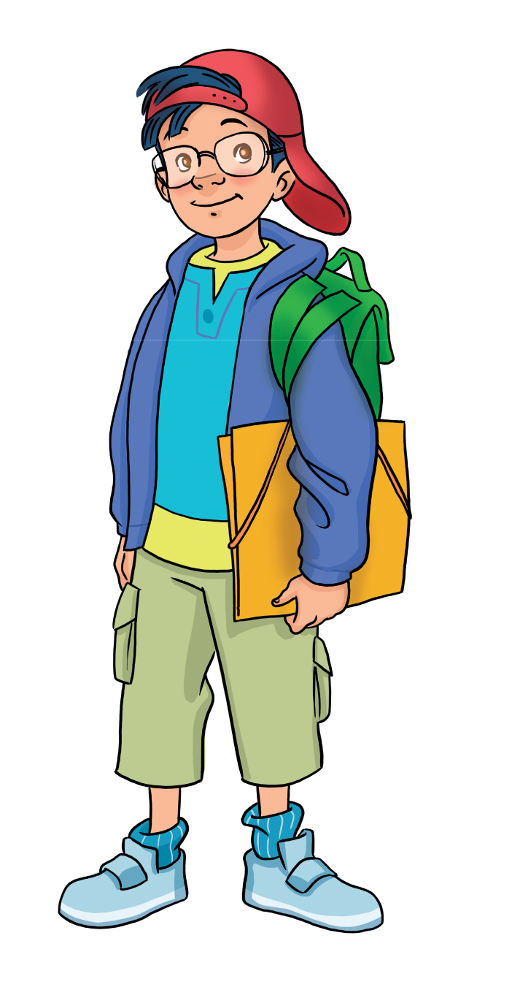
WARM-UP ACTIVITY
Let’s play!
Divide the class into groups of four. Draw 5 hearts for each group. Call two groups to stand up and take turns saying a letter to guess the word.
Students look at the letters on the screen and guess what they are.
If they guess the correct letter, they receive a point.
But if not, they lose a heart, and another team gets a chance to guess.
The first team who can guess the correct word receives 2 points.
Click on ”Hint” to show the picture of the word if students don’t know the word.
Notes:
Link Youtube:

Slide 4

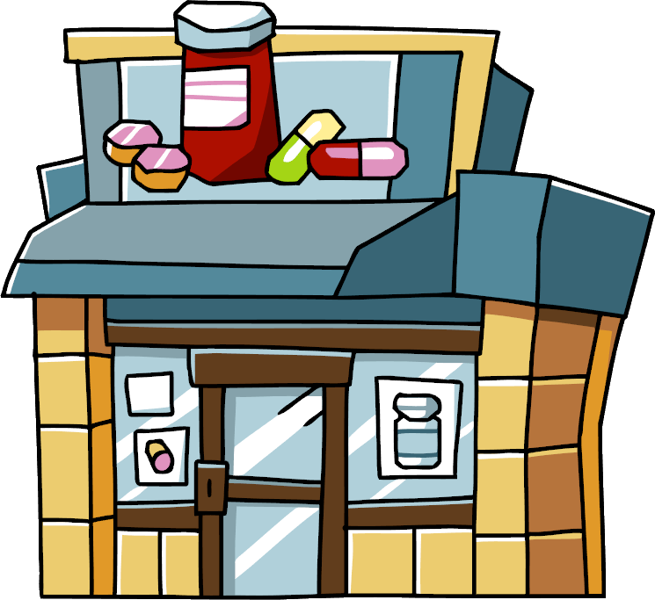

A
B
C
D
E
F
G
H
I
J
K
Where is it?
__ __ __ __ __ __ __
C
H
E
M
I
S
T
L
M
N
O
P
R
S
T
U
W
Y

Slide 5

A
B
C
D
E
F
G
H
I
J
K
Where is it?
__ __ __ __ __ __ __ __ __ __
R
E
S
T
A
U
R
A
N
T
L
M
N
O
P
R
S
T
U
W
Y

Slide 6

A
B
C
D
E
F
G
H
I
J
K
Where is it?
__ __ __ __
P
A
R
K
L
M
N
O
P
R
S
T
U
W
Y

Slide 7
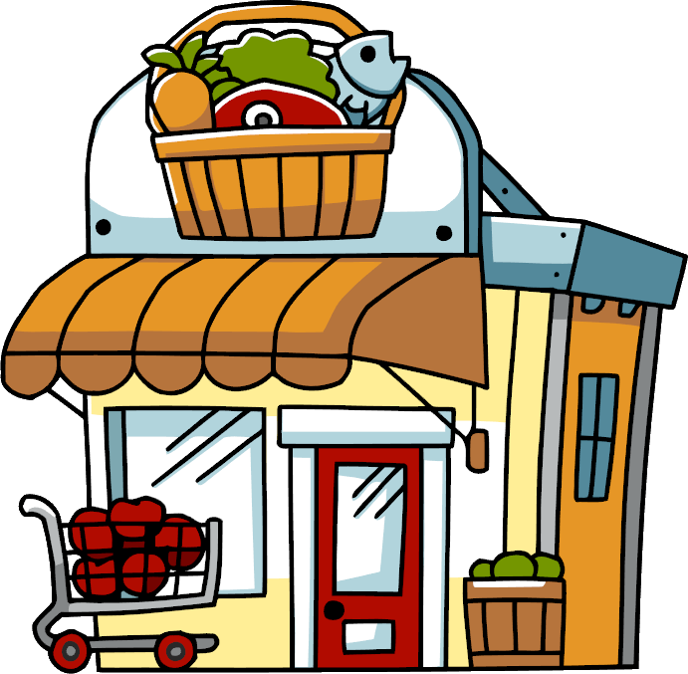
A
B
C
D
E
F
G
H
I
J
K
Where is it?
__ __ __ __ __ __ __ __ __ __ __
S
U
P
E
R
M
A
R
K
E
T
L
M
N
O
P
R
S
T
U
W
Y

Slide 8

A
B
C
D
E
F
G
H
I
J
K
Where is it?
__ __ __ __ __ __ __ __
B
O
O
K
S
H
O
P
L
M
N
O
P
R
S
T
U
W
Y

Slide 9
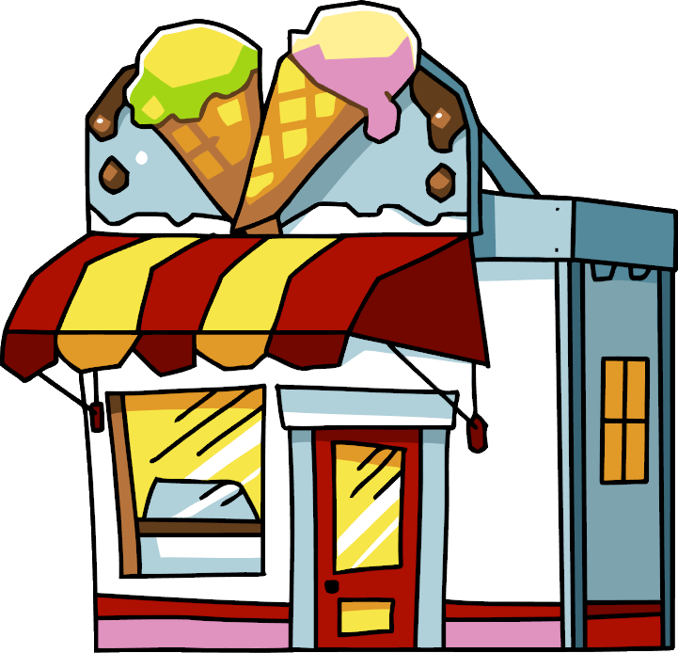

Slide 10
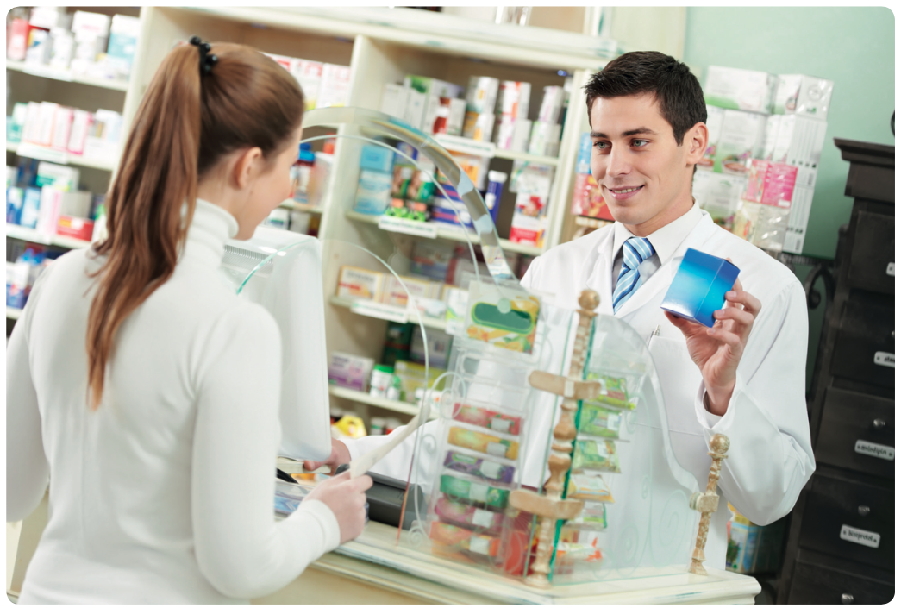
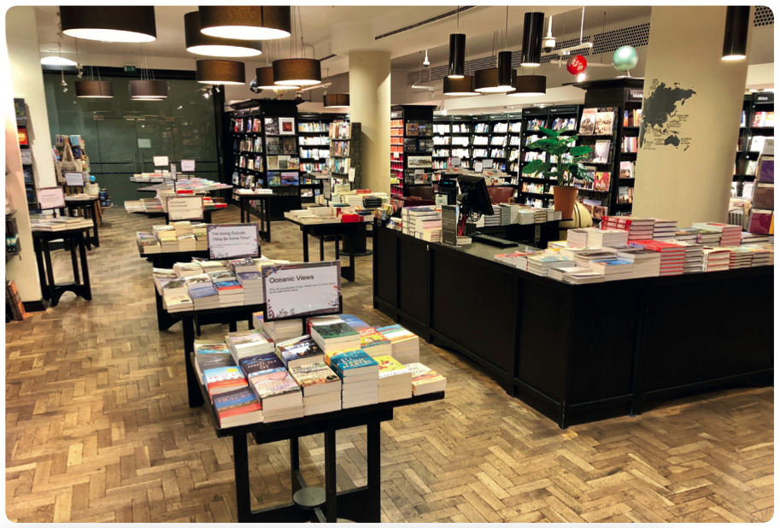
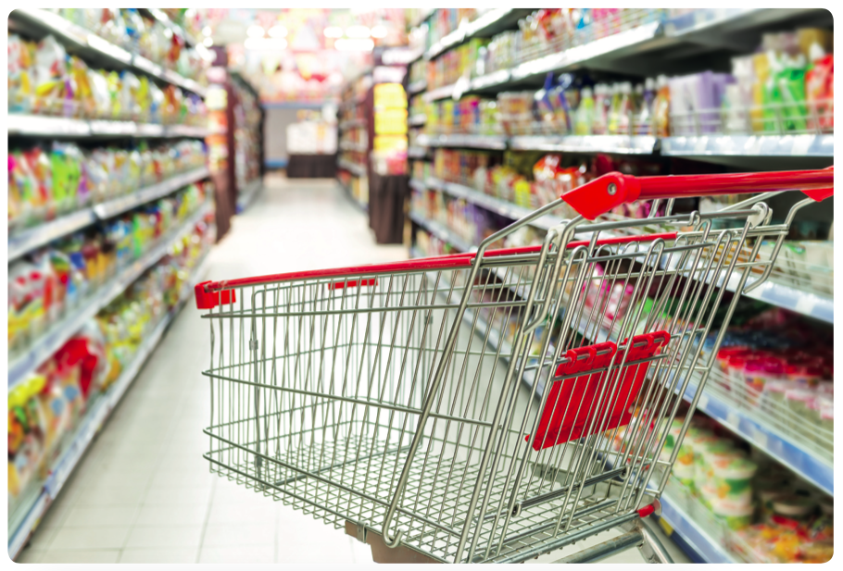
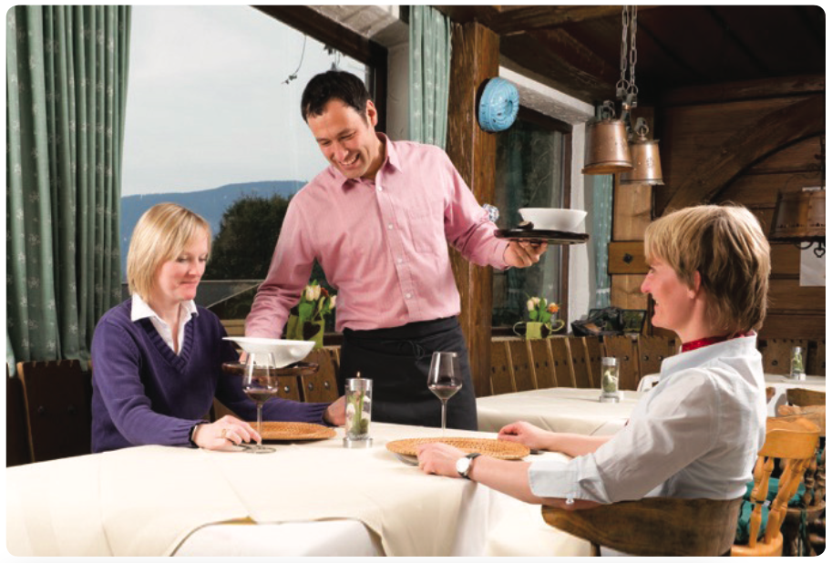
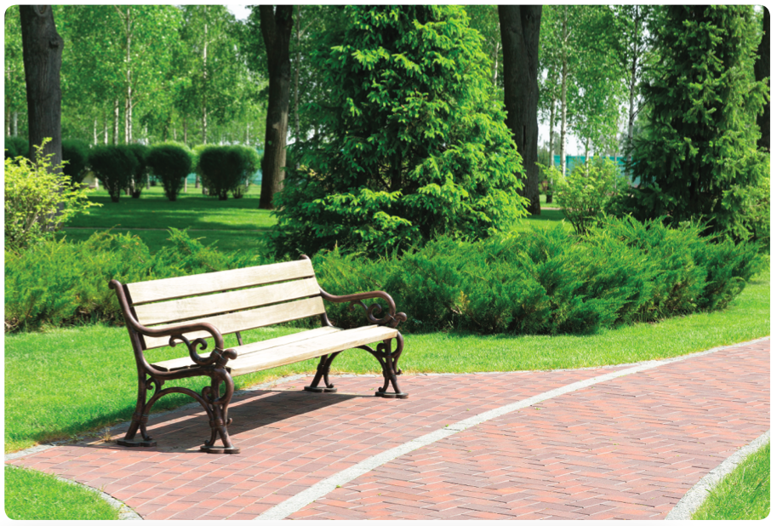
REVIEW VOCABULARY
1
supermarket
2
chemist
3
bookshop
4
restaurant
5
park
Divide the class into groups of four. Each member takes turns writing a word for the pictures from 1 to 5.
They raise the answers to check. The groups with all correct answers receive 2 points.
The answers are on the next slide.

Slide 11
REVIEW VOCABULARY
1
2
3
chemist
bookshop
supermarket
4
5
restaurant
park
Click on the numbers to show the answer.
Ask all students to say the words aloud.

Slide 12
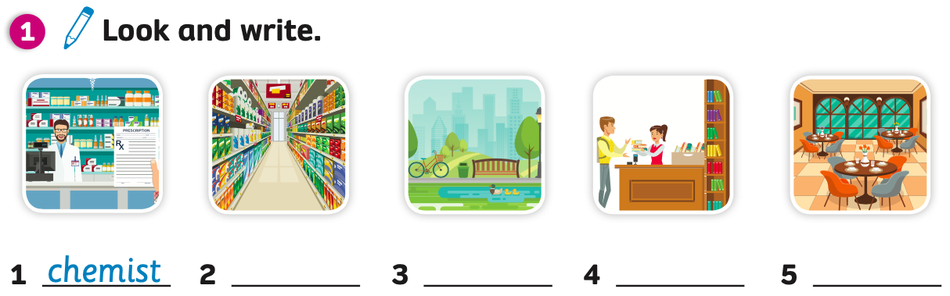
PUPILS’ BOOK (p.112)
Answers
supermarket
park
bookshop
restaurant
Have students open the books and look at the task.
Students work individually to write down the words.
Put students into pairs. They swap the answers to check.

Slide 13
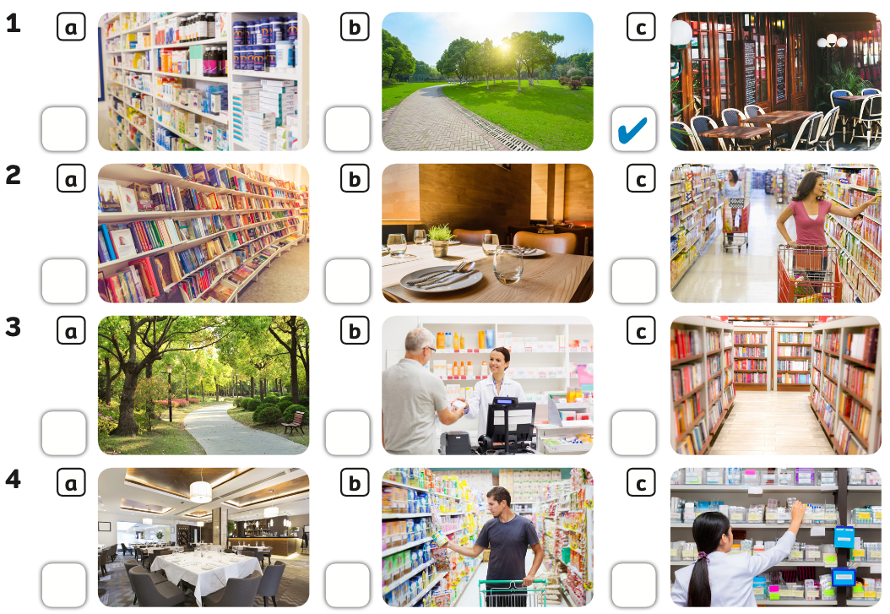
PUPILS’ BOOK p.112

Slide 14
PRACTICE
Let’s play!
Divide the class into groups of four. Each member of the group stands up and plays the game.
The teacher shows a sentence. Ex: “Yesterday, I was at the restaurant.” Students listen and say the correct picture a, b, or c.
Students raise their hands to get a chance to answer. The first student with the correct answer receives 2 points for the team.
All students repeat the sentences.
Notes:
Link Youtube:

Slide 15

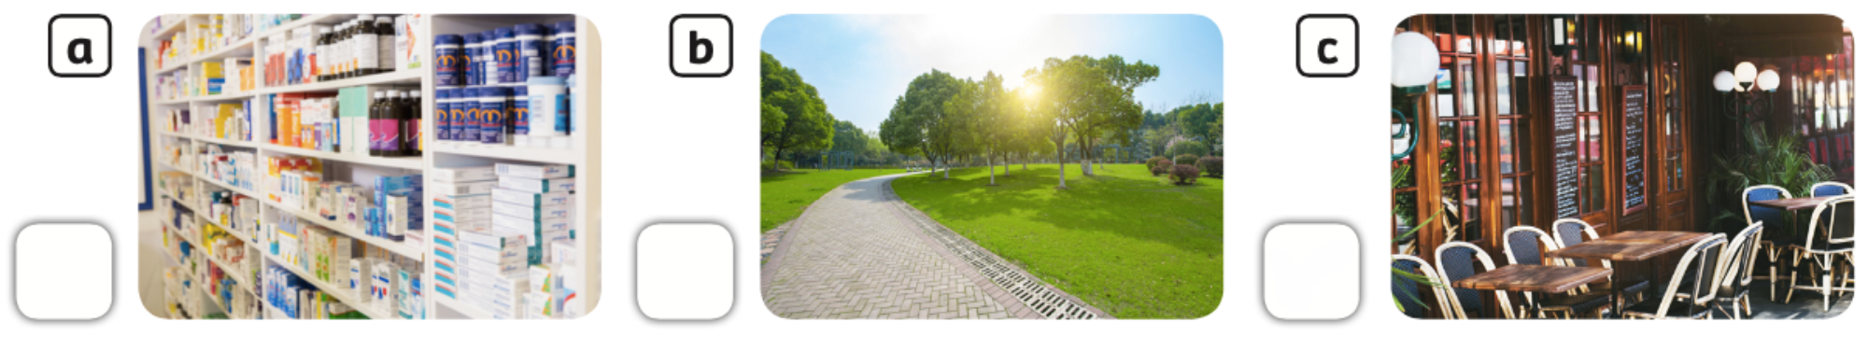

PUPILS’ BOOK p.112
Example
Yesterday, I was at the restaurant.
Click on “Example” to show the sentence with the voice.

Slide 16
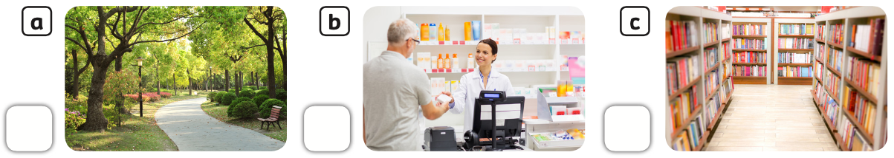
PUPILS’ BOOK p.112
Sentence
Answer
Last night, I was at the supermarket.

Slide 17
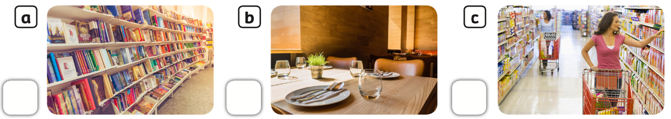
PUPILS’ BOOK p.112
Sentence
Answer
Last weekend, I was at the bookshop.

Slide 18
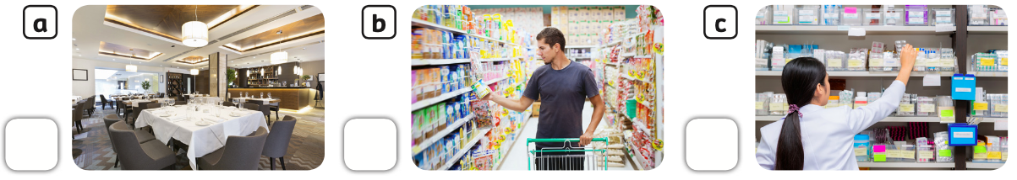
PUPILS’ BOOK p.112
Sentence
Answer
Yesterday, I was at the chemist.

Slide 19
PUPILS’ BOOK p.112
Sentence
Answer
Last weekend, I was at the park.

Slide 20

PUPILS’ BOOK p.112
Answer
- Have students open the books and look at the task.
Play the audio, students listen and tick the place they hear.
Play the audio again and pause after each sentence, students listen and check the answers.

Slide 21
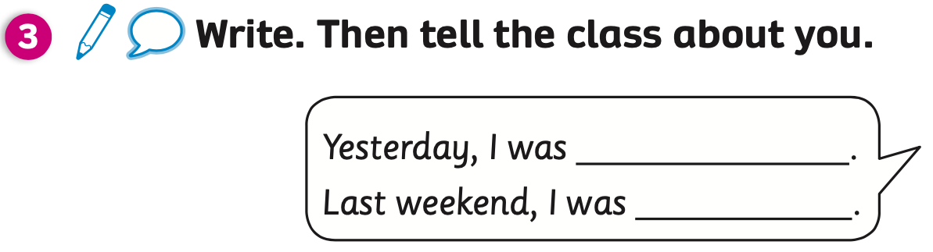
PUPILS’ BOOK p.112
Example
at the bookshop
at the park
Have students look at the task and read the example sentences.

Slide 22
PUPILS’ BOOK p.112
Yesterday, I was at the bookshop.
Last weekend, I was at the park.
Have students look, listen and repeat.

Slide 23
PRODUCTION
Ask students to write about themselves.
Put students into groups of four. Each student reads out loud the sentences.
The first 3 groups who finish the activity receive 2 points.

Slide 24

HOMEWORK
Review vocabulary and grammar.
Do exercises in the Activity book (page 97).
Check answers in the Teacher’s book (page 206) or Active Teach.

Slide 25

UNIT 10: AROUND THE TOWN
We’ve learned…
Review the names of shops.

