Slide 1

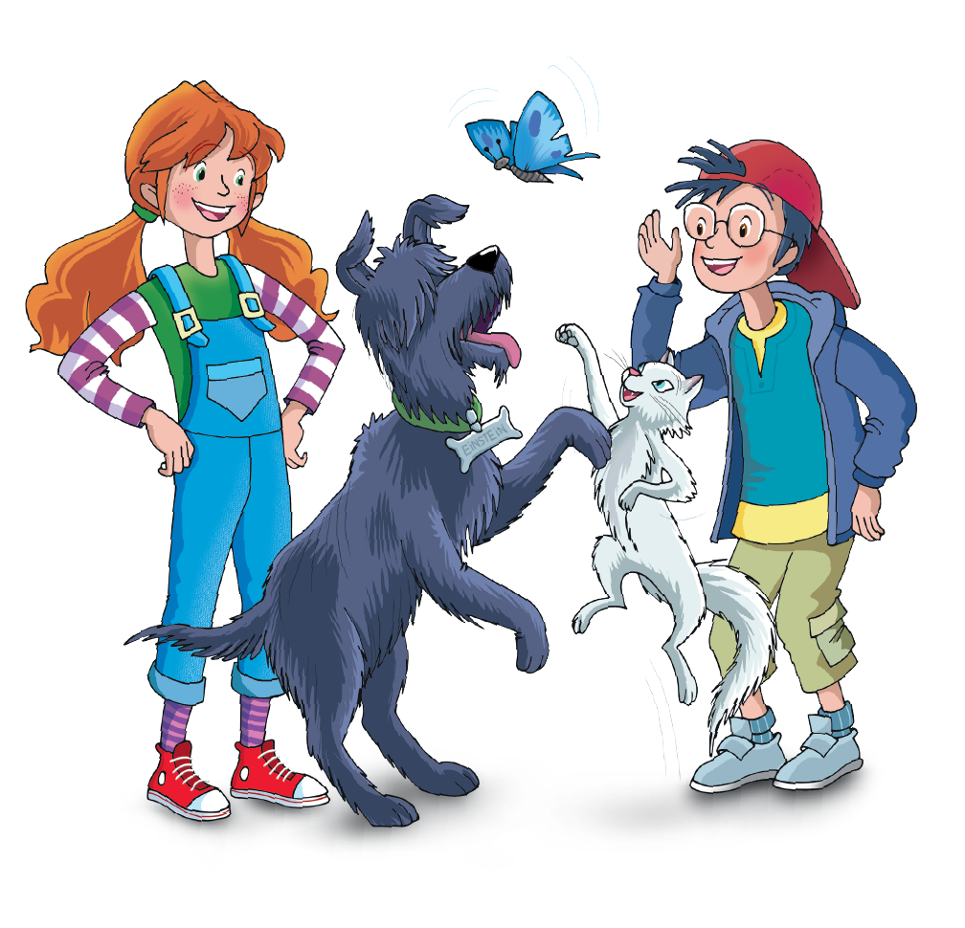
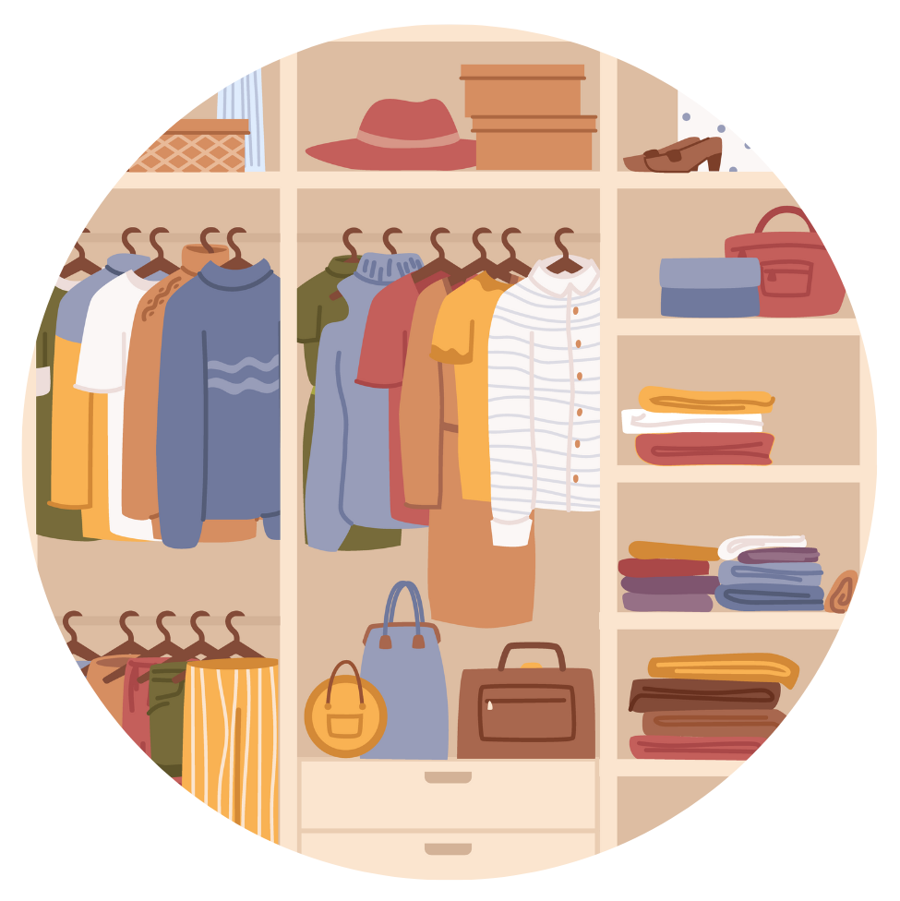
UNIT 8 – LET’S DRESS UP!
Lesson 8 – Skills

Slide 2

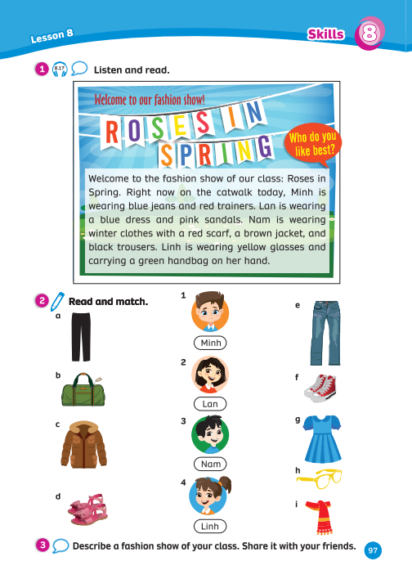
UNIT 8: LET’S DRESS UP!
We’re learning…
Clothes
Describe the clothes
To read a short fashion show text, to read for details.
PB p.97
AB p.81

Slide 3




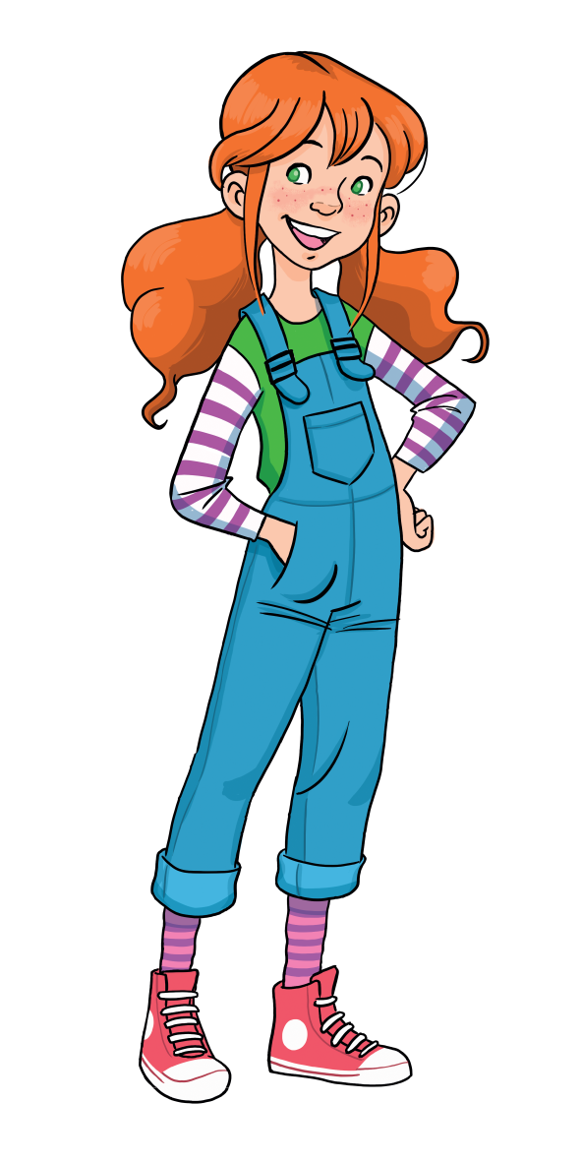


WARM - UP
Song: Storm Clap Song!
Listen to the song.
Stand up and dance along.
Notes:
Link video: https://www.youtube.com/watch?v=mrXbsRPgnvY

Slide 4

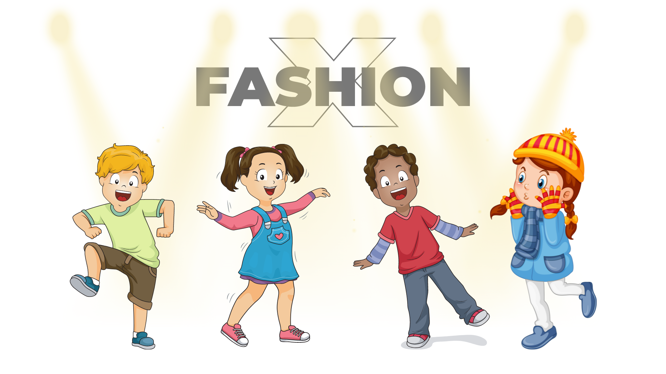
LEAD-IN – Activity: Describe the fashion show
Jack
Mimi
Bin
Linda
Look at the picture and introduce these children they’re in the fashion show.
Work in pairs, describe what they are wearing.

Slide 5
LEAD-IN – Activity: Describe the fashion show
Jack is wearing a green T-shirt and blue trainers.
Jack
Mimi
Bin
Linda
Example
Invites some pairs to present in front of the class.

Slide 6


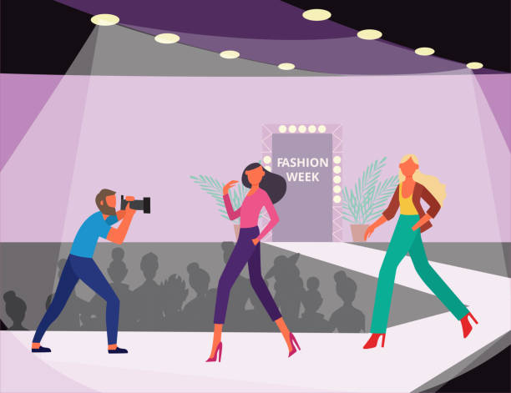


READING: Pre-teach Vocabulary
fashion show
a catwalk
Listen and say the words

Slide 7
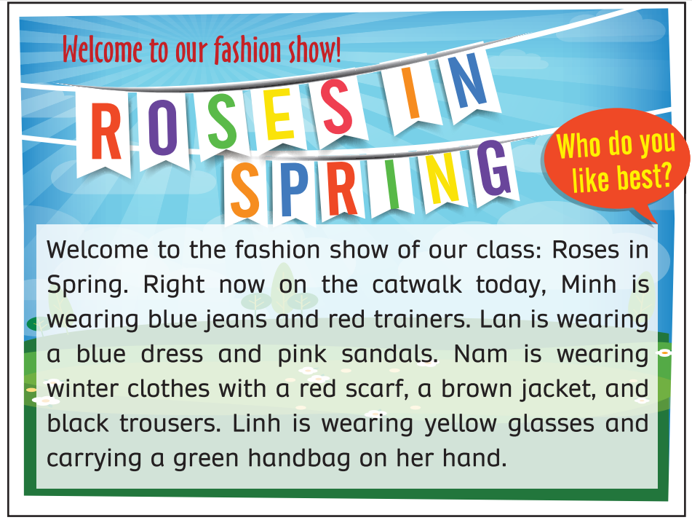
Listen and read
Answer
Play the audio; students listen, circle the name, and underline the clothing items.
Play the audio again; students listen and read along.

Slide 8


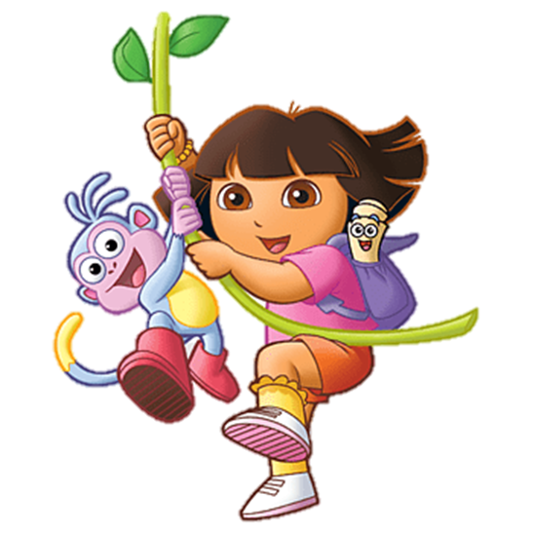
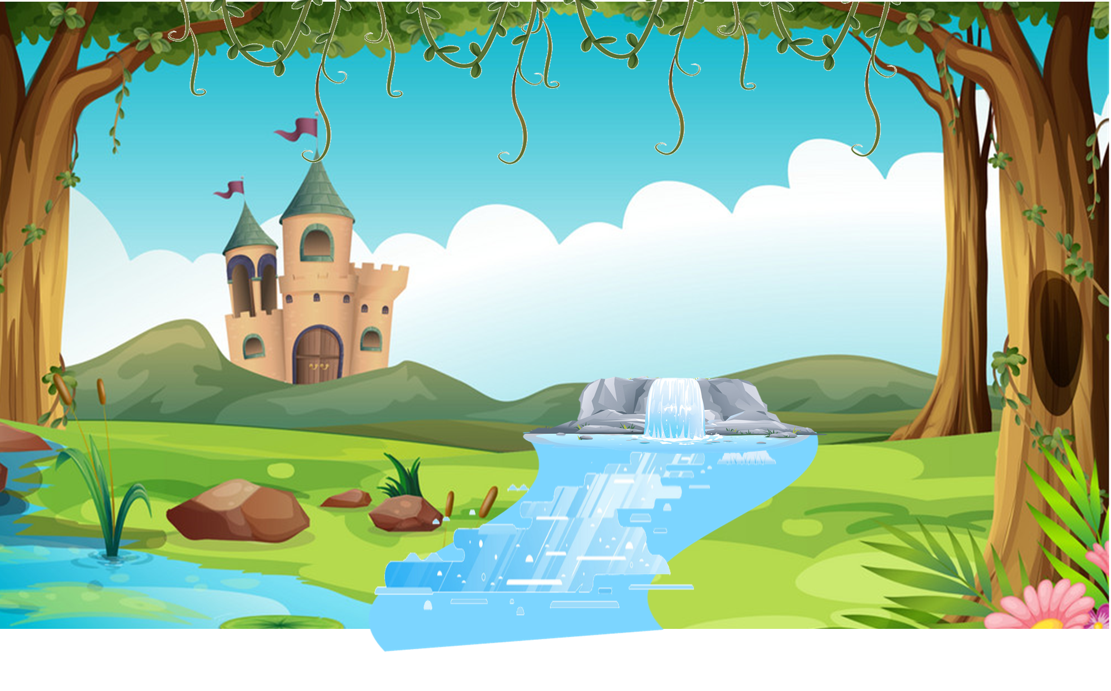

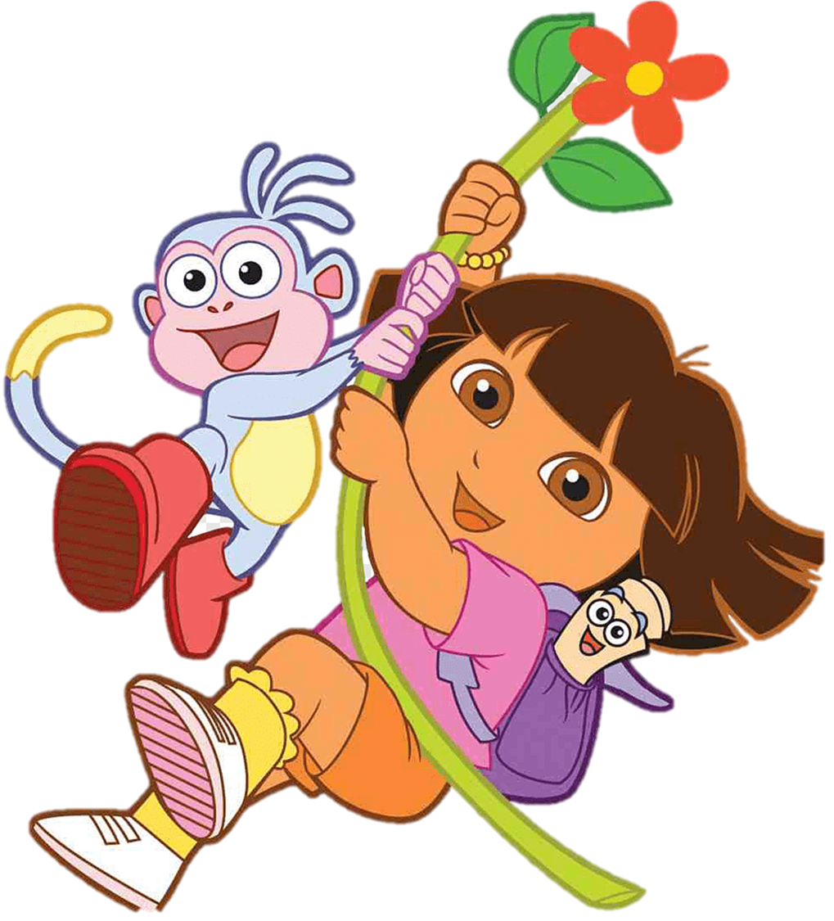
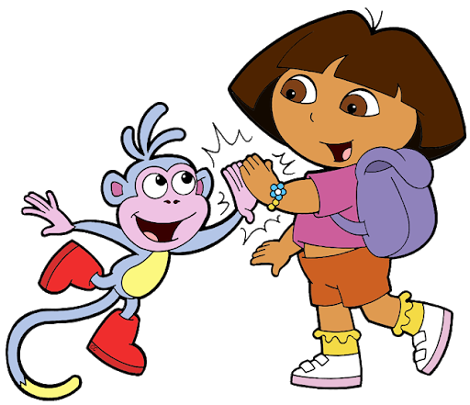
START
How to play:
Divide the class into two or three teams. Each team takes turns play the game.
Read the question, discuss it with your teammates.
Choose the correct answer by saying it aloud.
Ask students to show how they select the answer.
Check the answer.

Slide 9

Read the question and choose the correct answer. Show how to select that answer.
Click on the answer to check.
How many students are at the fashion show?
2
5
4

Slide 10

Read the question and choose the correct answer. Show how to select that answer.
Click on the answer to check.
What is the name of the fashion show?
Roses in spring
The fashion show
Clothing items

Slide 11
Read the question and choose the correct answer. Show how to select that answer.
Click on the answer to check.
Who’s wearing blue jeans and red trainers?
Nam
Minh
Linh
Notes:
\

Slide 12
Read the question and choose the correct answer. Show how to select that answer.
Click on the answer to check.
Who’s wearing
yellow glasses?
Linh
Lan
Nam

Slide 13
Read the question and choose the correct answer. Show how to select that answer.
Click on the answer to check.
Who’s wearing winter clothes?
Minh
Nam
Lan

Slide 14
Read the question and choose the correct answer. Show how to select that answer.
Click on the answer to check.
Who’s wearing a blue dress and pink sandals?
Linh
Lan
Minh

Slide 15

END
START

Slide 16
Activity: Sorting
Minh
Lan
Nam
Linh
blue dress
blue jeans
red scarf
pink sandals
brown jacket
red trainers
yellow glasses
green handbag
black trousers
Answers
Look at the words and sort the clothing items for each student in the text.

Slide 17

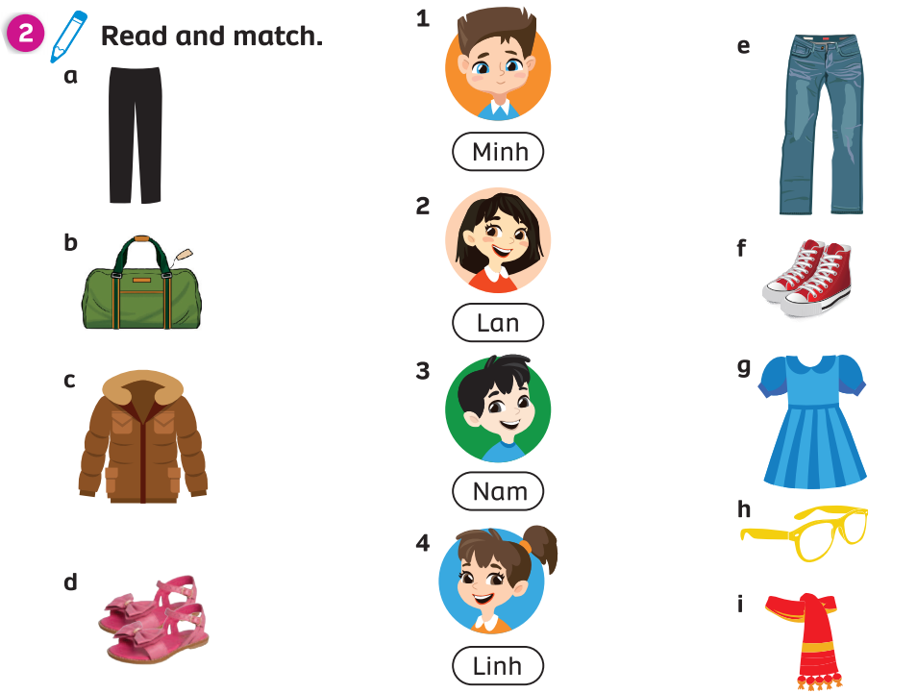
PUPILS’ BOOK (Page. 97)
Answers
Read again and draw lines to match the clothes with the students.
In pairs, complete and check the answers.

Slide 18
PRODUCTION (Pupils’ book – p.97)
Example
Title of the text
Name of students
Clothing items
Wonderful Summer
Cool Winter
Orange Autumn
Lucy
Hoa
Huy
Sam
Khoa
green dress
purple sandals
blue T-shirt
black hat
Put students into groups of 4. Each group takes out a sheet of paper.
They discuss and write ideas for their fashion show in class.
They look at and say the examples.

Slide 19
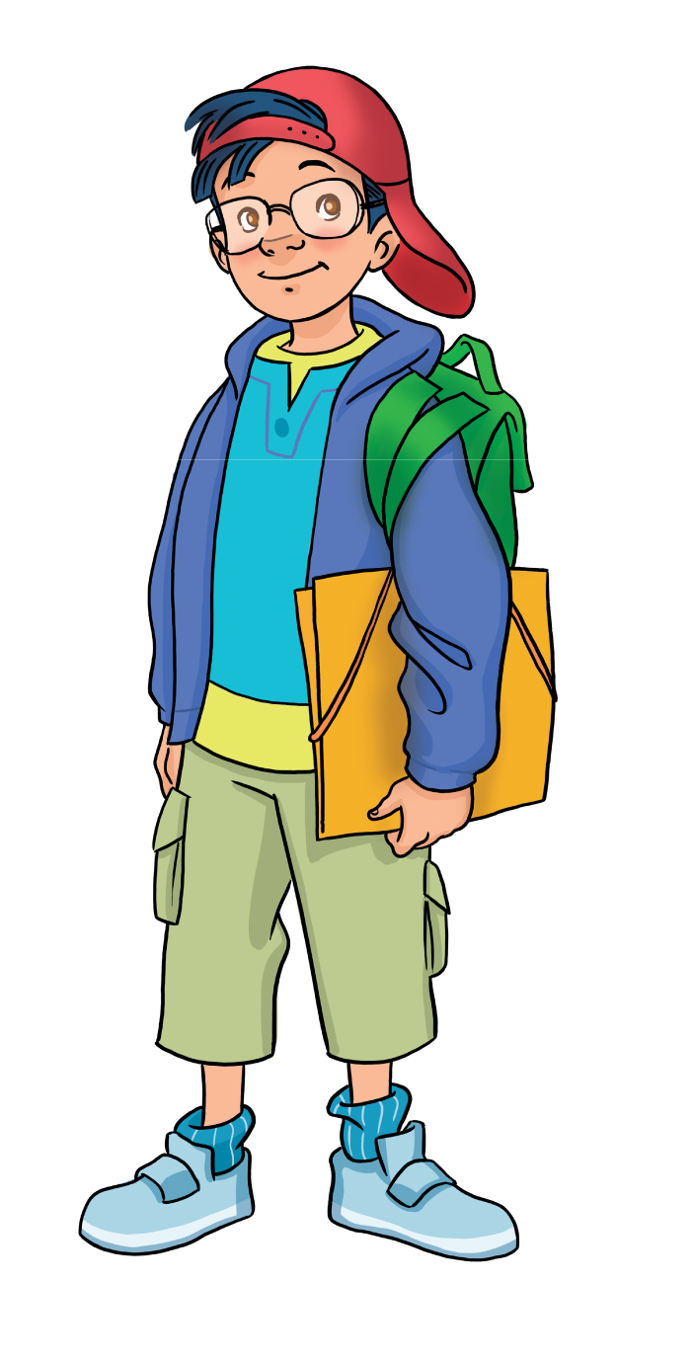
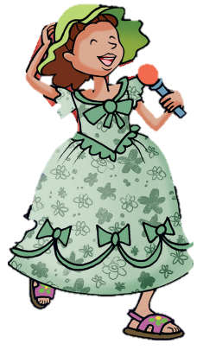
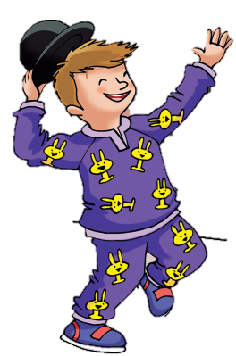
PRODUCTION (Pupils’ book – p.97) - Speaking
Welcome to the fashion show of our class: Orange Autumn. Lucy is wearing a green dress and purple sandals on the catwalk today. Sam is wearing a blue T-shirt, green backpack and glasses. Ben is wearing purple pyjamas and a black hat.
Example
After students have ideas for their fashion show, they practice talking about it.
Show the example text, students look and read together.
- Invite some students to present about the fashion show in class.

Slide 20
HOMEWORK
Review vocabulary and grammar.
Do exercises in the Activity book (page 63).
Check answers in the Teacher’s book (page 144) or Active Teach.

Slide 21
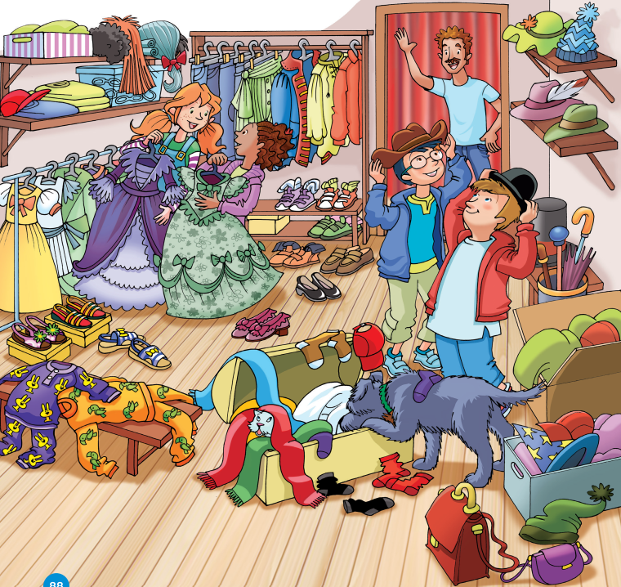

UNIT 8: LET’S DRESS UP!
We’re learning…
Lesson 6

