Slide 1

Revision 5
Unit 9 and Unit 10

Slide 2


Song: Boom, Slap, Clap
WARM-UP
All students stand up.
Listen to the song.
Dance along.
Notes:
Step 1: Have all students stand up and look at the screen.
Step 2: Play the video song for students to listen and dance along with the character in the video.

Slide 3

Review

Slide 4


attic

Slide 5

bedroom

Slide 6

house

Slide 7
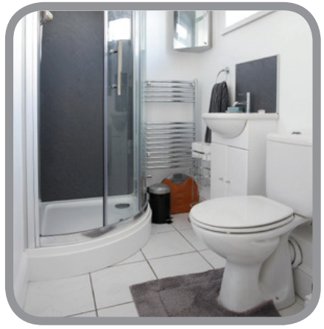
bathroom

Slide 8
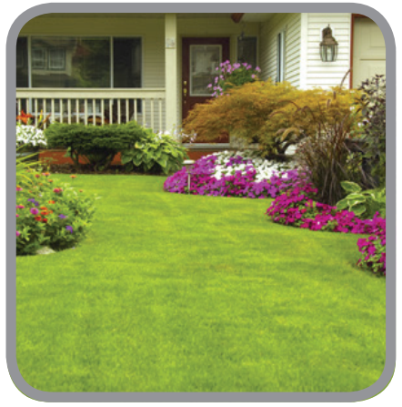
garden

Slide 9
house
attic
bedroom
bathroom
garden

Slide 10







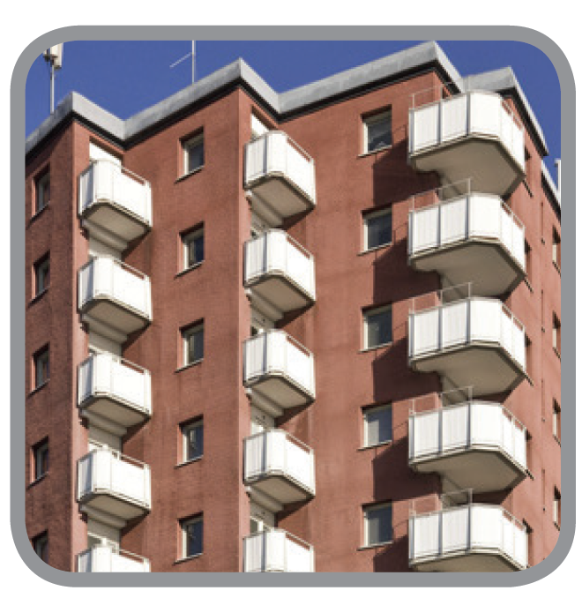

flat

Slide 11

hall

Slide 12
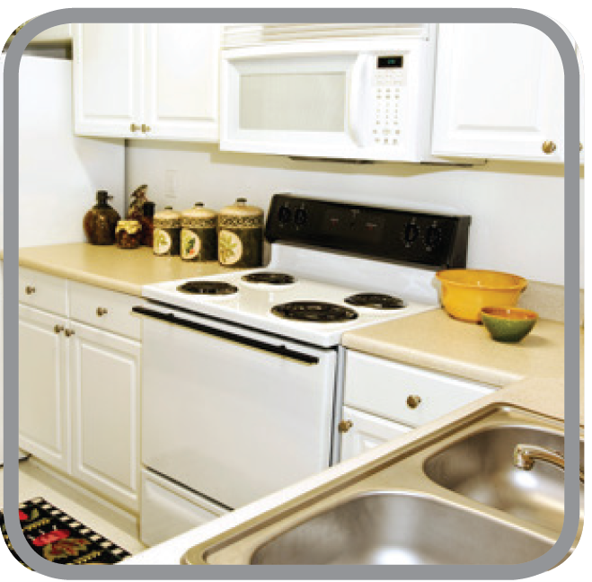
kitchen

Slide 13
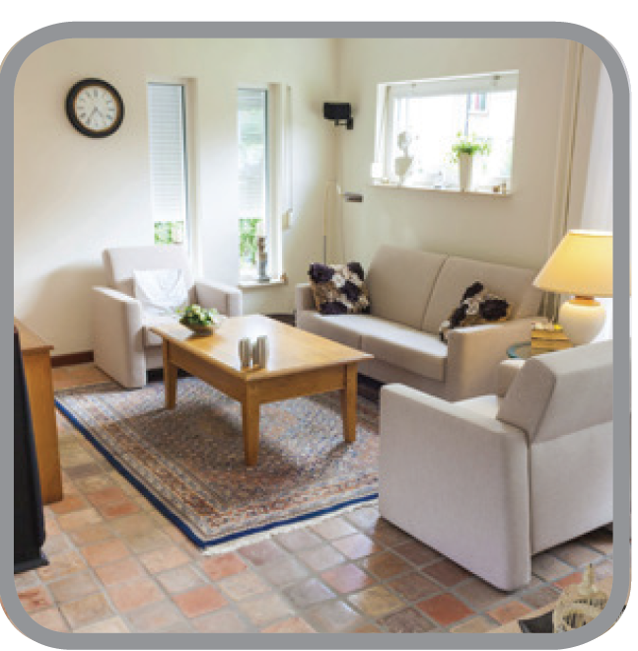
living room

Slide 14


garage

Slide 15

Notes:
Students will see images of different rooms of the house that are hidden behind color shapes.
As the shapes disappear, the students should guess what room of the house it is.
Remember to PAUSE THE VIDEO when students are ready to guess.

Slide 16

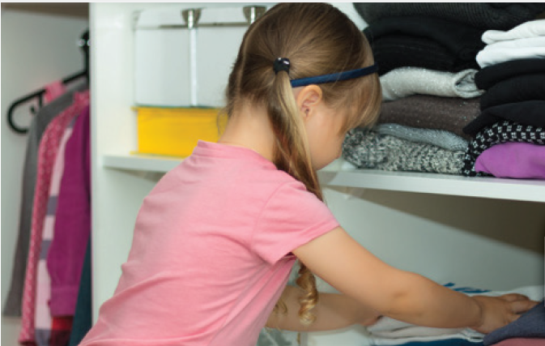
tidying up

Slide 17

making the bed

Slide 18
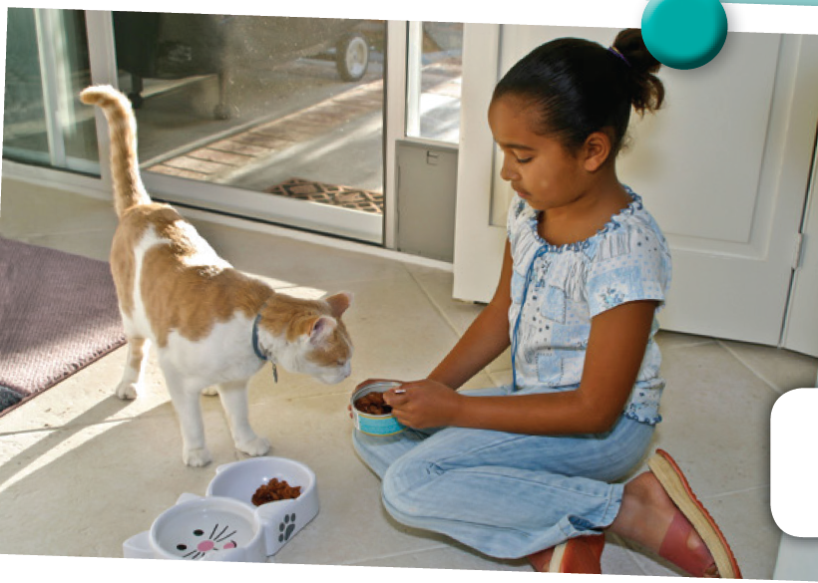
feeding the cat

Slide 19
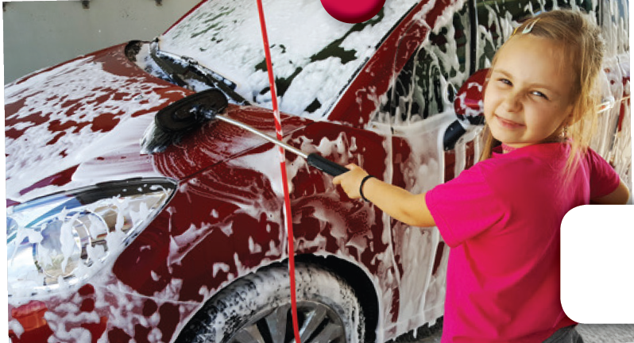
washing the car

Slide 20
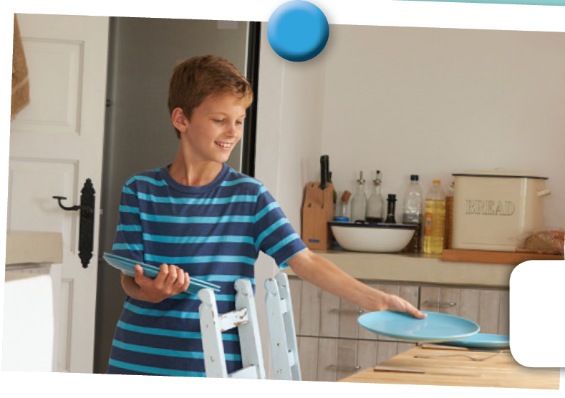
laying the table

Slide 21
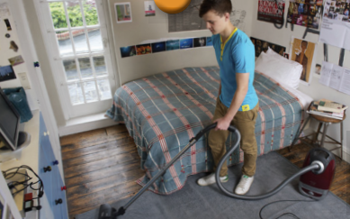
cleaning the floor

Slide 22

walk
1 / 40

Slide 23

skip
1 / 40

Slide 24

run
1 / 40

Slide 25

jump
1 / 40

Slide 26

ride a bike
1 / 40

Slide 27

fly a kite
1 / 40

Slide 28
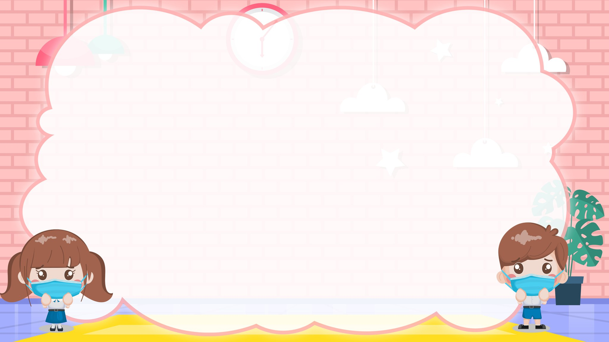
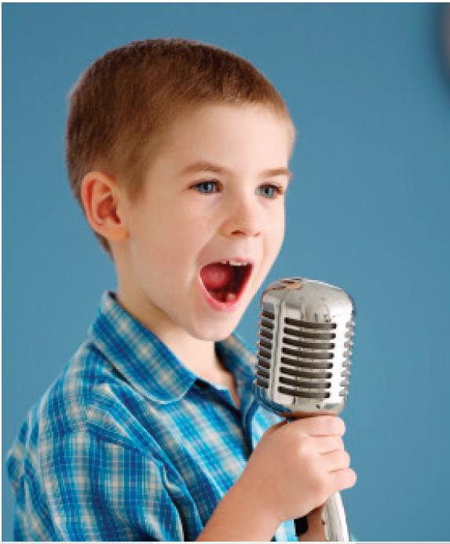
sing

Slide 29
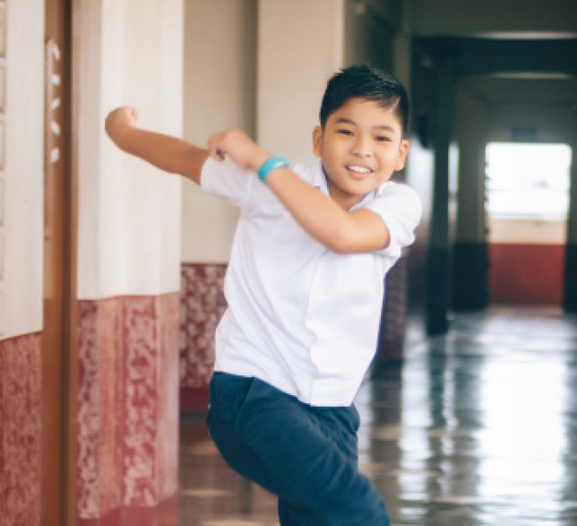
dance

Slide 30
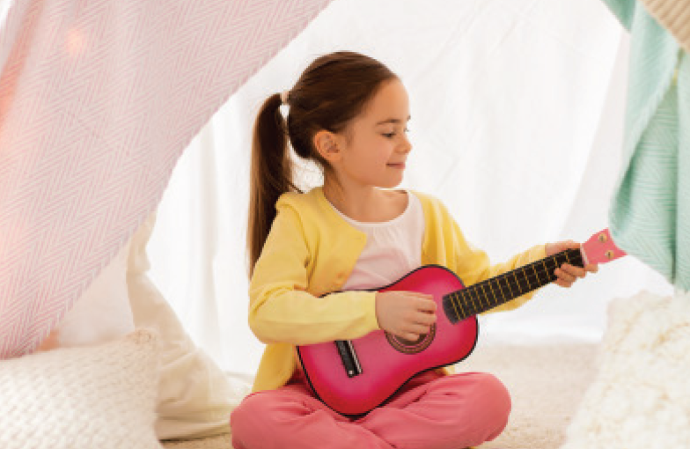
play the guitar

Slide 31

paint

Slide 32
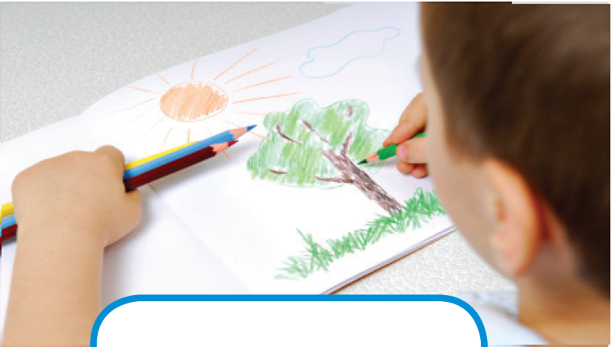
draw

Slide 33
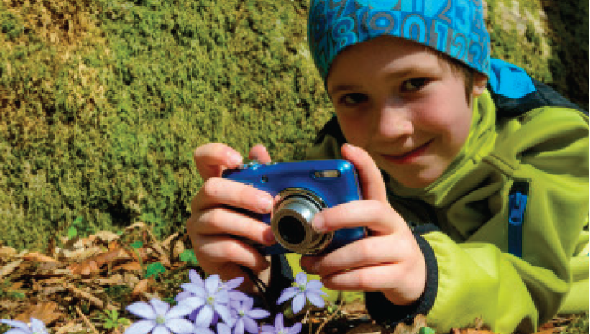
take photos

Slide 34

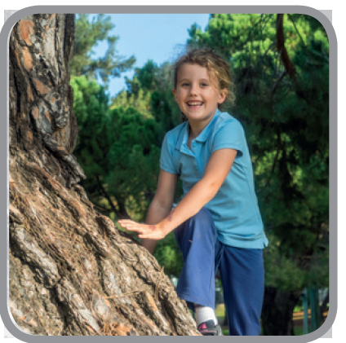
climb

Slide 35

swim

Slide 36

play football

Slide 37

play baseball

Slide 38



Slide 39
Review
Grammar

Slide 40
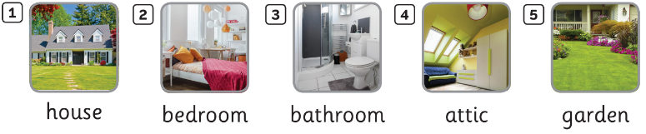
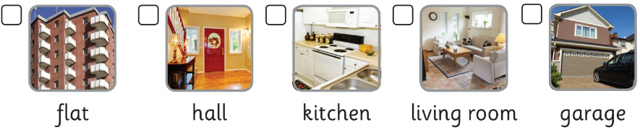
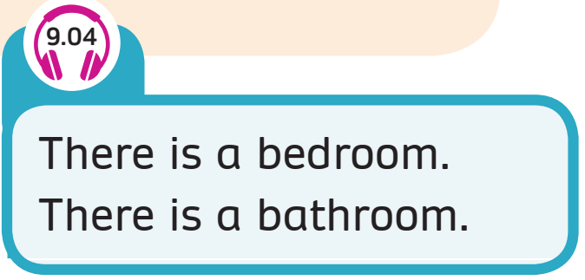
GRAMMAR: Rooms
Notes:
Step 1: Have students look at the picture and elicit them to say the rooms.
Step 2: Play the audio once and have students recall what words they hear
Step 3: Show the text, say aloud the text and have the whole class repeat. Check pronunciation if necessary.
Step 4: Invite some students to introduce some rooms

Slide 41
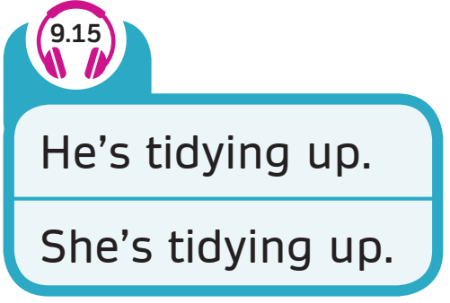
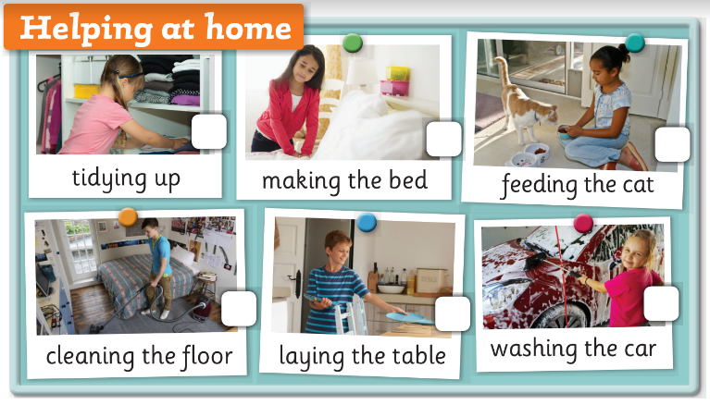
GRAMMAR: Chores
Notes:
Step 1: Ask Ss to look at 4 students in the classroom
Step 2: Direct Ss’s attention to their activities
Step 3: Elicit the new sentence and display the speech bubbles.
I am making the bed, I am cleaning the floor…
Step 4: Tell students to practice in pairs and talk about their housework

Slide 42
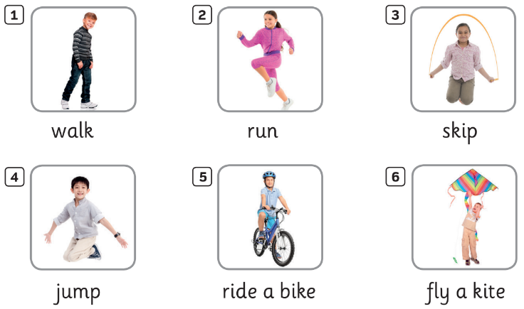
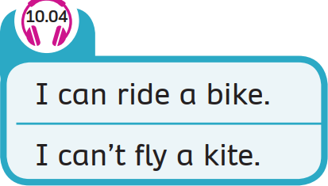
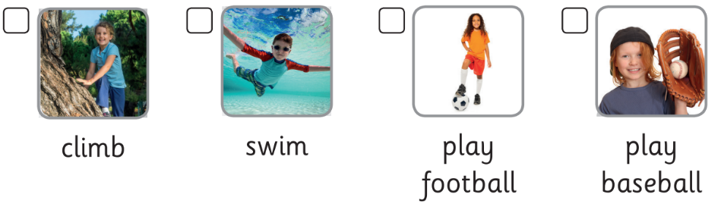
GRAMMAR: Abilities
Notes:
Step 1: Have students look at the picture and elicit them to say the activities they can or can’t do
Step 2: Play the audio once and have students recall what words they hear
Step 3: Show the text, say aloud the text and have the whole class repeat. Check pronunciation if necessary.
Step 4: Invite some students to introduce their abilities

Slide 43
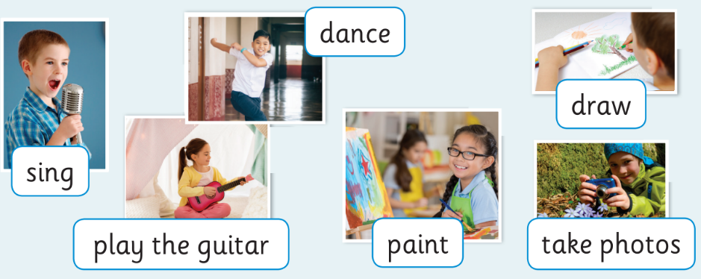
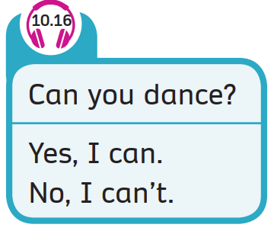
GRAMMAR: Abilities
Notes:
Step 1: Have the class play in teams. Introduce the activity to the class and explain the rules.
Teacher describes one activity using “ Can I dance?” -> Yes, I can./ No, I can’t. (Students guess the answer through the teacher’s action)
The fastest team will get points
All students say the correct sentences.
Step 2:
- Invite one student from each team to take the demonstration for the whole class.
- Allow Ss to discuss in teams about the answers.
- Confirm the answer and ask the whole class to say the full sentence
Step 3: Invite some volunteers to take the teacher’s role to lead the game.

Slide 44


Slide 45





There is a hall.
A. Yes
B. No

Slide 46
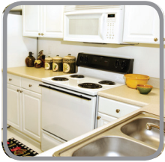
There is a living
room.
A. Yes
B. No

Slide 47
He’s cleaning
the floor.
A. Yes
B. No

Slide 48

I can skip.
A. No
B. Yes

Slide 49
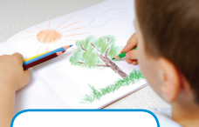
Can you draw?
A. Yes, I can.
B. No, I can’t.

Slide 50

Can you run?
A. No, I can’t.
B. Yes, I can.

Slide 51
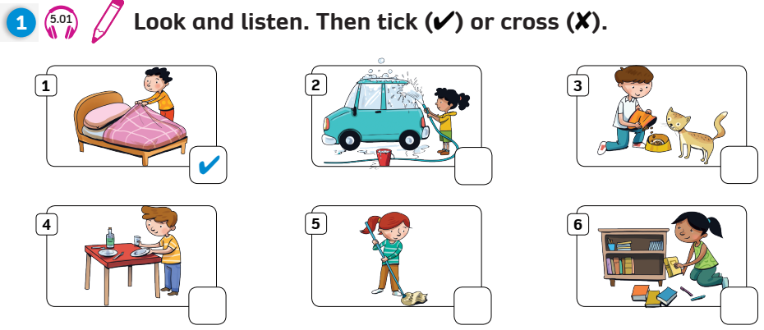
Pupil’s book (p. 138)
✗
✗
✓
✗
✓

Slide 52
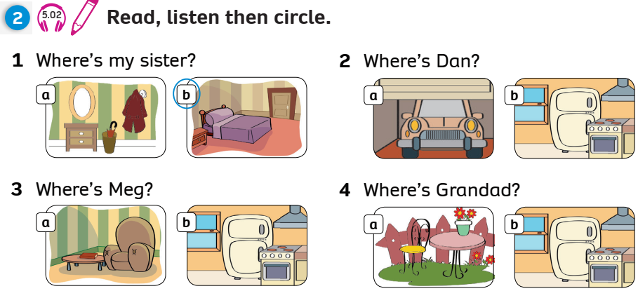
Pupil’s book (p. 138)

Slide 53
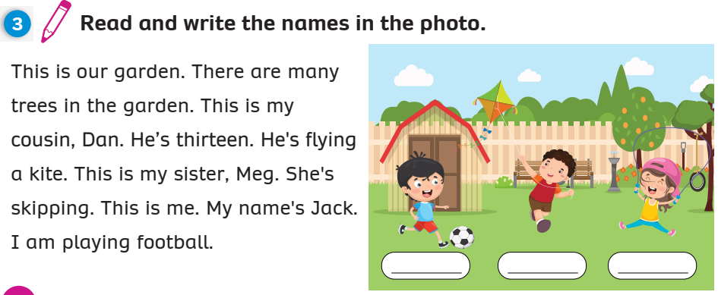
Pupil’s book (p. 138)
Jack
Dan
Meg

Slide 54
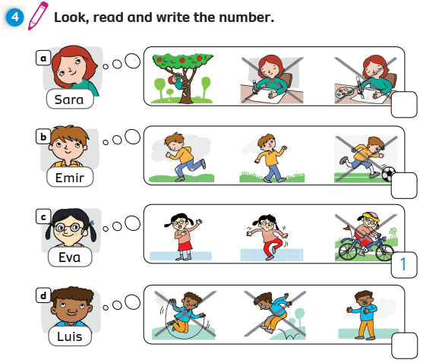
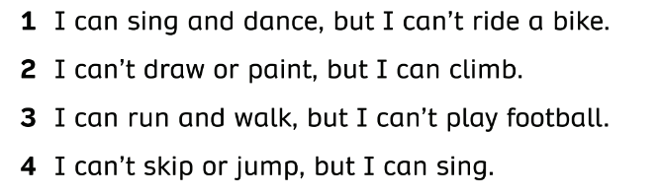
Pupil’s book (p. 139)
2
3
4

Slide 55
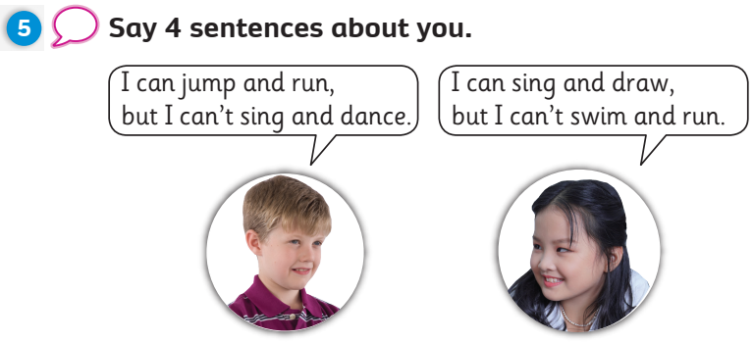
Pupil’s book (p. 139)

Slide 56


Review Unit 9 -10

