Slide 1
IN THE COUNTRYSIDE
Log in Bamboozle to play the game.
https://www.baamboozle.com/index.php/game/1145344

Slide 2
UNIT 2
Life in the countryside Lesson 5: Skills 1
(page 24)

Slide 3
After this lesson, students will be able to:
01
02
UNIT 2
Life in the countryside Lesson 5: Skills 1
READING
read for specific information about different aspects of a Vietnamese village
SPEAKING
talk about the village or town where someone lives

Slide 4
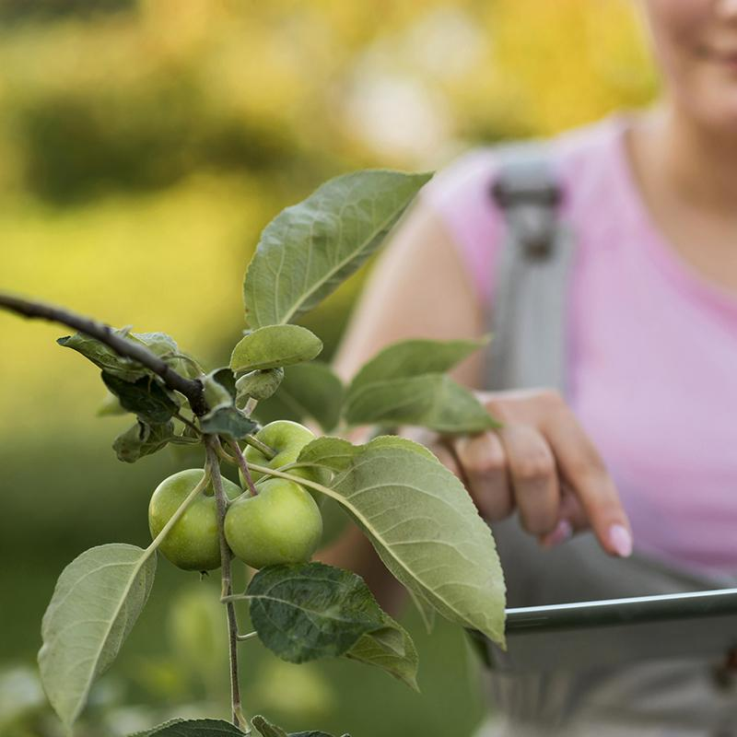
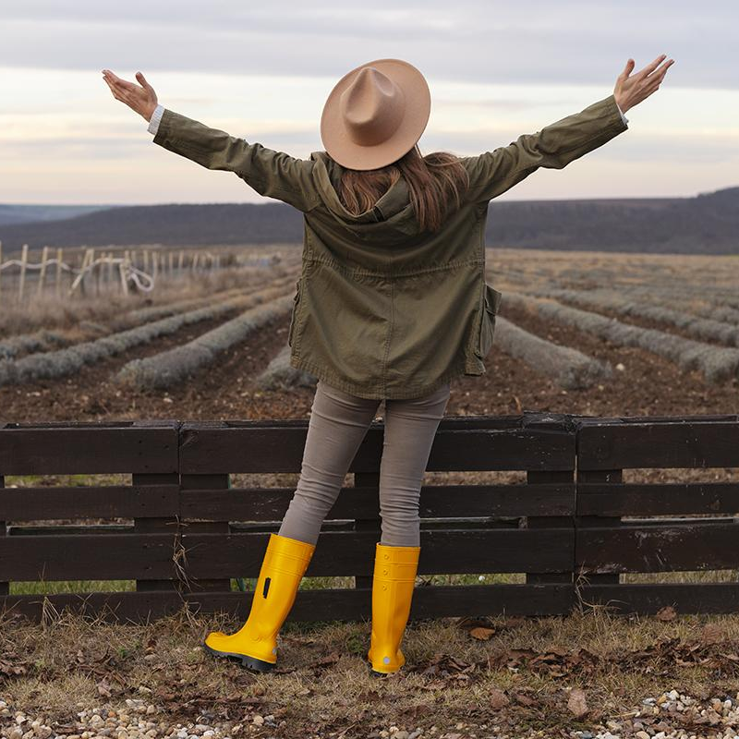
01
READING

Slide 5
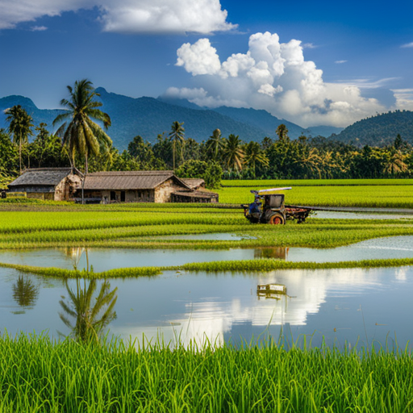
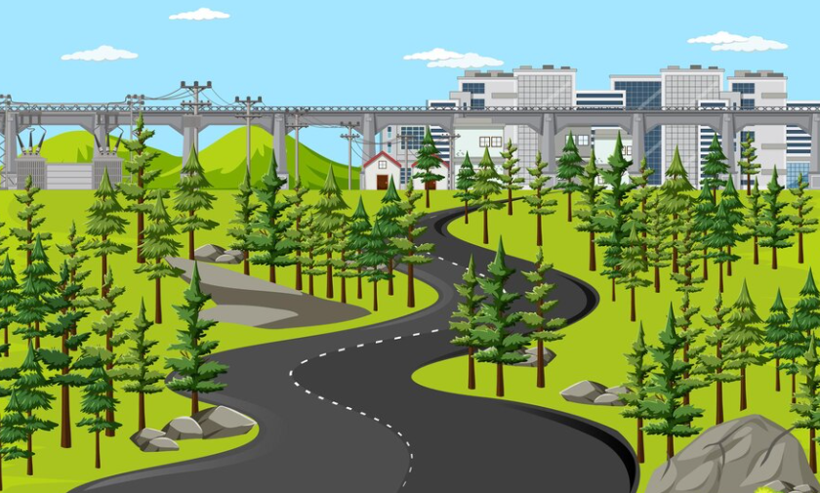
Look at the picture and answer the questions
After this lesson, students will be able to:
1. What can you see in it?
2. Which of the following adjectives describe the picture?
peaceful
vast
crowded
noisy
picturesque

Slide 6

NEW WORDS
stretch (v)
/stretʃ/
trải dài

Slide 7
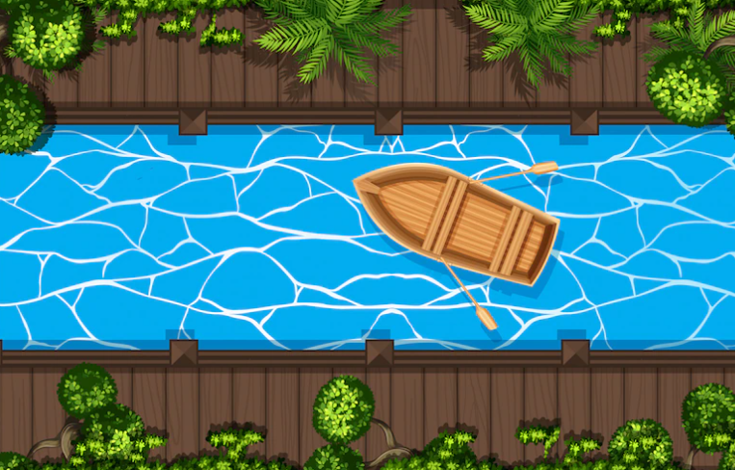
NEW WORDS
canal (n)
/kəˈnæl/
kênh đào

Slide 8
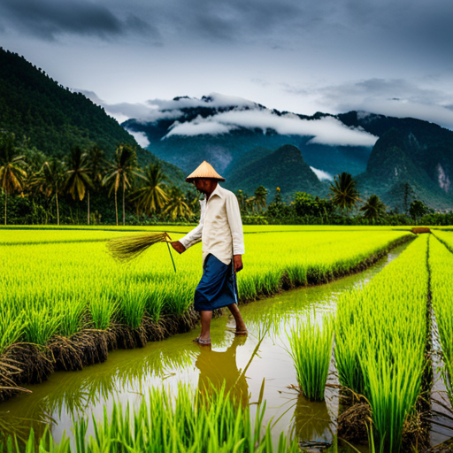
NEW WORDS
cultivate (v)
/ˈkʌltɪveɪt/
canh tác

Slide 9
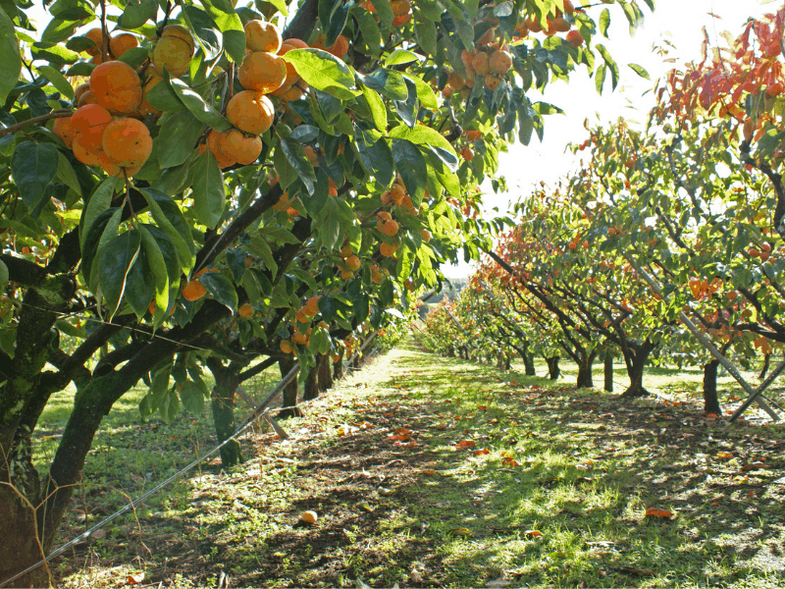
NEW WORDS
orchard (n)
/ˈɔːtʃəd/
cây ăn quả

Slide 10
NEW WORDS
New words | Pronunciation | Meanings
1. stretch (v) | /stretʃ/ | trải dài
2. canal (n) | /kəˈnæl/ | kênh đào
3. cultivate (v) | /ˈkʌltɪveɪt/ | canh tác
4. orchard (n) | /ˈɔːtʃəd/ | vườn cây ăn quả

Slide 11
Exercise 2. Read the text about life in a village in Viet Nam. Match the highlighted words in the text with their meanings
1
streching
canal
a. small passages used for carrying water to fields, crops, etc.
2
canals
orchards
b. places where people grow fruit trees
3
c. covering a large area of land
cultivate
streching
4
d. to grow plants or crops
orchards
cultivate

Slide 12
Exercise 2. Find the words the in the text, read the whole sentences and try to guess the meaning.
I feel fortunate that I am living in a peaceful village in southern Viet Nam. The scenery here is beautiful and picturesque with vast fields stretching long distances. The houses are surrounded by green trees. There are lakes, ponds, and canals here and there. The air is fresh and cool. Life here seems to move more slowly than in cities. The people work very hard. They grow vegetables, cultivate rice, and raise cattle. At harvest time, they use combine harvesters to harvest their crops. Many families live by growing fruit trees in the orchards. Others live by fishing in lakes, ponds, and canals. Life in the village is very comfortable for children. They play traditional games. Sometimes they help their parents pick fruit and herd cattle. People in my village know each other well. They are friendly and hospitable. They often meet each other in the evening, eating fruit, playing chess, singing folk songs, and chatting about everyday activities.
I feel fortunate that I am living in a peaceful village in southern Viet Nam. The scenery here is beautiful and picturesque with vast fields stretching long distances. The houses are surrounded by green trees. There are lakes, ponds, and canals here and there. The air is fresh and cool. Life here seems to move more slowly than in cities. The people work very hard. They grow vegetables, cultivate rice, and raise cattle. At harvest time, they use combine harvesters to harvest their crops. Many families live by growing fruit trees in the orchards. Others live by fishing in lakes, ponds, and canals. Life in the village is very comfortable for children. They play traditional games. Sometimes they help their parents pick fruit and herd cattle. People in my village know each other well. They are friendly and hospitable. They often meet each other in the evening, eating fruit, playing chess, singing folk songs, and chatting about everyday activities.
1
streching
2
canals
3
cultivate
4
orchards

Slide 13
Exercise 3. Read the sentences and underline the key words.
 | T | F
1. Life in the author’s village is very peaceful.
2. The people in the village work very hard.
3. Villagers live only by catching fish in lakes, ponds, and canals.
4. The children are always busy helping their parents.
5. The villagers get along well.

Slide 14
Exercise 3. Read the text again and tick T (True) or F (False) for each sentence.
TRUE OR FALSE?
1. Life in the author’s village is very peaceful.
2. The people in the village work very hard.
3. Villagers live only by catching fish in lakes, ponds, and canals.
4. The children are always busy helping their parents.
5. The villagers get along well.
I feel fortunate that I am living in a peaceful village in southern Viet Nam. The scenery here is beautiful and picturesque with vast fields stretching long distances. The houses are surrounded by green trees. There are lakes, ponds, and canals here and there. The air is fresh and cool. Life here seems to move more slowly than in cities. The people work very hard. They grow vegetables, cultivate rice, and raise cattle. At harvest time, they use combine harvesters to harvest their crops. Many families live by growing fruit trees in the orchards. Others live by fishing in lakes, ponds, and canals. Life in the village is very comfortable for children. They play traditional games. Sometimes they help their parents pick fruit and herd cattle. People in my village know each other well. They are friendly and hospitable. They often meet each other in the evening, eating fruit, playing chess, singing folk songs, and chatting about everyday activities.

Slide 15

Exercise 3. Check your answers.
 | T | F
1. Life in the author’s village is very peaceful.
I feel fortunate that I am living in a peaceful village in southern Viet Nam.
 | T | F
2. The people in the village work very hard.
Life here seems to move more slowly than in cities. The people work very hard…

Slide 16
Exercise 3. Check your answers.
 | T | F
3. Villagers live only by catching fish in lakes, ponds, and canals.
There are lakes, ponds, and canals here and there. The air is fresh and cool. Life here seems to move more slowly than in cities. The people work very hard. They grow vegetables, cultivate rice, and raise cattle.
(catching fish = no information)

Slide 17
Exercise 3. Check your answers.
 | T | F
4. The children are always busy helping their parents
Life in the village is very comfortable for children. They play traditional games. Sometimes (> < always) they help their parents pick fruit and herd cattle.
 | T | F
5. The villagers get along well.
People in my village know each other well. They are friendly and hospitable.

Slide 18
Exercise 3. Check your answers.
 | T | F
1. Life in the author’s village is very peaceful.
2. The people in the village work very hard.
3. Villagers live only by catching fish in lakes, ponds, and canals.
4. The children are always busy helping their parents.
5. The villagers get along well.

Slide 19
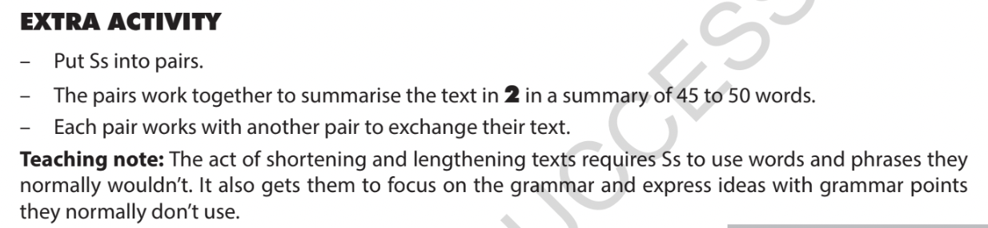



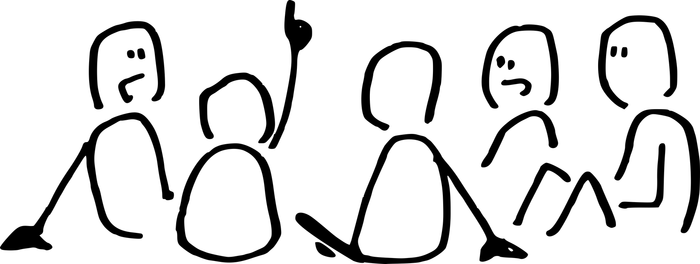
READING SUMMARY
Work in pairs. Summary the text in exercise 2 in a summary of 40 – 50 words.
Exchange your work with another pair and check.

Slide 20
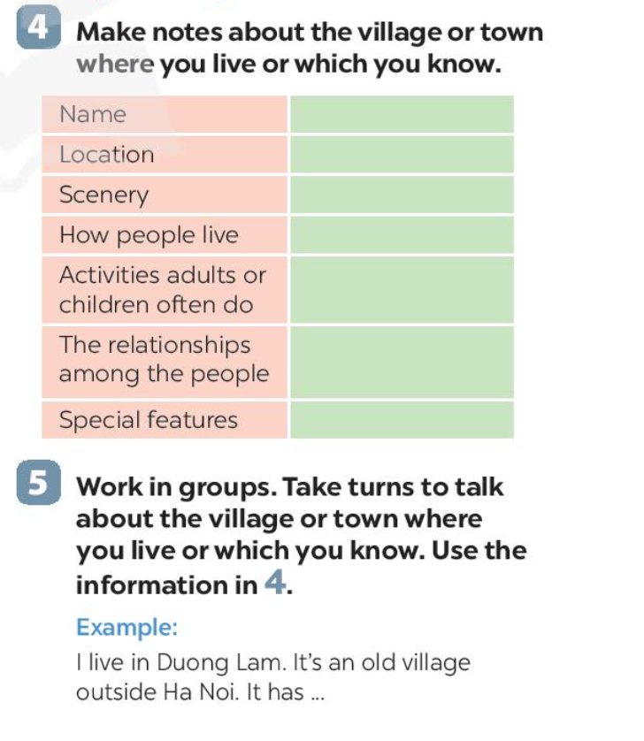
02
SPEAKING

Slide 21
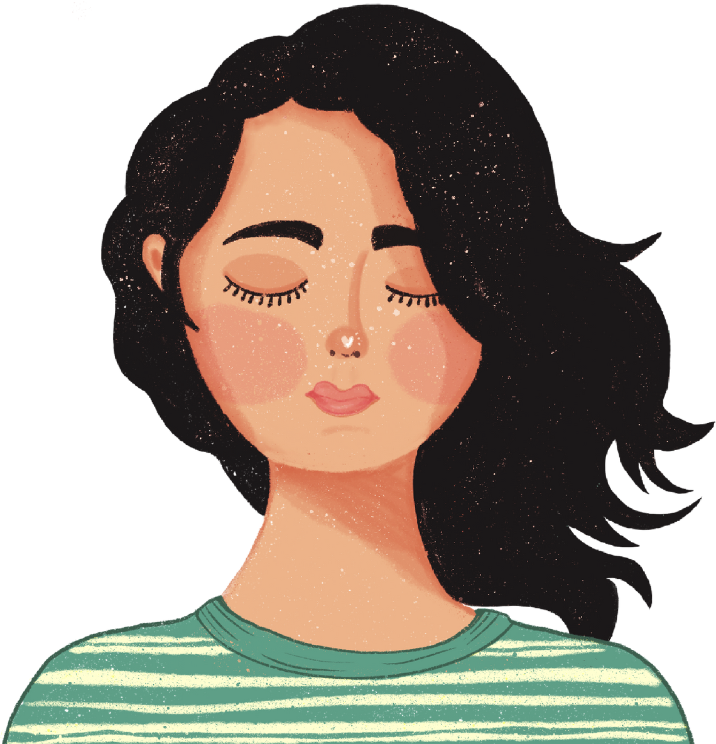


SENSORY IMAGINATION
Gently close your eyes

Slide 22
Teacher reads aloud these questions and students THINK about them.
1. What is the village’s name?
2. Where is it? (Is it far from Ha Noi?)
3. How is the scenery here? (The houses, the air, …)
4. How do people live?
Do they work? Do they grow anything?
Do they cultivaterice? What animals do they raise?
5. How is the relationship among the people?
Do they get on well to each other?
6. What are any special features?

Slide 23
Exercise 4. Students take note of what you already think about.
Ideas | Examples
Name
Location
Scenery
How people live
Activities adults or children often do
The relationships among the people
Special features
Duong Lam village
in Son Tay
golden rice fields,…
friendly and hospitable
making specialities: keo doi, che lam…
getting on well to each other
its ancient pagoda, traditional houses…

Slide 24
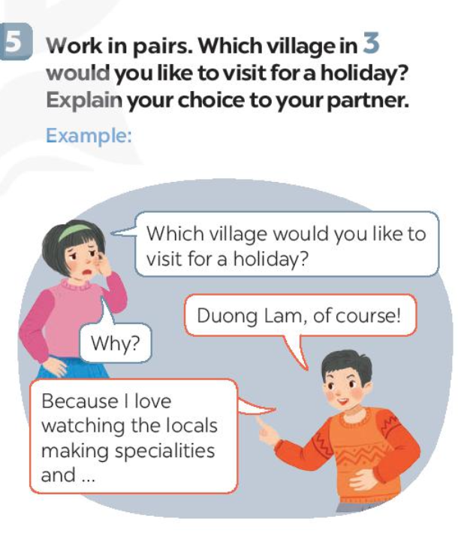
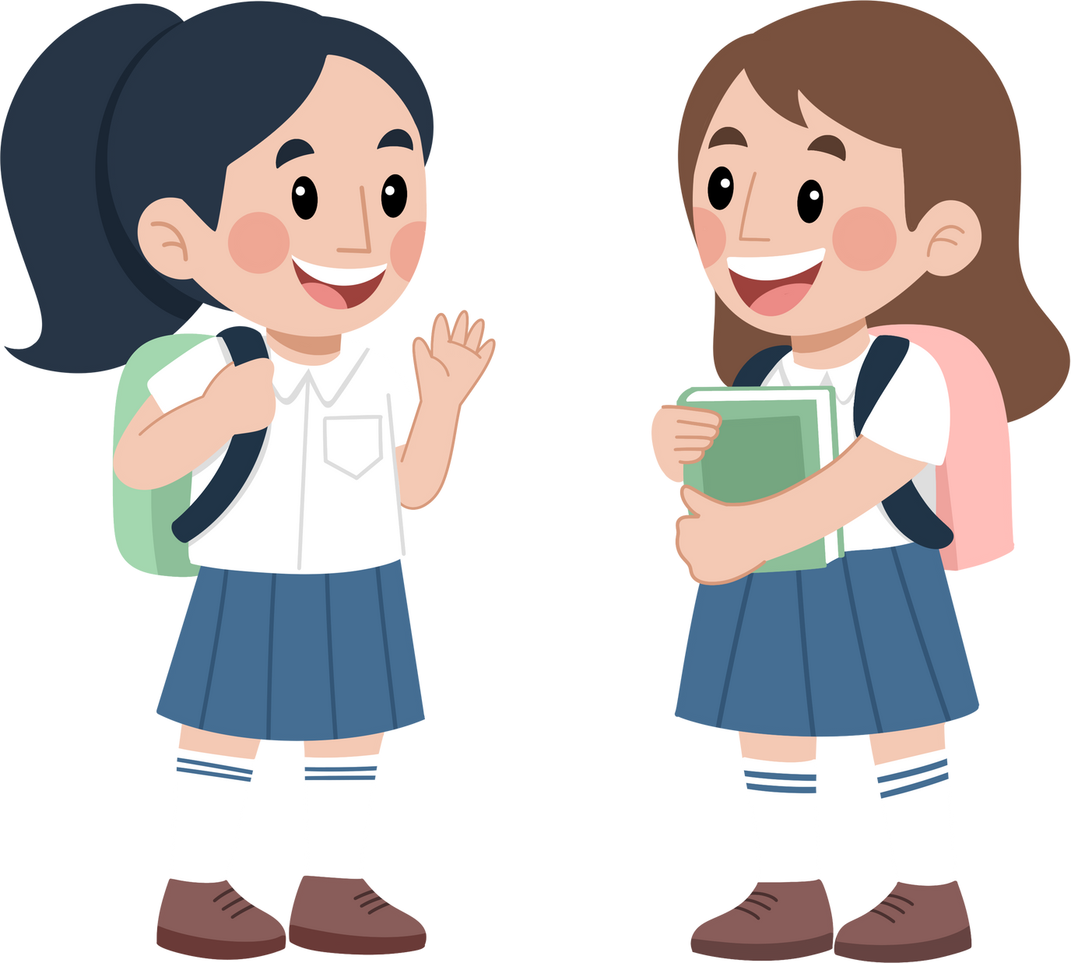
Exercise 5. Work in pairs. Choose a village to visit for a holiday. Explain your choice to your partner.
Which village would you like to visit for a holiday?
Duong Lam, of course!
Because I love watching the locals making specialities,…
Why?

Slide 25
ASSESS YOUR SPEAKING
Did they ask relevant questions and provide thoughtful answers?
Did the students use appropriate vocabulary, grammar, and language structures?
Did the student actively listen and respond to partner's statements in the role-play?
Did the student add any unexpected questions and the other could handle them?

Slide 26
WRAP UP
By the end of this lesson, students have been able to:
read for specific information about a Vietnamese village
talk about the village or town where someone lives

Slide 27
THANKS!
Do you have any questions?
youremail@freepik.com
+91 620 421 838
yourwebsite.com
Please keep this slide for attribution

Slide 28
ALTERNATIVE RESOURCES
Here’s an assortment of alternative resources whose style fits the one of this template:
PHOTOS:
Man choosing vegetable from vegetable stall at supermarket

