Slide 1
GUESSING GAME

Slide 2

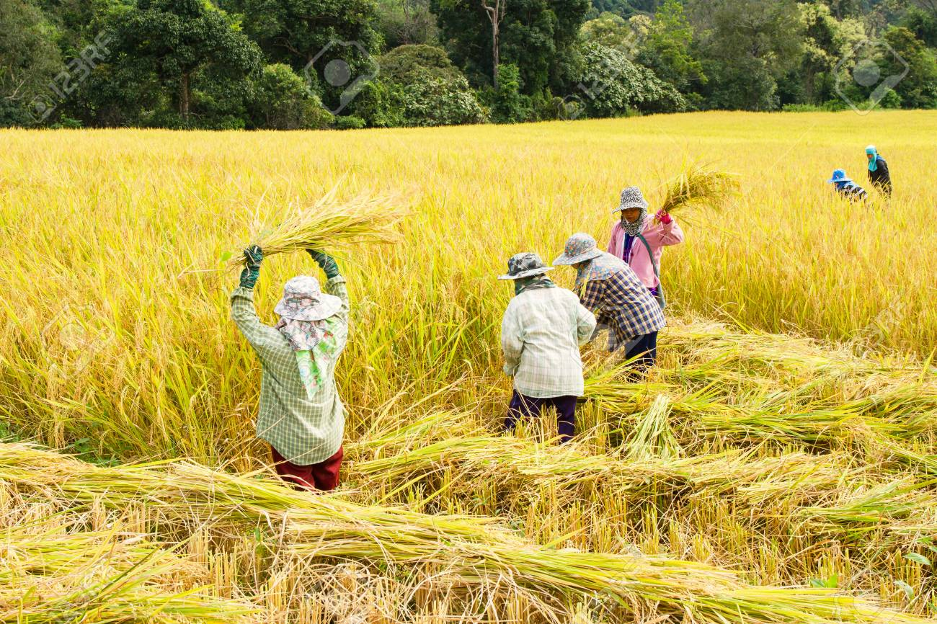
What are people doing?
harvesting rice

Slide 3
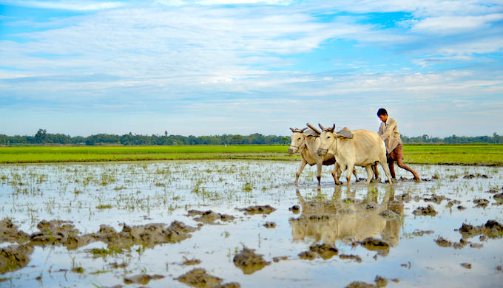
What are people doing?
ploughing a field

Slide 4
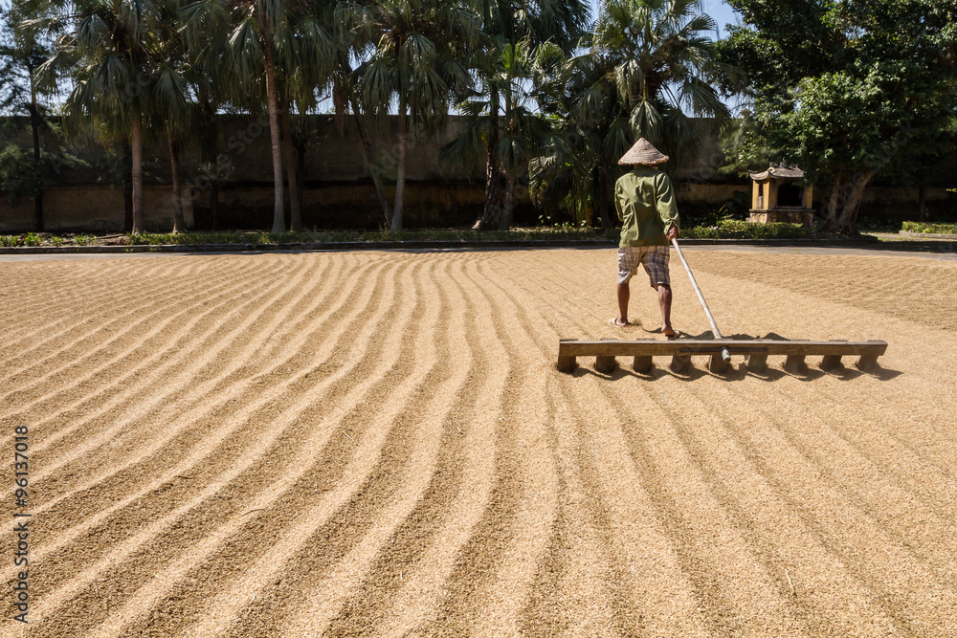
What are people doing?
drying rice

Slide 5
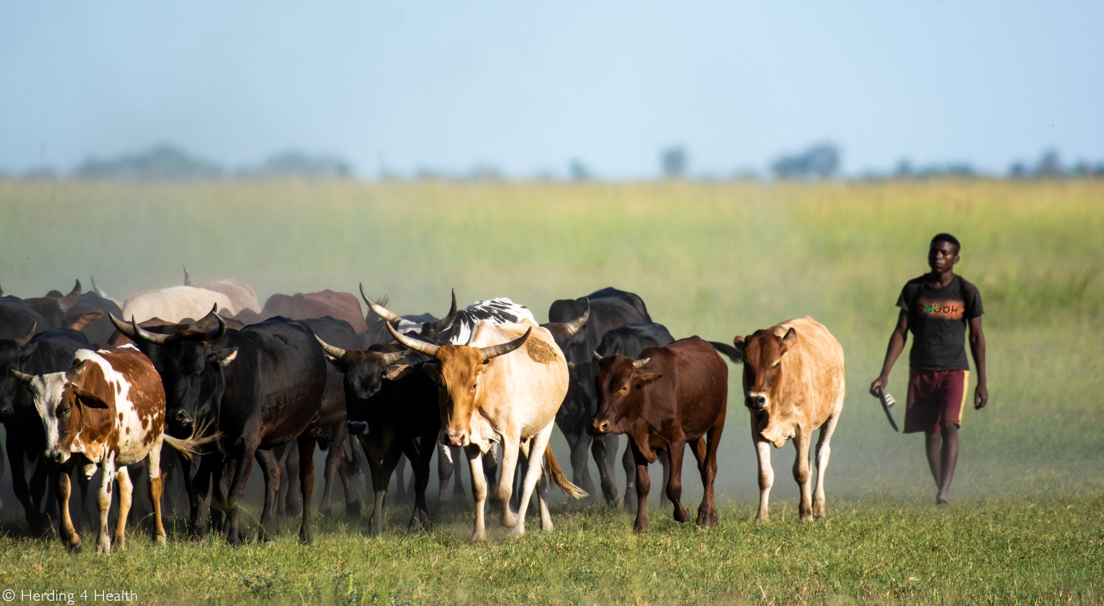
What are people doing?
herding cows

Slide 6
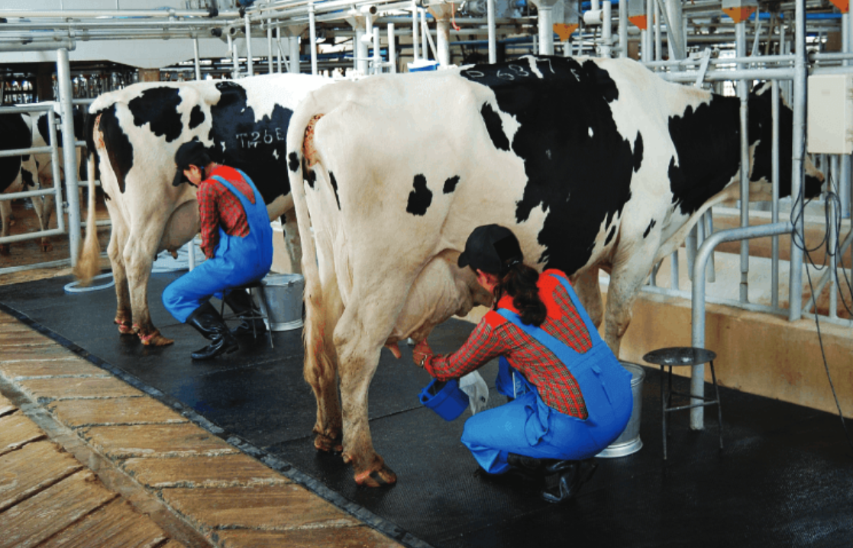
What are people doing?
milking cows

Slide 7
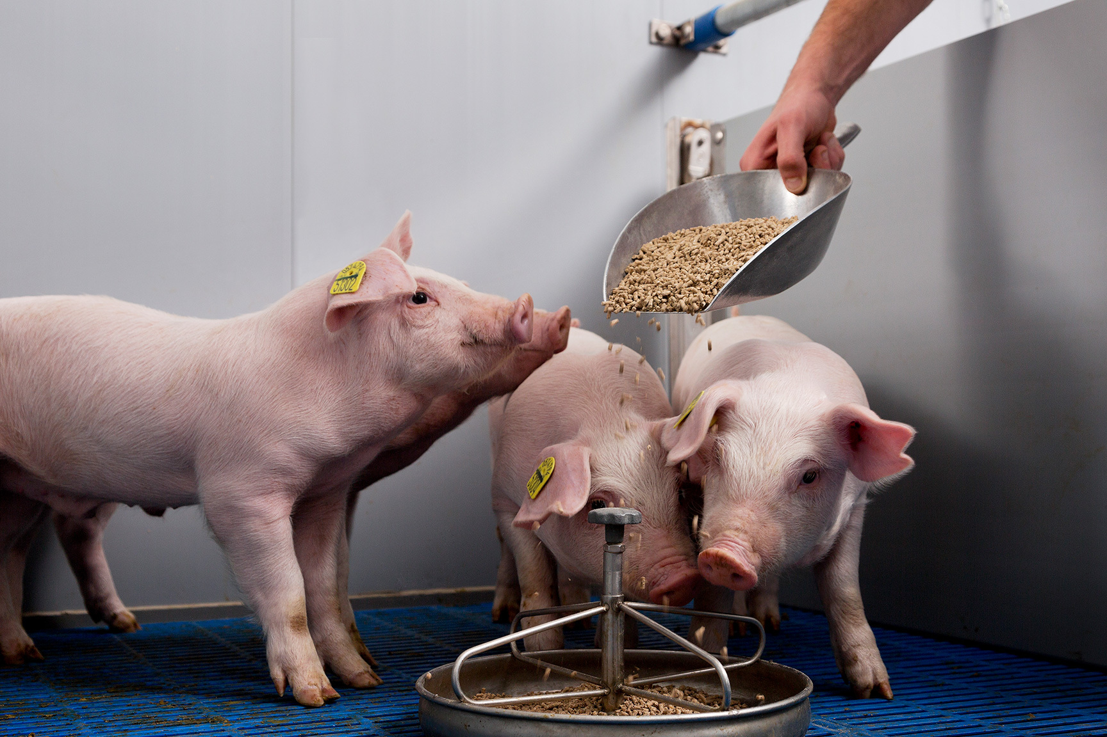
What are people doing?
feeding pigs

Slide 8
Do you like living in the countryside?
Do you like doing these activities?

Slide 9
UNIT 2:
LIFE IN THE COUNTRYSIDE
LESSON 6: SKILLS 2

Slide 10
OBJECTIVES
LISTENING
01
WRITING
02
By the end of the lesson, students will be able to:
Listen to someone’s opinion about life in the countryside
Write a paragraph about what someone likes or dislikes about life in the countryside

Slide 11
01
NEW WORDS

Slide 12
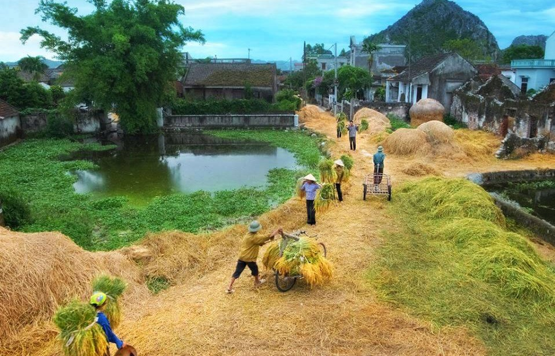

NEW WORDS
rural (adj)
/ˈrʊə.rəl/
(thuộc) nông thôn
rural life = life in the countryside

Slide 13

NEW WORDS
community (n)
/kəˈmjuː.nə.ti/
cộng đồng
sense of community = ý thức cộng đồng

Slide 14

NEW WORDS
duty (n)
/ˈdʒuː.ti/
nghĩa vụ, trách nhiệm
= responsibility

Slide 15
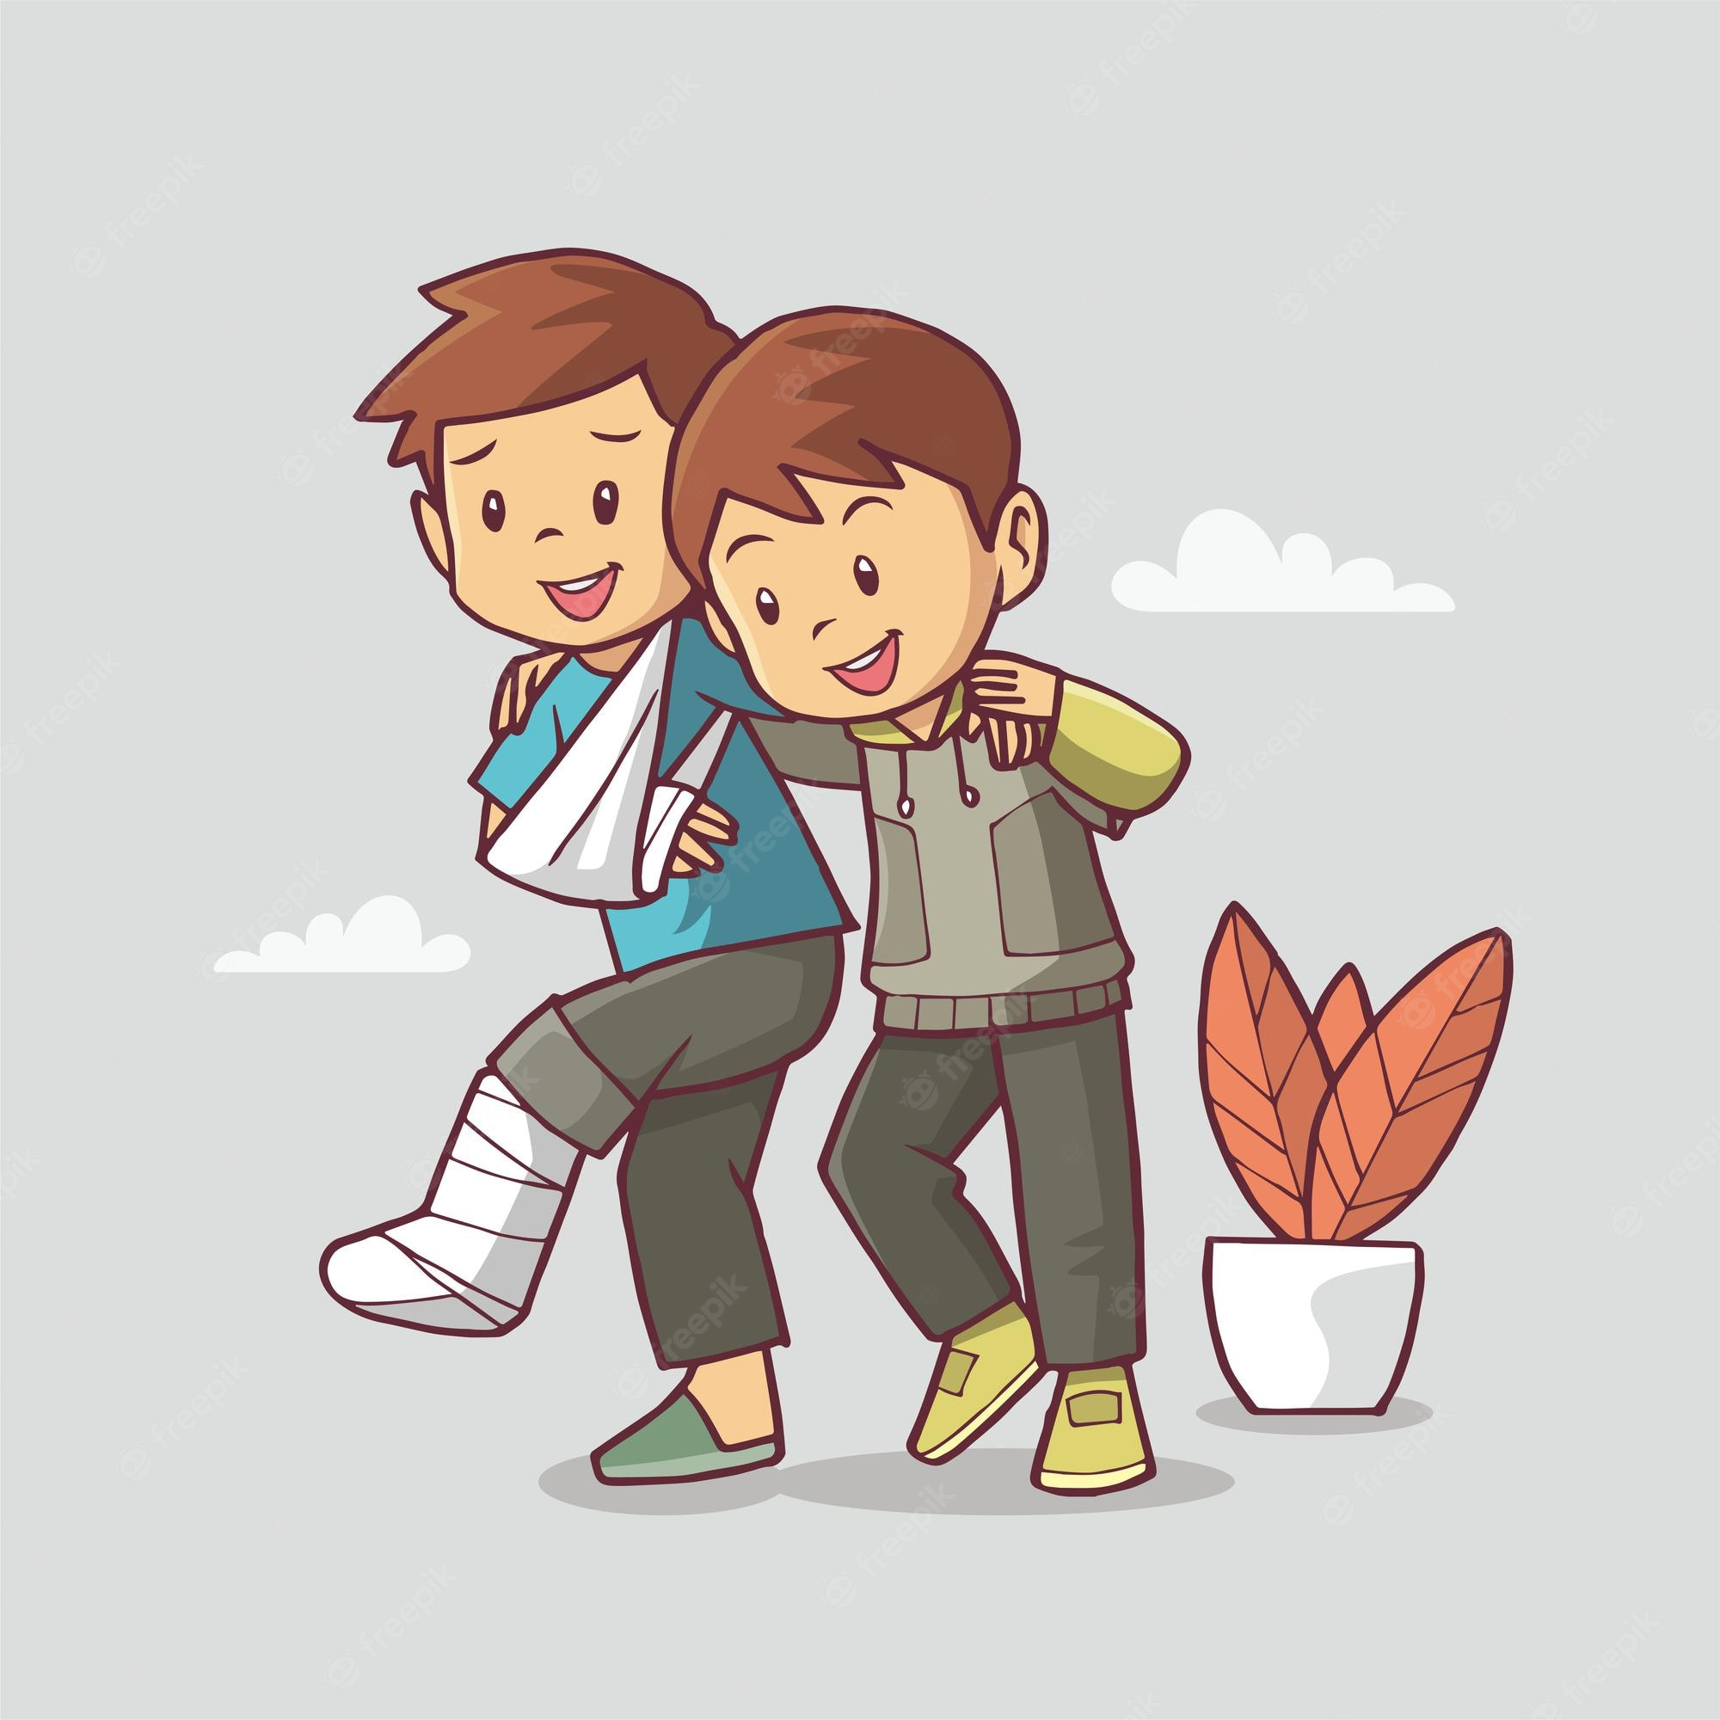
NEW WORDS
supportive (adj)
/səˈpɔː.tɪv/
đem lại hỗ trợ, khuyến khích

Slide 16
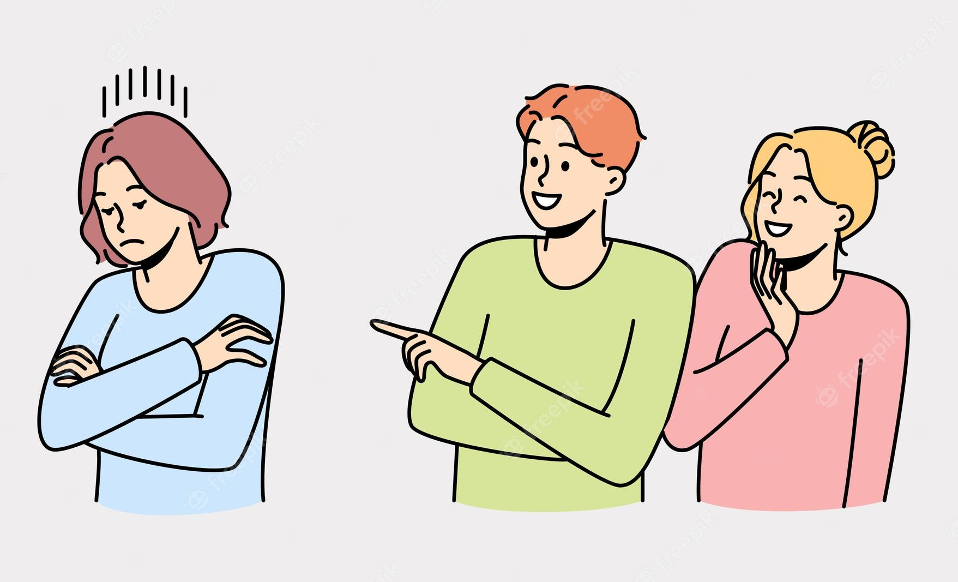
NEW WORDS
unsociable (adj)
/ʌnˈsəʊ.ʃə.bəl/
khó gần

Slide 17
02
LISTENING

Slide 18
Ex 1. (P.25). Work in pairs. Discuss the questions
What do you like or dislike about life in the countryside?

Slide 19
Ex 2. Listen to three people talking about life in the countryside.
Choose the opinion (A – C) that each speaker (1 – 3) expresses.
Speaker 1
Speaker 2
Speaker 3
Opinions
A. I don’t like rural life because there are not many good schools and colleges. And entertainment and means of transport are very poor.
B. I like rural life because the people here are close to each other.
C. I want to live in the countryside because there are many things I can’t easily do in the city.
B
A
C
Speaker 1
Speaker 2
Speaker 3
Notes:
Ấn vào từng ô speaker để nghe lại hoặc muốn check kĩ hơn cho học sinh. Bài này chưa để hiện tapescript.

Slide 20
Ex 3. Listen again. Choose the correct answer A, B, or C.
1. According to speaker 1, there is a great sense of ______ in his village.
A. security B. duty C. community
2. Speaker 1 says that people in his village are very ______.
A. supportive B. unsociable C. well-trained
3. In speaker 2’s opinion, ______ is a big problem in the countryside.
A. the cost of living B. safety C. transportation
4. Speaker 2 says that they should ______ in the countryside.
A. improve the lives of people B. prevent crime C. protect nature
5. According to speaker 3, life in the countryside is peaceful and ______.
A. slow B. simple C. safe
speaker 1
sense of
village
Speaker 1
people
very
speaker 2
big problem
countryside
Speaker 2
they should
speaker 3
life
countryside
peaceful
Read and underline key words
Listen and choose.

Slide 21
Ex 3. Listen again. Choose the correct answer A, B, or C.
1. According to speaker 1, there is a great sense of ______ in his village.
A. security B. duty C. community
2. Speaker 1 says that people in his village are very ______.
A. supportive B. unsociable C. well-trained
speaker 1
sense of
village
Speaker 1
people
very
Speaker 1: I chose to live in a village because the relationships between people here are very good. There is a great sense of community here. The people welcome neighbours to their homes. They are always willing to help each other. They share almost everything with one another.
Speaker 1: I chose to live in a village because the relationships between people here are very good. There is a great sense of community here. The people welcome neighbours to their homes. They are always willing to help each other. They share almost everything with one another.

Slide 22
Ex 3. Listen again. Choose the correct answer A, B, or C.
3. In speaker 2’s opinion, ______ is a big problem in the countryside.
A. the cost of living B. safety C. transportation
4. Speaker 2 says that they should ______ in the countryside.
A. improve the lives of people B. prevent crime C. protect nature
speaker 2
big problem
countryside
Speaker 2
they should
Speaker 2:
There are many things I don't like about life in the countryside. There aren't many good schools or colleges. It's boring here because there aren't many places for entertainment like theatres, cinemas, etc. Transportation is another big problem. There are few means of public transport. And in general, there are many things that we should do to improve the life of villagers.
Speaker 2:
There are many things I don't like about life in the countryside. There aren't many good schools or colleges. It's boring here because there aren't many places for entertainment like theatres, cinemas, etc. Transportation is another big problem. There are few means of public transport. And in general, there are many things that we should do to improve the life of villagers.

Slide 23
Ex 3. Listen again. Choose the correct answer A, B, or C.
5. According to speaker 3, life in the countryside is peaceful and ______.
A. slow B. simple C. safe
speaker 3
life
countryside
peaceful
Speaker 3:
I love to live in the countryside. It is spacious. We can do many, many things that are hard to do in the city. We can go swimming, play football, fly kites, and do other interesting things. Life is also peaceful and simple here.

Slide 24
Ex 3. Listen again. Choose the correct answer A, B, or C.
1. According to speaker 1, there is a great sense of ______ in his village.
A. security B. duty C. community
2. Speaker 1 says that people in his village are very ______.
A. supportive B. unsociable C. well-trained
3. In speaker 2’s opinion, ______ is a big problem in the countryside.
A. the cost of living B. safety C. transportation
4. Speaker 2 says that they should ______ in the countryside.
A. improve the lives of people B. prevent crime C. protect nature
5. According to speaker 3, life in the countryside is peaceful and ______.
A. slow B. simple C. safe

Slide 25
What about you?

Slide 26


Ex 4. Work in groups. Discuss and write what you like or dislike about life in the countryside.
LIKE | DISLIKE
LIKE | DISLIKE
– low cost of living – many cheap things … | – not many entertainment places, such as theatres, cinemas, etc. – poor means of transport ...

Slide 27
03
WRITING

Slide 28
Ex 5. Write a paragraph (80 - 100 words) about what you like OR dislike about life in the countryside.
There are some things I like / dislike about life in the countryside. __________________________ _____________________________________________________________________________________________________________________________________________________________________________________________________________________________________________________

Slide 29
Ex 5. Write a paragraph (80 - 100 words) about what you like OR dislike about life in the countryside.
SAMPLE:
There are some things I like about life in the countryside. One of the main attractions is its peacefulness. It helps people living there feel comfortable and relaxed. Additionally, I enjoy its natural beauty. The countryside often offers picturesque views of rolling hills, rolling meadows, and vast green fields. This can be a great source of inspiration. Finally, I really love the strong sense of community in rural areas. Rural people are very tight-knit and always willing to help their neighbours. Overall, these are just some of the many things I enjoy about rural life.
SAMPLE:
There are some things I like about life in the countryside. One of the main attractions is its peacefulness. It helps people living there feel comfortable and relaxed. Additionally, I enjoy its natural beauty. The countryside often offers picturesque views of rolling hills, rolling meadows, and vast green fields. This can be a great source of inspiration. Finally, I really love the strong sense of community in rural areas. Rural people are very tight-knit and always willing to help their neighbours. Overall, these are just some of the many things I enjoy about rural life.

Slide 30
SWAP AND CHECK
Check for spelling
Check for ideas
Did your friend write about what he/she likes and dislikes about living in the countryside?
Check for comprehension
Does the writing make sense?
Check for grammar
Does the writing use the correct tenses and structures?

Slide 31


RECAP
In this lesson, students have learned to:
listen for specific information about someone’s opinion about life in the countryside.
Write a paragraph about what someone likes or dislikes about life in the countryside.

Slide 32
Thanks!
Do you have any questions?

