Slide 1
UNIT 1:
LEISURE TIME
LESSON 7: LOOKING BACK

Slide 2
VOCABULARY
LEISURE TIME:
Go to the movies, listen to music, watch TV, go out with friend s, spend time with family, play video games, read a book, go to the park, ride horse, do exercise, play a sport, etc.
EXPRESSIONS ABOUT LIKES :
love, adore, fancy, prefer, mad about, crazy about, fond of, really like, quite like, huge fan of, etc.
EXPRESSIONS ABOUT DISLIKES:
hate, don’t like, not my cup of tea, not into, can’t stand, can’t bear, detest, loathe, etc.

Slide 3
pronunciation
/ʊ/ | /u:/
cook, would, could, woman, put, good, full, look, should, took, hoods, sugar, bush, wolf, etc.
group, June, school, move, who, too, use, through, few, student, do, value, etc.

Slide 4
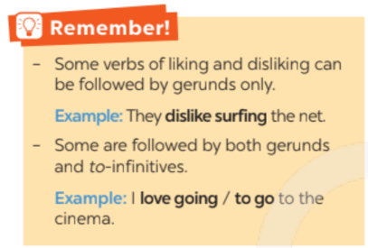
Grammar

Slide 5
grammar
verbs of liking/disliking + gerunds: Những động từ chỉ đi với danh động từ.
(Verb of liking/ dislike + V- ing)
Verbs | Example
adore | They adore eating ice cream. (Họ cực thích ăn kem)
enjoy | We enjoy playing basketball. (chúng tôi thích chơi bóng rổ)
fancy | Do you fancy making crafts? (Cậu thích làm đồ thủ công không?)
don’t mind | I don’t mind cooking. (Tôi không phiền việc nấu nướng.)
dislike | Does he dislike badminton? (Có phải anh ấy không thích cầu lông?)
detest | I detest doing housework? (Tôi căm ghét việc nhà)

Slide 6
grammar
2. verbs of liking/disliking + to – infinitives: Những động từ đi với cả danh động từ và động từ nguyên thể có “to” mà không thay đổi về nghĩa.
Verbs | Verbs + V – ing | Verbs + to V
Like | I like skateboarding in my free time. | I like to skateboard in my free time.
 | Tôi thích trượt ván trong thời gian rảnh
Love | She loves training her dog. | She loves to train her dog.
 | Cô ấy yêu thích huấn luyện chú cún cưng.
Hate | I hate eating out. | I hate to eat out.
 | Tôi ghét việc ăn ngoài hàng quán.
Prefer | My father prefers going jogging. | My father prefers to go jogging.
 | Bố tôi thích đi bộ hơn

Slide 7
COMPLETE THE SENTENCES WITH APPROPRIATE LEISURE ACTIVITIES
Mai loves ______________ online for about 30 minutes a day. She thinks puzzles are good for the brain.
My favourite leisure activity is ______________ I can make many things myself, such as paper flowers and bracelets.
__________________is a popular way for teens to spend their free time. Many of them send messages to each other every day.
My brother is fond of _____________with his friends. On Sundays, he usually plays football, goes swimming, or plays badminton with them.
Tom spends one hour on the Internet almost every day. He is keen on __________________
doing puzzles
doing DIY
Messaging friends
playing sports
surfing the net

Slide 8
Write complete sentences from the given cues.
1. I / not / fond / make models / because / I / not patient.
2. my friends / keen / do judo / and / they / go / judo club / every Sunday.
3. - why / you / not into / cook? - because / often / burn / myself.
4. they / interested / play / badminton / after / school?
5. my cousin / crazy / about / surf / net / and / play / computer / games.

Slide 9
Write complete sentences from the given cues.
3. I / not / fond / make models / because / I / not patient.
→ I’m not fond of make models because I’m not patient.
5. my friends / keen / do judo / and / they / go / judo club / every Sunday.
→ My friends are keen on doing judo and they go to judo club every Sunday.
4. - why / you / not into / cook? - because / often / burn / myself.
→ - Why are you not into cooking? - Because I often burn myself.
2. they / interested / play / badminton / after / school?
→ Are they interested in playing badminton after school?
1. my cousin / crazy / about / surf / net / and / play / computer / games.
→ My cousin is crazy about surfing the net and playing computer games.
Fond of + V : thích làm điều gì đó thường xuyên
Keen on + Ving: thích say mê
Not into: không thích
Interested in: thích thú làm điều gì
Crazy about + Ving : phát điên vì điều gì (rất thích)

Slide 10
Fill in each blank with the correct form(s) of the verb in brackets.
Does Tom enjoy (cycle)_____________ in the park with his friends?
Some teenagers don't like (read) __________________ comic books.
Mai detests (play) ___________________sport because it's tiring.
Trang and Ann love (chat) _______________ with each other in their free time.
What do Nam and Mark prefer (do) ___________________at the weekend?
clycing
enjoy + ving: thích làm gì
reading/ to read
like + ving/ to v: thích làm gì
playing
detest + ving: ghét làm gì
chatting/ to chat
love + ving/ to v: thích làm gì
doing/ to do
prefer + ving/to v: thích làm gì

Slide 11
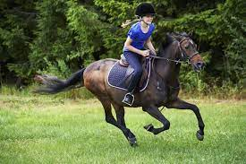

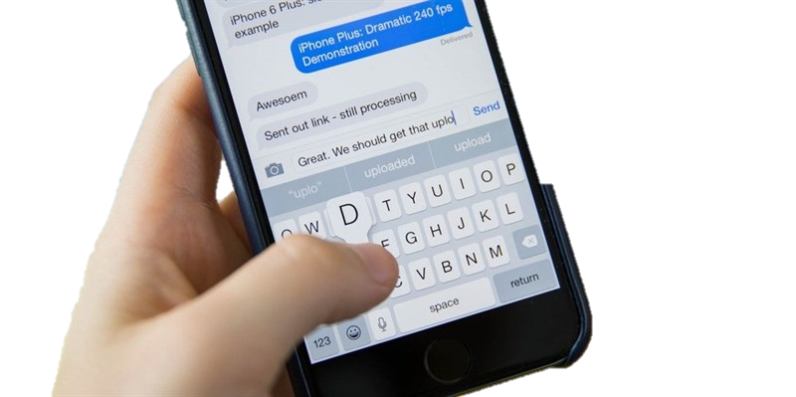

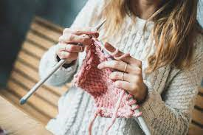
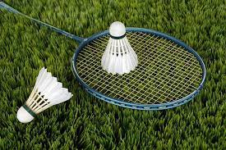
Complete the passage. Use the correct form(s) of the verbs in brackets and the pictures. Add more words if necessary.
Ann is my best friend. She usually has free time at the weekend. She enjoy
(1.ride) riding a horse at the riding club. Sometimes, she likes (2. read) _________________ or (3.message) ________________. She also loves (4. make) _______________ and (5. knit) _______________. However, there is one thing she doesn't like doing in her free time. She dislikes (6. play) _______________________.
reading
/ to read books
messaging (friends)
making
/to make flowers
knitting / to knit
playing badminton

Slide 12
Thank you!
Do you have any questions?

