Slide 1

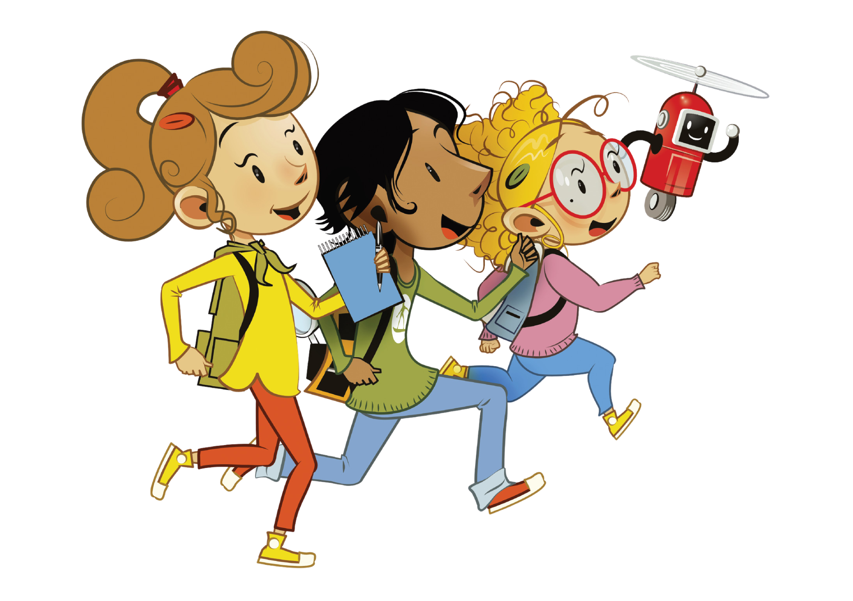
UNIT 6 + UNIT 7 + UNIT 8
REVISION 4B

Slide 2
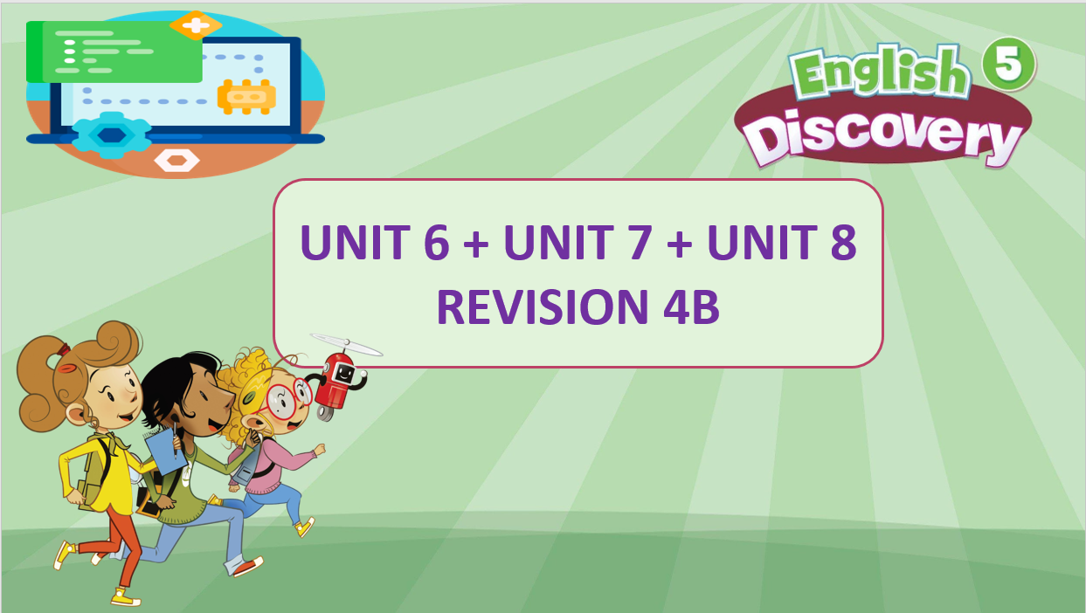

Slide 3

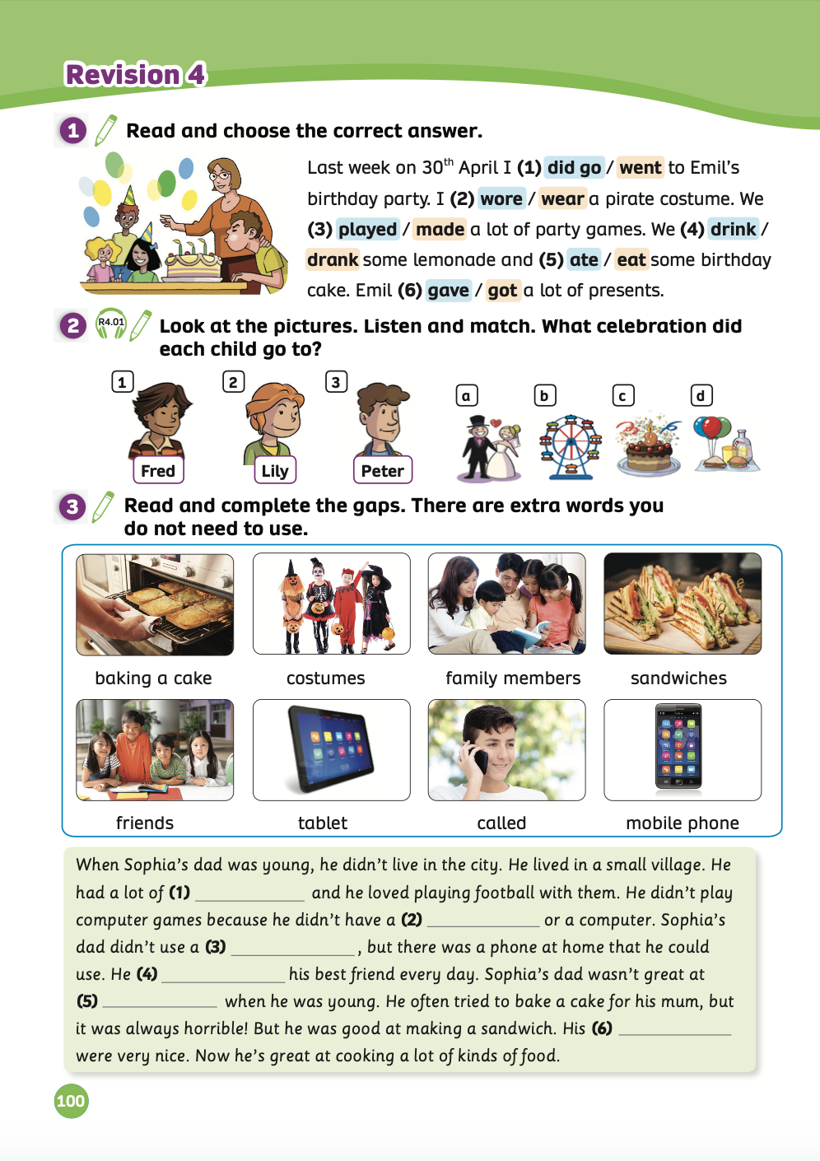
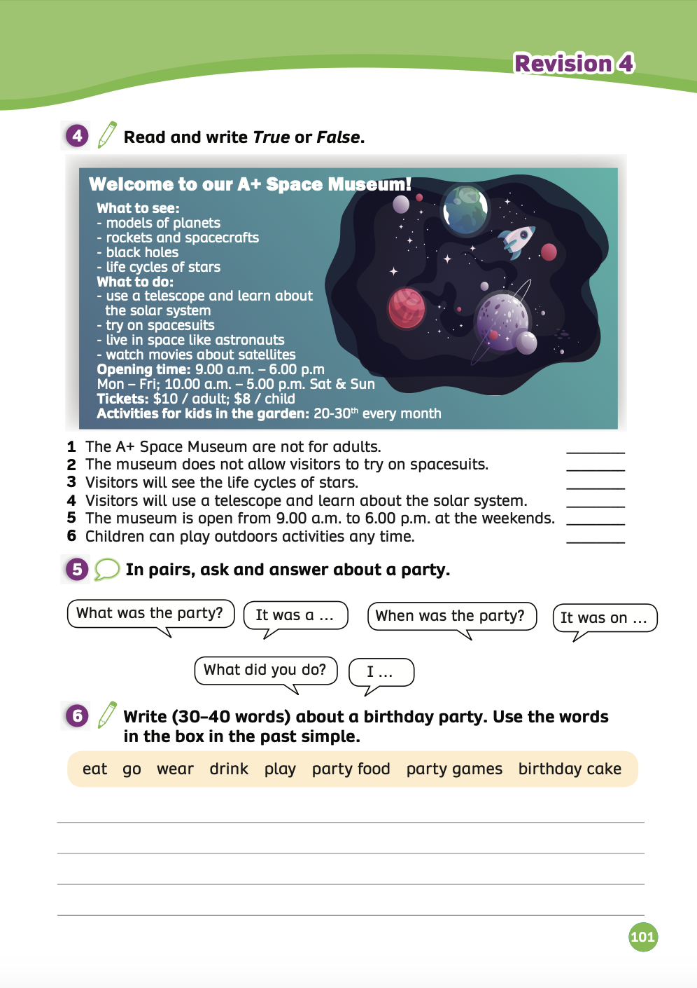
UNIT 6, 7 & 8 – Revision
We’re learning…
- To review the words related to technology, celebrations, and space.
- To ask and answer about technology, celebrations, and space.
- PB p. 100, 101

Slide 4


WARM-UP ACTIVITY
Divide the class into 2 teams.
Each team will look at pictures about vocabulary in Unit 6 or Unit 7 or Unit 8 and choose the correct answers.
Then, ask students to raise their hands to check.
The fastest group with all correct answers will receive 2 points.

Slide 5
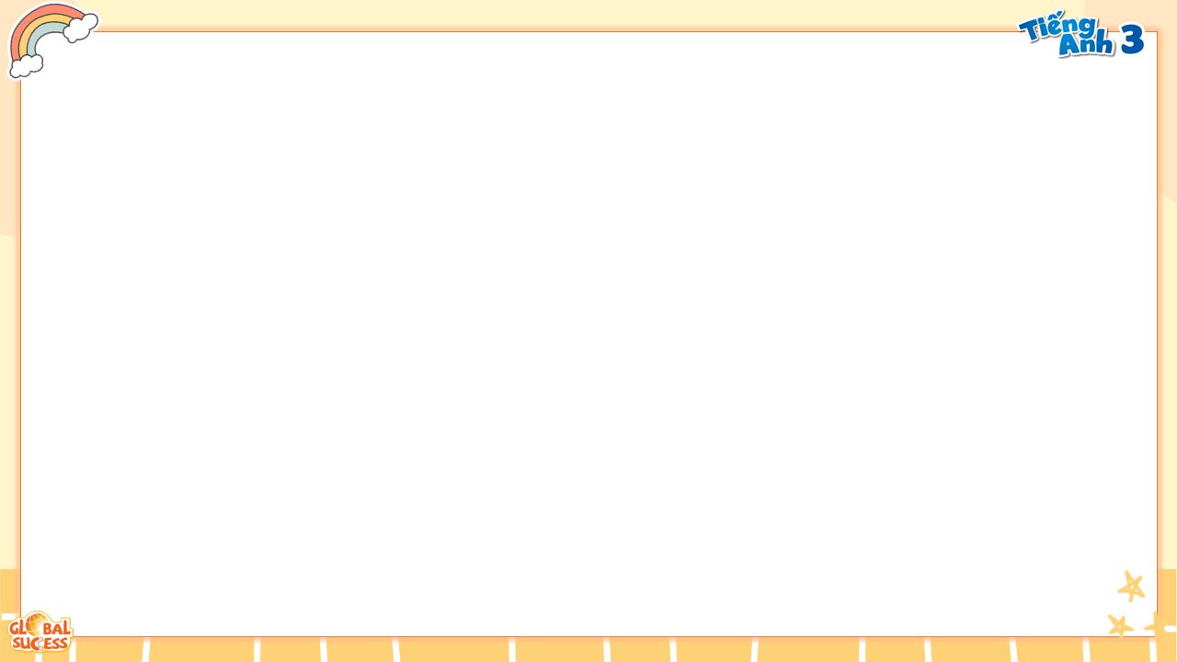


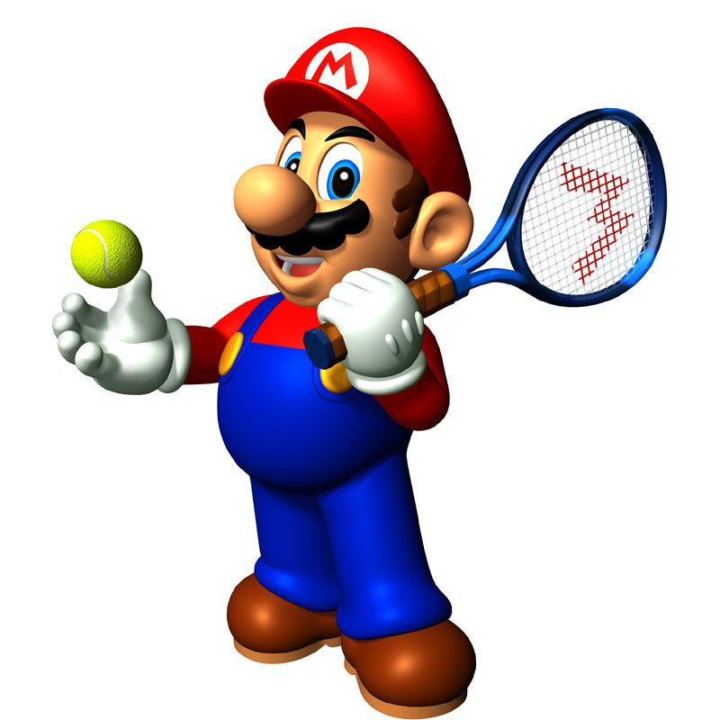





Slide 6
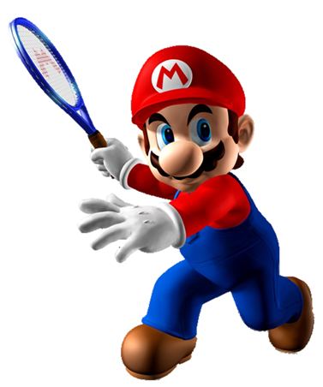
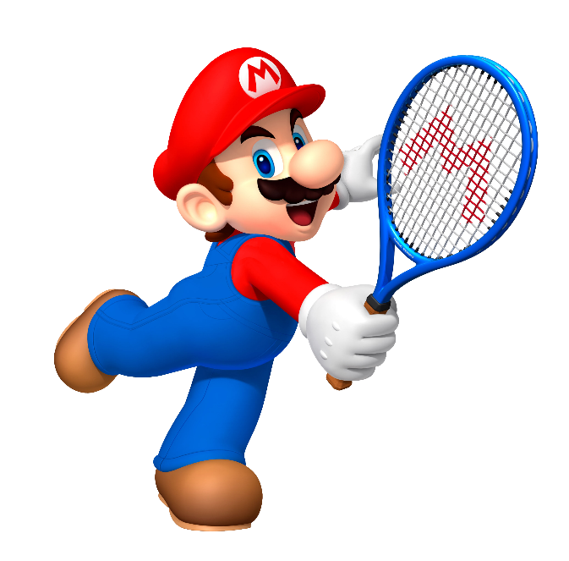
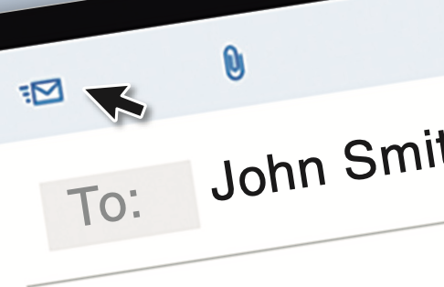


telephone
email
letter

Slide 7

study
use
call

Slide 8
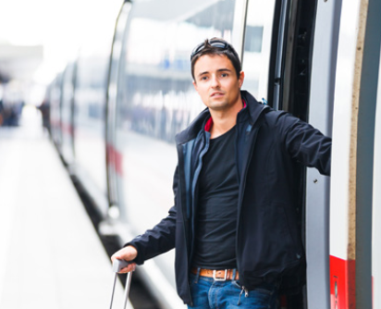
need
live
arrive

Slide 9
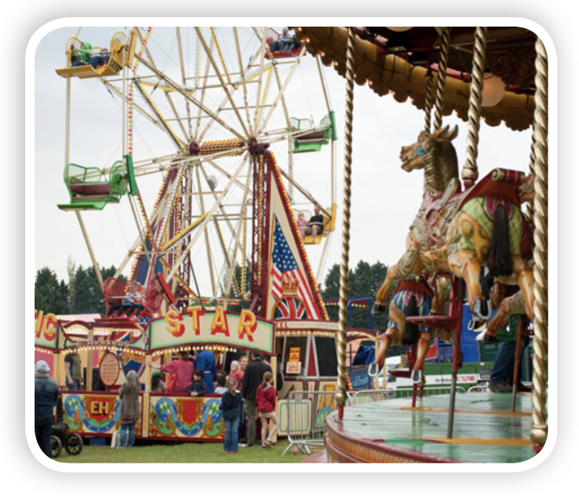
band
funfair
big wheel

Slide 10
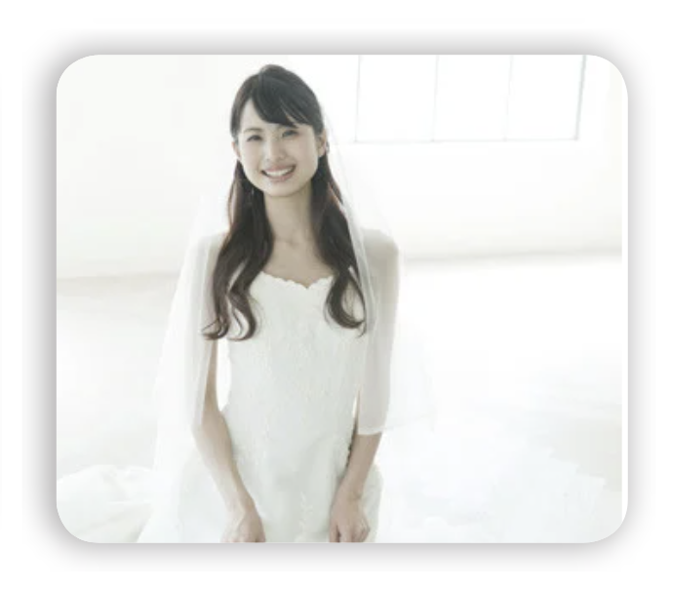
bride
groom
honeymoon

Slide 11

twenty-fiveth
twenty-five
twenty-fifth

Slide 12
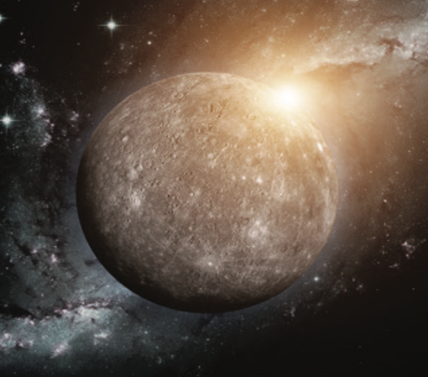
Earth
Mercury
Venus

Slide 13
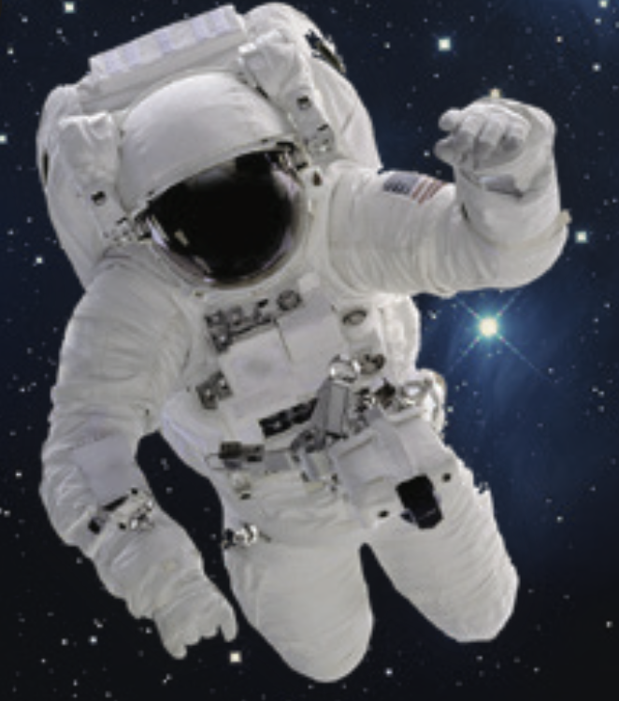
comet
spacesuit
space station

Slide 14

fifty hundred
fifty thousand
fifteen thousand

Slide 15
Good job!

Slide 16
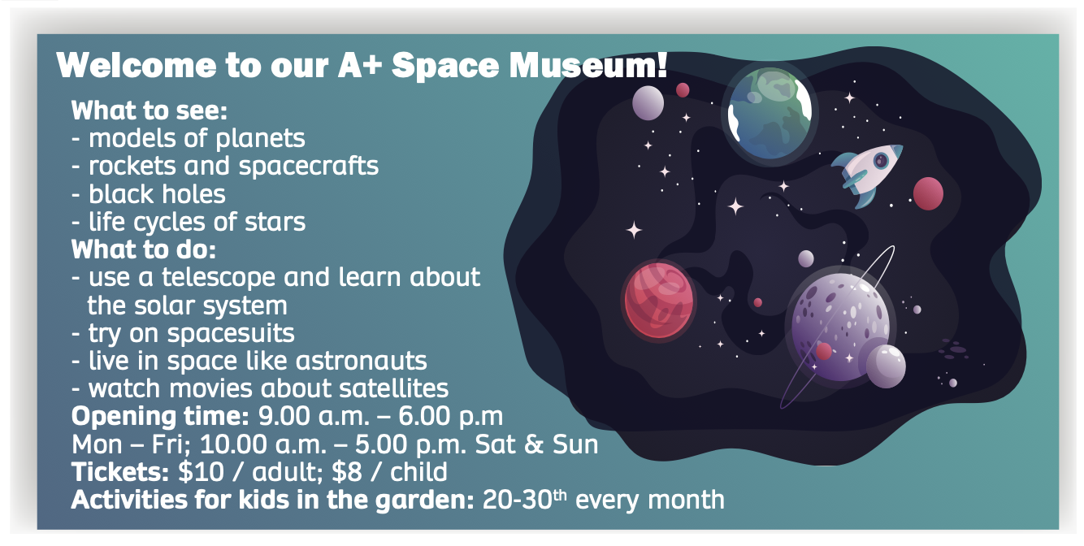
KEYWORD

Slide 17
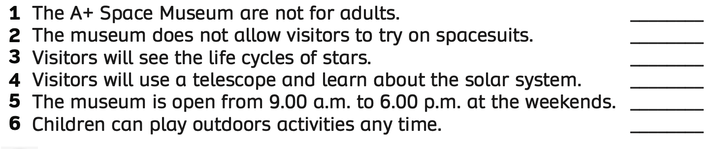
Pupils’ Book (p.101)
REVIEW
False
False
True
True
False
False
ANSWER
- Have students read the text again and write True or False.
- Check the answers with the whole class.

Slide 18
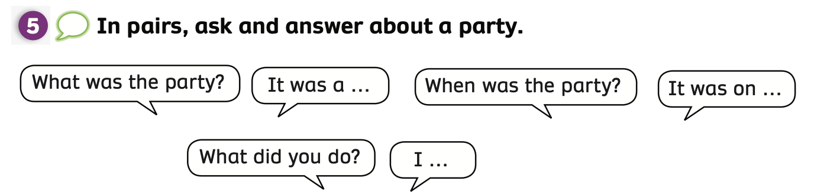
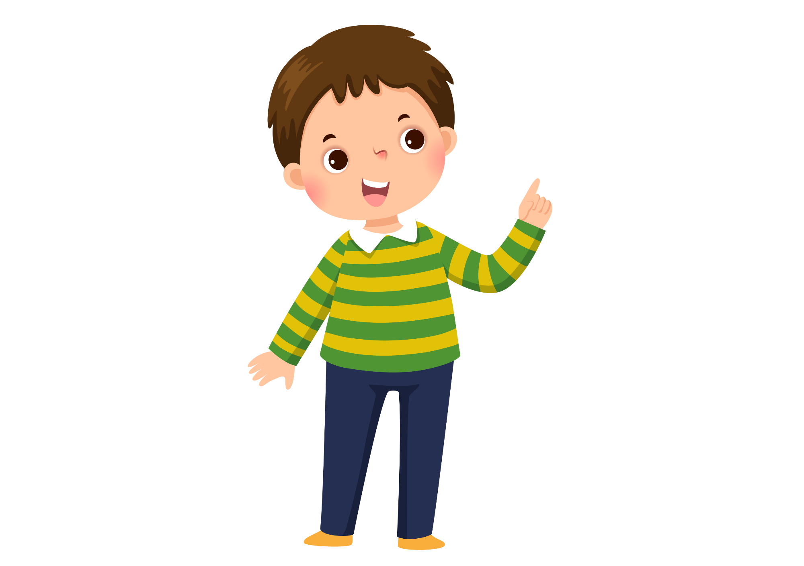
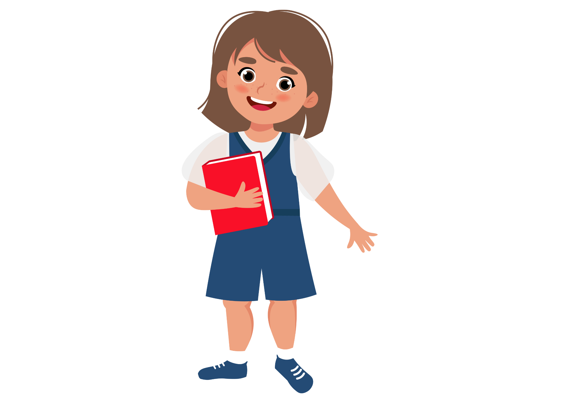
Pupils’ Book (p.101)
REVIEW
- Work in pairs, look at the speech bubbles and have them ask and answer about the party.
- Examples are on the next slides.

Slide 19
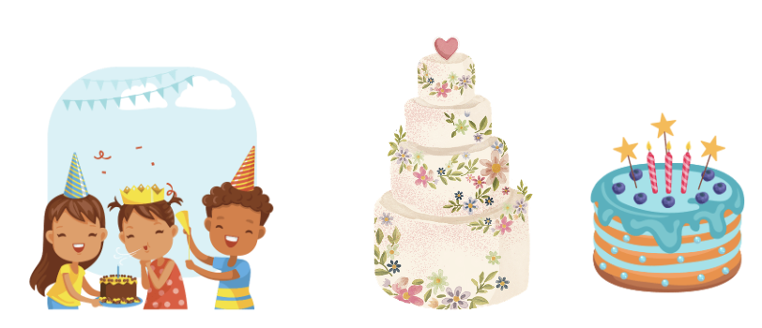
Pupils’ Book (p.101)
REVIEW
What was the party?
It was a ….
- Have students look at the example.
Ask students to work in pairs to ask and answer about their party.
Ask them to take turns to practice.
Invite some pairs to present in front of the class.

Slide 20

Pupils’ Book (p.101)
REVIEW
When was the party?
It was on ….
- Have students look at the example.
Ask students to work in pairs to ask and answer about their party.
Ask them to take turns to practice.
Invite some pairs to present in front of the class.

Slide 21
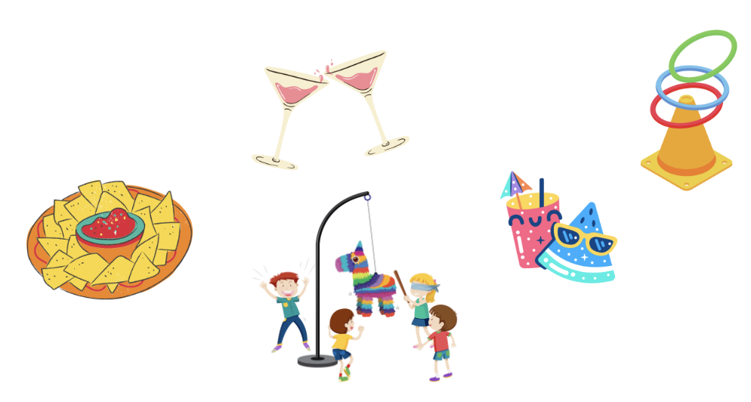
Pupils’ Book (p.101)
REVIEW
What did you do?
I ….
- Have students look at the example.
Ask students to work in pairs to ask and answer about their party.
Ask them to take turns to practice.
Invite some pairs to present in front of the class.

Slide 22
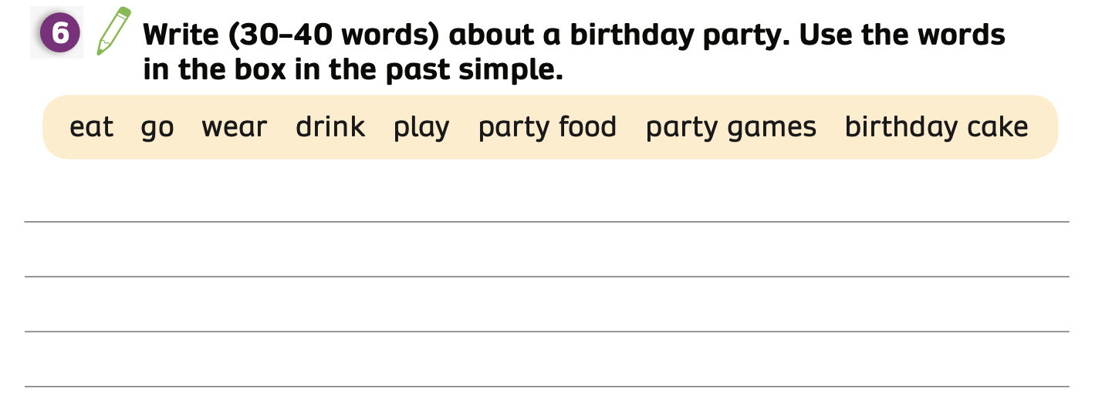
Pupils’ Book (p.101)
REVIEW
Hello, my name is Hoa.
Yesterday, I went to a birthday party.
I wore a dress, ate party food, and drank orange juice.
I played many party games and I was happy.
ANSWER
Using some of the words in the box and past simple tense.
The teacher explains to the class that they are going to write about a birthday party that happened in the past.
Then, students write the text individually and compare it with their partner.
Check the answers with the whole class.

Slide 23
HOMEWORK
Review the classroom language.
Do exercises in the Activity Book (page 78, 79).
Check answers in the Teacher’s book (page 172) or Active Teach.

Slide 24
UNIT 6, 7 & 8 – Revision
We’re learned…
- To review the words related to technology, celebrations, and space.
- To ask and answer about technology, celebrations, and space.
- PB p. 100, 101

