Slide 1
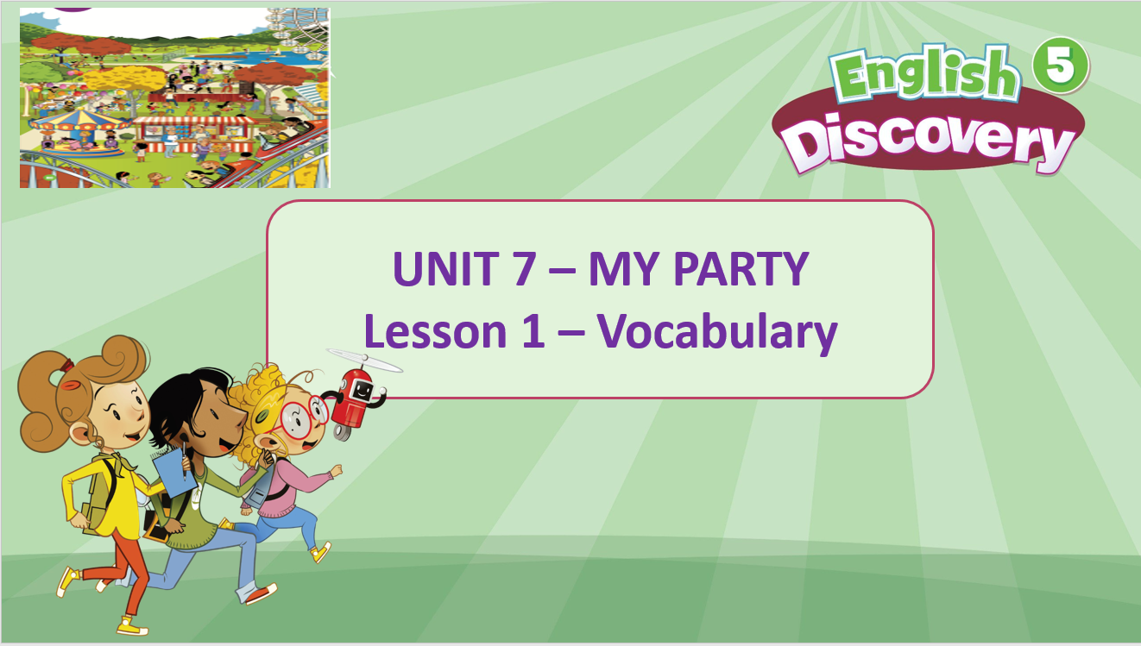

Slide 2
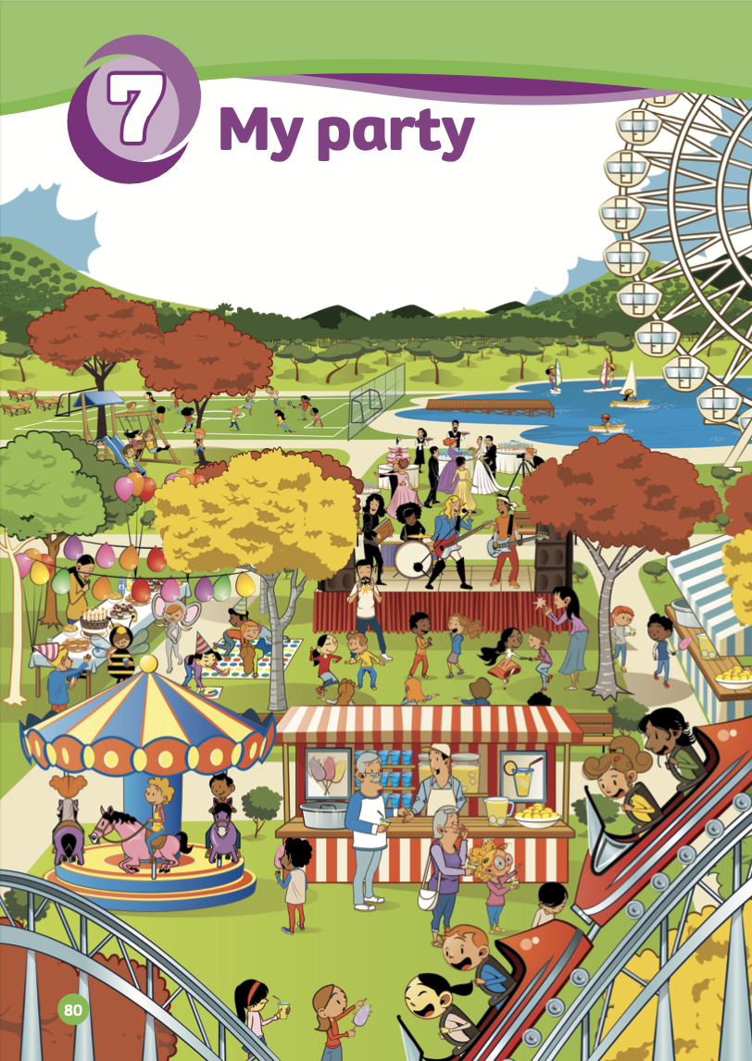
LEAD-IN
go sailing
play football
rollercoaster
funfair
dance
dress up
big wheel

Slide 3

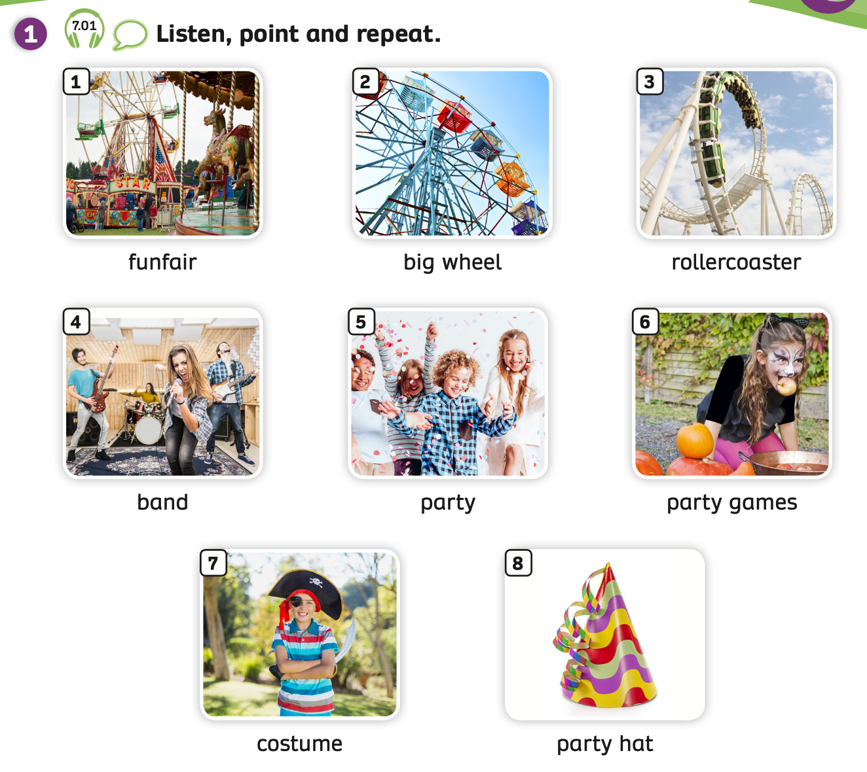

VOCABULARY – My party
Play the audio, students listen and repeat the words.

Slide 4
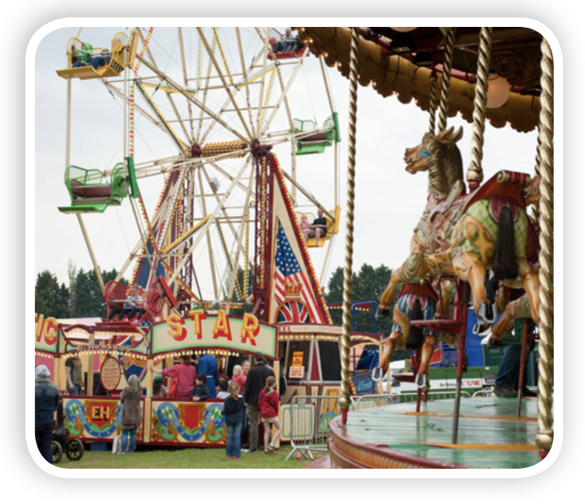

c
funfair

Slide 5
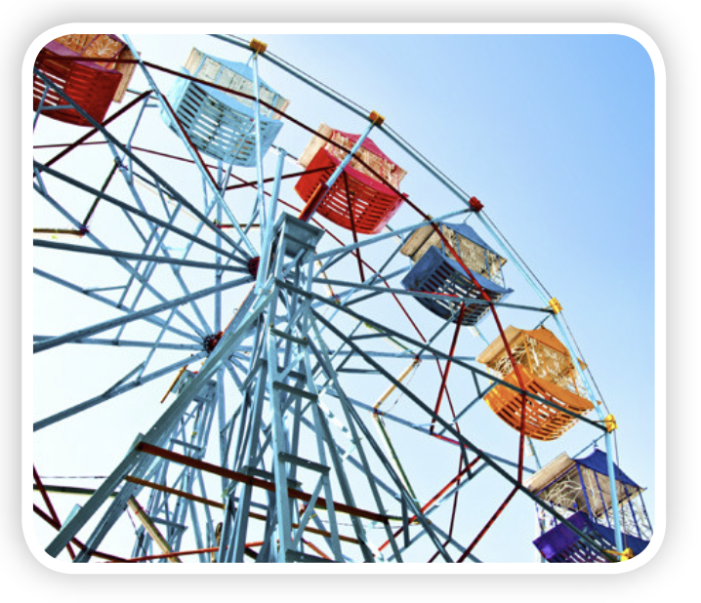
c
big wheel

Slide 6
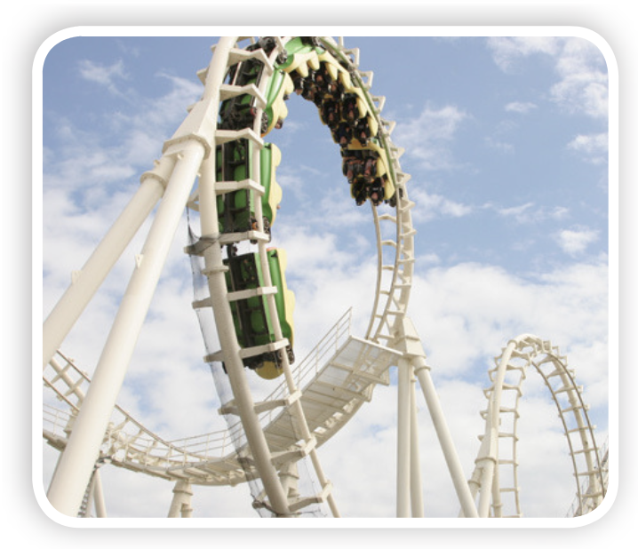
c
rollercoaster

Slide 7
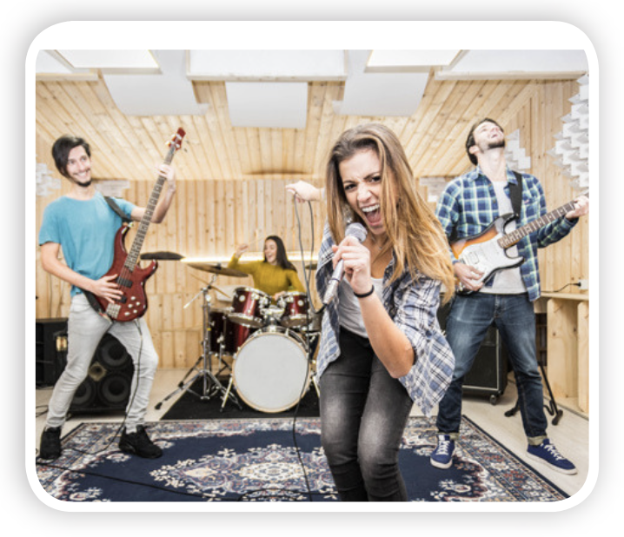
c
band

Slide 8
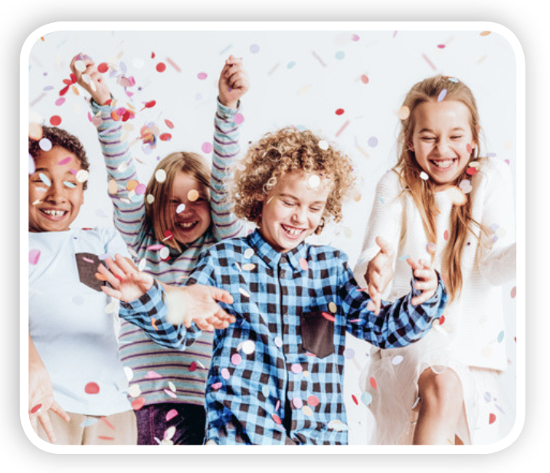
c
party

Slide 9
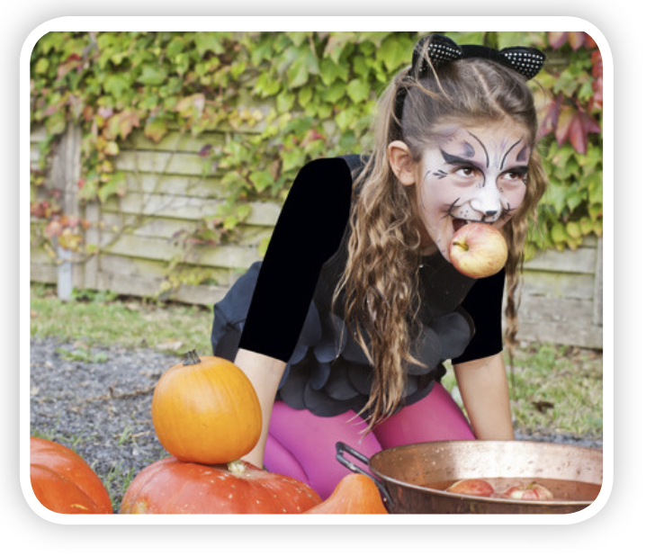
c
party games

Slide 10
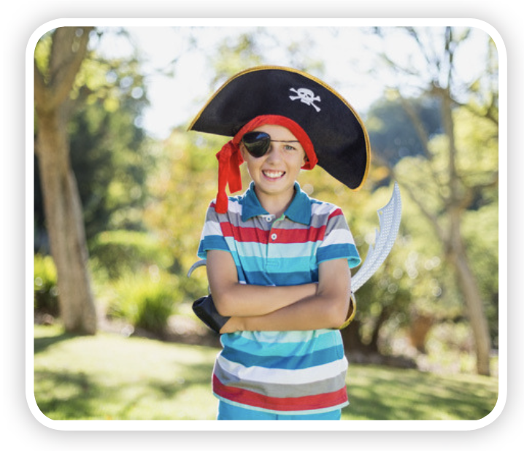
c
costume

Slide 11
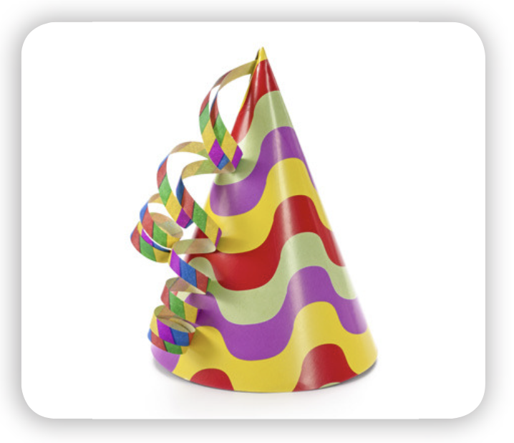
c
party hat

Slide 12

VOCABULARY - REVIEW
c
c
c
c
funfair
big wheel
rollercoaster
band
c
c
c
c
party
party games
costume
party hat
Show each picture, students look at and say the word.

Slide 13
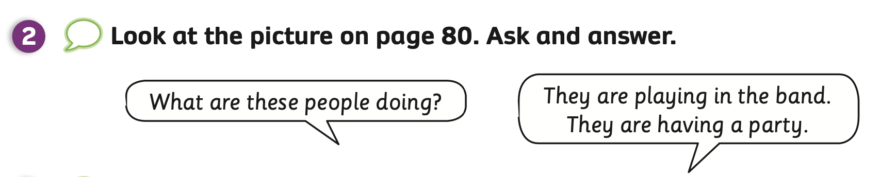

Slide 14

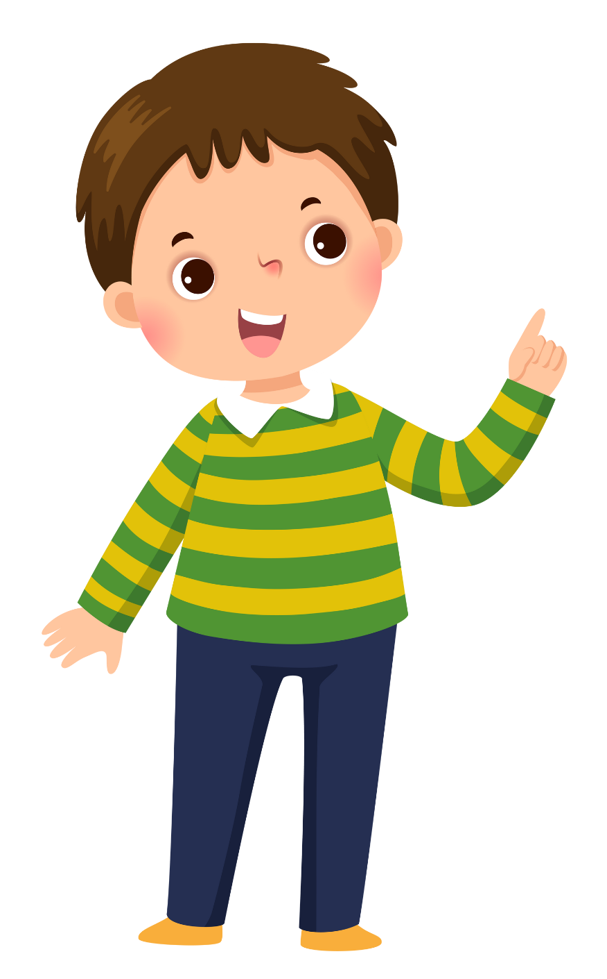

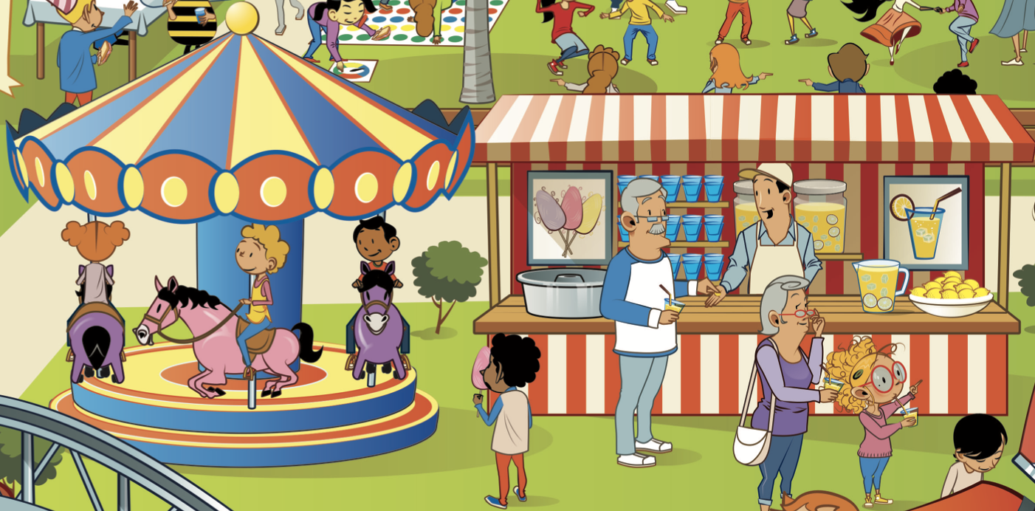
What are these people doing?
They are playing in the funfair.

Slide 15
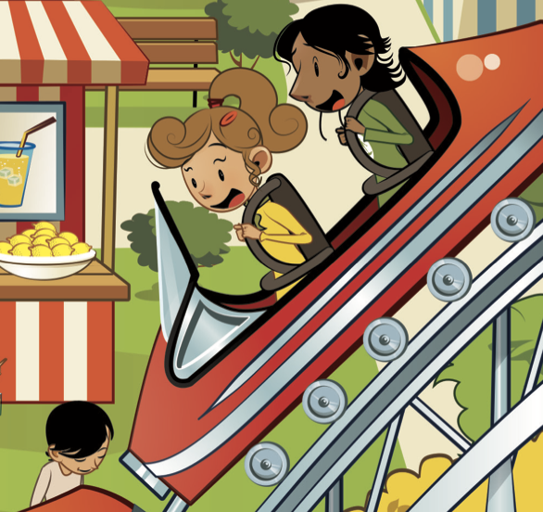
What are these people doing?
They are playing
rollercoaster.

Slide 16
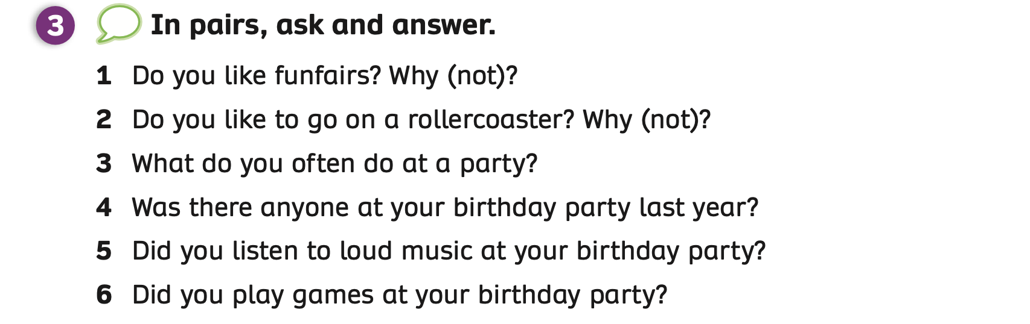
STRUCTURE – Pupils’ Book (p.81)
- Show the questions and introduce the activity.

Slide 17


STRUCTURE – Pupils’ Book (p.81)
Divide the class into groups of 5 to 6 students.
Give each student a piece of paper with 6 columns on it.
Students choose a member in the group, ask 6 questions in Activity 3 and write the information on the paper.
After finishing 3 names on the paper, students say Bingo.
The teacher goes around, checks and helps students if needed.
The 5 fastest students who finish all columns on the paper receive 2 points.

Slide 18
STRUCTURE – Pupils’ Book (p.81)
Name | Funfairs | Rollercoaster | Do at a party | Anyone at party | Listen to loud music | Play games
1
2
3
Teacher shows this table.
Teacher can print out this table or ask students to draw the table on the piece of paper.

Slide 19

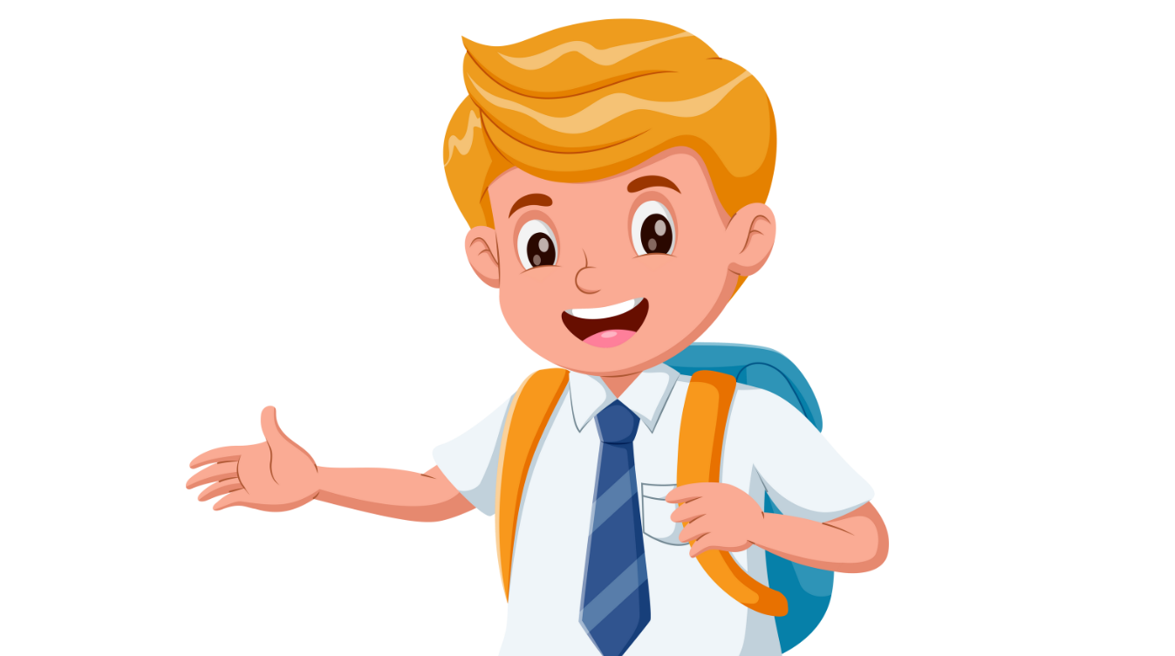
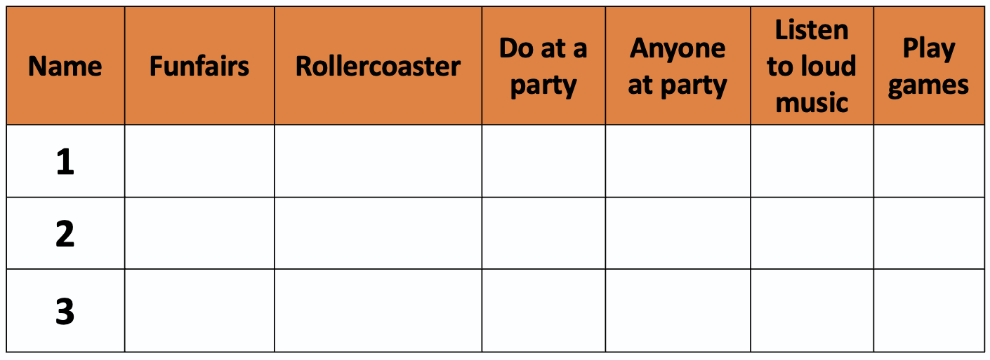


STRUCTURE – Pupils’ Book (p.81)
Do you like to go on
a rollercoaster?
What do you often do at a party?
Yes, I do.
No, I don’t.
Do you like funfairs?
I play games.
Minh
games
Liên
Minh
Students look at the example conversation.
Then, switch roles to practice.

Slide 20
STRUCTURE – Pupils’ Book (p.81)
Was there anyone at your birthday party last year?
Did you listen to loud music at your birthday party?
Yes, there was.
Yes, I did.
Minh
games
Liên
Minh
Students look at the example conversation.
Then, switch roles to practice.

Slide 21
PRODUCTION
c
c
c
c
funfair
big wheel
rollercoaster
band
c
c
c
c
party
party games
costume
party hat
Show each picture, students look at and say the word.

Slide 22
HOMEWORK
Review vocabulary.
Do exercises in the Activity Book (page 62).
Check answers in the Teacher’s Book (page 139) or Active Teach.

