Slide 1
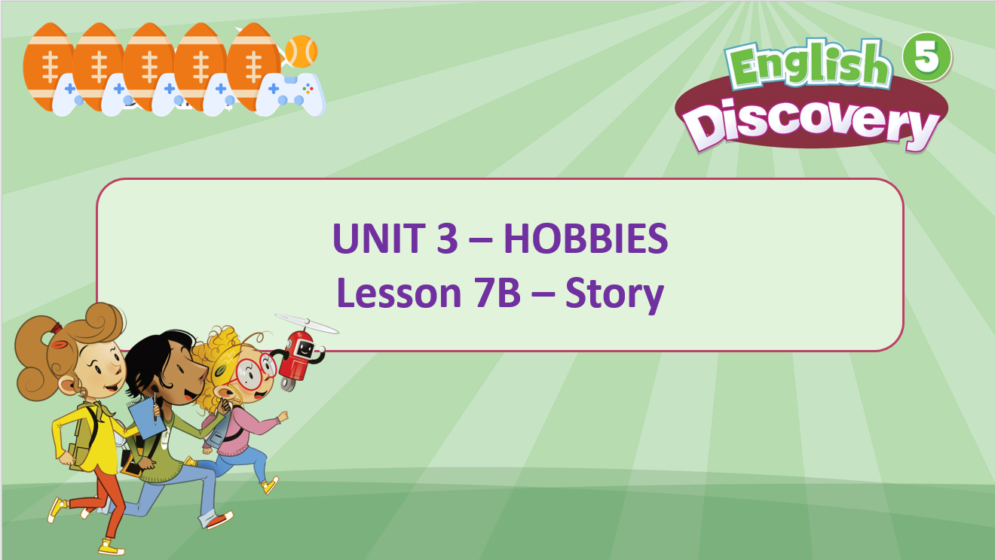

Slide 2


STORY TIME

Slide 3
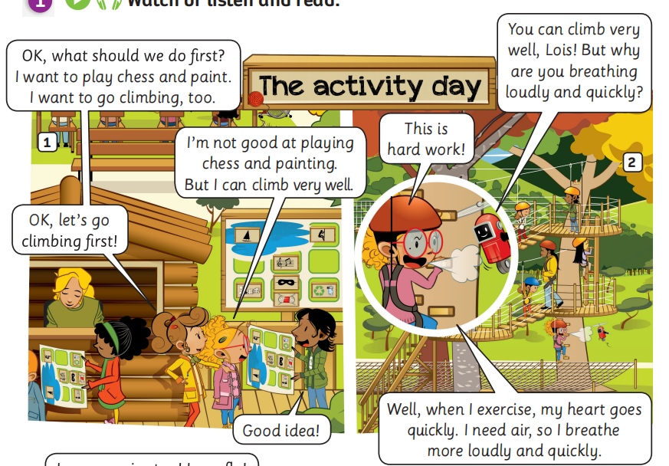

STORY TIME
Listen and read
Listen

Slide 4
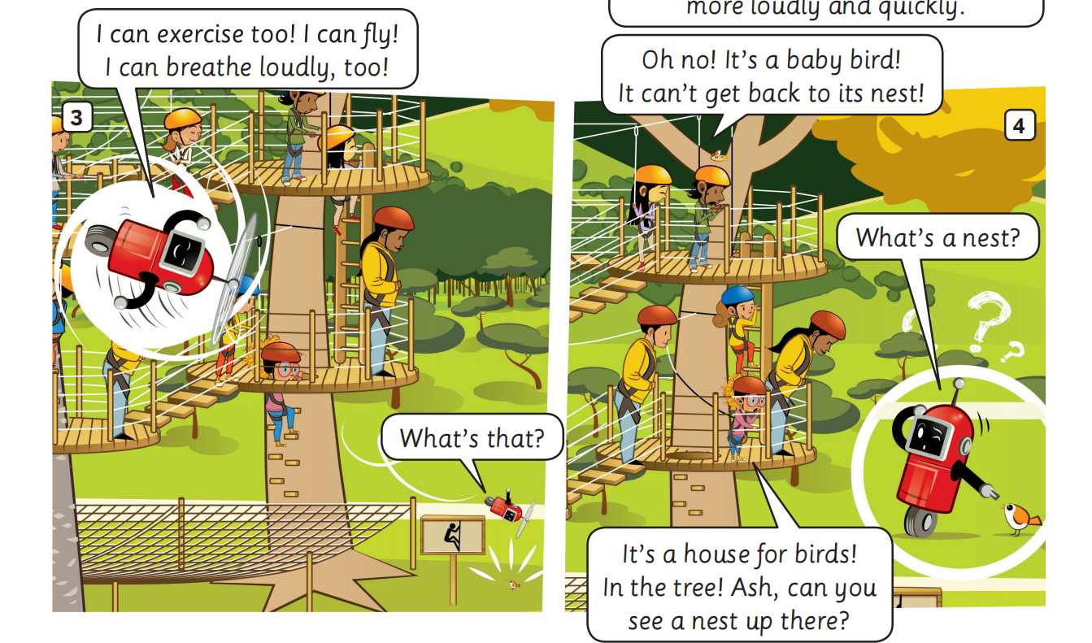
STORY TIME
Listen and read
Listen

Slide 5
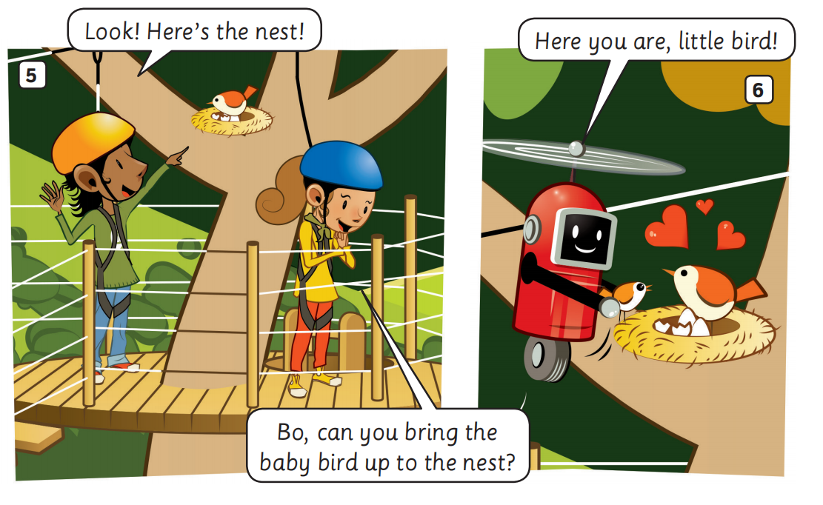
STORY TIME
Listen and read
Listen

Slide 6



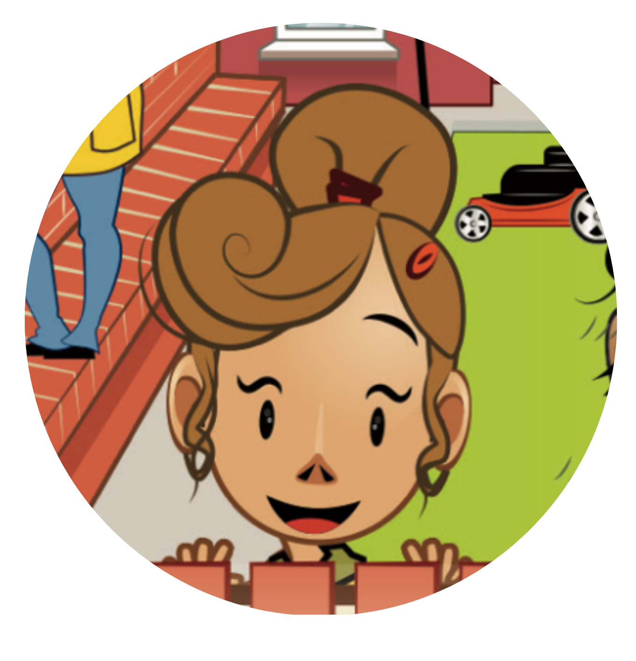

STORY TIME
CHARACTERS IN THE STORY
Ash
Lottie
Bo
Lois
Look at the picture of each character in the story and read their name.

Slide 7
PUPILS’ BOOK p.40
Activity: TRUE or FALSE
Put the class into pairs. Each pair takes out 2 pieces of paper.
Students write True and False for each piece.
Show a sentence, students look at, choose and raise their answer: True or False.
The fastest pair with the correct answer receives 2 points.

Slide 8
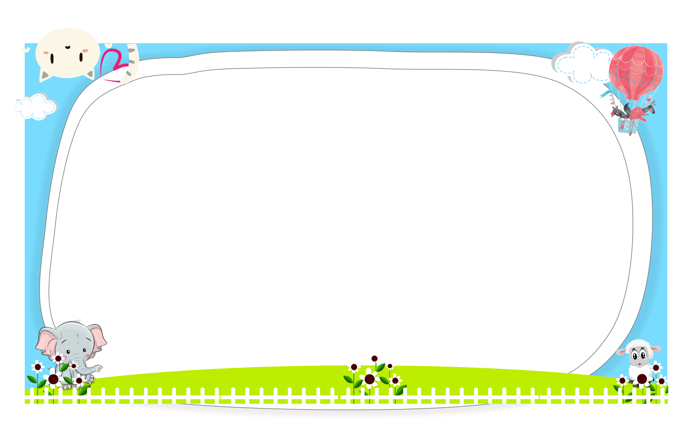



Ms Huyền Phạm - 0936.082.789
Notes:
Ms Huyền Phạm - 0936.082.789

Slide 9






1. The children want to go climbing first.
Ms Huyền Phạm - 0936.082.789
TRUE
FALSE
Notes:
Ms Huyền Phạm - 0936.082.789

Slide 10

2. Ash can climb very well.
Ms Huyền Phạm - 0936.082.789
FALSE
TRUE
Notes:
Ms Huyền Phạm - 0936.082.789

Slide 11
3. Lottie finds the baby bird.
Ms Huyền Phạm - 0936.082.789
TRUE
FALSE
Notes:
Ms Huyền Phạm - 0936.082.789

Slide 12
4. Ash finds a nest.
Ms Huyền Phạm - 0936.082.789
TRUE
FALSE
Notes:
Ms Huyền Phạm - 0936.082.789

Slide 13
5. Lois brings the baby bird to the nest.
Ms Huyền Phạm - 0936.082.789
TRUE
FALSE
Notes:
Ms Huyền Phạm - 0936.082.789

Slide 14

Ms Huyền Phạm - 0936.082.789
Notes:
Ms Huyền Phạm - 0936.082.789

Slide 15
PRACTICE
Activity: Dub Out The Story
Divide students into small groups.
Tell them to choose the characters and act out the story.
Give students a little time to practice.
Have groups perform in front of the class without the audio.

Slide 16
PRACTICE
CHARACTERS IN THE STORY
Ash
Lottie
Bo
Lois

Slide 17
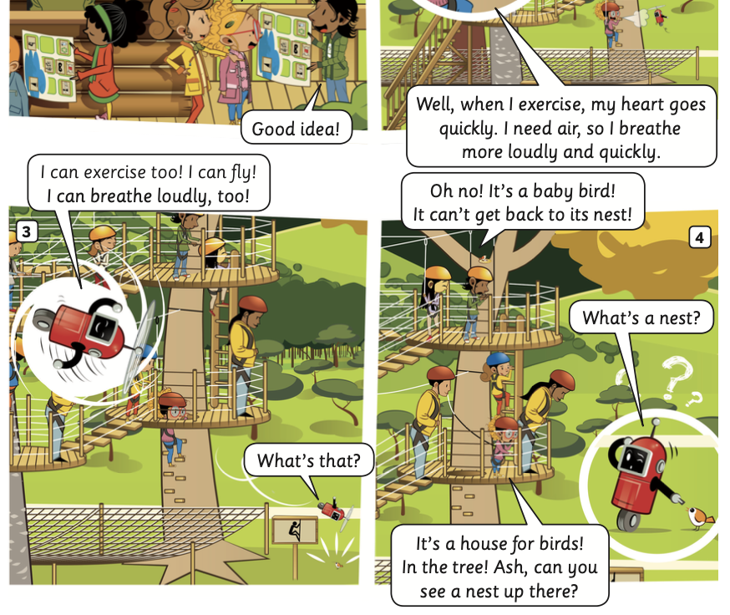
PRACTICE

Slide 18

PRODUCTION
Put students into groups of 4.
Students think about the story and each member of the group retells the story. Students look at the pictures in Activity 1 and the information in Activity 3 on page 40.
Show the example for the class.
Call out some groups to present in front of the class.

Slide 19
PRODUCTION
EXAMPLE
1. Ash and his friends want to go climbing first.
4. At the playground, Bo finds a baby bird. Then, Ash finds a nest.
2. Lois can climb very well and she breathes loudly and quickly.
5. Bo brings the baby bird to the nest.
3. Bo can exercise, fly, and breathe loudly too.

Slide 20

HOMEWORK
Review vocabulary and grammar.
Do exercises in the Activity book (page 32).
Check answers in the Teacher’s book (page 72) or Active Teach.

