Slide 1
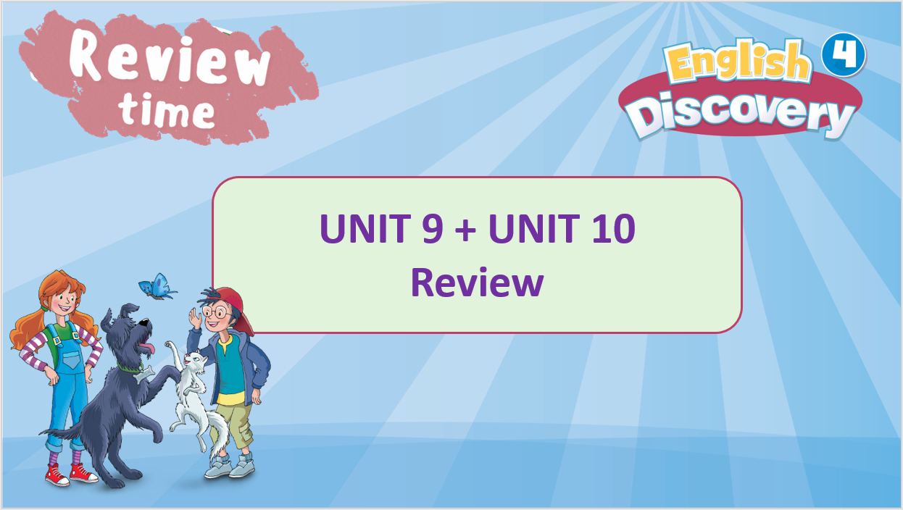

Slide 2

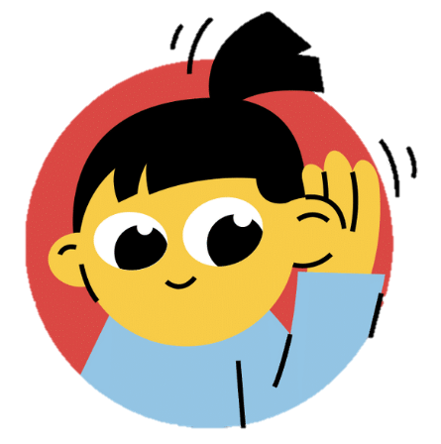
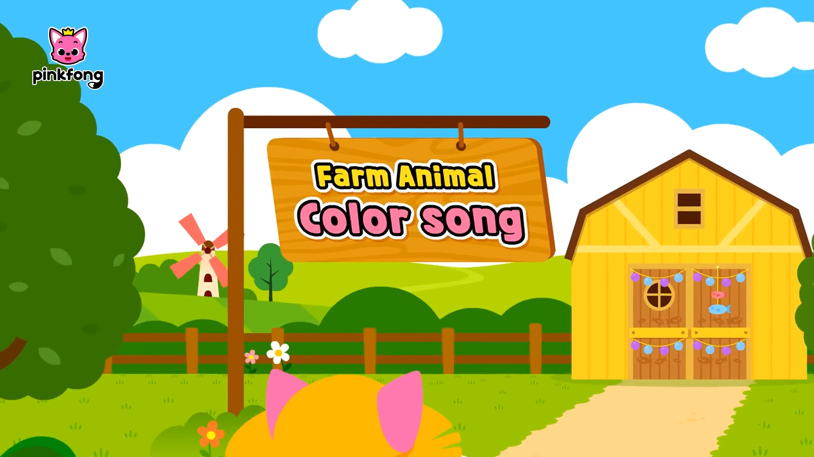

Listen and sing along.
Pause after each animal and ask students to answer what animal it is.
Notes:
Link Youtube: https://www.youtube.com/watch?v=UpQ6Izgy6kI

Slide 3
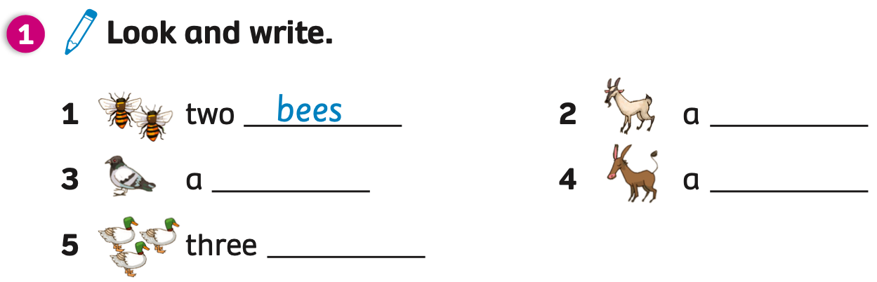
PUPILS’ BOOK p.120
Answers
goat
bird
donkey
ducks
Have students open books, look at the pictures from 1 to 6 and write words in each line.
Check answers with the whole class.

Slide 4

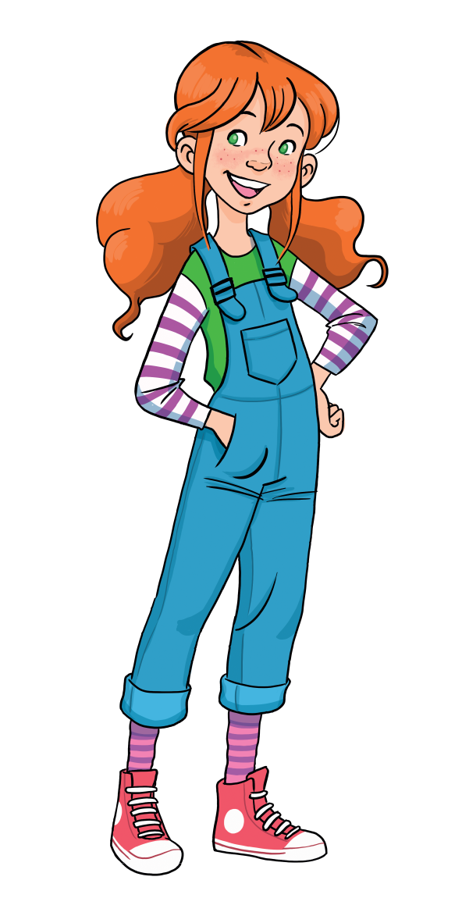
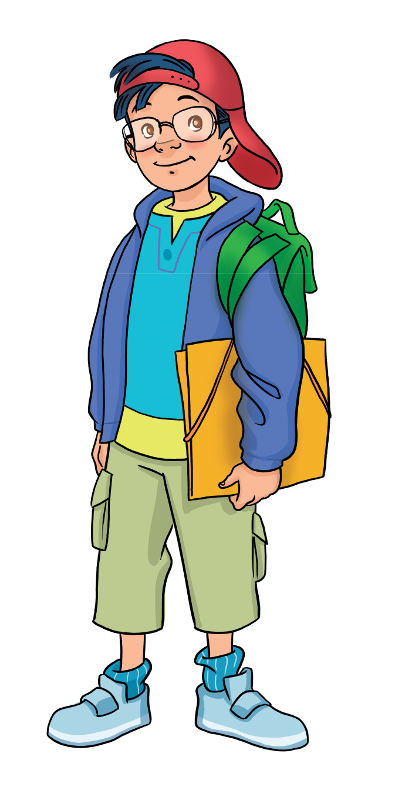
REVIEW GRAMMAR
Divide students into groups of four. Each member of the team stands up and plays the game.
Show the question, students look and choose the correct answer by saying it aloud: A, B or C. They raise their hands to get a chance to answer.
The fastest student with the correct answer receives 2 points.
All students repeat the answer.

Slide 5

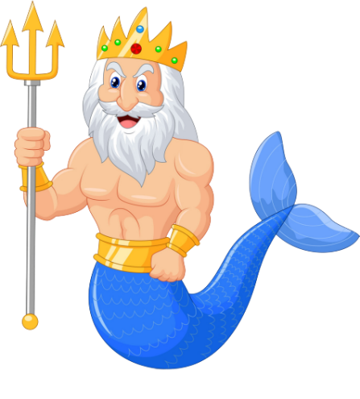


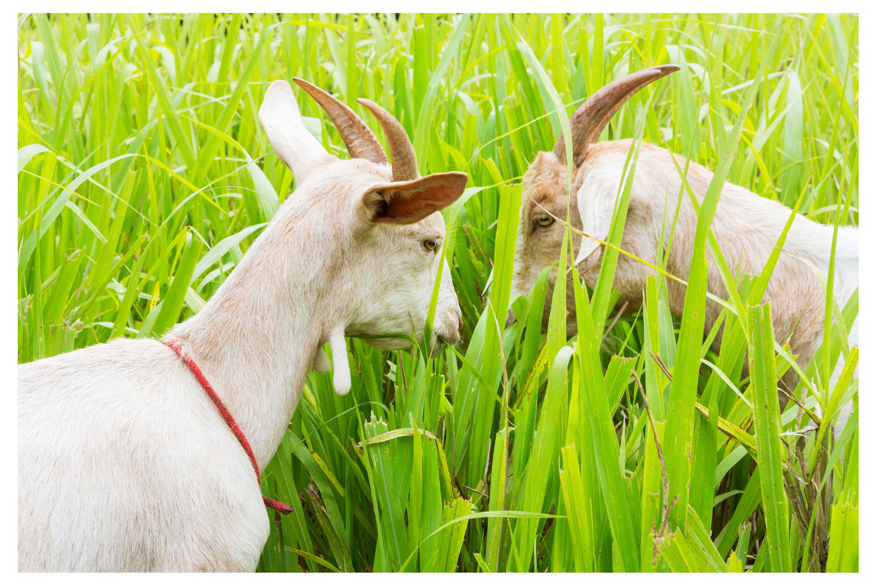
What are the goats doing?
A
They are sleeping.
They are eating grass.
B
D
Climb
C
They are running.

Slide 6
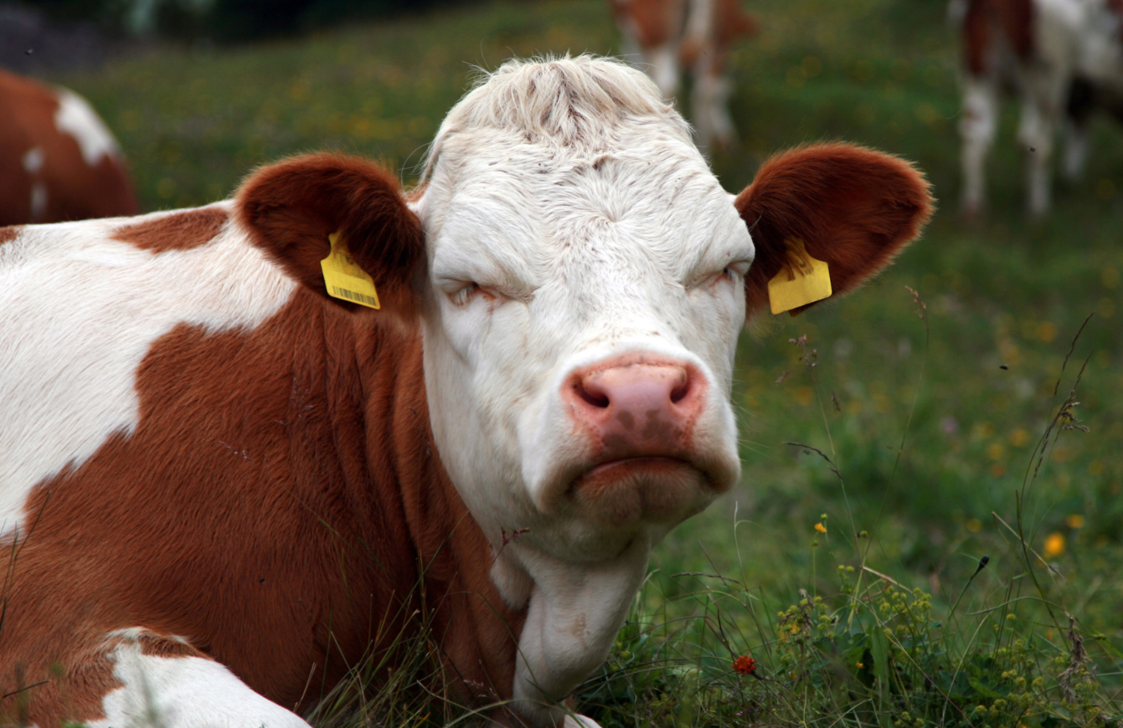
What is the cow doing?
A
It is sleeping.
B
It is walking.
D
STOVE
C
It is running.

Slide 7
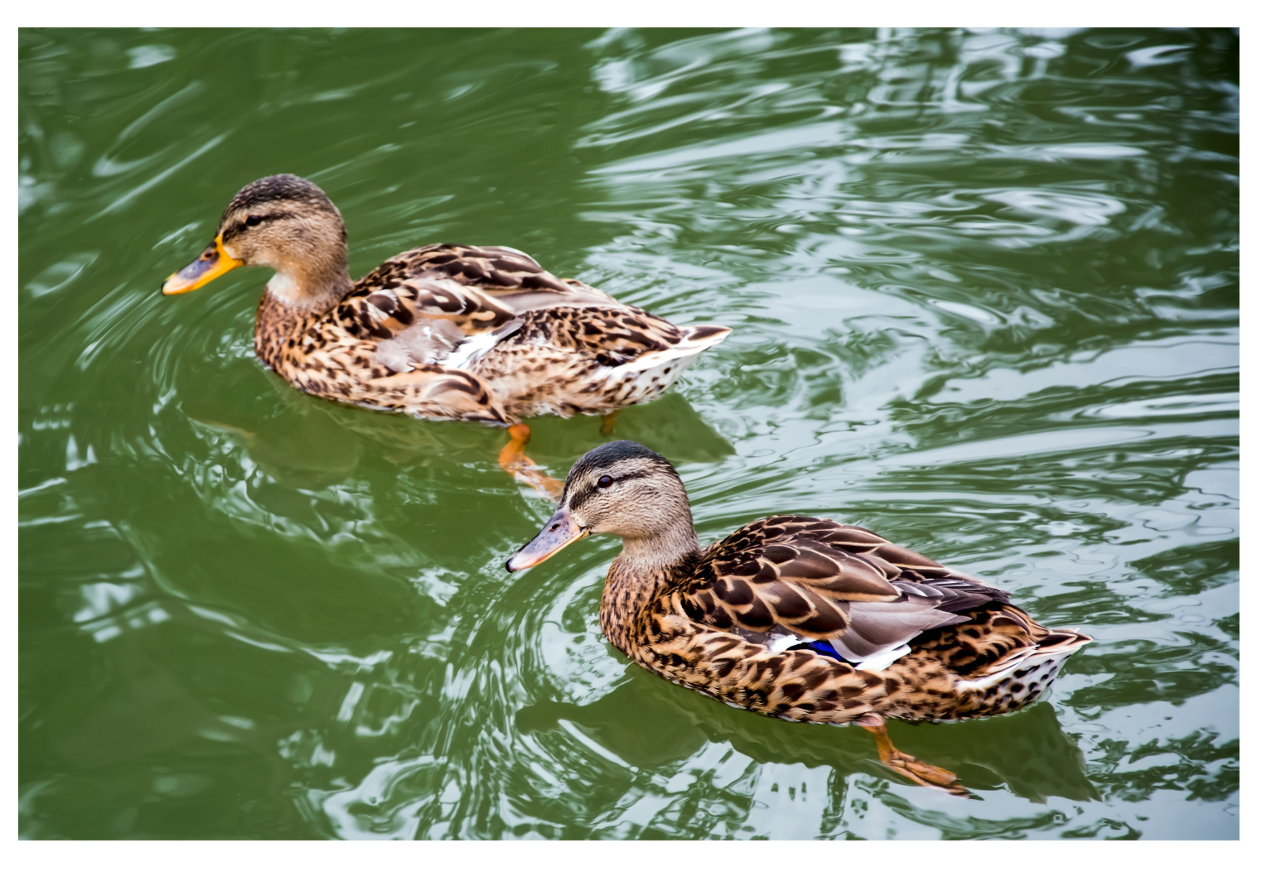
Which animals do you prefer, cows or ducks?
I like cows and ducks.
A
B
I prefer cows.
D
Next to
C
I prefer ducks.

Slide 8
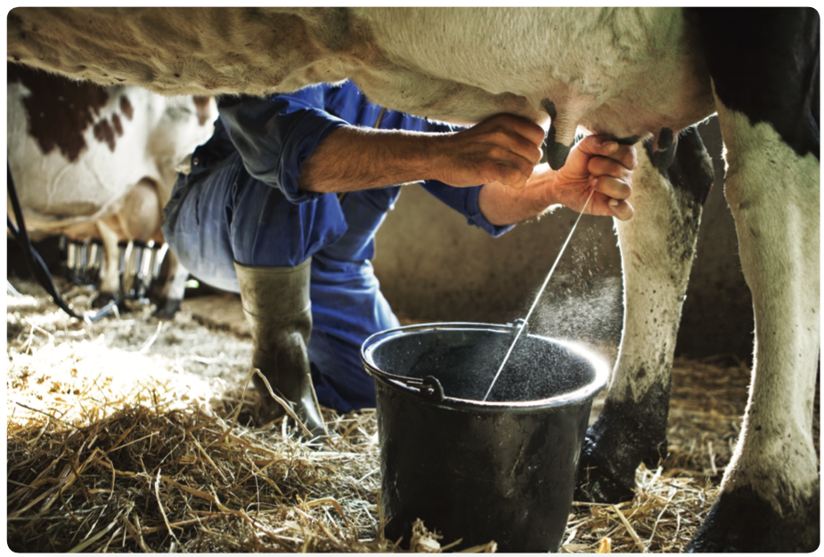
A
What are they doing?
They are collecting eggs.
They are milking the cows.
B
D
Climb
They are brushing the horses.
C

Slide 9
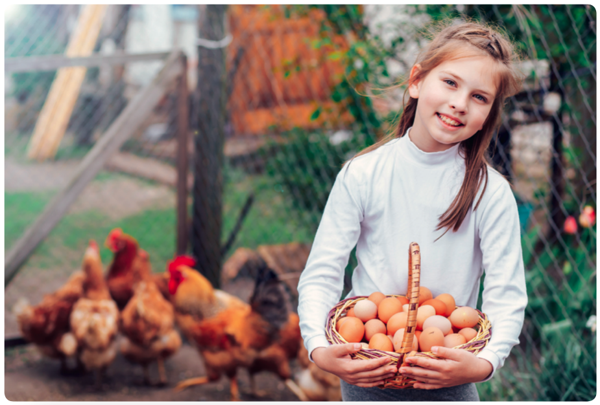

Can you collect the eggs, please?
A
Sure, I can.
B
Sorry, I can’t.
D
STOVE
C
Thank you!

Slide 10

D
STOVE

Slide 11
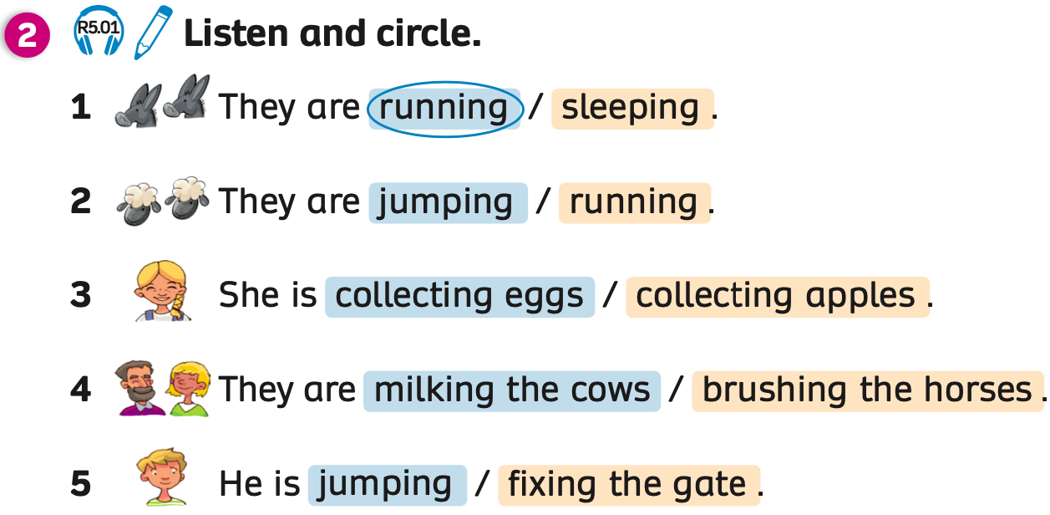

Listen
Answers
Have students open the books and look at the task.
Play the audio, students listen and circle the correct word.
Play the audio again and pause after each sentence. Students listen and check answers.

Slide 12
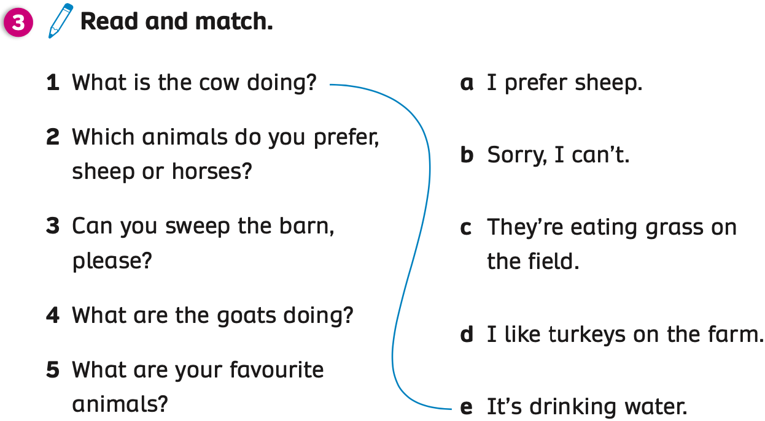
Answers
Have students look at the task and read the questions on the left and the answers on the right.
Students draw lines to match the questions to the correct answers.
Check answers with the whole class.

Slide 13
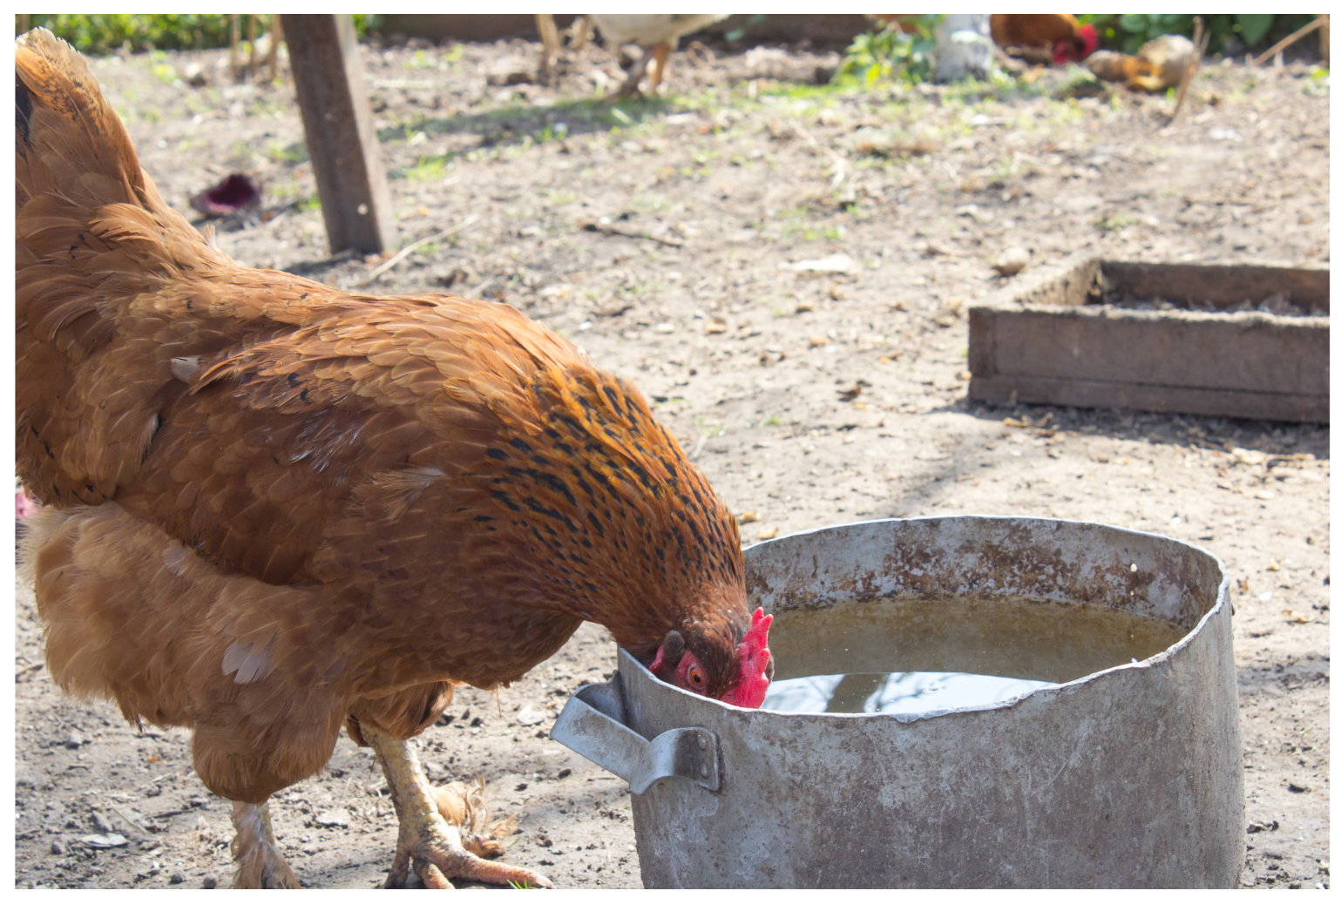
PRODUCTION
What is the chicken doing?
It’s drinking water.
Divide students into two teams. Students look at the examples.
One team asks, and one team answers. Then they switch roles.

Slide 14
PRODUCTION
What are your favourite animals?
I like horses.
One team asks, and one team answers. Then they switch roles.

Slide 15
PRODUCTION
Which animals do you prefer, chickens or horses?
I prefer horses.
One team asks, and one team answers. Then they switch roles.

Slide 16
PRODUCTION
Can you brush the horses?
Sure, I can.
One team asks, and one team answers. Then they switch roles.

Slide 17
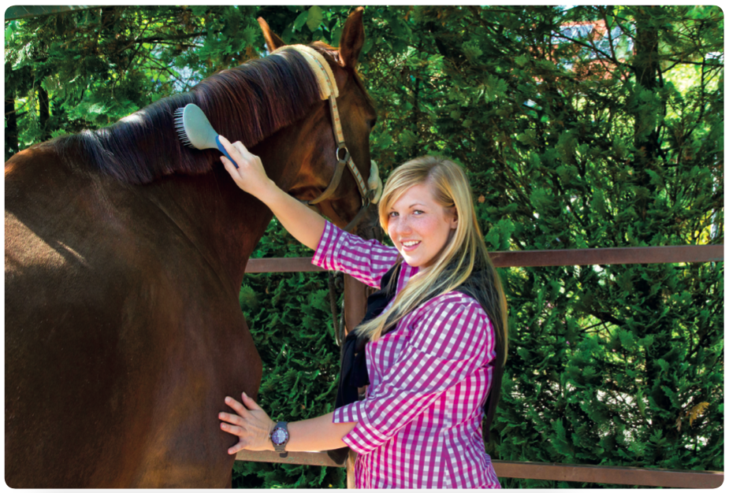
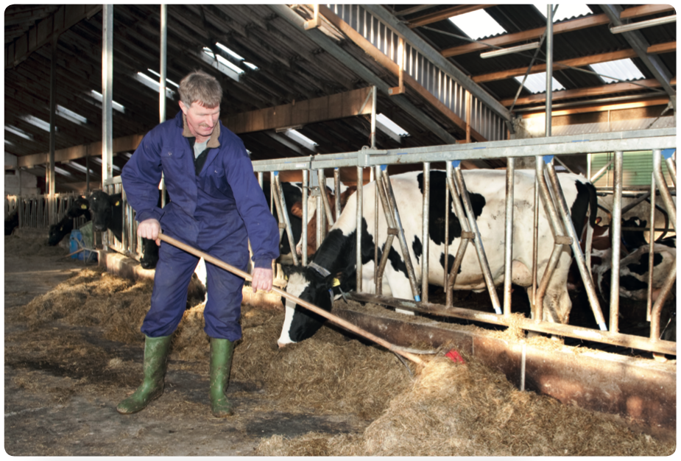
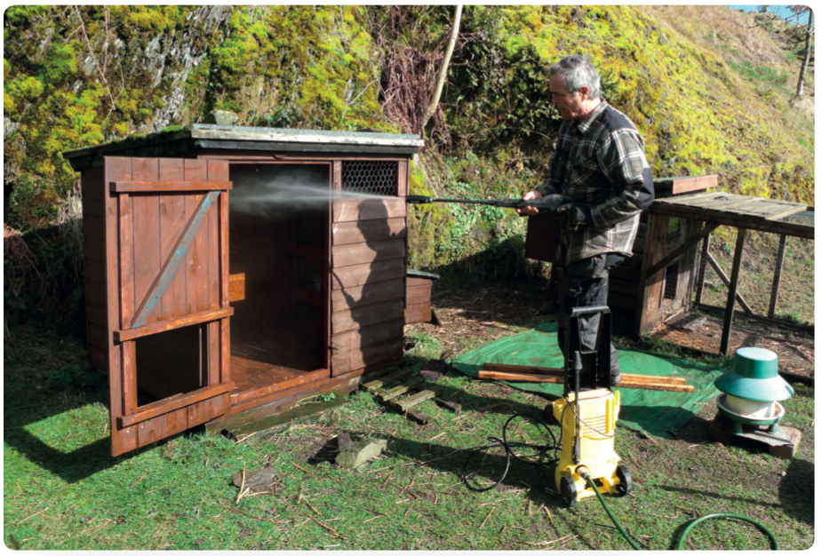
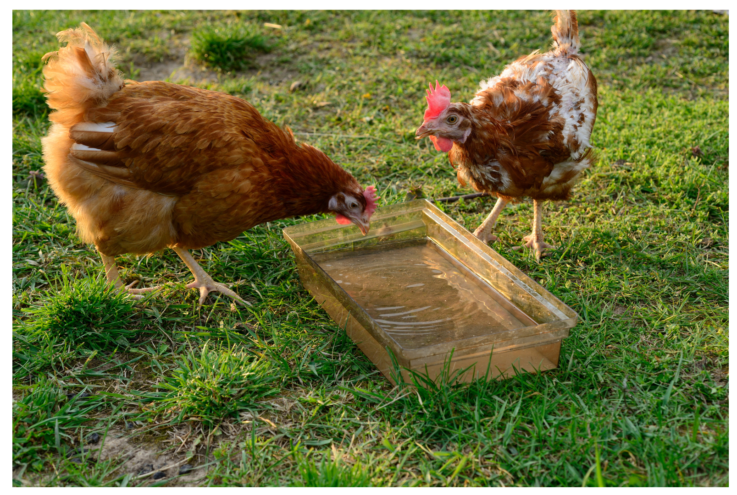
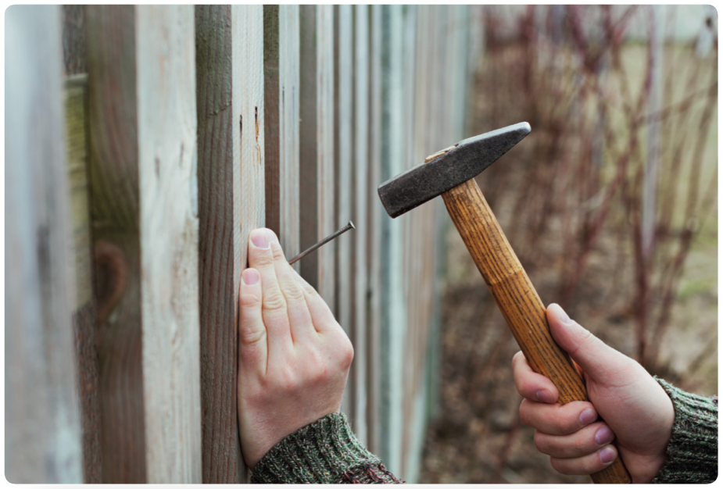
PRODUCTION
QUESTIONS
What is the ____ doing?
What are the ___ doing?
What are your favourite animals
Which animals do you prefer, ___ or ___?
Can you _____, please?
Divide students into pairs. Students look at the question and pictures.
One student asks and one student answers, then they switch roles.
The first 5 pairs who finish the questions say Bingo and receive a point.

Slide 18
Review vocabulary and grammar.
Do exercises in the Activity book (page 104 ).
Check answers in the Teacher’s book (page 220) or Active Teach.

