Slide 1


Slide 2

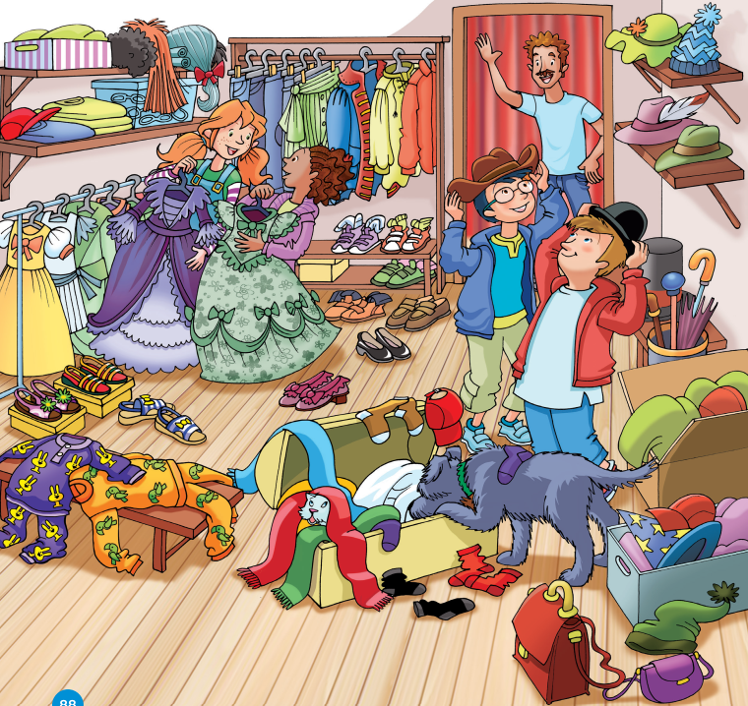

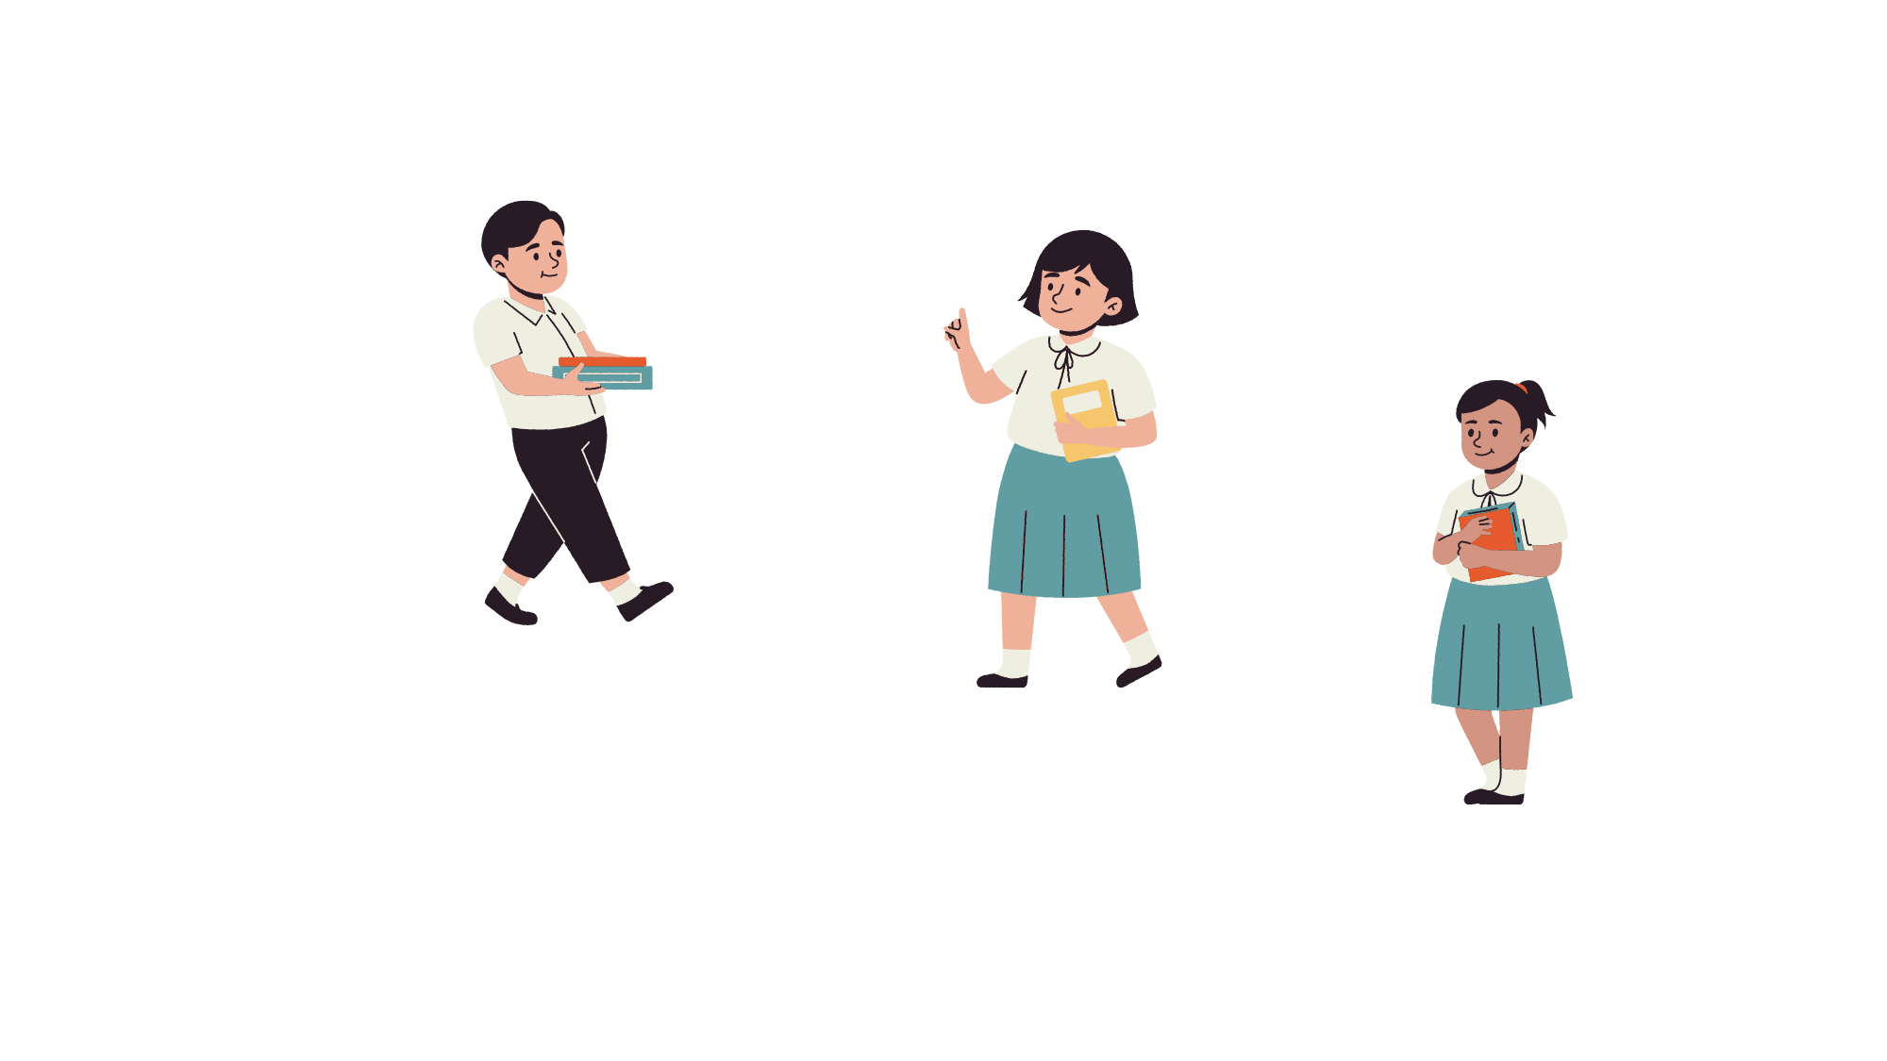
LEAD-IN
Who’s wearing a blue T-shirt?
The man is wearing a blue T-shirt.

Slide 3
LEAD-IN
How many shoes can you see?
I see 10 shoes.

Slide 4
LEAD-IN
What colour are the shoes?
They are purple, orange green and blue.

Slide 5
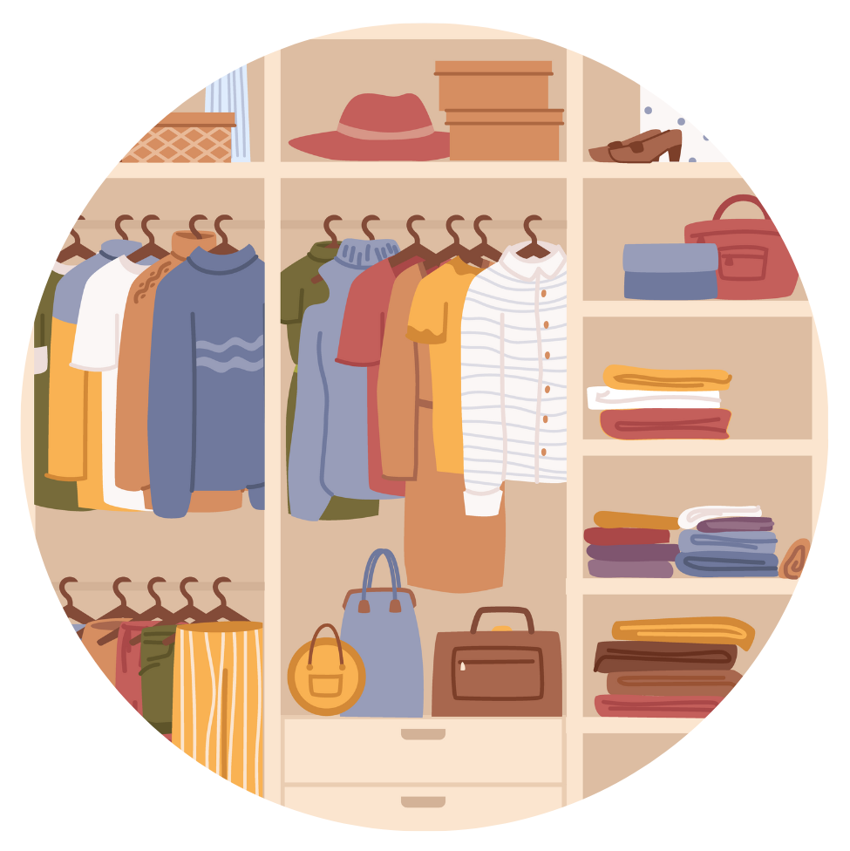
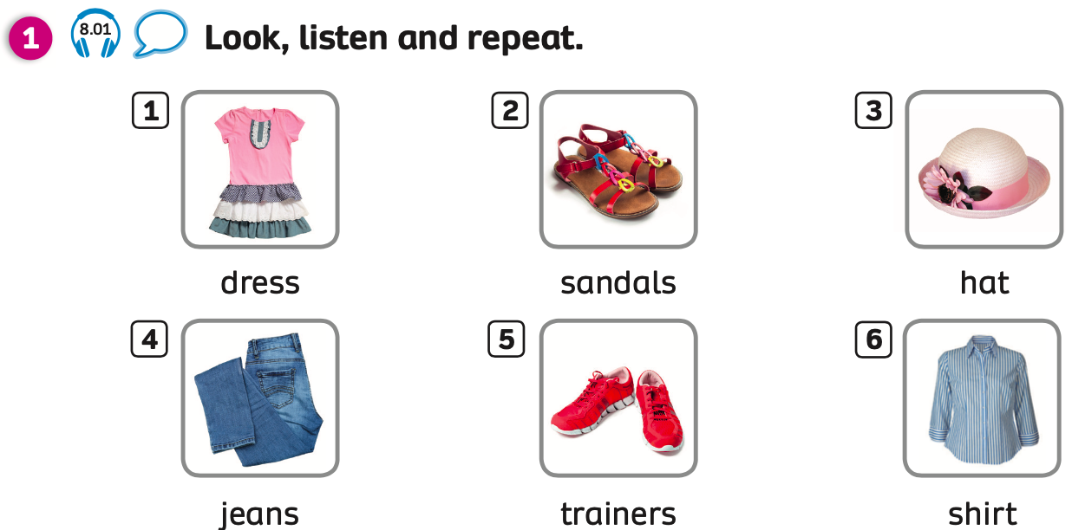
PUPILS’ BOOK (p.89)
Listen to the audio and repeat.

Slide 6

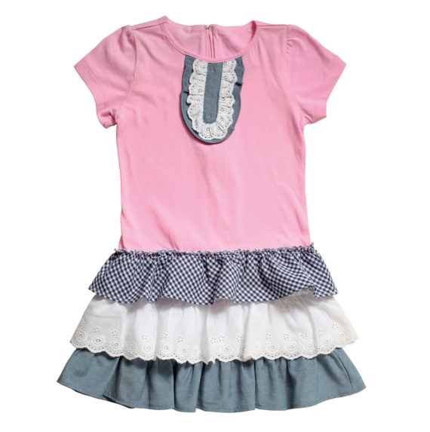
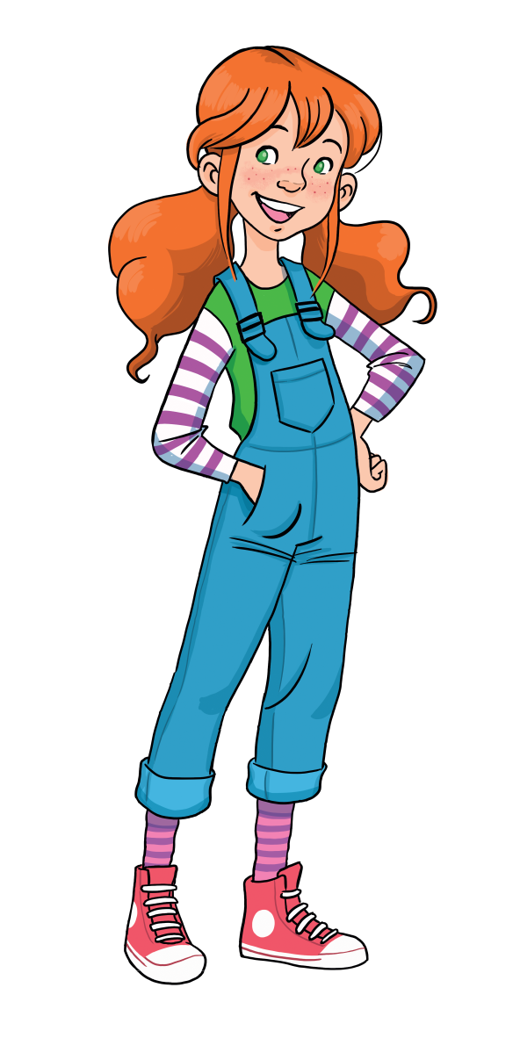
VOCABULARY: Clothes
c
dress

Slide 7
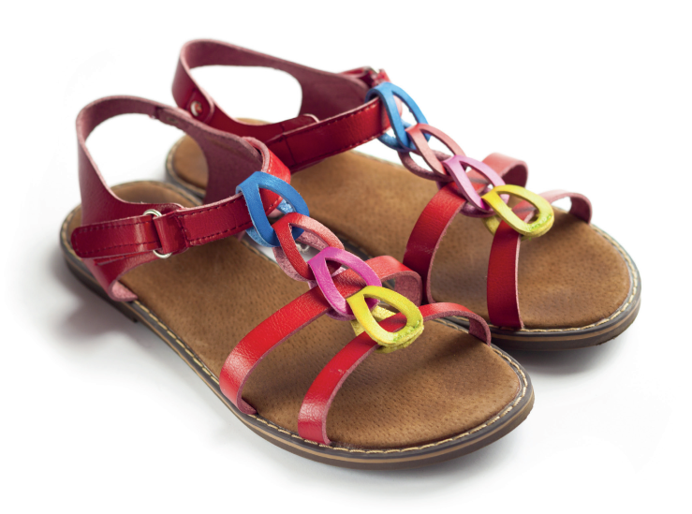
VOCABULARY: Clothes
c
sandals

Slide 8
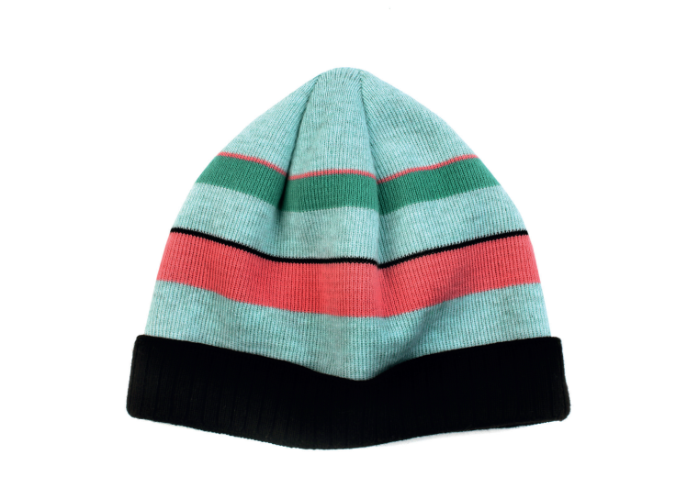
VOCABULARY: Clothes
c
hat

Slide 9
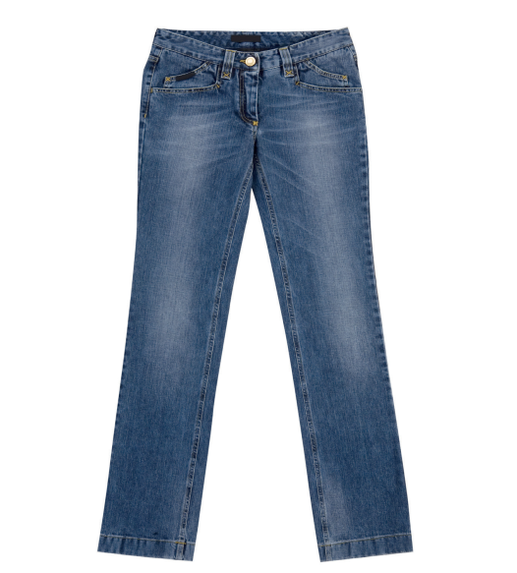
VOCABULARY: Clothes
c
jeans

Slide 10

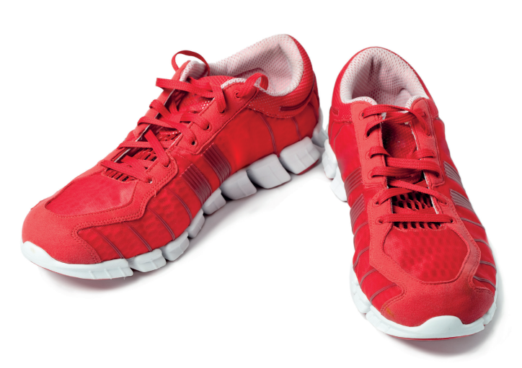
VOCABULARY: Clothes
Let’s spell!
c
trainers

Slide 11
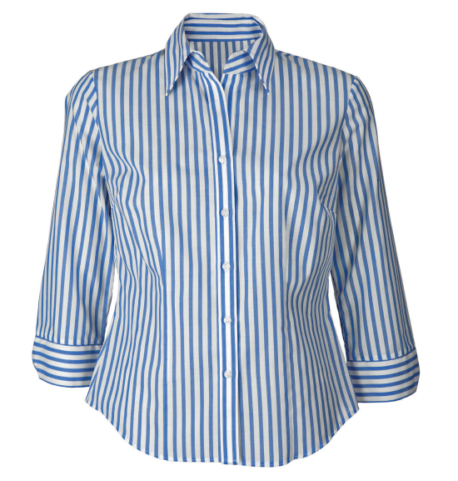
VOCABULARY: Clothes
c
shirt

Slide 12
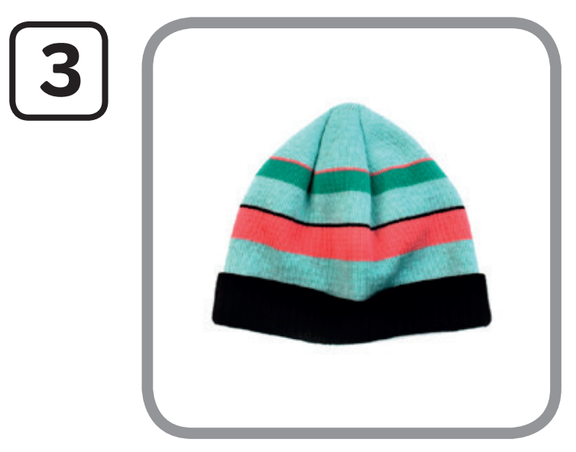
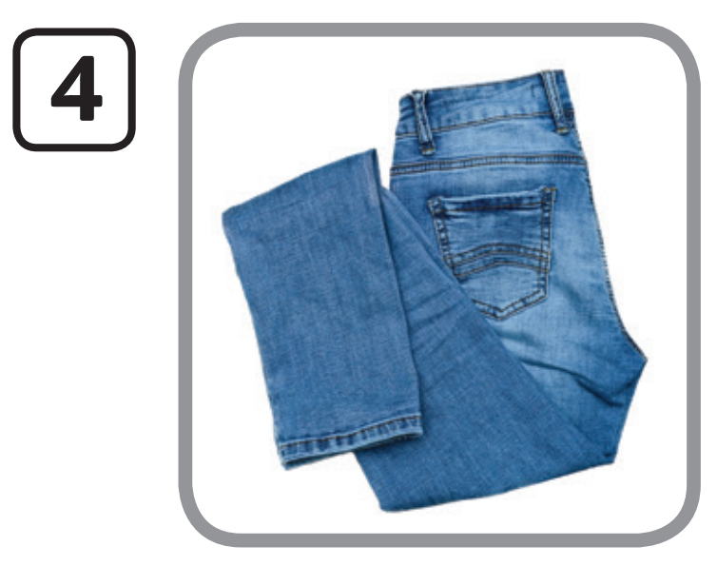
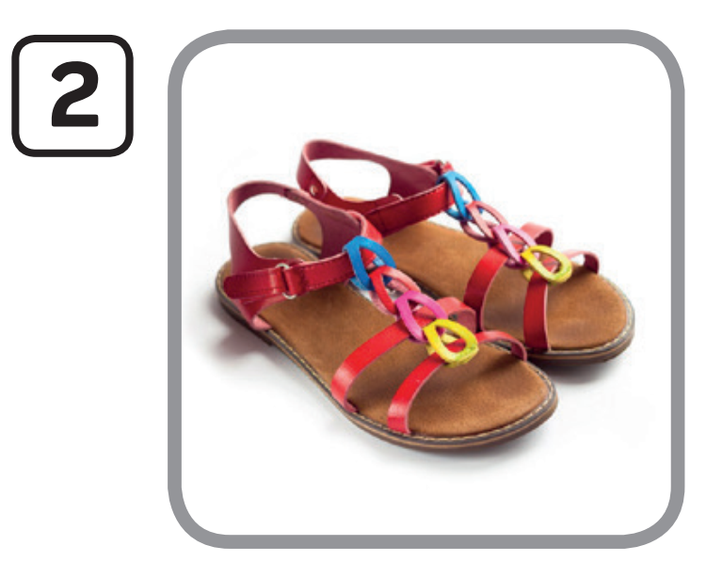
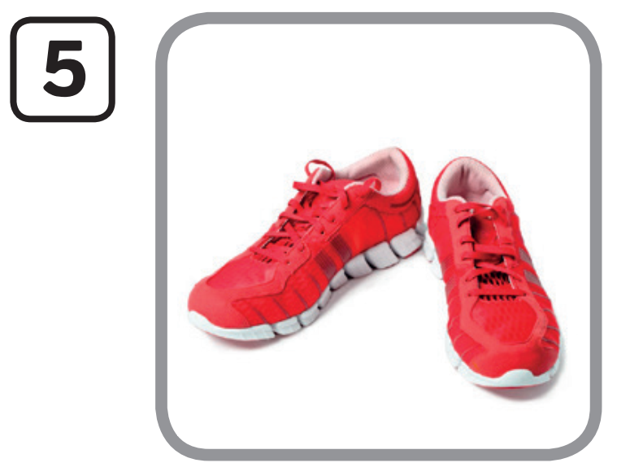

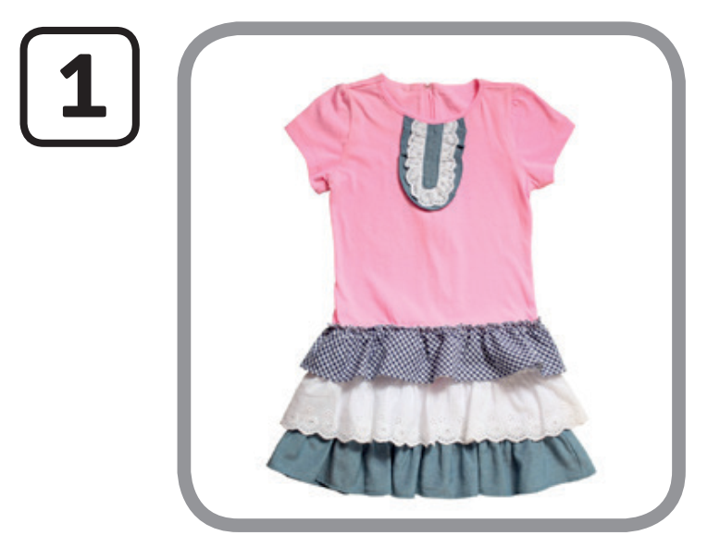
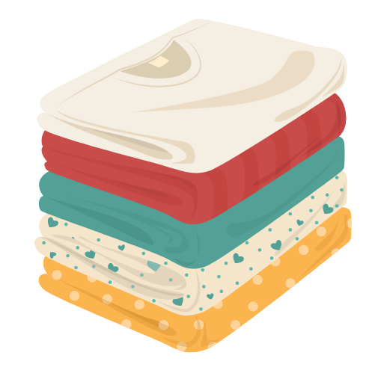
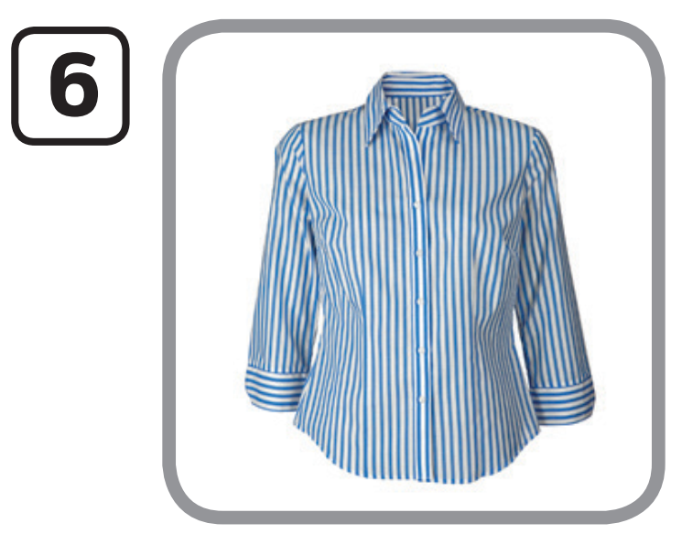
VOCABULARY: Clothes
hat
jeans
sandals
trainers
dress
shirt
T calls the number and Ss say the word.

Slide 13


PUPILS’ BOOK (p.79)
It’s a dress. It’s purple.
It’s a brown hat.
Example

Slide 14
PUPILS’ BOOK (p.79)
1. dress - yellow
2. sandals - blue
3. hat - green
4. jeans - blue
5. trainers - orange
6. shirt - red
Answer
Look for some clothing items in the picture. In pairs, say the clothes and what colour they are.

Slide 15

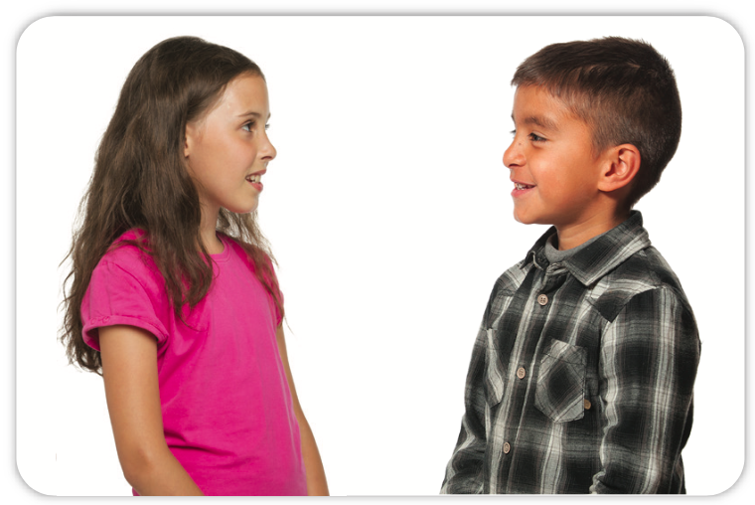
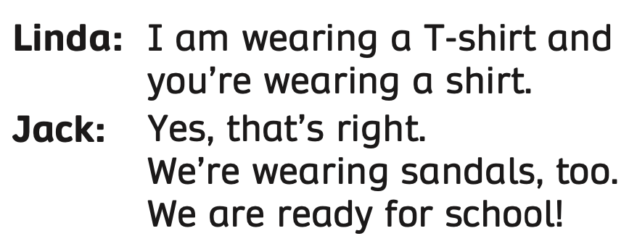
Listen and read. In pairs, practice the conversation together.
Notes:
Post - listening

Slide 16
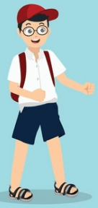
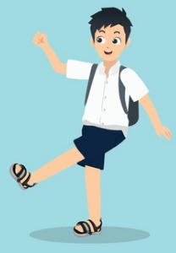
I’m wearing a shirt and you’re wearing a shirt.
Yes, that’s right.
We’re wearing sandals, too.
Look and say the conversation between Sam and Maire.

Slide 17
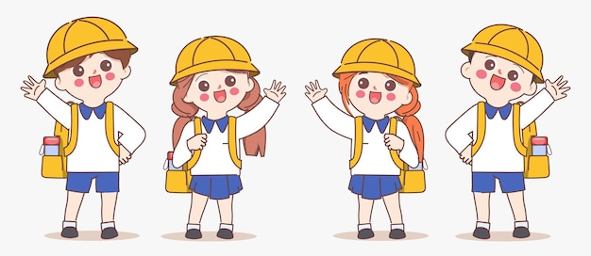
I am wearing a hat. You’re wearing a hat.
We’re wearing hats and trainers.

Slide 18
I am wearing a T-shirt.
I + am + wearing + clothes (singular noun)
Show the structures, students look and read again.
Put students in pairs, say the sentences.
Notes:
Post - listening

Slide 19
You’re wearing a T-shirt and jeans.
You + are + wearing + clothes (singular noun + plural noun)
Show the structures, students look and read again.
Put students in pairs, say the sentences.
Notes:
Post - listening

Slide 20
We’re wearing sandals and hats.
We + are + wearing + clothes (plural noun)
Show the structures, students look and read again.
Put students in pairs, say the sentences.
Notes:
Post - listening

Slide 21

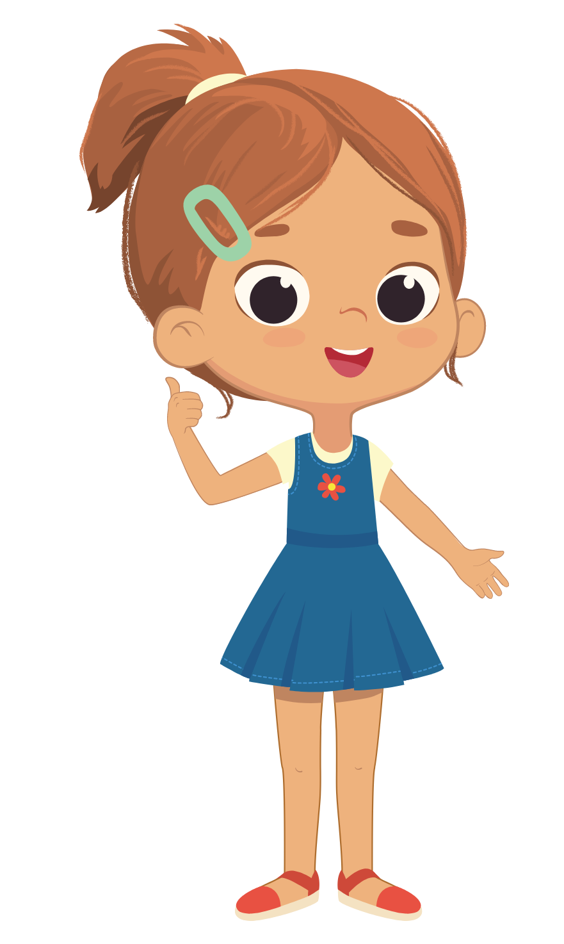
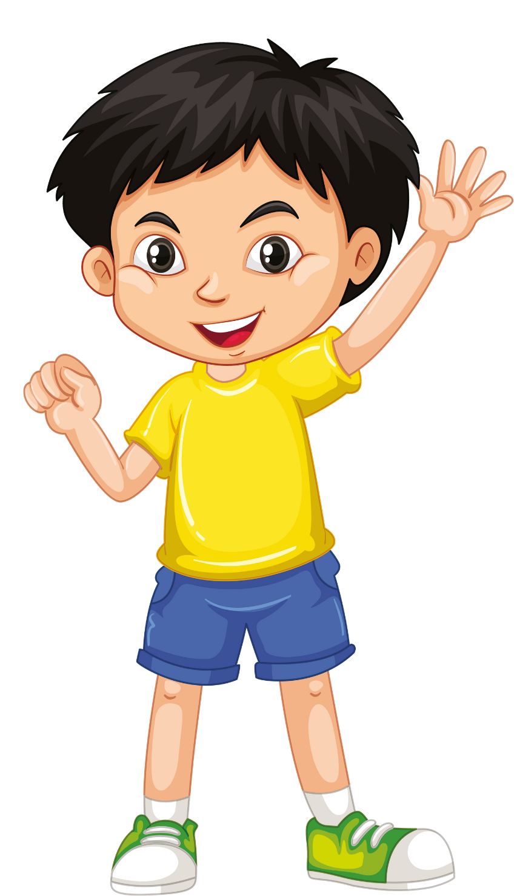
We’re wearing shoes.
I’m wearing a dress.
I’m wearing a T - shirt.
Ask students to look at the read the examples.
Divide students into groups of four. Each student takes turns to describe what they are wearing.
Call some students to present in front of the class.
Notes:
Post - listening

Slide 22
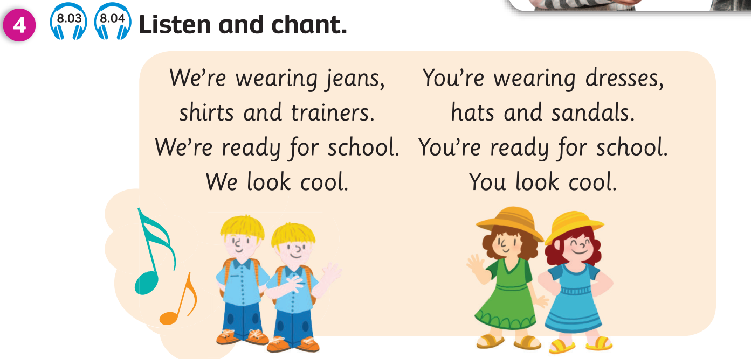
Point to a student and say you’re wearing (jeans). Then point to 2 students and say, “They’re wearing (shirts). Play the chant.
Tell students to clap their hands if the clothes appear in the song.

Slide 23

Let’s chant together.

Slide 24
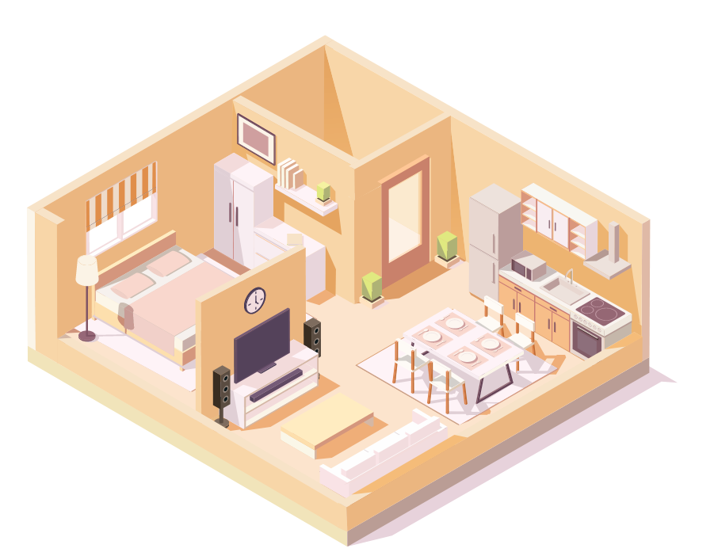
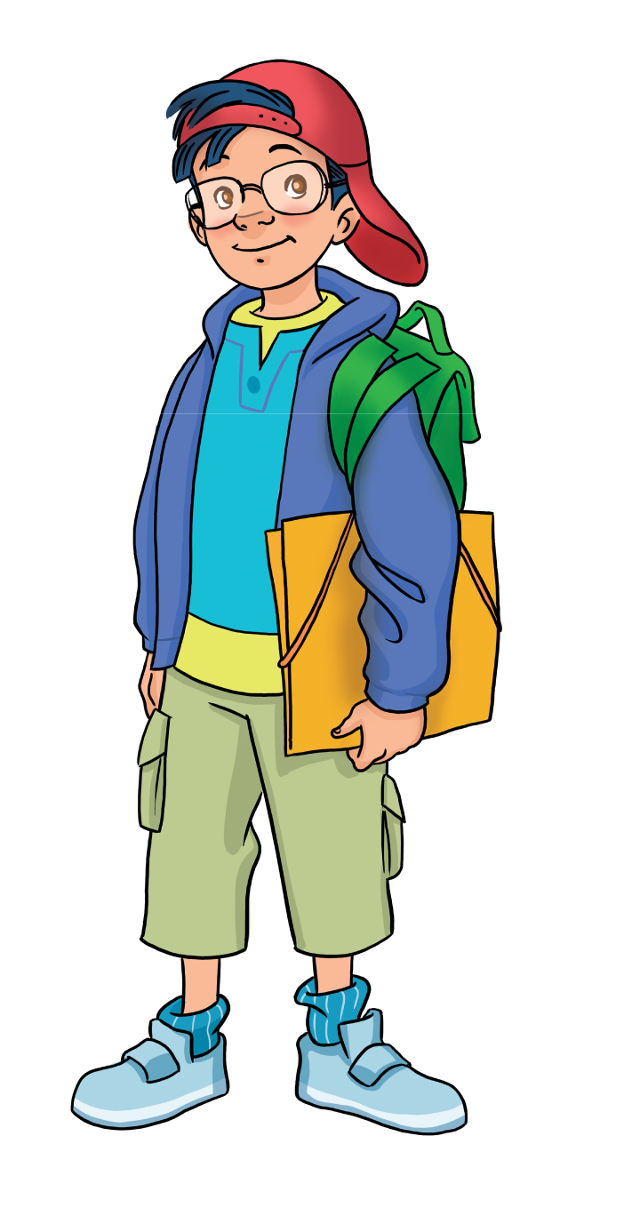
Review vocabulary and grammar.
Do exercises in the Activity book (page 74).
Check answers in the Teacher’s book (page 148) or Active Teach.

Slide 25
hat
jeans
sandals
trainers
dress
shirt
T calls the number and Ss say the word.

Slide 26
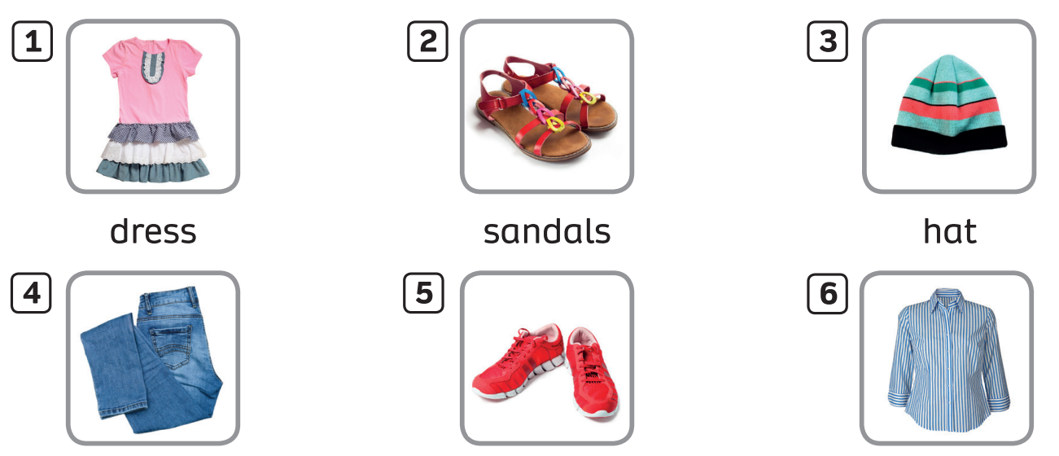

UNIT 7: MY HOME
We’re learning…

