Slide 1
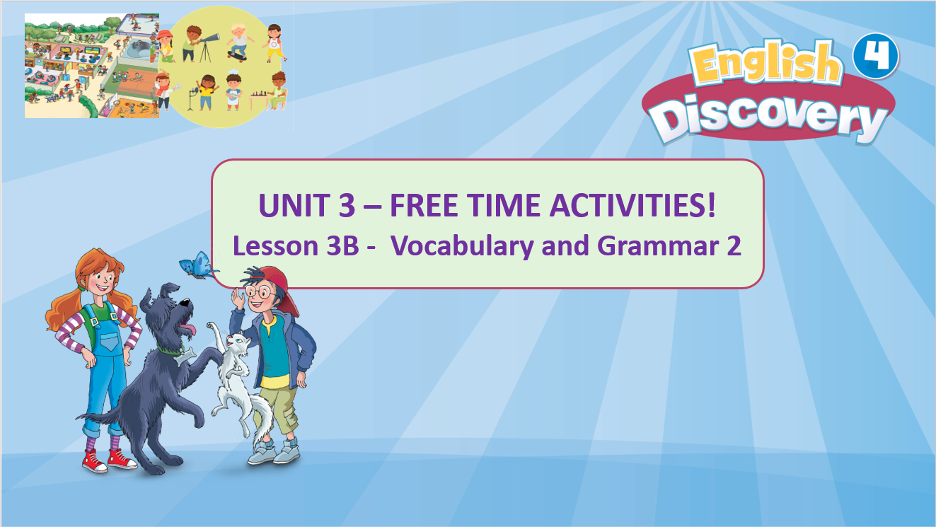

Slide 2


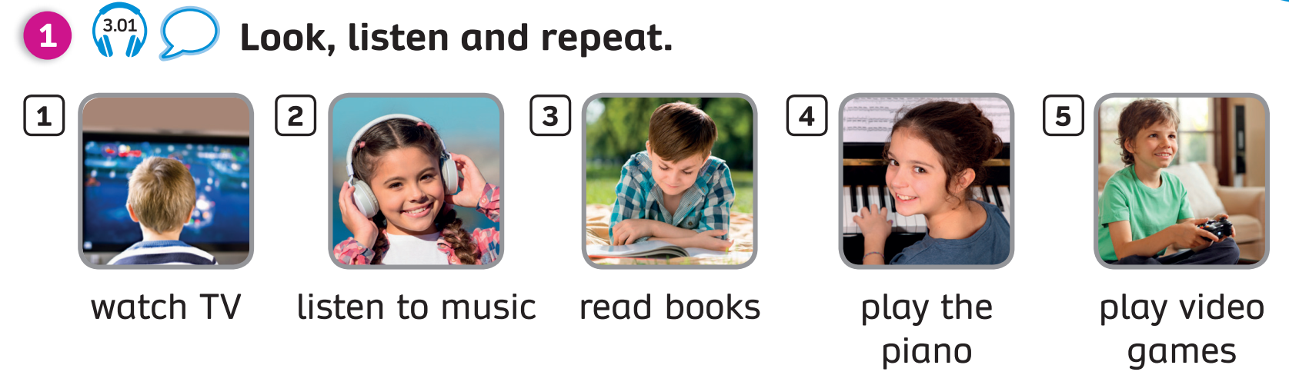
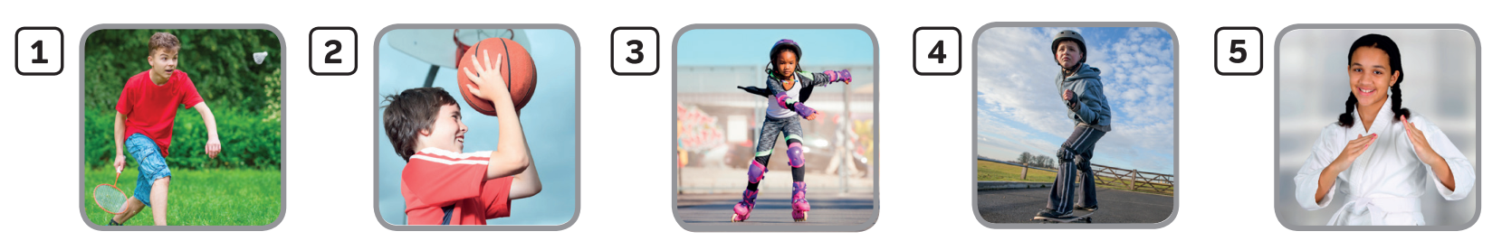


WARM-UP and REVIEW: Vocabulary
1
2
3
4
5
watch TV
listen to music
read books
play the piano
play video games
6
7
8
9
10
play badminton
play
basketball
roller skate
skateboard
do karate
Teacher says the number, students look and say the phrase.
Click on each number to show the answer.

Slide 3
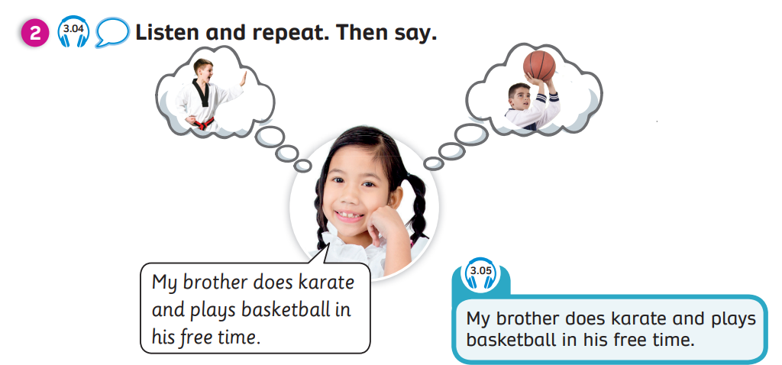

GRAMMAR: Pupils’ book – page.33
Have students look at the girl and ask them who the boy is in the bubbles.
Point to the bubbles and say the words, students listen and repeat.
Play recording 3.04, students listen and repeat.

Slide 4


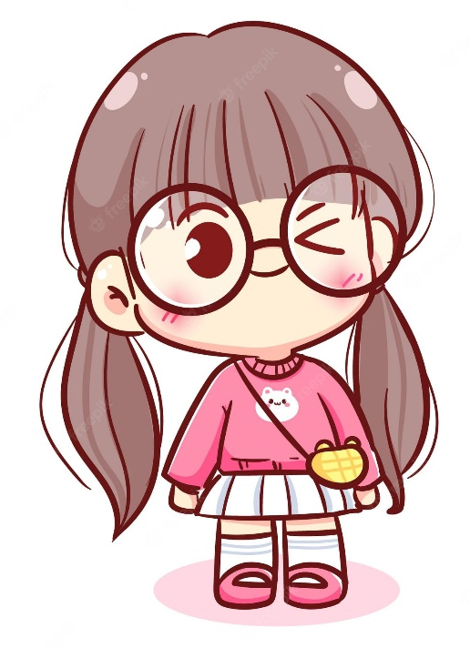
GRAMMAR:
I read books and play badminton
in my free time.
Look and read. Focus on the read words in the text.

Slide 5
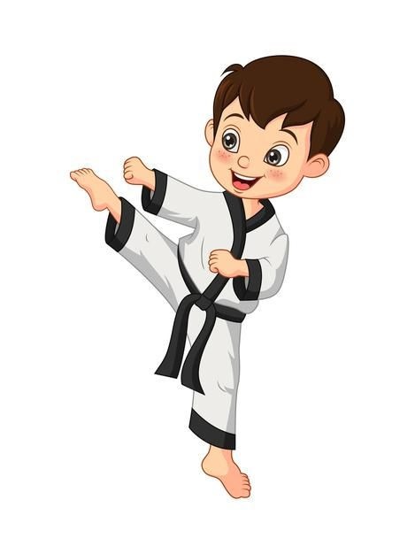
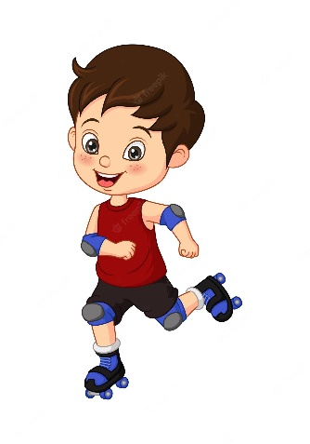
GRAMMAR:
My brother roller skates and does karate in his free time.
Look and read. Focus on the read words in the text.

Slide 6
GRAMMAR: Pupils’ book – page.33
Then say.
Put students into pairs. Students look at and say the sentence.
Using the flashcards, ask students to replace the phrases in the sentence.

Slide 7
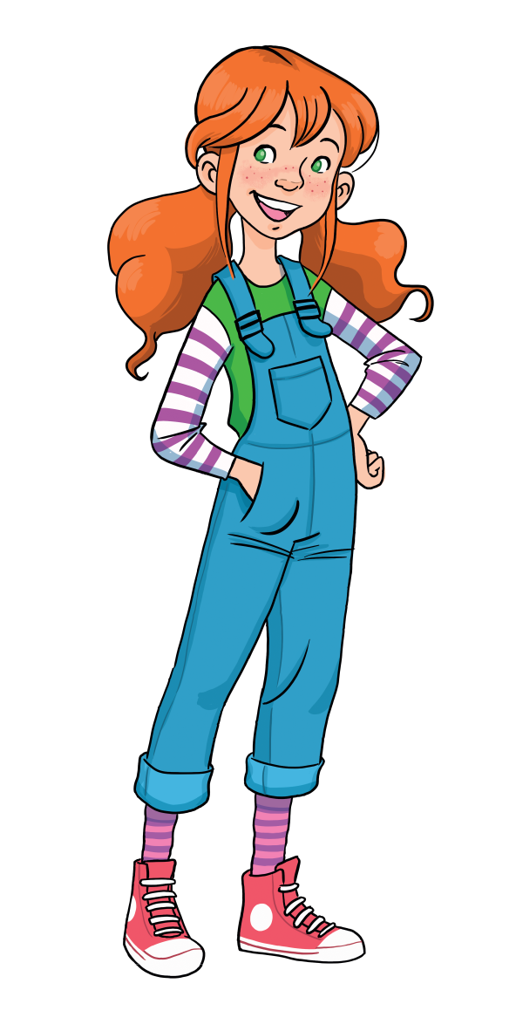
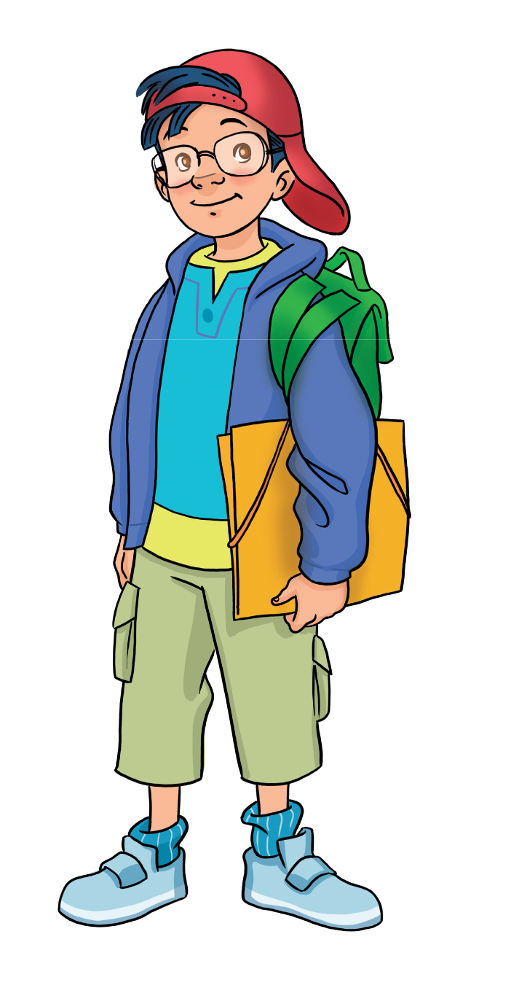
GRAMMAR: Pupils’ book – page.33
Then say.
My brother watches TV and reads books
in his free time.

Slide 8
GRAMMAR: Pupils’ book – page.33
Then say.
My sister listens to music and plays the piano
in her free time.

Slide 9
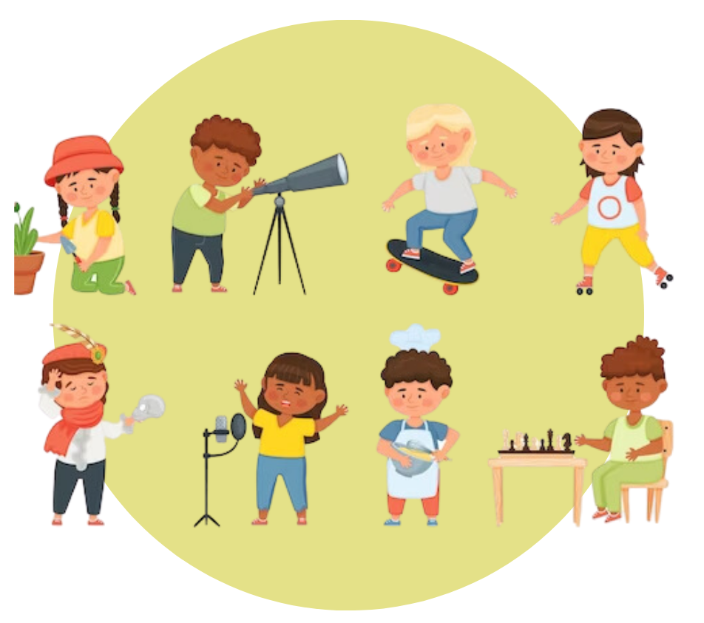

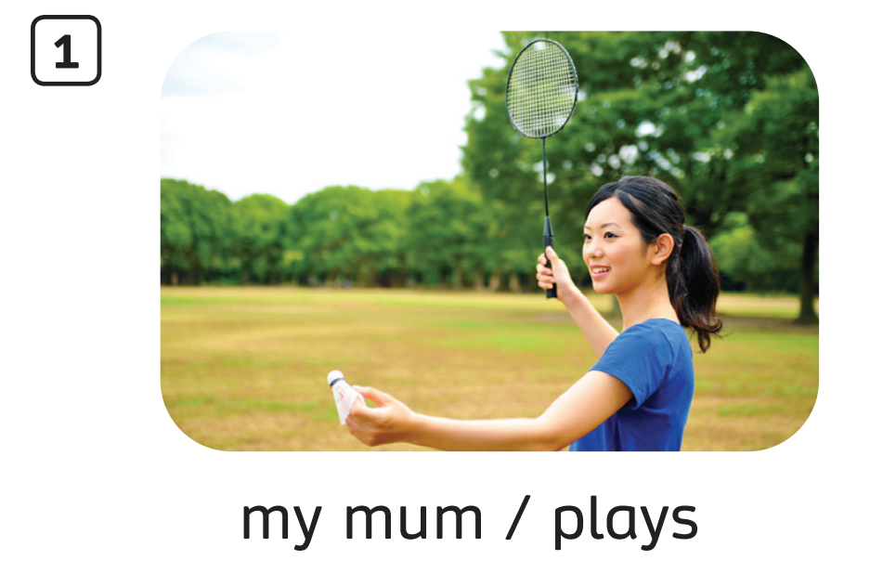
Pupils’ Book (p.33)
My mum plays badminton in her free time.
Look at the pictures and the keywords below. Then look at the example sentence. Read and finish the exercise 3

Slide 10
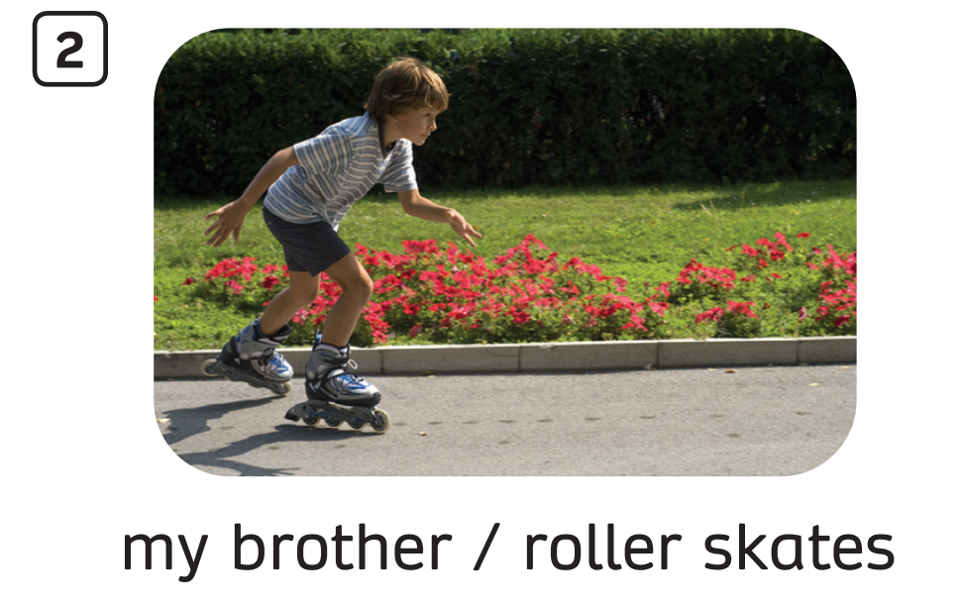
Pupils’ Book (p.33)
My brother roller skates in his free time.
Answer
Click on the answer to check

Slide 11
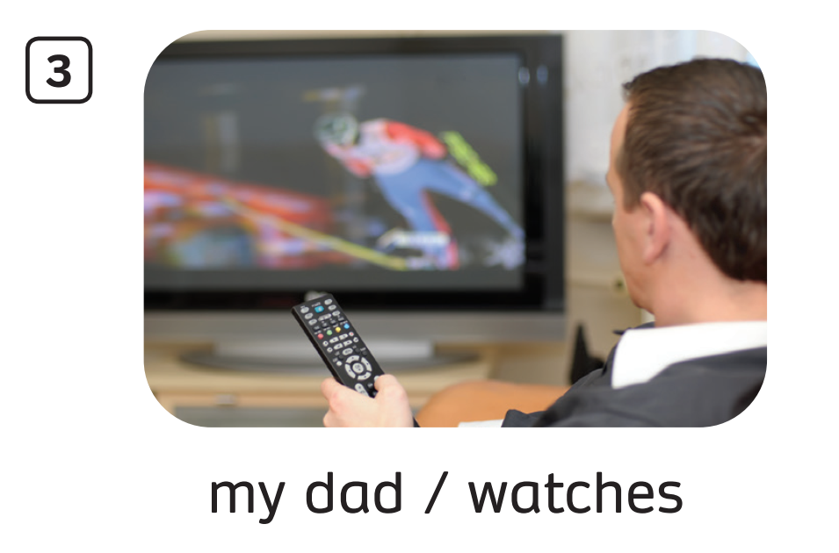
Pupils’ Book (p.33)
My dad watches TV in his free time.
Answer
Click on the answer to check

Slide 12
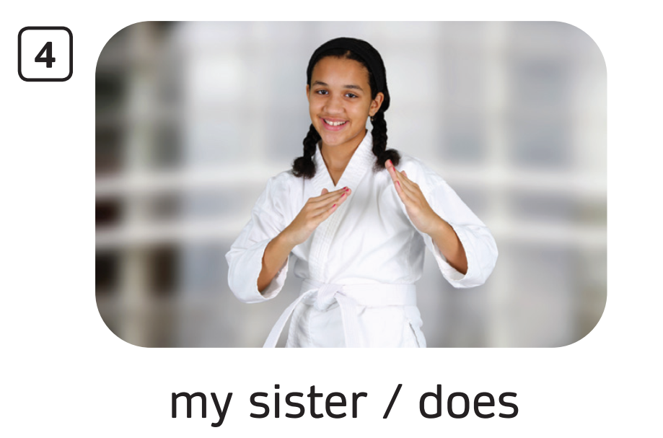
Pupils’ Book (p.33)
Answer
My sister does karate in her free time.
Click on the answer to check

Slide 13
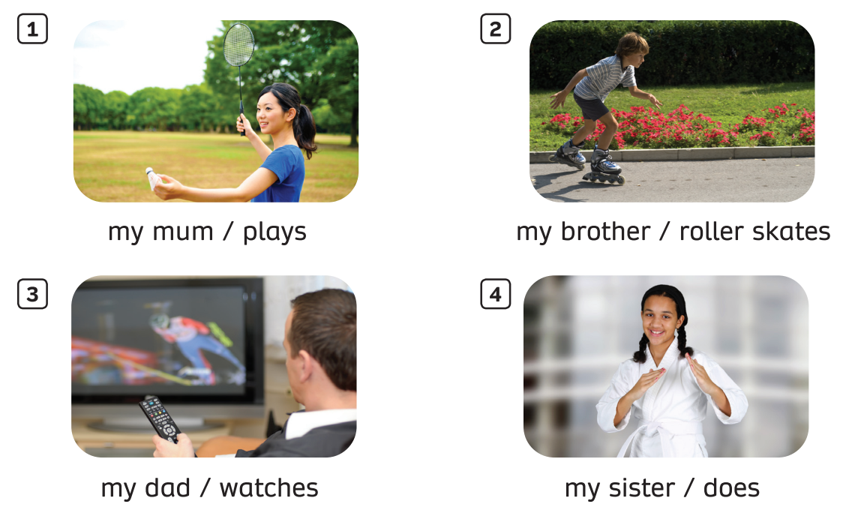
Pupils’ Book (p.33)
In pairs, point to the pictures and say.

Slide 14
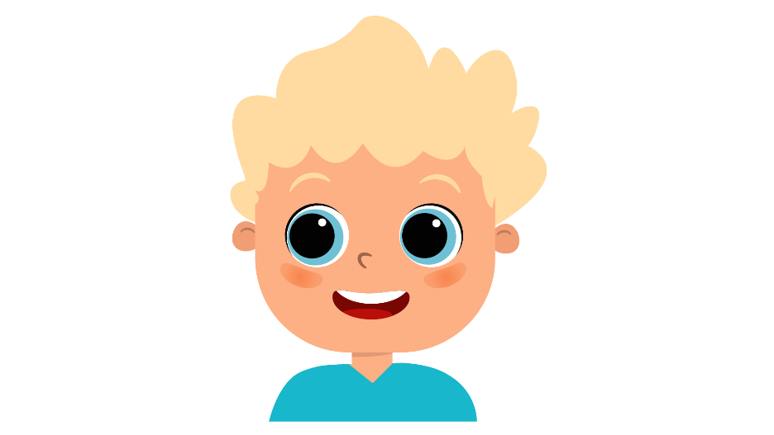
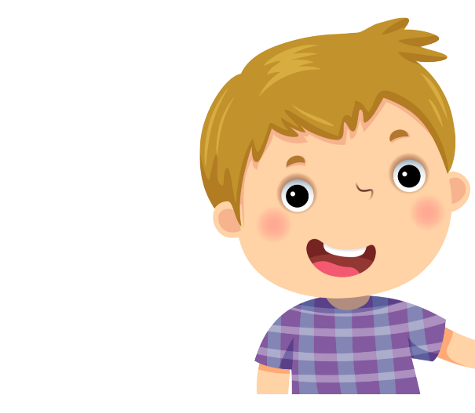

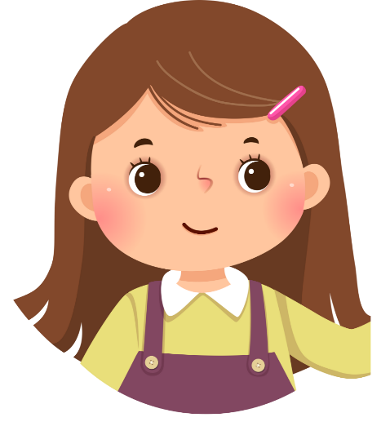
PRODUCTION
My mom listens to music in her free time.
My dad reads books in his free time.
Look at the model text and talk about your family does activities in the free time.

Slide 15


PRODUCTION
My dad _______ in his free time.
My mom ______ in her free time.
My brother ______ in his free time.
My sister _______ in her free time.
Look at the model text and talk about your family does activities in the free time.

Slide 16

HOMEWORK
Review vocabulary 2
Do exercises in the Activity book (page 30).
Check answers in the Teacher’s book (page 70) or Active Teach.

Slide 17
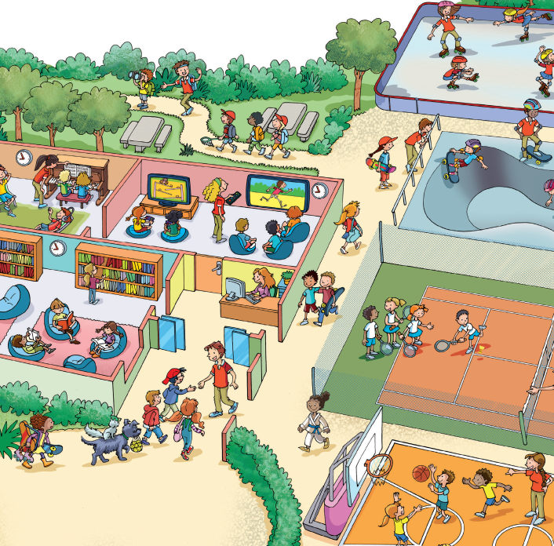
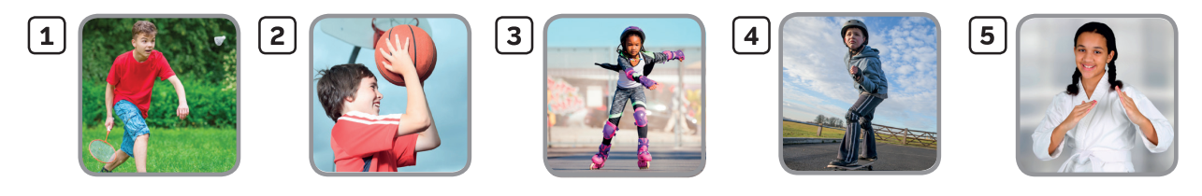

UNIT 3: FREE TIME ACTIVITIES!
We’re learning…

