Slide 1
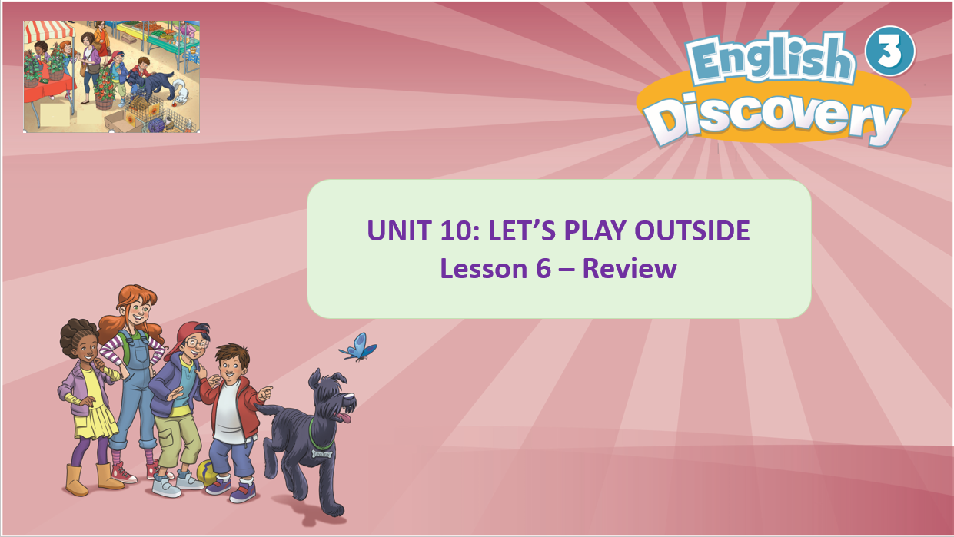

Slide 2


Song: Yes, I can.
WARM-UP
All students stand up.
Listen to the song.
Dance along.

Slide 3

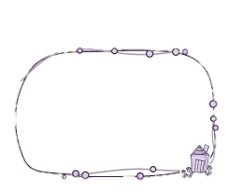
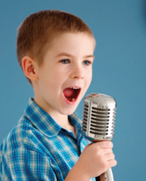
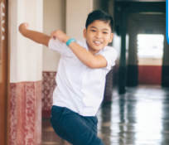


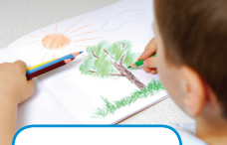
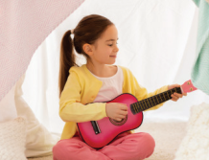
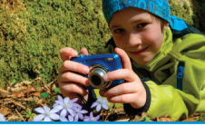
sing
dance
paint
play the guitar
draw
take photos

Slide 4

REVIEW: Grammar
Can you dance?
+ Yes, I can.
- No, I can’t.

Slide 5

Play the
Guessing game
(1 act – 1 guess)

Slide 6
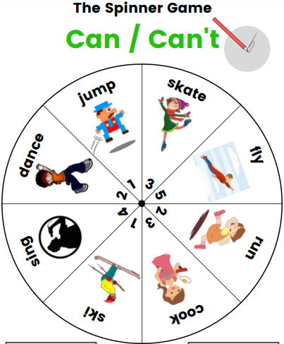
Practice: Throwing dice game

Slide 7
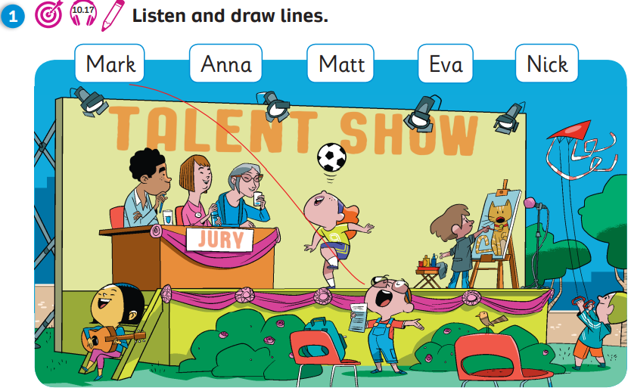

Pupil’s Book (p.132)

Slide 8
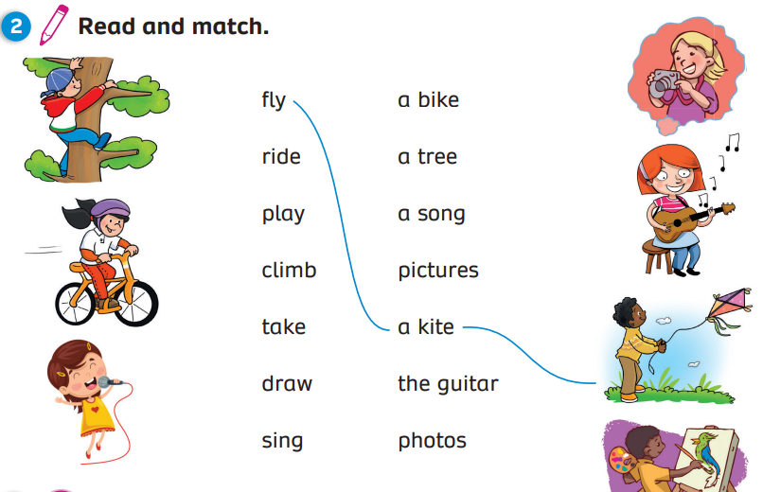
Pupil’s Book (p.132)

Slide 9

Pupil’s Book (p.132)

Slide 10
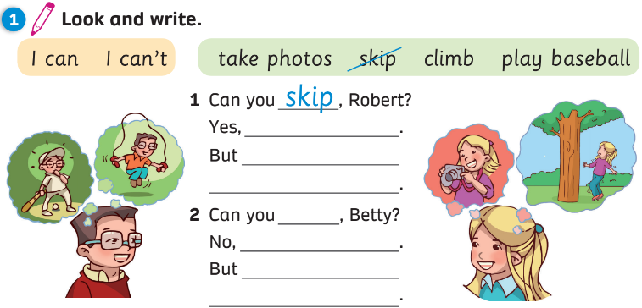
Activity Book (p.109)
I can
I can’t play baseball
climb
I can’t
I can take photos

Slide 11
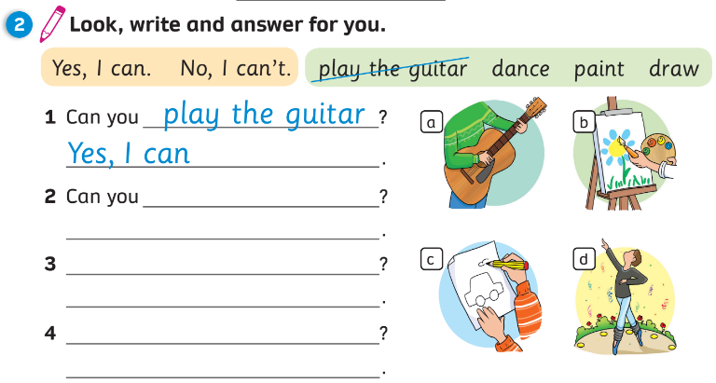
Activity Book (p.109)

Slide 12
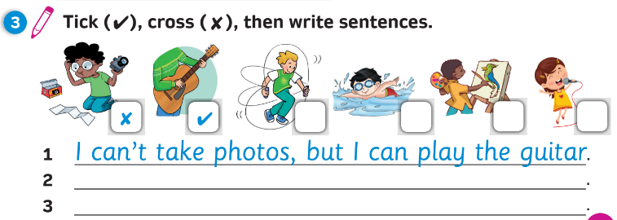
Activity Book (p.109)

Slide 13
