Slide 1
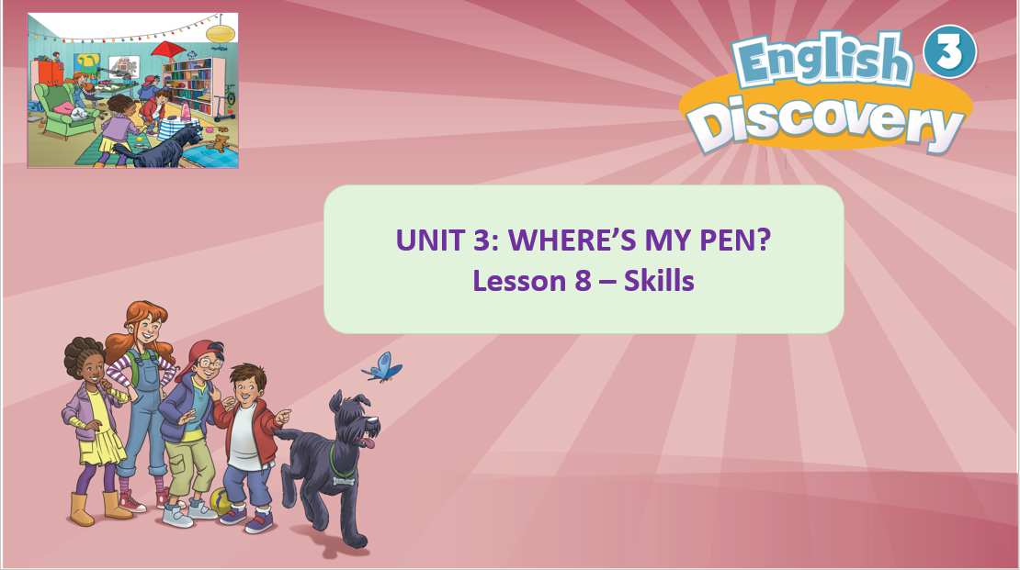

Slide 2


Song: Freeze Dance
All students stand up.
Listen to the song.
Dance along.

Slide 3
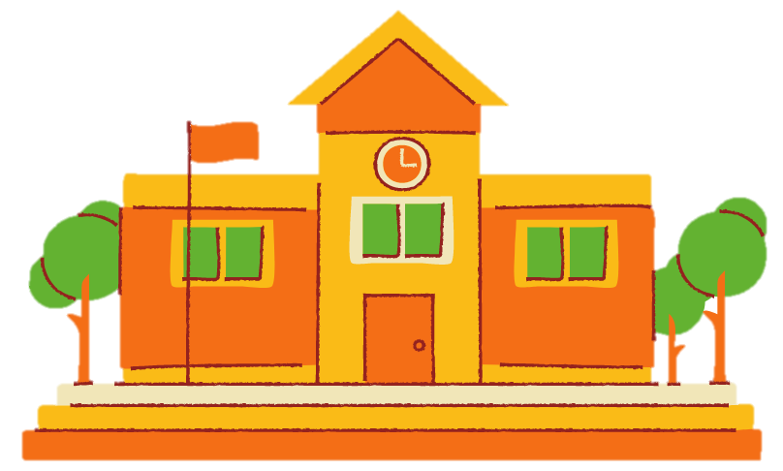
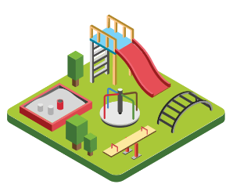
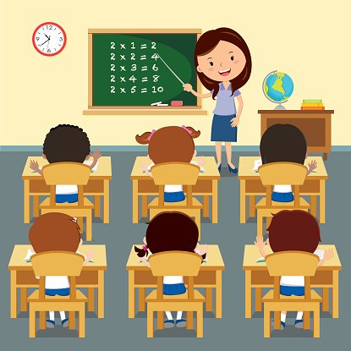

school
playground
classroom
Notes:
Show the pictures one by one.
Ask Ss some questions about the pictures (e.g. What can you see? Who are they? What are they doing? Where is it?)
Have Ss listen to the word and repeat several times.

Slide 4



library
hall
Notes:
Show the pictures one by one.
Ask Ss some questions about the pictures (e.g. What can you see? Who are they? What are they doing? Where is it?)
Have Ss listen to the word and repeat several times.

Slide 5

school
playground
classroom
library
hall

Slide 6
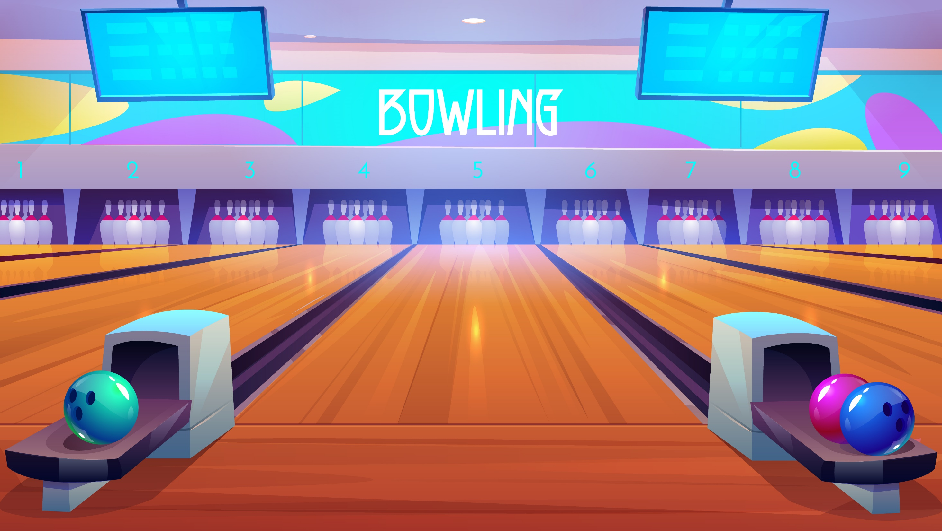
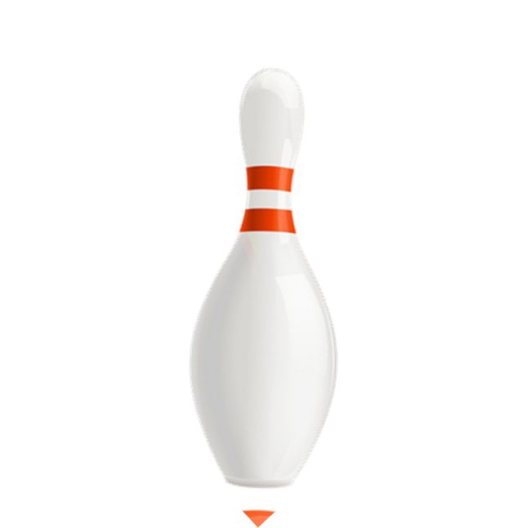

RULES
Look at the pictures.
Raise fingers 1, 2 or 3 to answer.
1 student says aloud the correct answer and throw the bowling ball.
Get 1 star if the ball hits all the pins.
All students say aloud the sentence again.
Note: Click on NEXT to continue.

Slide 7
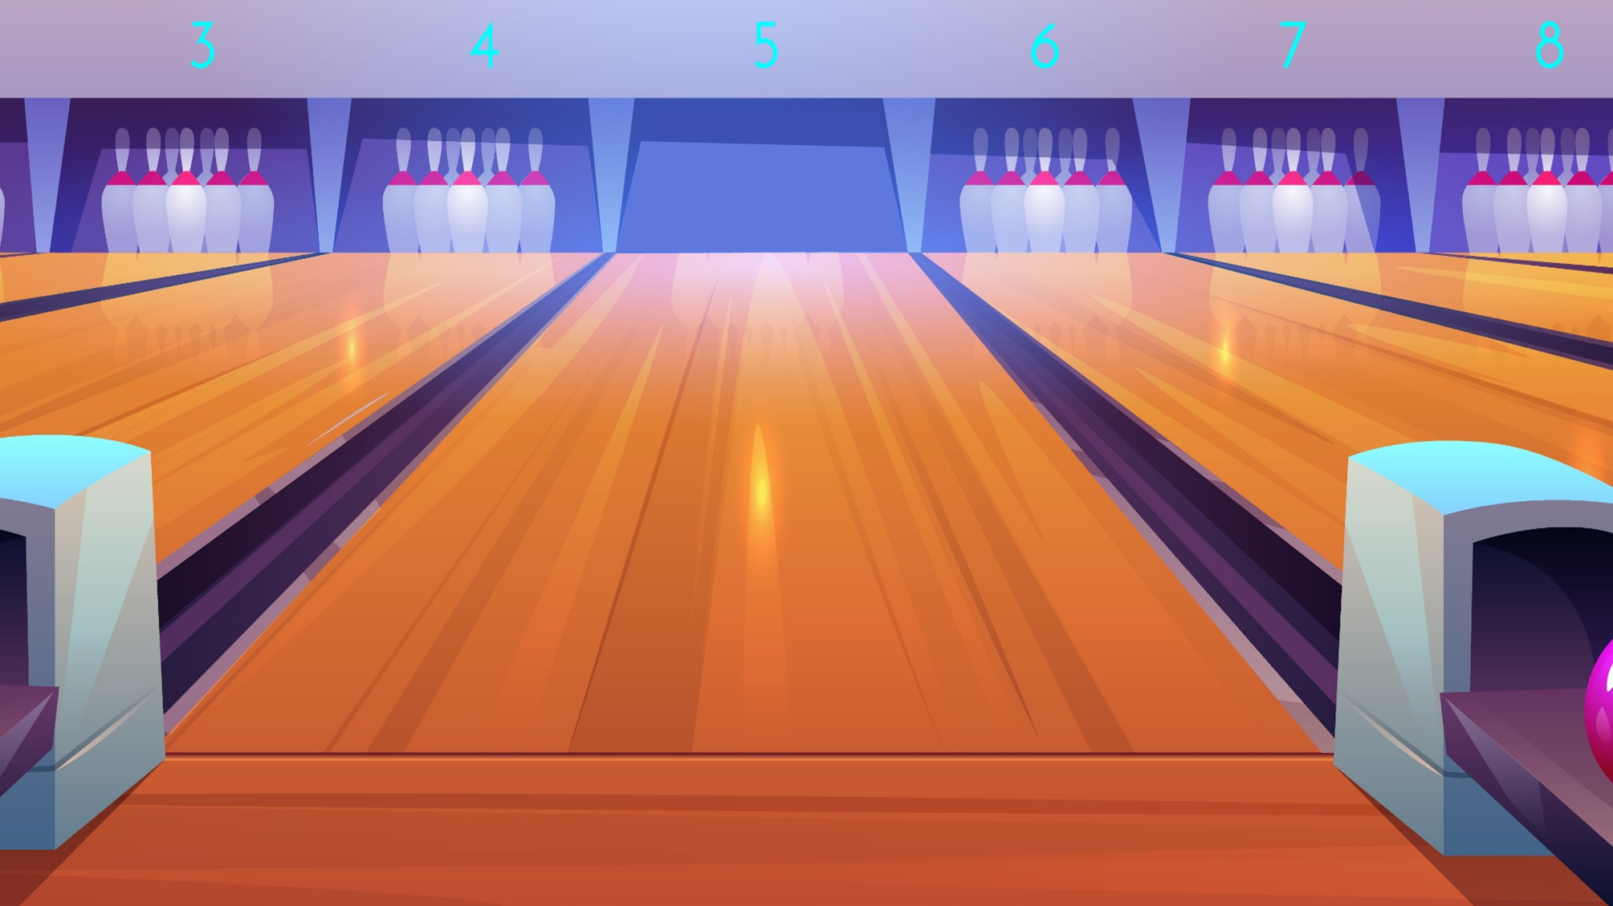



This is a
____________.
1.
playground
2.
library
library
3.
school
Next

Slide 8
This is a
____________.
1.
hall
2.
classroom
hall
3.
school
Next

Slide 9
This is a
____________.
1.
library
2.
school
playground
3.
playground
Next

Slide 10
This is a
____________.
1.
classroom
2.
school
classroom
3.
library

Slide 11
This is a
____________.
1.
playground
2.
classroom
school
3.
school
Next

Slide 12
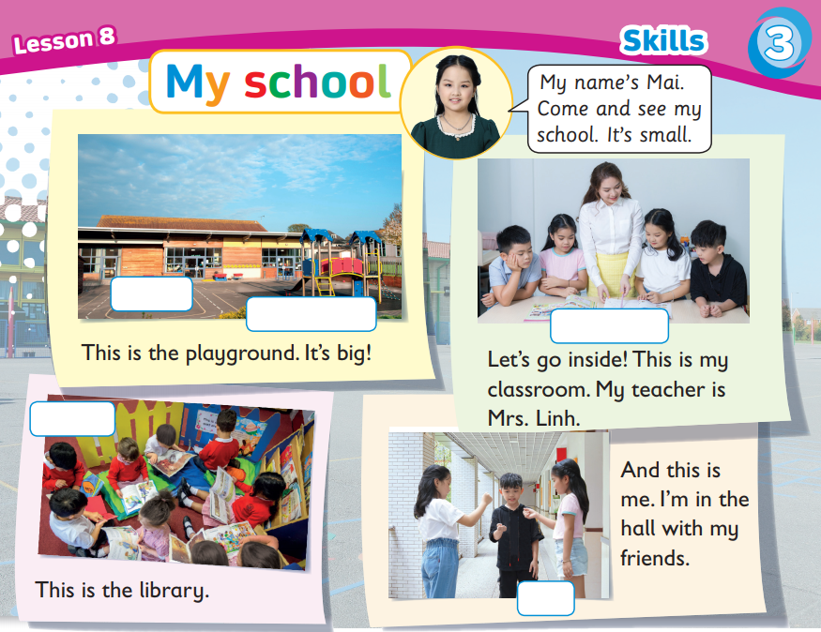
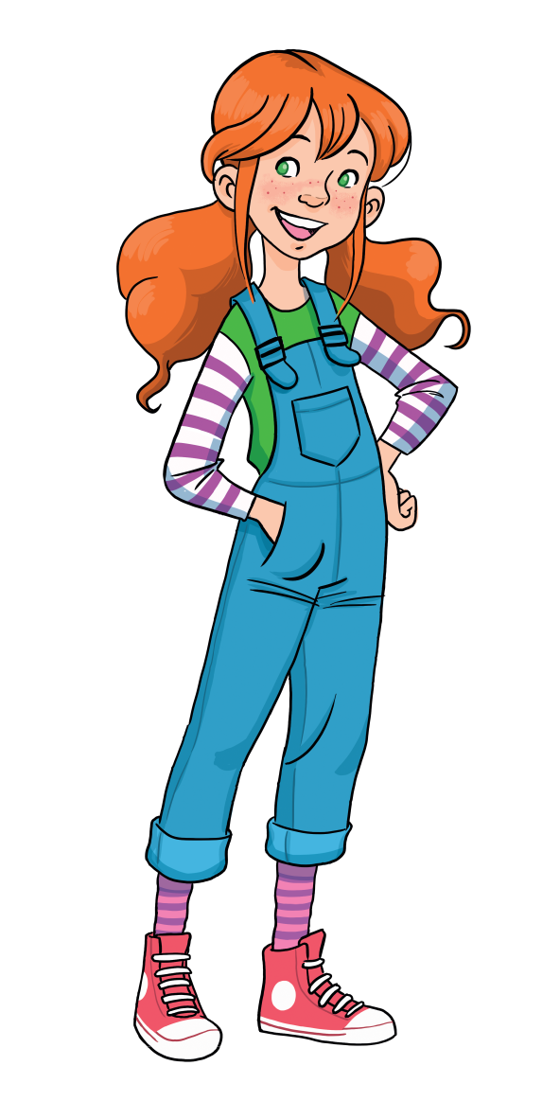
Fill in the blank.
Listen and read.
school
playground
classroom
library
hall
Click on “Answers” to show the answers
Notes:
Play the audio twice.
Point at each picture and ask Ss the phrases they have just learnt, then show the phrases, say aloud and have Ss repeat.
1st listen: Ss just listen and point at the text.
2nd listen: pause at each sentence for Ss read along.

Slide 13
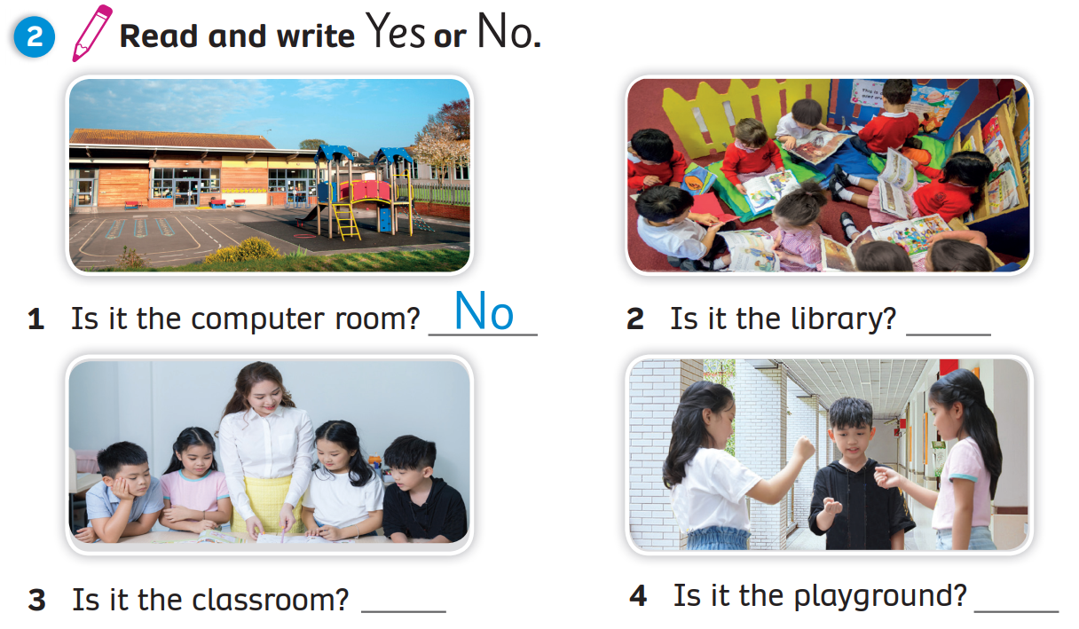
Answers
Yes
Yes
No
Click on “Answers” to show the answers

Slide 14


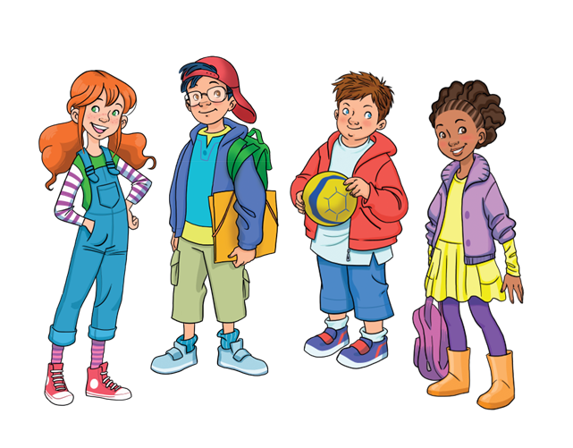

Example
My name is Marie.
Come and see my school. It’s big.
This is the playground. It’s small.
Let’s go inside.
This is my classroom.
My teacher is Mrs.Anna.
This is the hall.
It’s big.
And this is me. I’m in the library with my friends.
Click on “Example” to show the example
Notes:
Put Ss in pairs.
Ask them to base on the reading passage and make a presentation about their school.
Show Ss example and have them practice speaking in pairs.
Randomly choose 3-5 students to present in class.

Slide 15
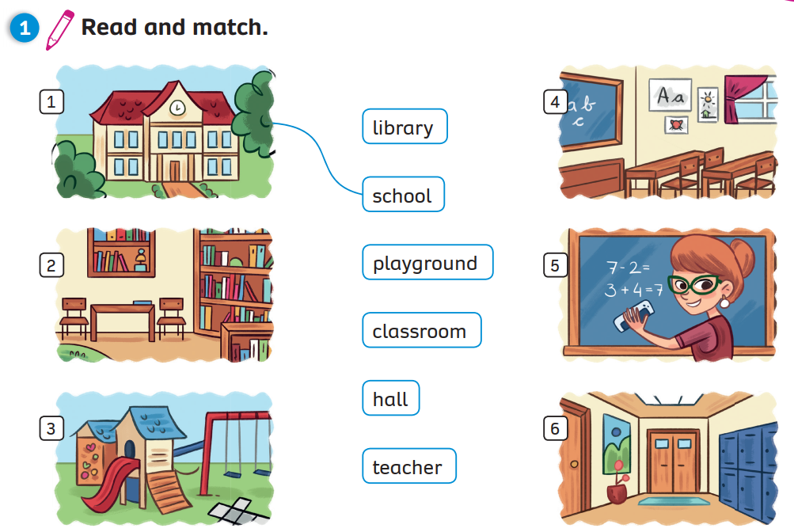
Match
Click on “Match” to show the answers

Slide 16
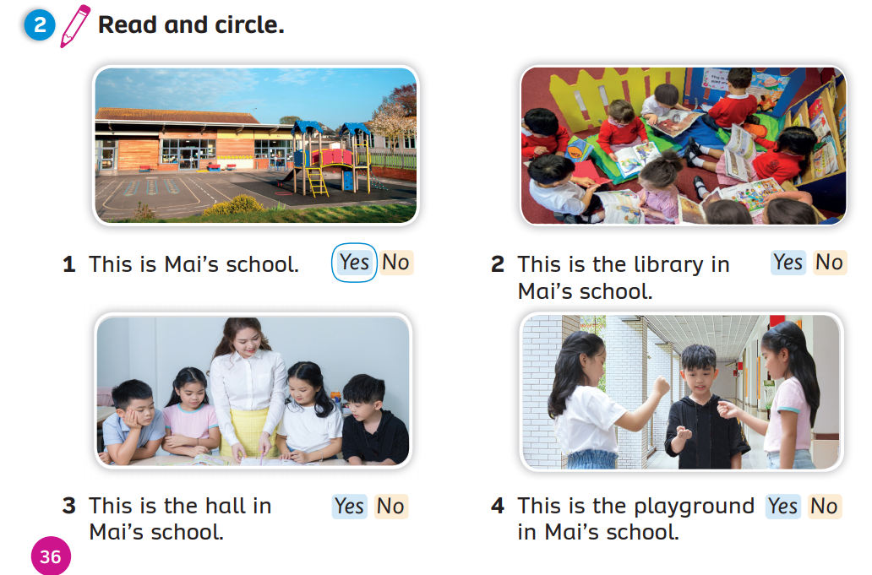
Activity Book (p.36)
Answers
Click on “Answers” to show the answers

Slide 17
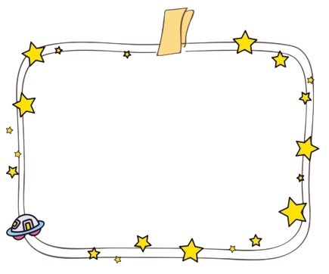
Examples
INSTRUCTIONS
Sit in small groups (depending on the class size)
Discuss in your groups about your ideal school by answering the following questions:
  Is it a big or a small school?
  How many classrooms are there?
  What facilities does it has?
  (library, playground, canteen, garden, gymnasium, swimming pool, toilet?)
  How big or small are the facilities?
  Where are you and your friends at school?
Make sentences about your ideal school and choose a leader to read them aloud to the class
MY IDEAL SCHOOL
1. My ideal school is a big school.
2. There are 20 classrooms.
3+4. There is a library. It’s small.
There is a playground. It’s big.
There is a canteen. It’s small.
There are 8 toilets. They are big.
5. My friends and I are in the library.
Click on “Examples” to show the examples

Slide 18
WRAP-UP
school
playground
classroom
library
hall

Slide 19
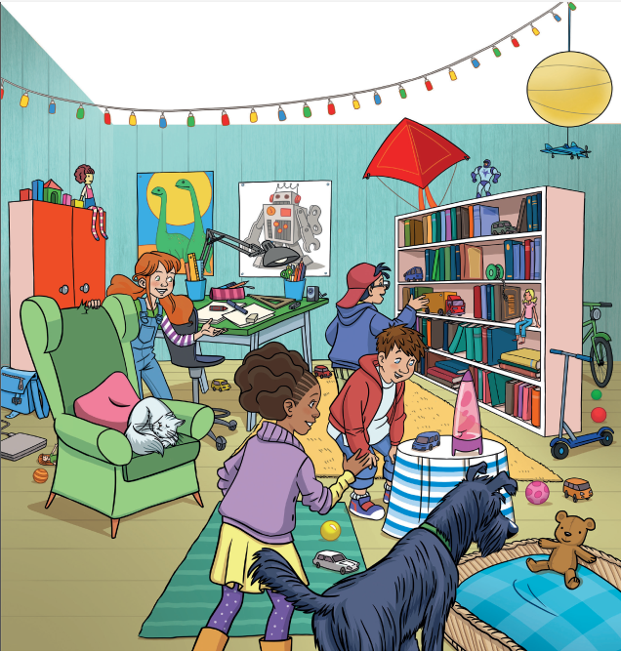
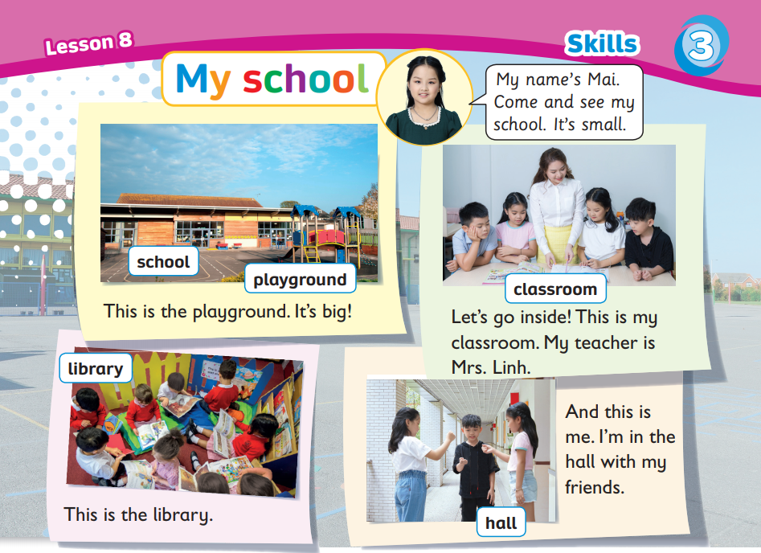

UNIT 3: Lesson 8
We’ve learnt…

