Slide 1



PHÒNG GIÁO DỤC VÀ ĐÀO TẠO CẨM PHẢ
TRƯỜNG TIỂU HỌC THÁI BÌNH
PHÒNG GIÁO DỤC VÀ ĐÀO TẠO CẨM PHẢ
TRƯỜNG TIỂU HỌC THÁI BÌNH
UNIT 8: IT’S WINDY
Lesson 7
Teacher : La Thi Huong

Slide 2


Song: Shake body
WARM-UP
All students stand up.
Listen to the song.
Dance along.

Slide 3
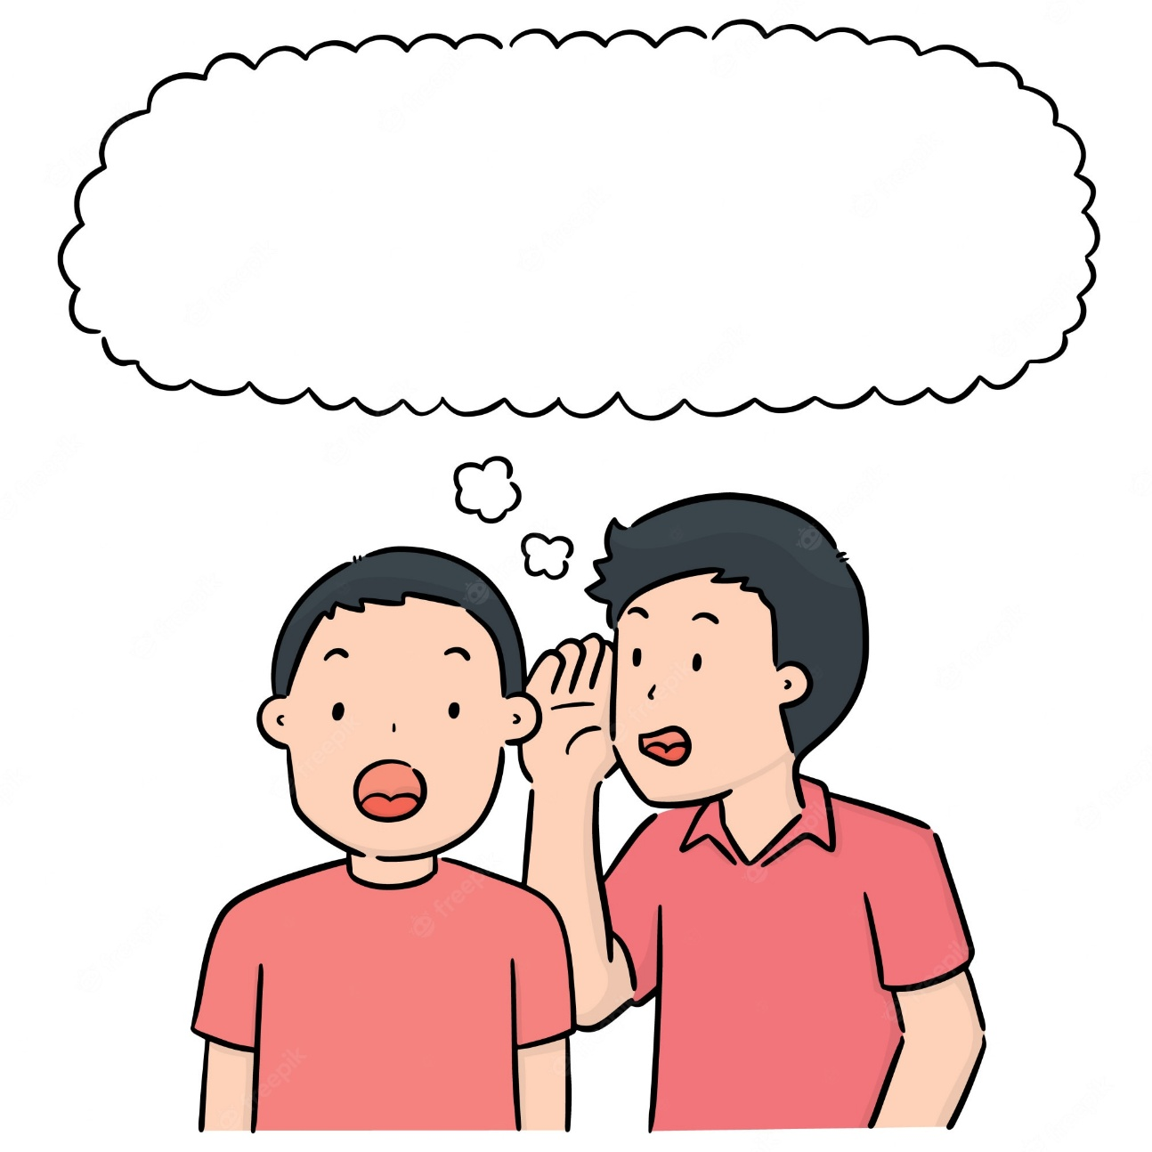
REVIEW: Weather and clothes
WHISPER
CHALLENGE
RULES
Students line up in teams (4-5 students each line) with their back facing the screen.
The first student of each line will turn back and look at the sentence(s).
Students whisper the sentence(s) to the next person.
The last student of each team shouts out the sentence(s).
The fastest team with the correct answer gets 1 point.
Notes:
Ask Ss to classify which speech bubbles are about greetings and which ones are about numbers

Slide 4
REVIEW: Weather and clothes
What’s the weather like?
WHISPER
CHALLENGE
Round 1
Click “Whisper Challenge” to reveal the sentence(s)
Click the grey triangle to move to the next slide

Slide 5
REVIEW: Weather and clothes
I’m wearing…
WHISPER
CHALLENGE
Round 2
Click “Whisper Challenge” to reveal the sentence(s)
Click the grey triangle to move to the next slide

Slide 6
REVIEW: Weather and clothes
What’s the weather like?
WHISPER
CHALLENGE
Round 3
Click “Whisper Challenge” to reveal the sentence(s)
Click the grey triangle to move to the next slide

Slide 7
REVIEW: Weather and clothes
I’m wearing….
WHISPER
CHALLENGE
Round 4
Click “Whisper Challenge” to reveal the sentence(s)
Click the grey triangle to move to the next slide

Slide 8
REVIEW: Weather and clothes
What’s the weather like today?
WHISPER
CHALLENGE
Round 5
Click “Whisper Challenge” to reveal the sentence(s)
Click the grey triangle to move to the next slide

Slide 9

REVIEW: Weather and clothes
WELL DONE!
Click the grey triangle to move to the next slide

Slide 10

STORY

Slide 11
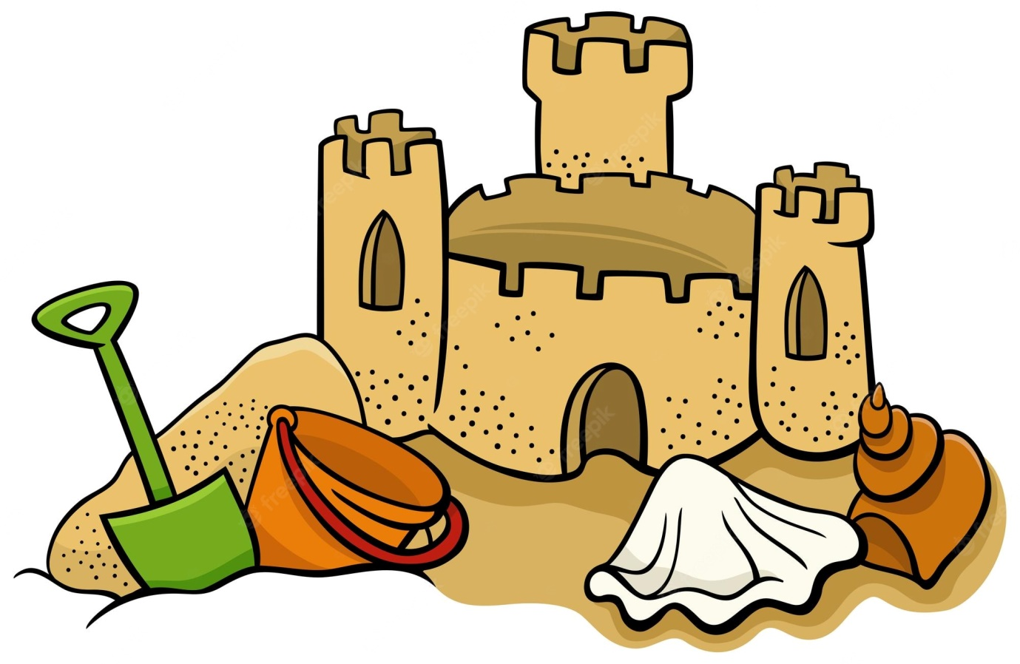

STORY: Vocabulary
sandcastle
Put on

Slide 12
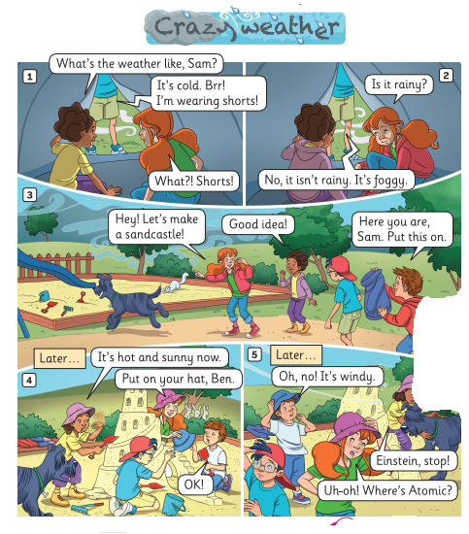
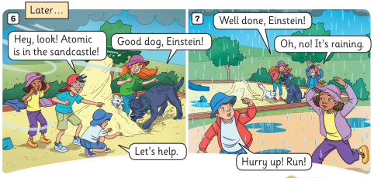
Crazy weather.
STORY: Introduction
1. What’s the story title?
->
2. How many story frames?
->
3. How many characters?
->
Seven
Five

Slide 13
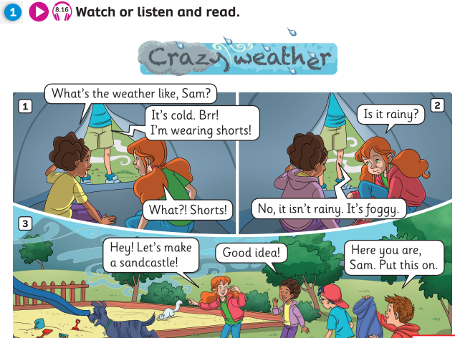

Pupil’s Book (p.107)

Slide 14

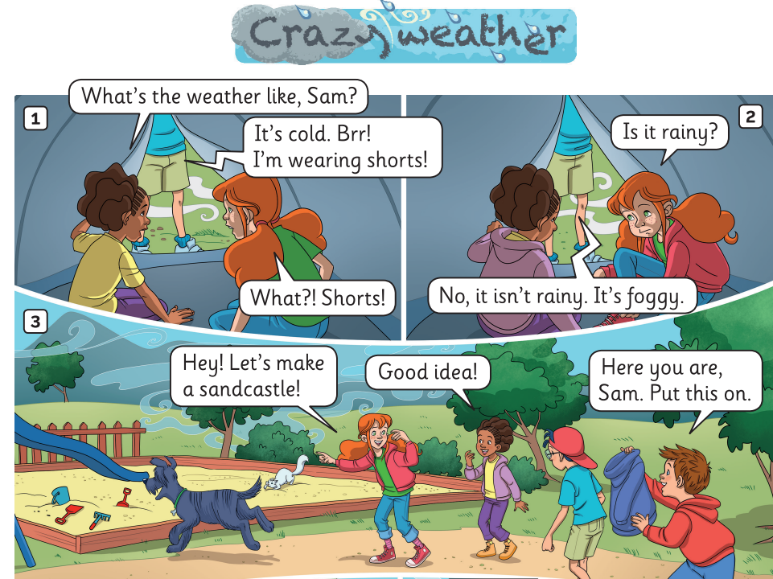
Pupil’s Book (p.107)

Slide 15
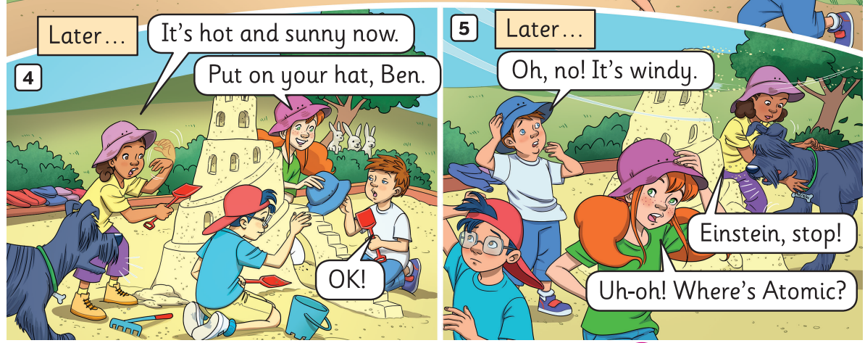
Pupil’s Book (p.107)

Slide 16
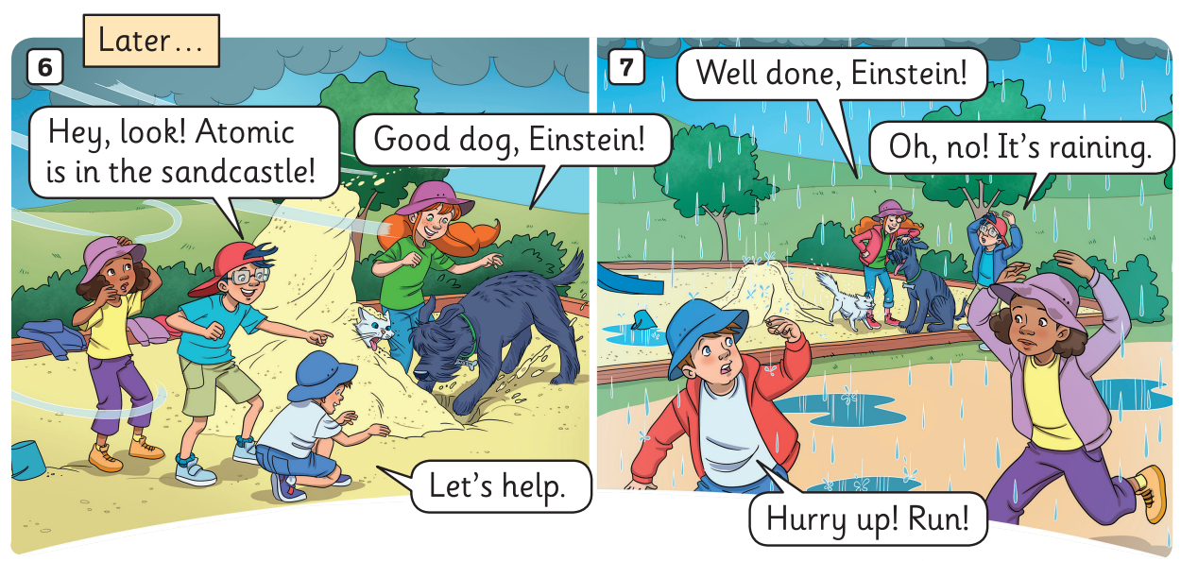
Pupil’s Book (p.107)

Slide 17
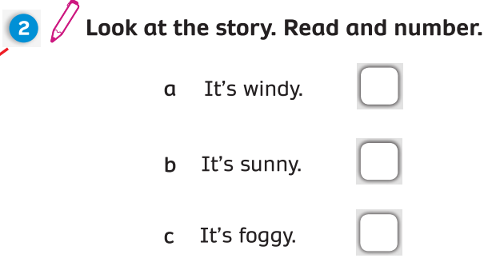

Pupil’s Book (p.108)
5
4
2

Slide 18
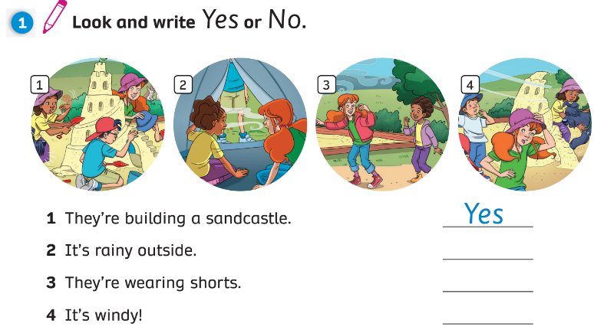
Activity Book (p.87)
No
No
Yes

Slide 19
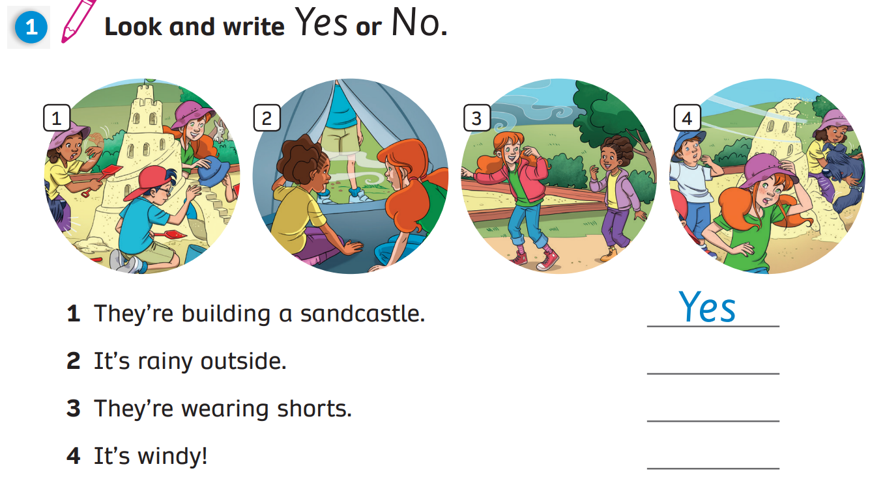
Activity Book (p.87)
No
No
Yes

Slide 20
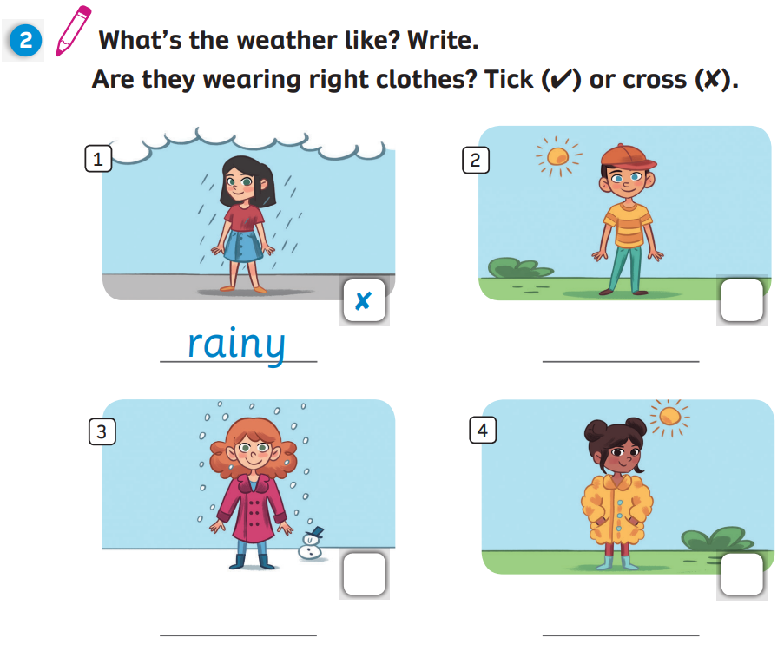
Activity Book (p.87)
✓
sunny
✓
✗
snowy
sunny

Slide 21



UNIT 8: Lesson 7
We’ve learnt…
Story

