Slide 1



PHÒNG GIÁO DỤC VÀ ĐÀO TẠO CẨM PHẢ
TRƯỜNG TIỂU HỌC THÁI BÌNH
PHÒNG GIÁO DỤC VÀ ĐÀO TẠO CẨM PHẢ
TRƯỜNG TIỂU HỌC THÁI BÌNH
UNIT 8: IT’S WINDY
Lesson 1B
Teacher : La Thi Huong

Slide 2
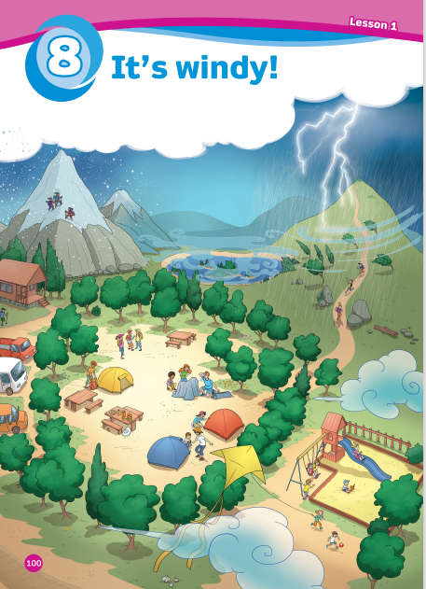
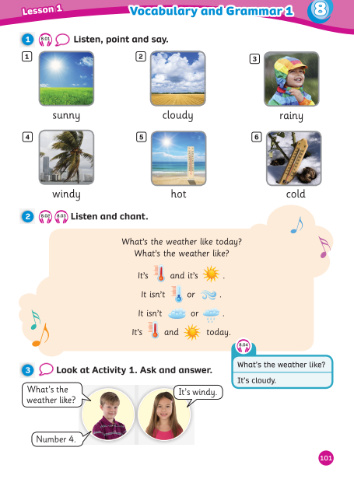
UNIT 8: IT’S WINDY!
We’re reviewing…
weather: sunny, cloudy, rainy, windy, hot, cold
How to talk about weather
SB p.100-101
AB p.80

Slide 3
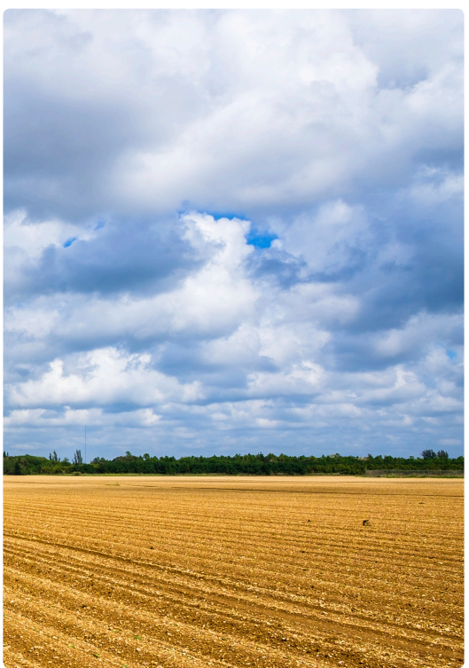
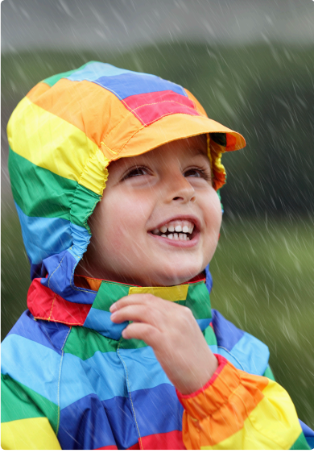
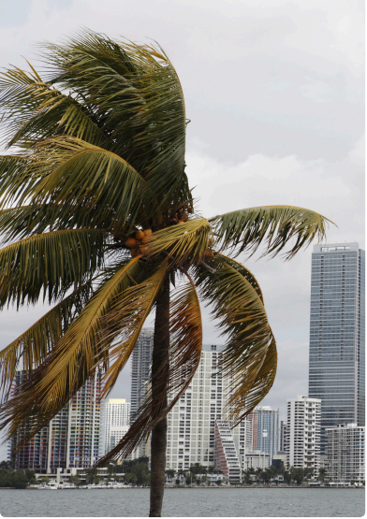
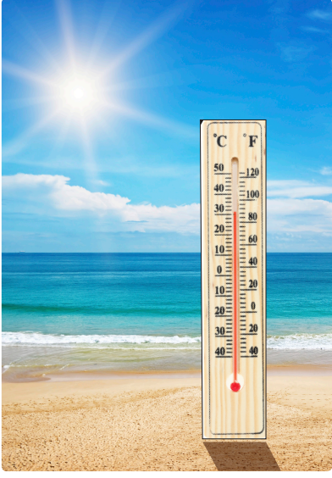





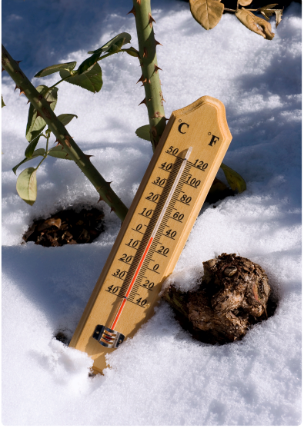


REVIEW: weather
cloudy
rainy
windy
hot
sunny
cold

Slide 4







REVIEW: weather
There are 6 questions.
For each question, teacher opens a rectangle and each team tries to guess the answer. Teacher can open rectangles until students can guess the answer. The team saying the correct answer first will get 2 points for their team.

Slide 5

sunny
SHOW

Slide 6

rainy
SHOW

Slide 7

cold
SHOW

Slide 8

hot
SHOW

Slide 9

windy
SHOW

Slide 10

cloudy
SHOW

Slide 11


Slide 12



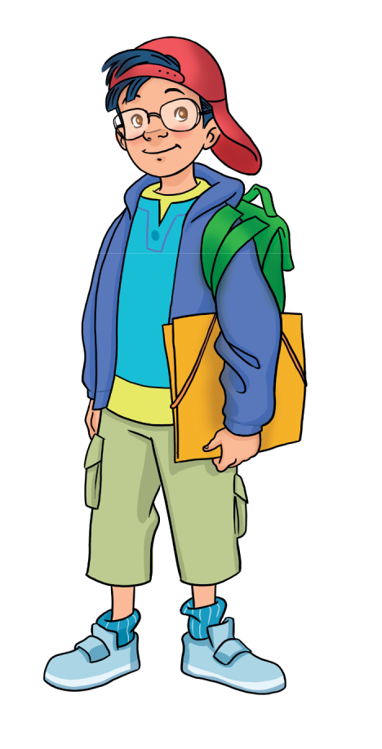
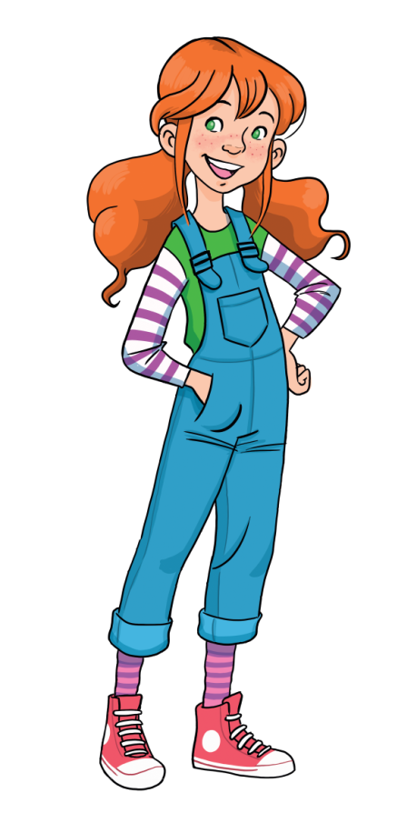

GRAMMAR
What’s the weather like?
It’s cloudy.
Click on the speaker icon to play the audio

Slide 13

Whisper challenge
Divide class into equal teams.
Each team sits in a row facing the board.
Whisper a sentence into the ears of the first student in each row. They whisper the sentence into the next student’s ear in their row until the whisper gets to the last person in the row.
When the sentence reaches the last person in front, that student stands up, write the sentence on the board.
The team that gets the sentence right scores a point.

Slide 14

Notes:
It’s windy.

Slide 15
Notes:
It’s cloudy

Slide 16
Notes:
It’s sunny.

Slide 17
Notes:
It’s rainy.

Slide 18
Notes:
What’s the weather like?

Slide 19
Notes:
It’s hot.

Slide 20
Notes:
It’s cold.

Slide 21
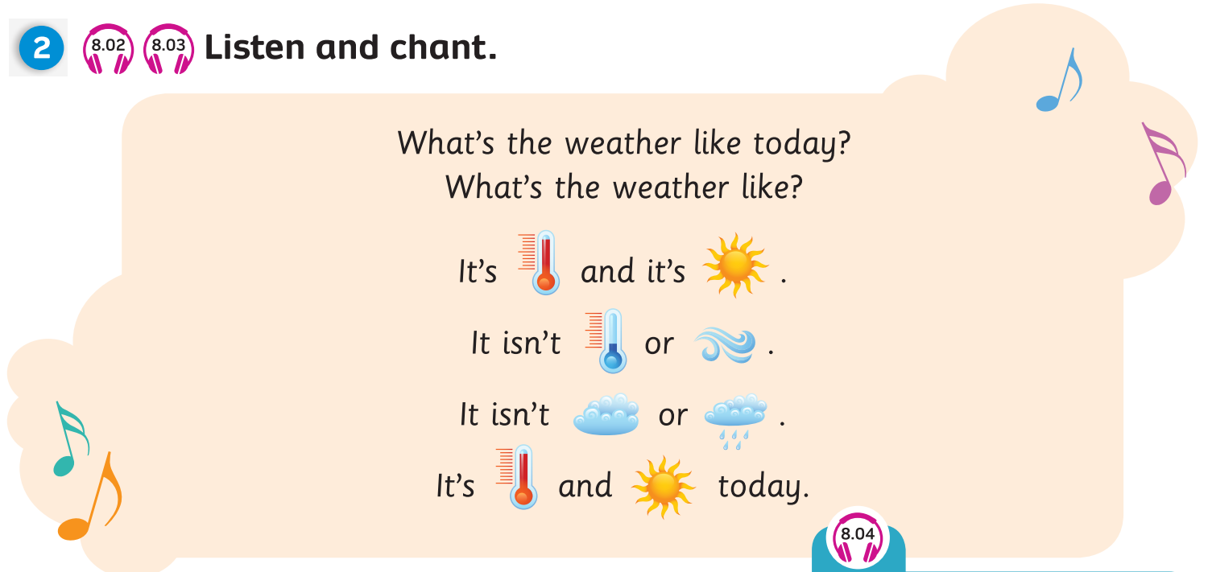



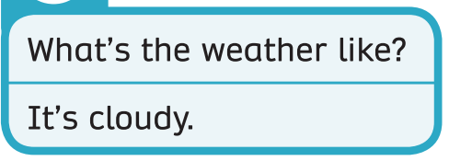
Pupil’s Book (p.101)

Slide 22
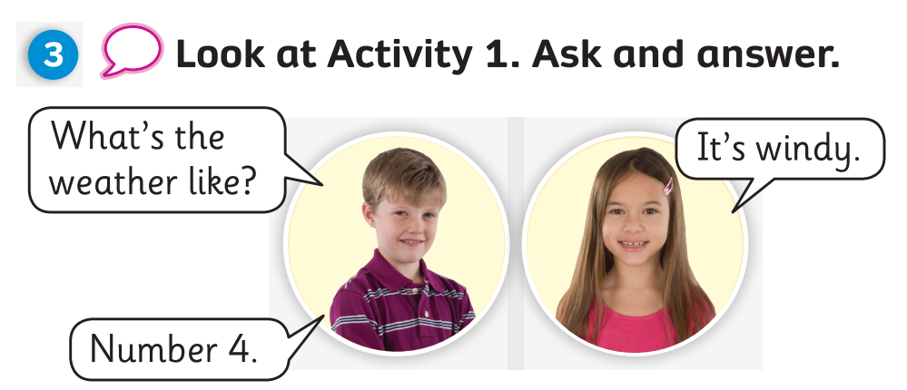
Pupil’s Book (p.101)
Notes:
Draw Ss’ attention to the grammar box and the recorded model (track 8.04)
Have Ss look at activity 1.
In pairs, Ss ask and answer weather.

Slide 23
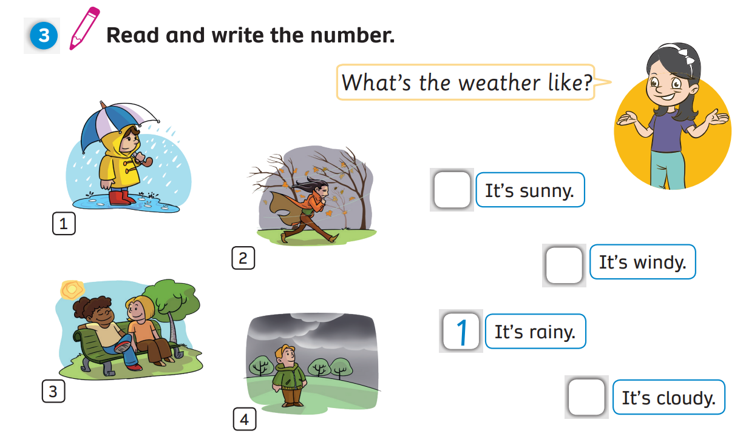
Activity Book (p.81)
3
2
4
Notes:
2 It’s windy. 3 It’s sunny. 4 It’s cloudy.

Slide 24
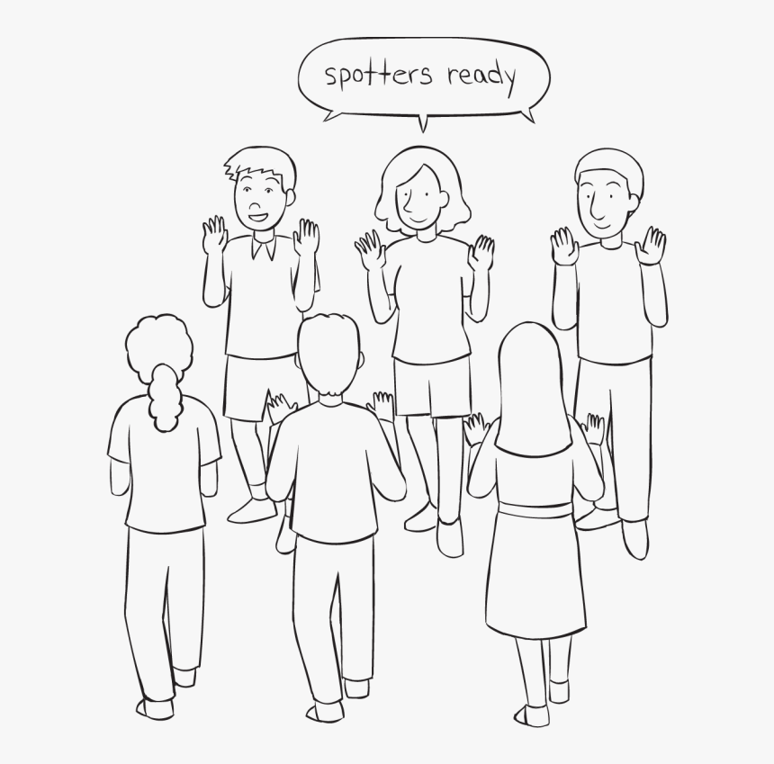
PRODUCTION
What’s the weather like?
Team A
ROUND 1
It’s rainy.
Team B
Notes:
RULES:
-First round: Team 1 asks What’s the weather like? Each student in team 1 has to ask this question and their partner in team 2 show his/ her picture and answer It’s (cloudy). When each student in team 1 finishes, they move to the right and ask the next student in team 2.

Slide 25
PRODUCTION
It’s windy.
Team A
ROUND 2
What’s the weather like?
Team B
Notes:
2nd round: Team 2 asks and team 1 answers. Team 2 moves.

Slide 26







Wrap-up
rainy
windy
cloudy
hot
It’s cold.
What’s the weather like?
sunny
cold

Slide 27
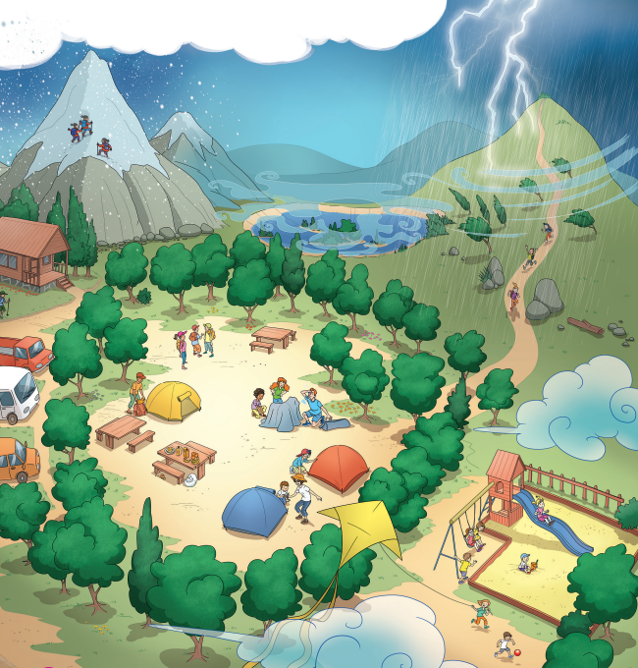
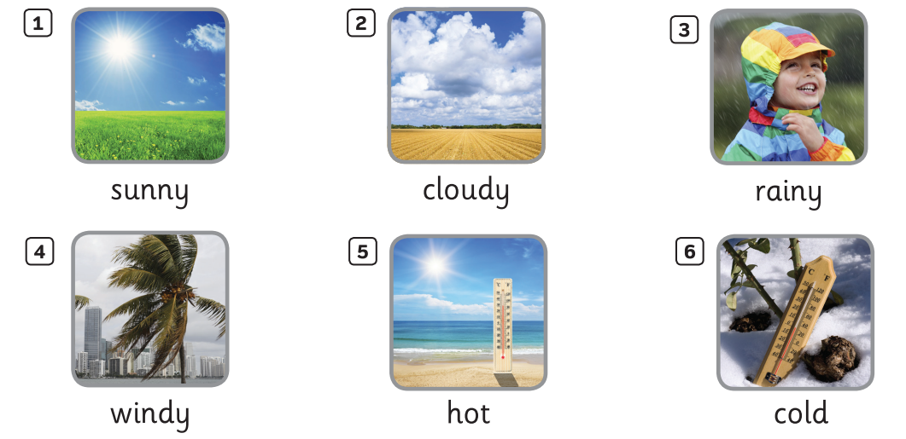


UNIT 8: Lesson 1B
We’ve reviewed…

