Slide 1



PHÒNG GIÁO DỤC VÀ ĐÀO TẠO CẨM PHẢ
TRƯỜNG TIỂU HỌC THÁI BÌNH
PHÒNG GIÁO DỤC VÀ ĐÀO TẠO CẨM PHẢ
TRƯỜNG TIỂU HỌC THÁI BÌNH
UNIT 7: DO YOU LIKE PEAS?
Lesson 8
Teacher : La Thi Huong

Slide 2

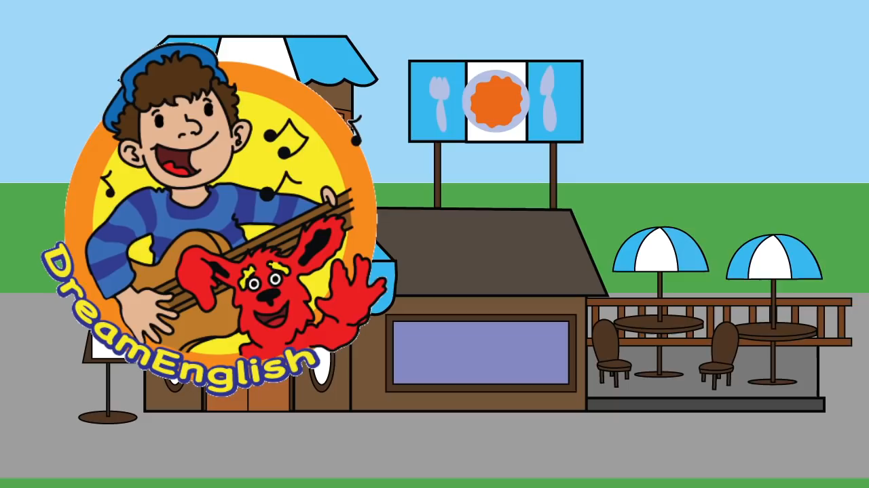
Song: Food song.
WARM-UP
All students stand up.
Listen to the song.
Dance along.

Slide 3


LEAD-IN
Musical ball
Notes:
Introduce the game Pass the paper.
Assign each student a number and have them say aloud their number in order.
Show this slide while having the Ss take turn to say their number. Click on the title Pass the paper to activate the animations.
Show the next slide. The last student to call out his/her number upon the slide transition has to say aloud the question and answer it.
With each correct pair of question and answer, the student gets 2 points (1 for the question and 1 for the answer).

Slide 4
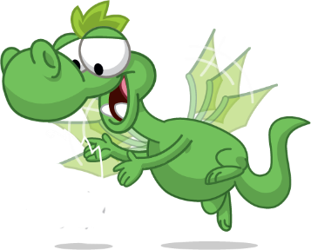
SKILLS: Vocab
Read about the Vietnamese bread

Slide 5
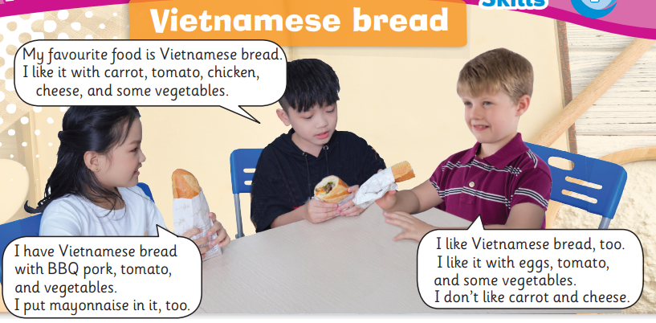
Pupil’s Book (p.97)
Read about the Vietnamese bread
Tell me describe your like and dislike.

Slide 6
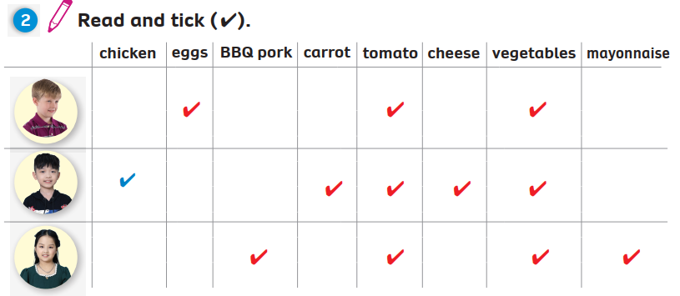
Pupil’s Book (p.97)

Slide 7
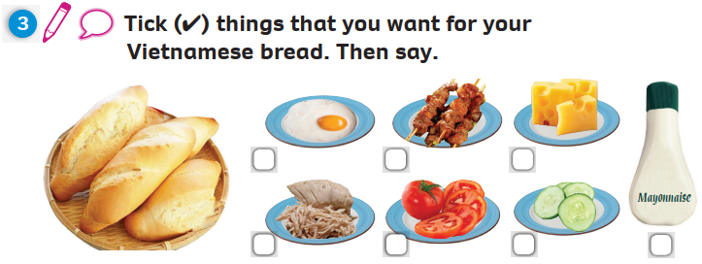
Pupil’s Book (p.97)

Slide 8
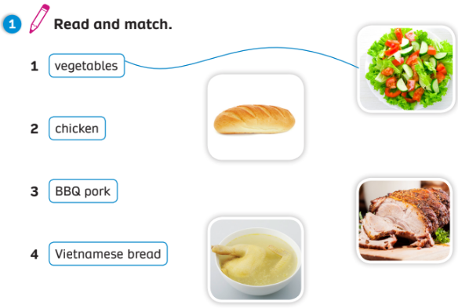
Activity Book (p.78)

Slide 9
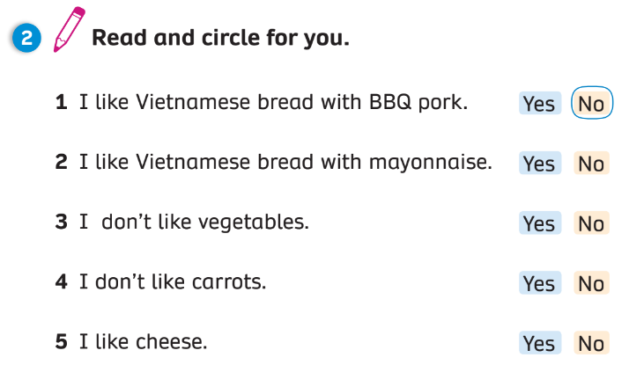
Activity Book (p.78)

Slide 10


Unit 7 Lesson 8
We’ve learned

