Slide 1



PHÒNG GIÁO DỤC VÀ ĐÀO TẠO CẨM PHẢ
TRƯỜNG TIỂU HỌC THÁI BÌNH
PHÒNG GIÁO DỤC VÀ ĐÀO TẠO CẨM PHẢ
TRƯỜNG TIỂU HỌC THÁI BÌNH
UNIT 7: DO YOU LIKE PEAS?
Lesson 3A
Teacher : La Thi Huong

Slide 2
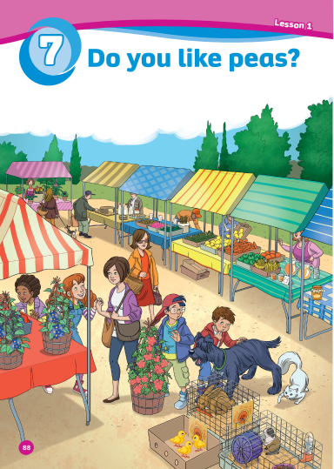
UNIT 7:
DO YOU LIKE PEAS?
We’re learning…
- food
- SB p.91
- AB p.72

Slide 3

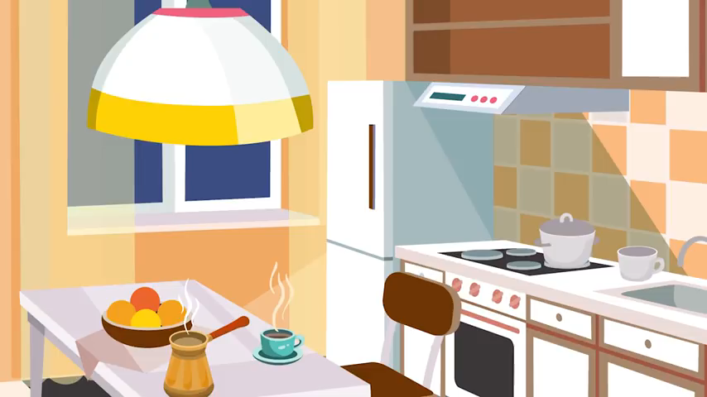
Song: I’m hungry.
WARM-UP
All students stand up.
Listen to the song.
Dance along.

Slide 4

Vocabulary

Slide 5
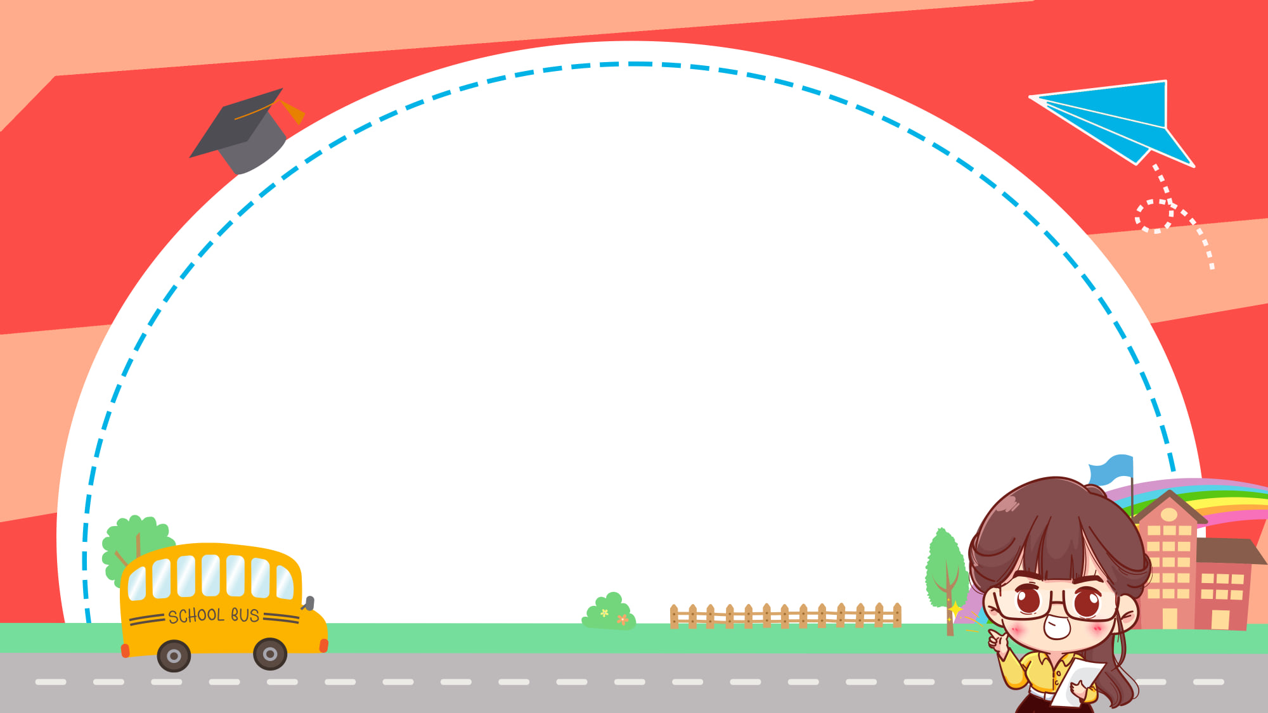






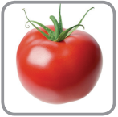


tomato

Slide 6
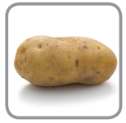
potato

Slide 7

peas

Slide 8
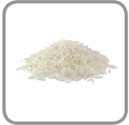
rice

Slide 9
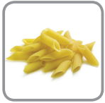
pasta

Slide 10
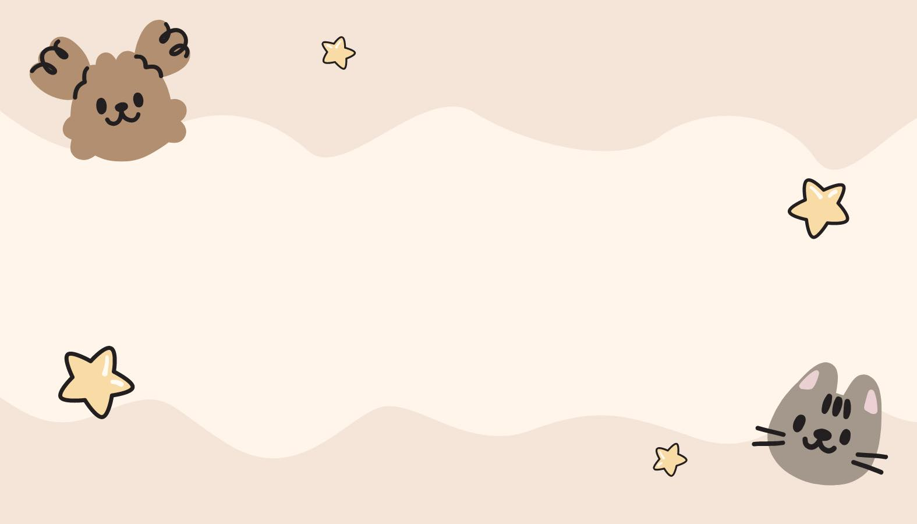
Practice
(Guessing game)

Slide 11
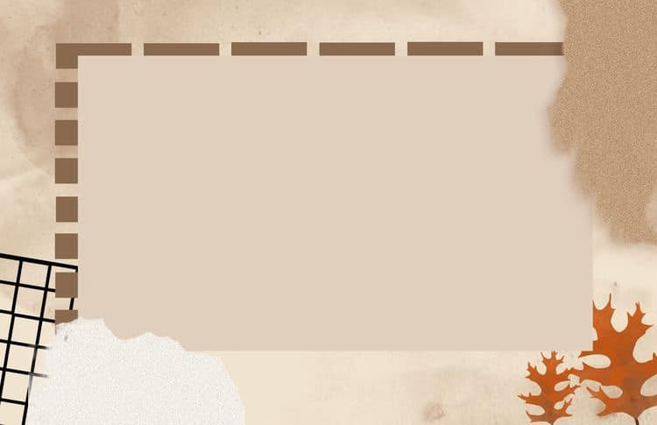
Grammar

Slide 12

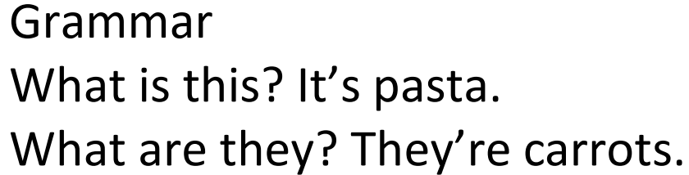

Slide 13
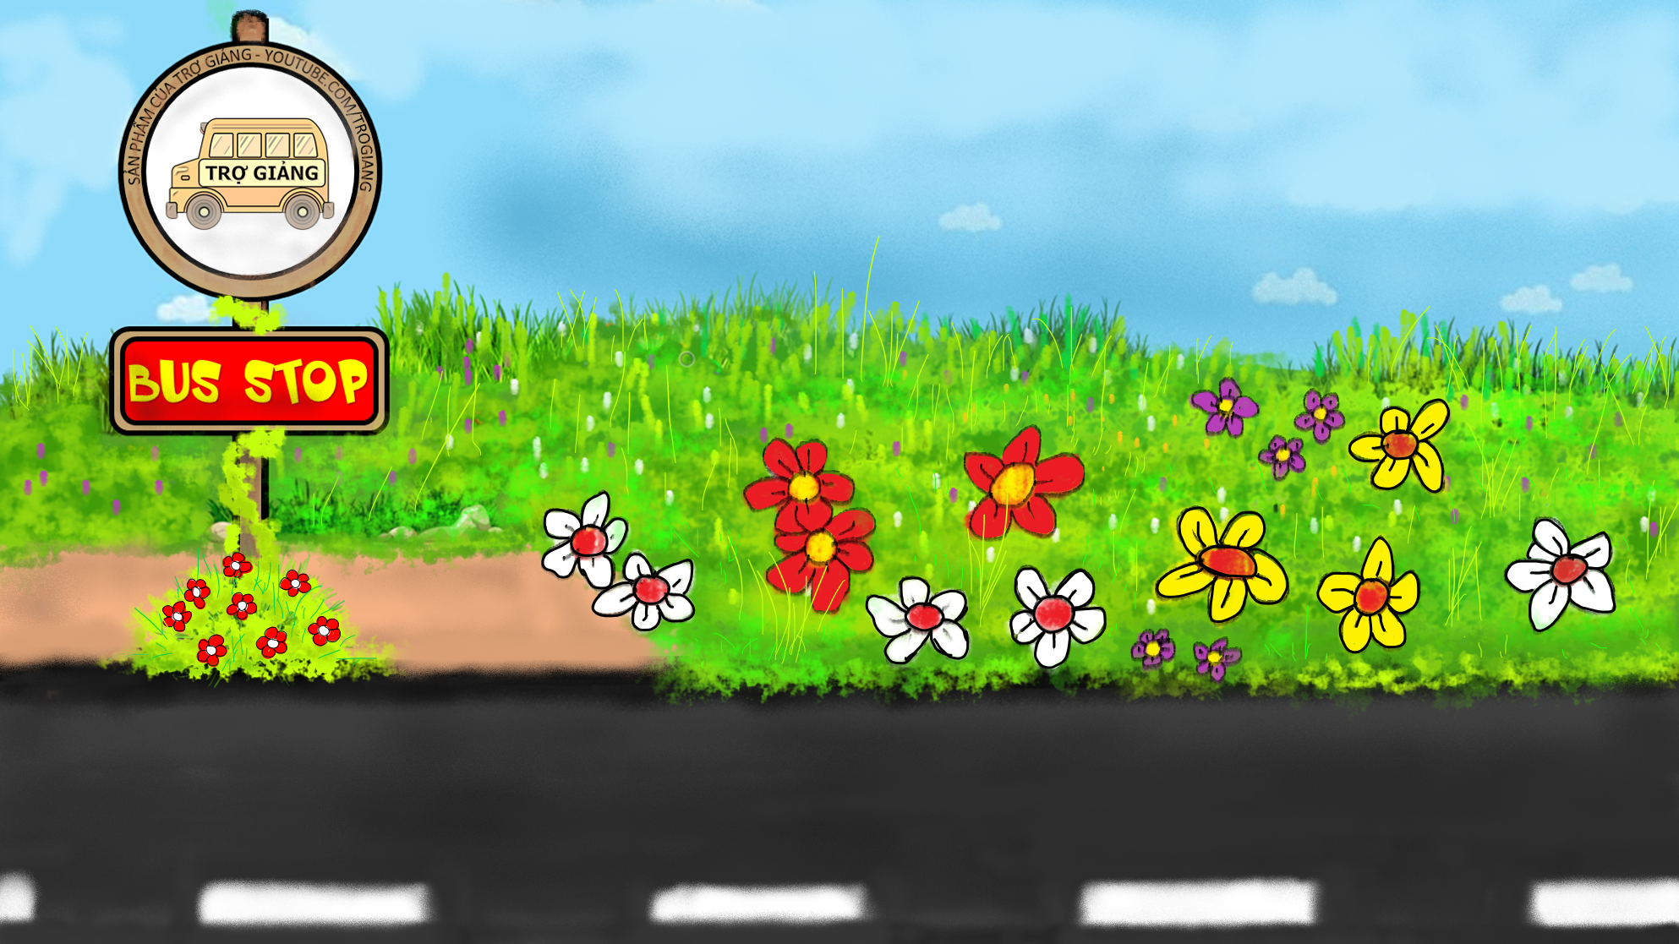

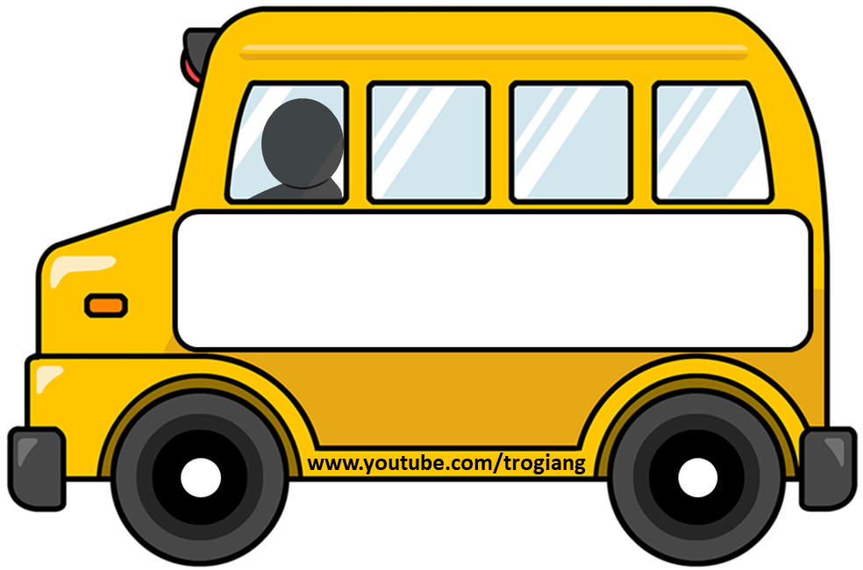




GAME
THE BUS STOP
PLAY

Slide 14


What is this?
It’s a tomato.
RIGHT
WRONG

Slide 15


What are they?
They are peas.
RIGHT
WRONG

Slide 16



What is this?
It’s a potato.
RIGHT
WRONG

Slide 17

What is this?
It’s pasta.
RIGHT
WRONG

Slide 18
What’s this?
It’s rice.
RIGHT
WRONG

Slide 19
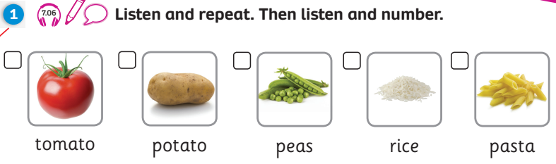
Pupil’s Book (p.91)
Answer
3
5
2
1
4
Click Answer to show keys

Slide 20
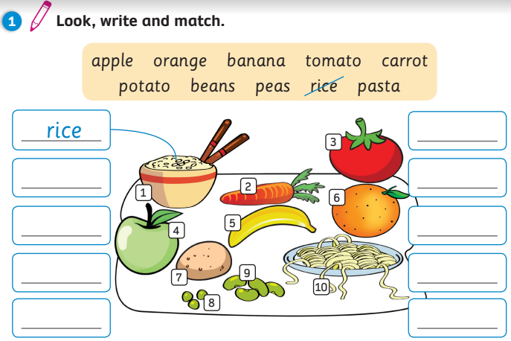
Activity Book (p.72)
Answer
3. tomato
2. carrot
6. orange
4. apple
8. peas
5. banana
9. beans
7. potato
10. pasta
Click Answer to show keys

Slide 21
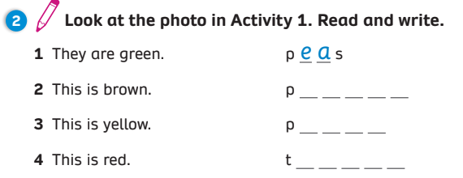
Activity Book (p.72)
Answer
o t a t o
a s t a
o m a t o
Click Answer to show keys

Slide 22
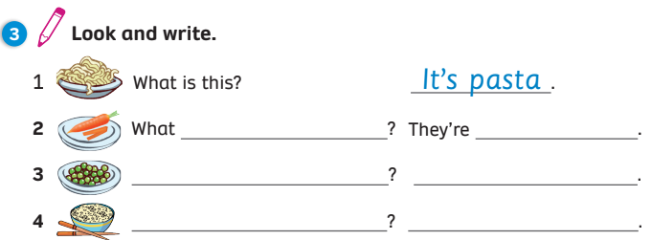
Activity Book (p.72)
Answer
are they
carrots
What are they
They’re peas
What is this
It’s rice
Click Answer to show keys

Slide 23


UNIT 7: Lesson 3A
We’ve learnt…
- food
- SB p.91
- AB p.72

