Slide 1



PHÒNG GIÁO DỤC VÀ ĐÀO TẠO CẨM PHẢ
TRƯỜNG TIỂU HỌC THÁI BÌNH
PHÒNG GIÁO DỤC VÀ ĐÀO TẠO CẨM PHẢ
TRƯỜNG TIỂU HỌC THÁI BÌNH
UNIT 5: MEET MY FAMILY
Lesson 6
Teacher : La Thi Huong

Slide 2
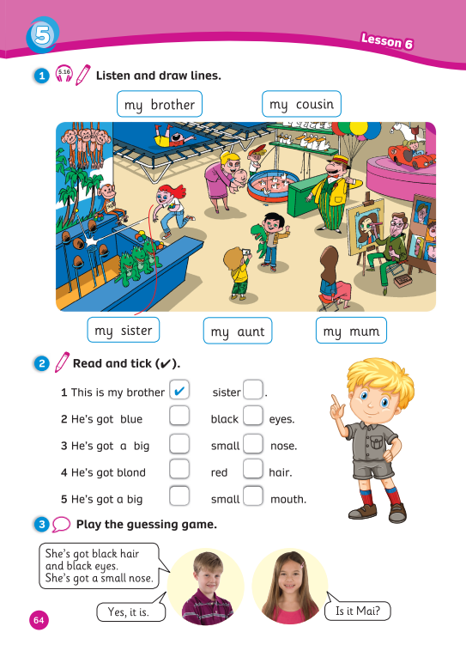
UNIT 5:
MEET MY FAMILY
We’re reviewing…
- family members
- body parts
- how to describe a family member
- SB p.64
- AB p.54

Slide 3


WARM-UP
Song: Head Shoulders Knees & Toes
All students stand up.
Listen to the song.
Dance along.

Slide 4

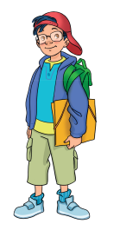
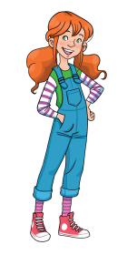
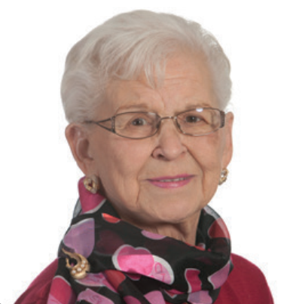
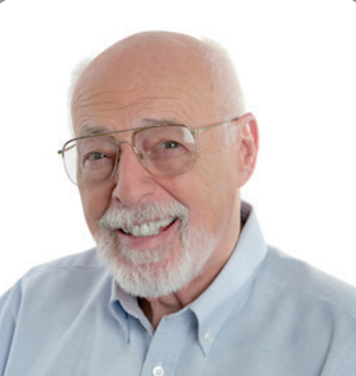
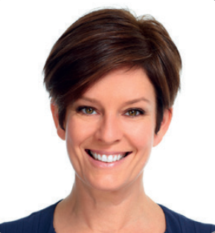

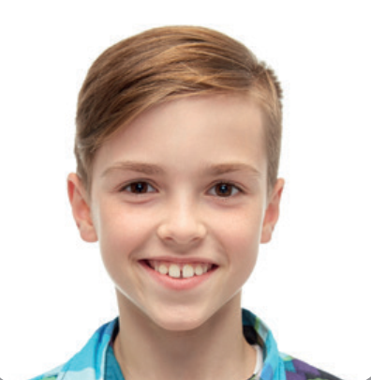
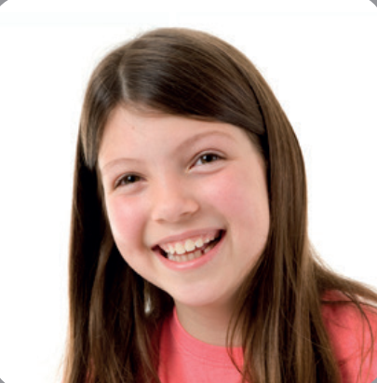
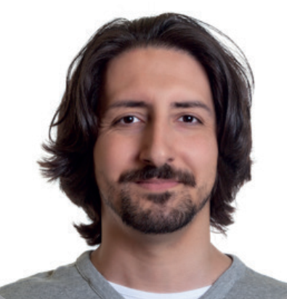
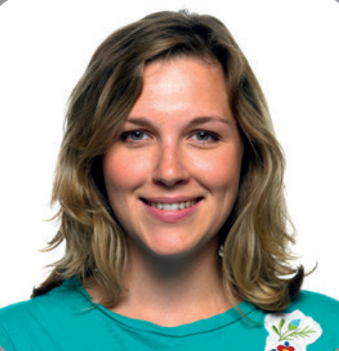
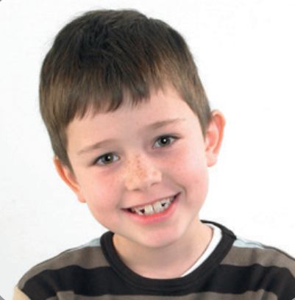
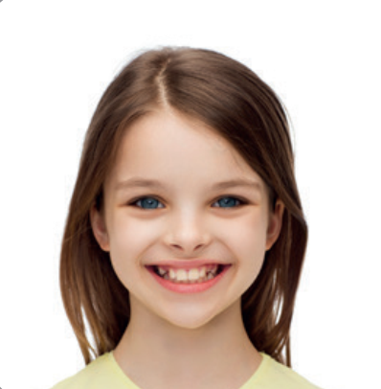
REVIEW: Family members
Who’s this?
It’s my …
It’s me!
granny | grandad | mum | dad | brother
sister | uncle | aunt | cousin | me

Slide 5


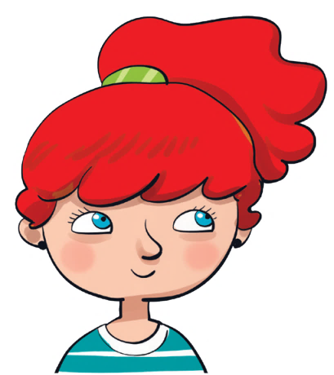
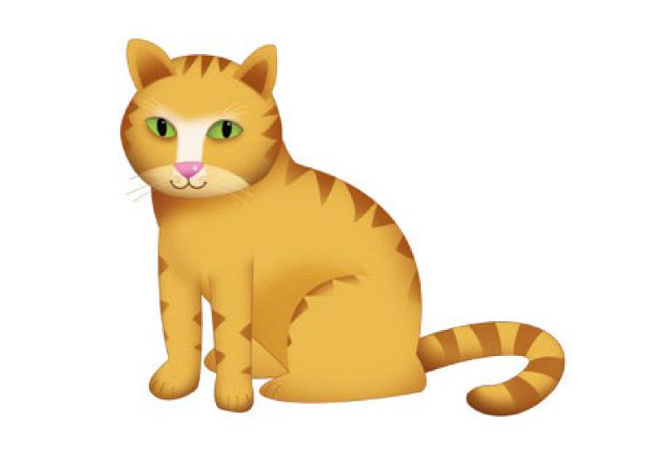

ASSEMBLING ROCKETS
RULES
There are 6 questions.
All students read the sentence and raise fingers 1, 2 or 3 to answer.
1 student says aloud the sentence and its number.
1 correct answer = 1 point.
The whole class says aloud the sentence one more time.
NOTE:
Click on the pictures to check the answer.
Click to continue.
This is
me.
PLAY

Slide 6
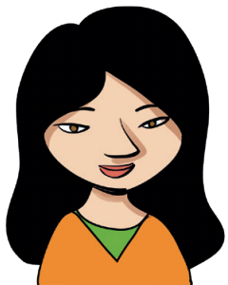
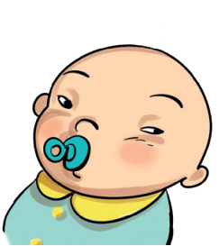
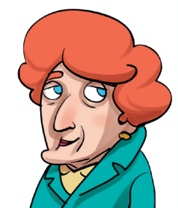



1
2
3
This is
my granny.

Slide 7
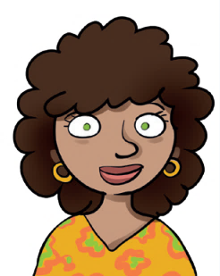
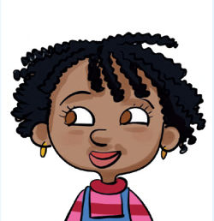
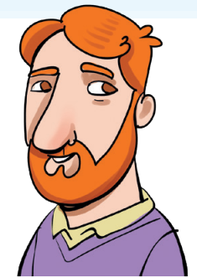
1
2
3
This is
my sister.

Slide 8
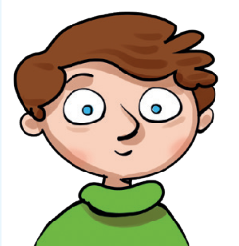
1
2
3
This is
my uncle.

Slide 9
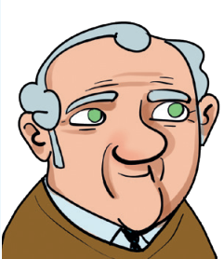
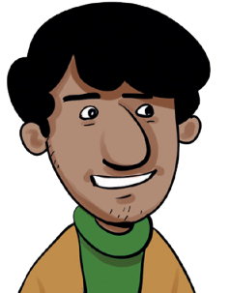
1
2
3
This is
my baby cousin.

Slide 10
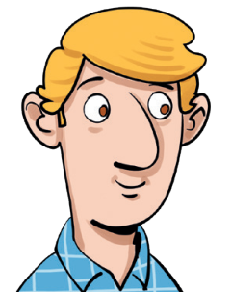
1
2
3
This is
my grandad.

Slide 11
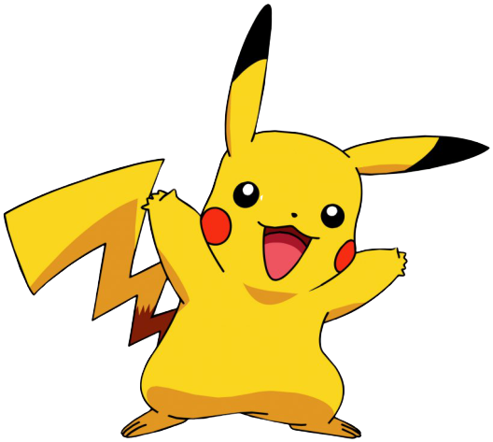
YOU’RE GREAT!
EXIT

Slide 12

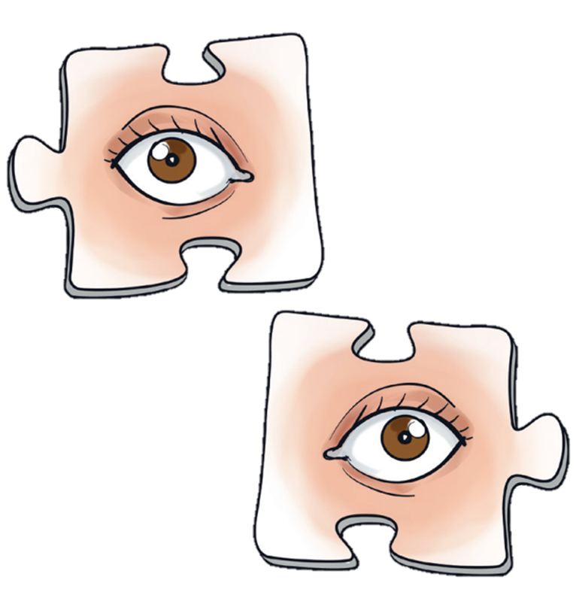
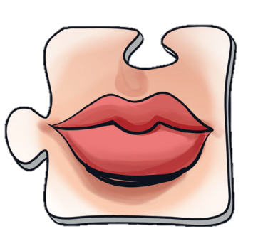
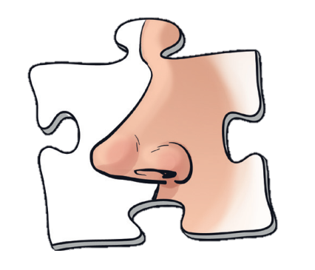
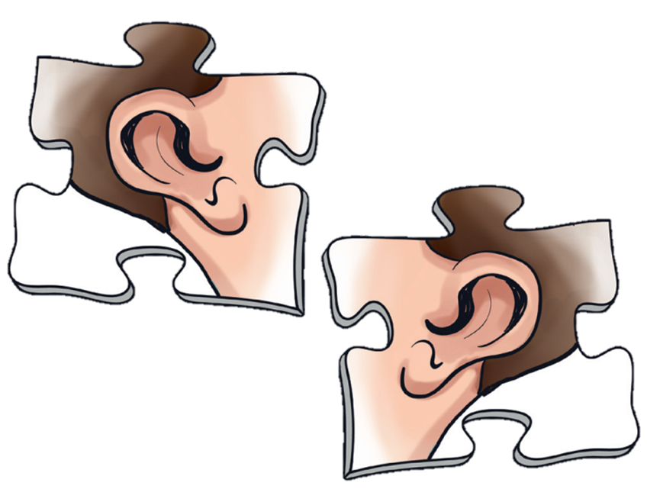
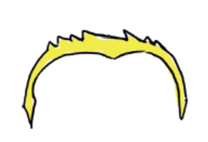
REVIEW: Body parts
hair
eyes
mouth
nose
ears
blond hair

Slide 13


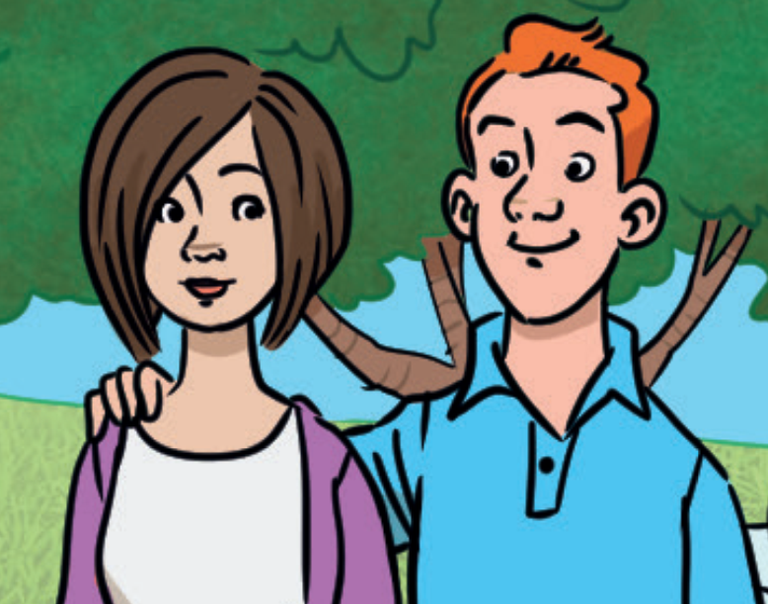




REVIEW: He’s got … / She’s got …
She’s got…
He’s got…
Tell me about your mom!
Tell me about your dad!
This is my mum.
She’s got black eyes.
This is my dad.
He’s got red hair.

Slide 14
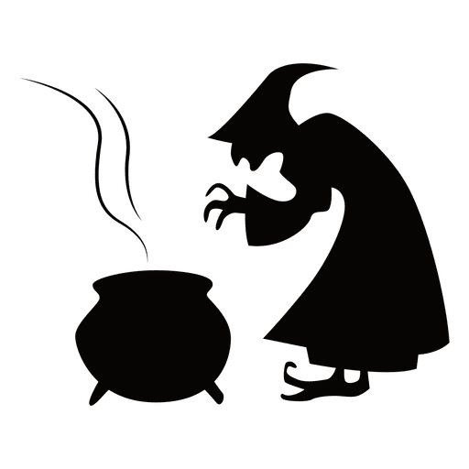


Slide 15
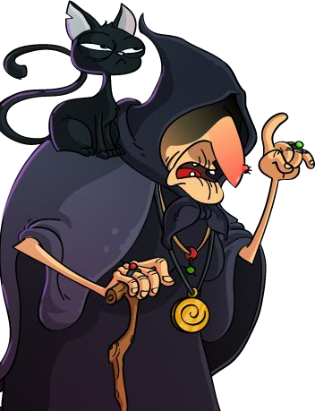
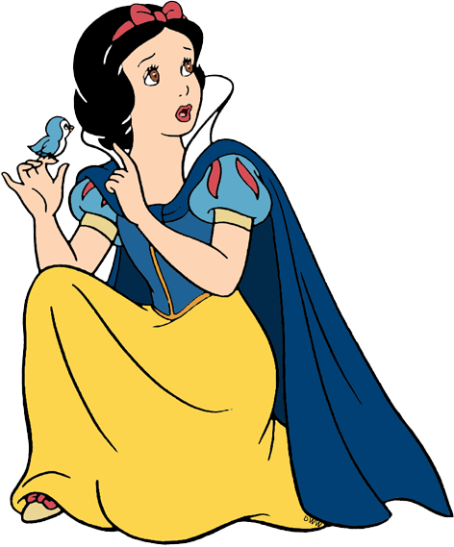

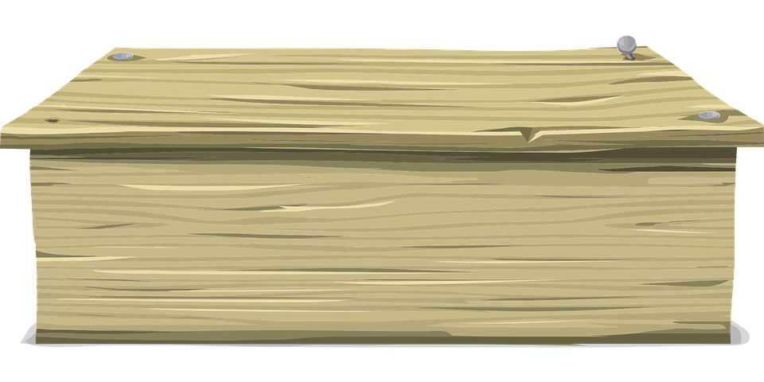
Rescue SNOW WHITE
RULES
All the students say aloud the sentence.
1 student answers by choosing 1 apple A or B.
1 correct answer = 1 point.
The whole class repeats the complete sentence.
A
B
PLAY

Slide 16
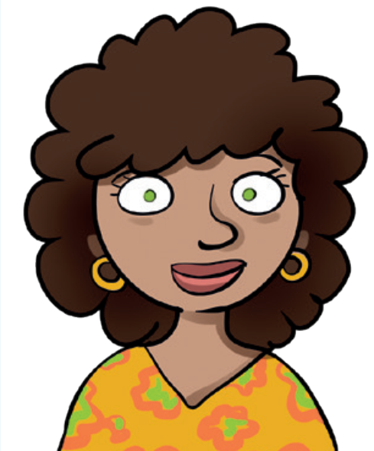
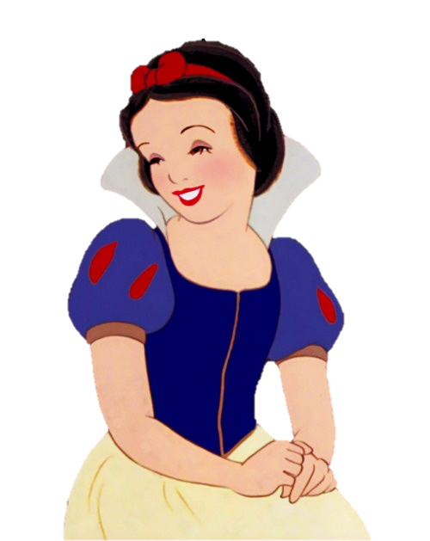
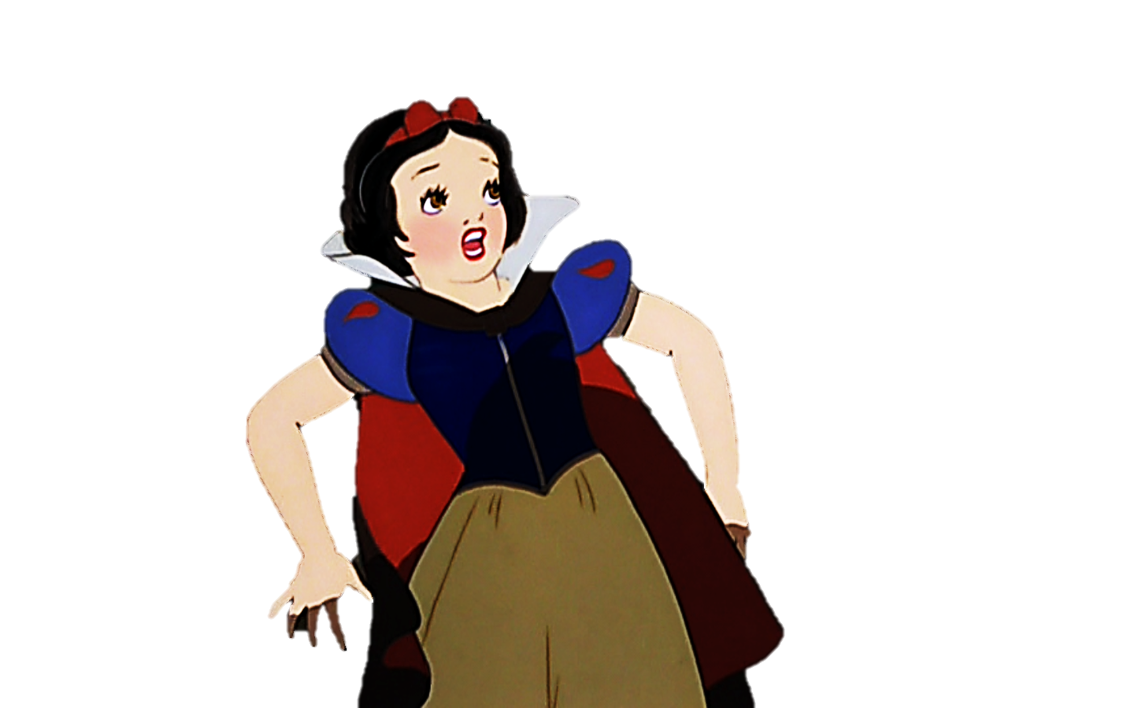
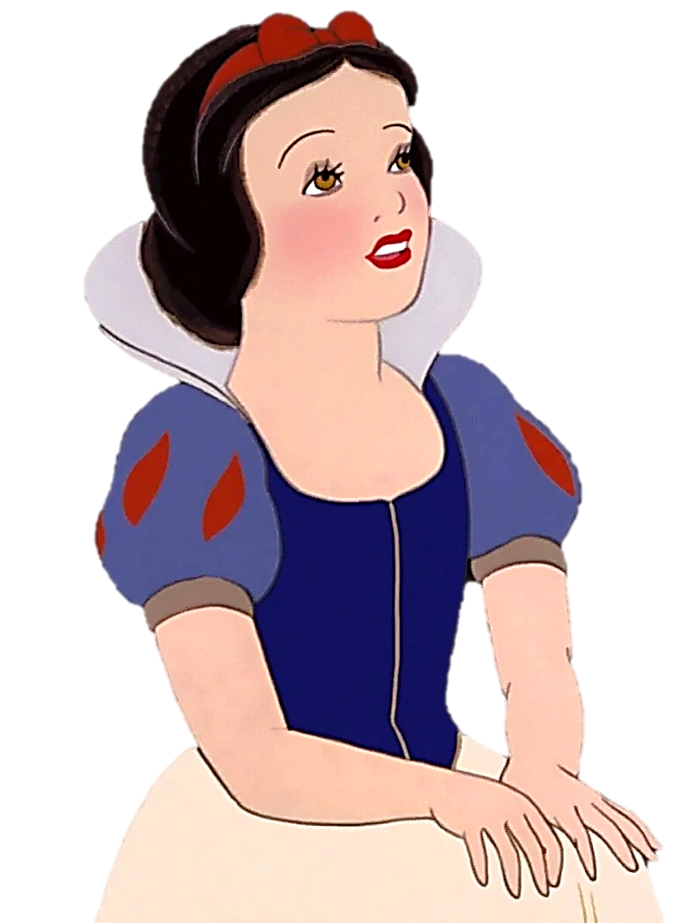
1. This is my mum.
She’s got ____________.
A. brown hair and big eyes
B. black hair and small eyes
A
B

Slide 17
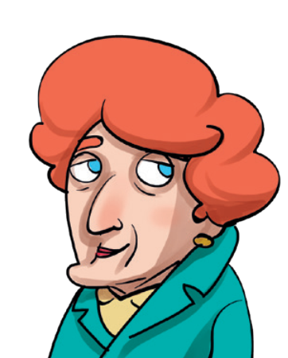
2. This is my granny.
She’s got ____________.
A. grey hair and a small nose
B. red hair and a big nose
A
B

Slide 18
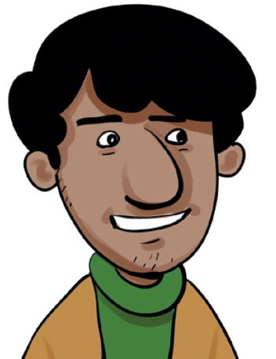
3. This is my cousin.
He’s got ____________.
A. a small nose and big ears
B. a big nose and small ears
A
B

Slide 19
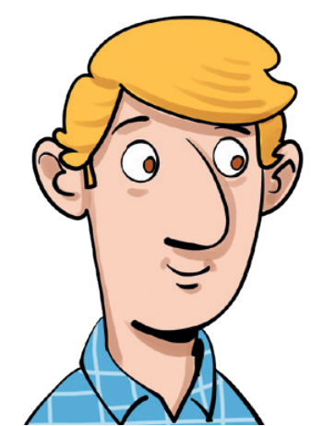
4. This is my dad.
He’s got ____________.
A. blond hair and big ears
B. long hair and a small nose
A
B

Slide 20
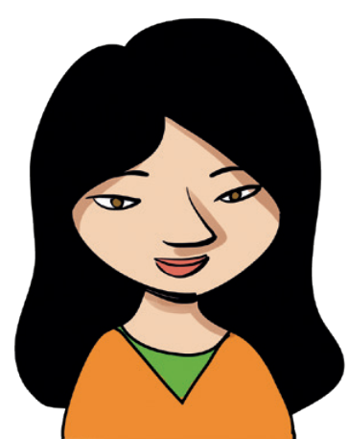
5. This is my aunt.
She’s got ____________.
A. long black hair
and a small mouth
B. long red hair
and a big mouth
A
B

Slide 21
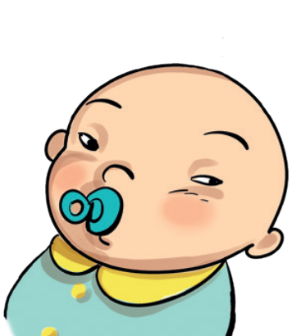
6. This is my baby cousin.
She’s got ____________.
A. small green eyes
and short hair
B. small black eyes
and no hair
A
B

Slide 22
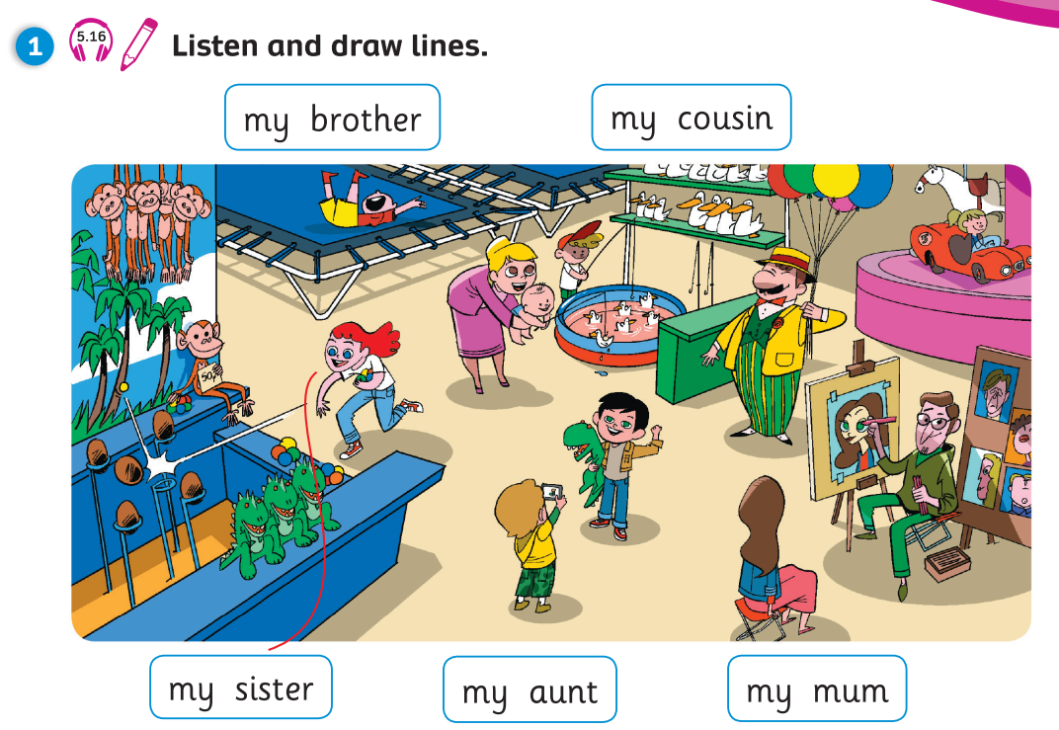
Pupils’ Book (p.64)
Answers
Click on “Answers” to show the answers

Slide 23
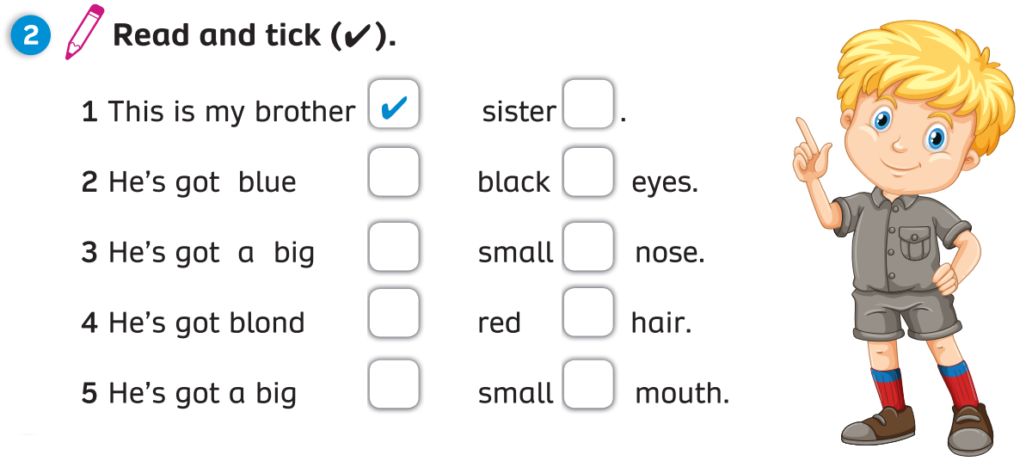

Pupils’ Book (p.64)
Answers
Click on “Answers” to show the answers

Slide 24
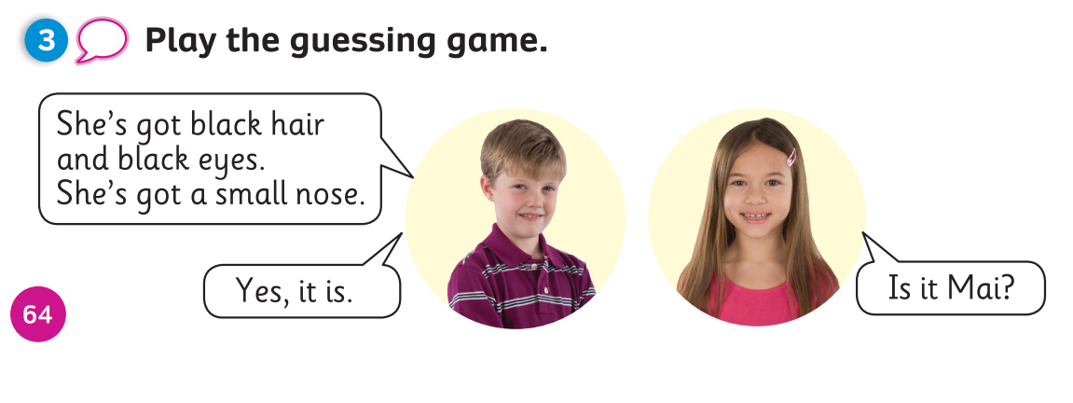
Pupils’ Book (p.64)
Notes:
Choose 1 student without the class knowing who is chosen. Describe him/her using sentences similar to Activity 2.
The class should guess who that student is by asking “Is it…?” and the teacher will answer either “Yes, it is.” or “No, it isn’t.”

Slide 25
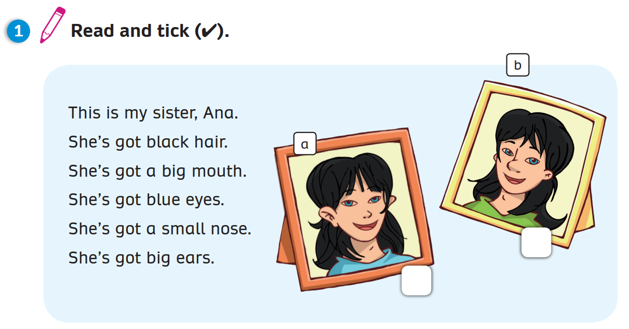
Activity Book (p.54)
Answers
Click on “Answers” to show the answers

Slide 26
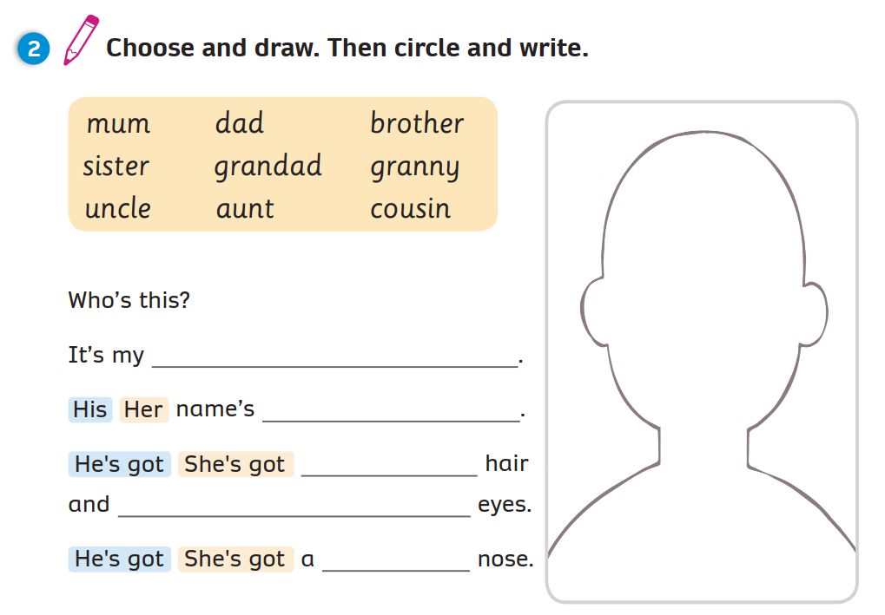
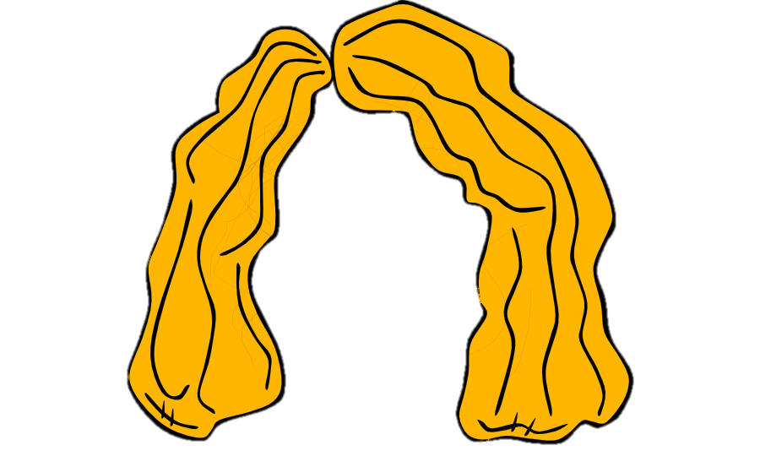

Activity Book (p.54)
Example
cousin
Pippi
blond
black
small
Click on “Example” to show the example

Slide 27



PRODUCTION
Draw a friend.
Write 5 sentences to
describe your friend.
This is my ________.
He’s got ____________,
__________ and __________.
friend
a big mouth
short hair
black eyes
Notes:
Give Ss instructions and show them an example.
Give each student a sheet of A4 paper or ask them to take out their notebook.
Tell them to draw a picture of a friend and write 3 body parts he/she has got. Then put Ss into pairs and have them tell their partner about their drawing.

Slide 28
WRAP-UP
hair
eyes
mouth
nose
ears
blond hair

Slide 29
WRAP-UP
She’s got…
He’s got…
Tell me about your mom!
Tell me about your dad!
This is my mum.
She’s got black eyes.
This is my dad.
He’s got red hair.

Slide 30


UNIT 5: Lesson 6
We’ve reviewed…

