Slide 1



PHÒNG GIÁO DỤC VÀ ĐÀO TẠO CẨM PHẢ
TRƯỜNG TIỂU HỌC THÁI BÌNH
PHÒNG GIÁO DỤC VÀ ĐÀO TẠO CẨM PHẢ
TRƯỜNG TIỂU HỌC THÁI BÌNH
UNIT 9: WHO’S AT HOME?
Lesson 9
Teacher : La Thi Huong

Slide 2
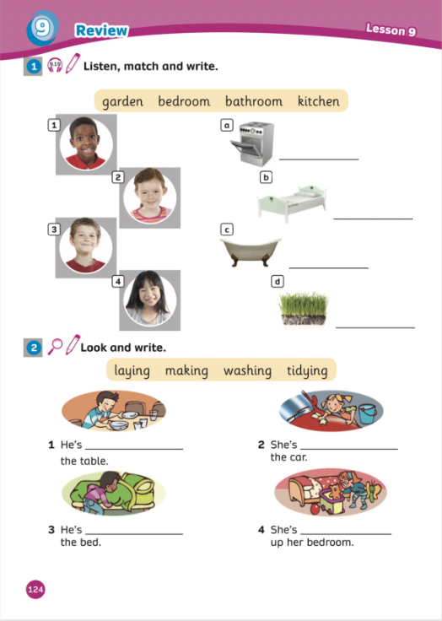
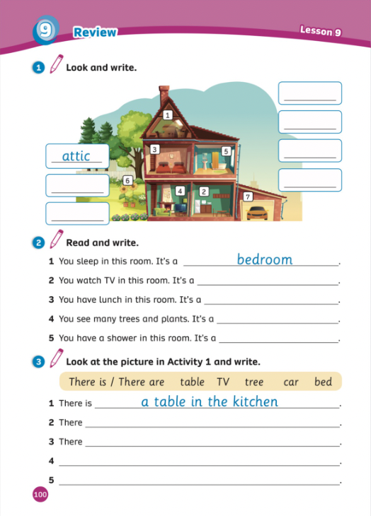
UNIT 9:WHO’S AT HOME?
We’re reviewing…
Home
- PB p.124
- AB p.100

Slide 3


Song: HOUSE HOUSE HOUSE
WARM-UP
All students stand up.
Listen to the song.
Dance along.

Slide 4

Review

Slide 5



Choose the correct answer.
What’s it?
garden
ask
house

Slide 6
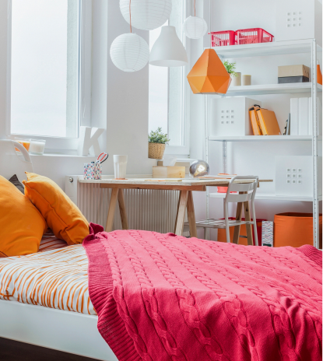
Choose the correct answer.
What’s it?
open
bedroom
kitchen

Slide 7
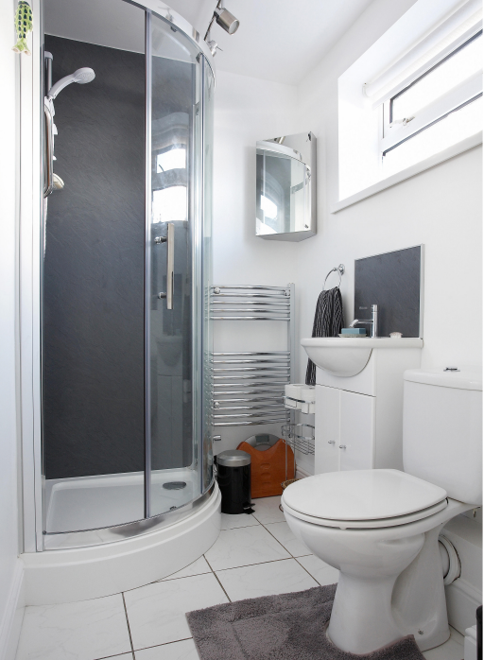
Choose the correct answer.
There is a ____.
sing
bathroom
attic

Slide 8
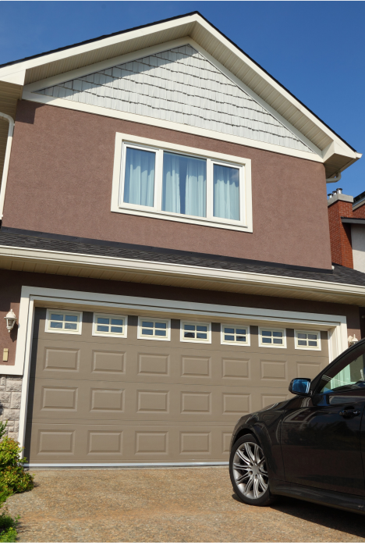
Choose the correct answer.
What’s it?
garden
attic
garage

Slide 9
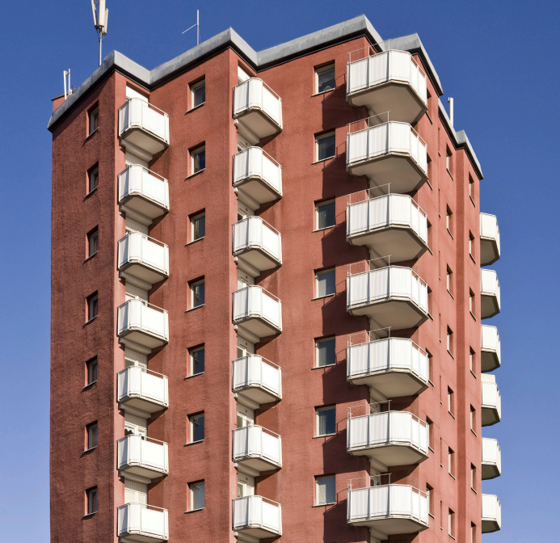
Choose the correct answer.
There are 20 rooms in the ____.
Living room
flat
kitchen

Slide 10
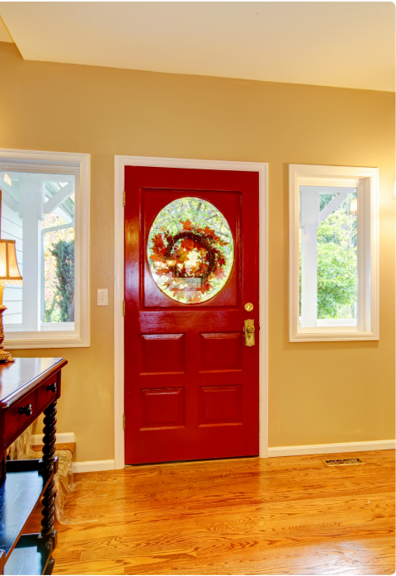
Choose the correct answer.
There is a ____.
house
hall
attic

Slide 11
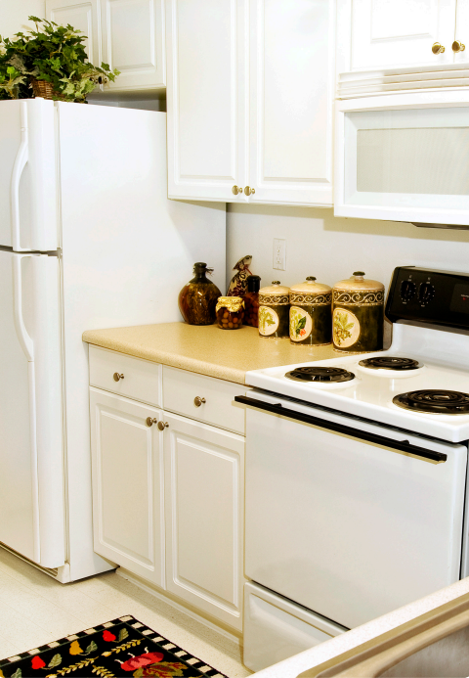
Choose the correct answer.
There are eggs in the __.
dining room
garden
kitchen

Slide 12
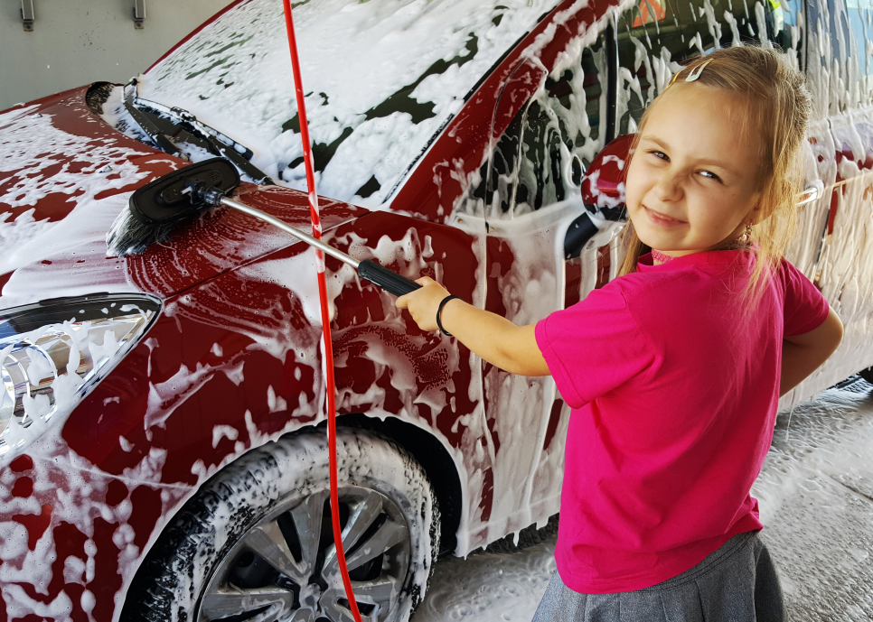
Choose the correct answer.
What’s she doing?
She’s washing the car
She’s tidying up.
She’s cleaning the floor

Slide 13
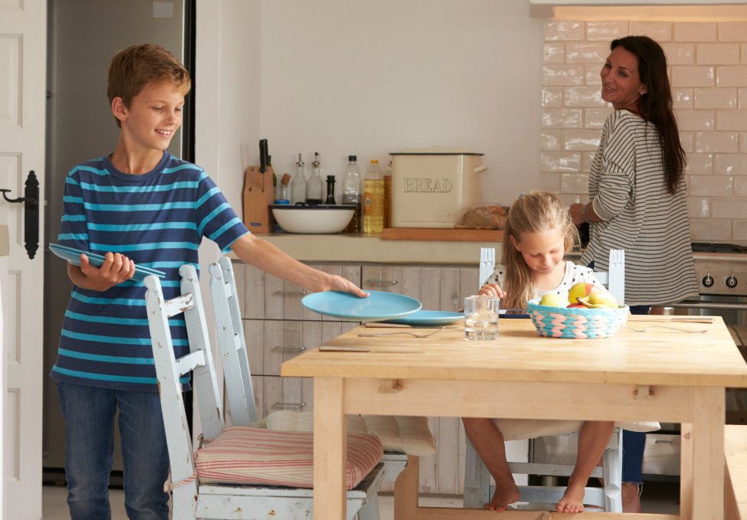
Choose the correct answer.
What’s he doing?
He’s laying the table.
He’s feeding the cat.
He’s making the bed.

Slide 14

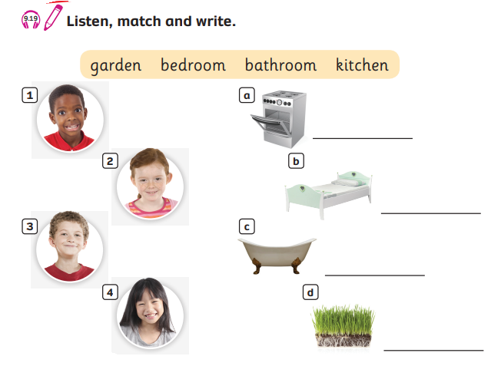
Pupils’ Book (p.124)
kitchen
bedroom
bathroom
garden

Slide 15
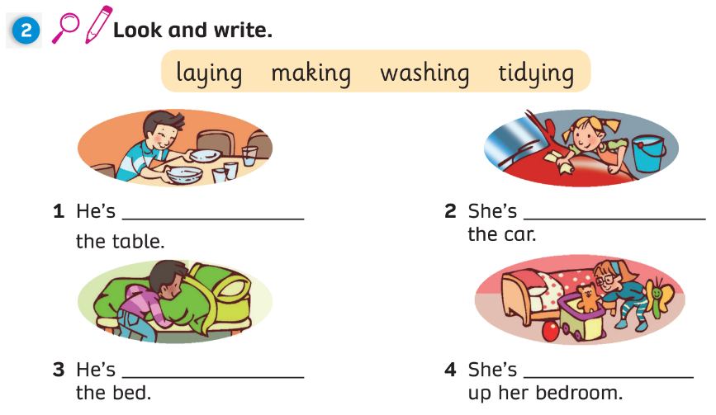
Pupils’ Book (p.124)
laying
washing
making
tidying

Slide 16
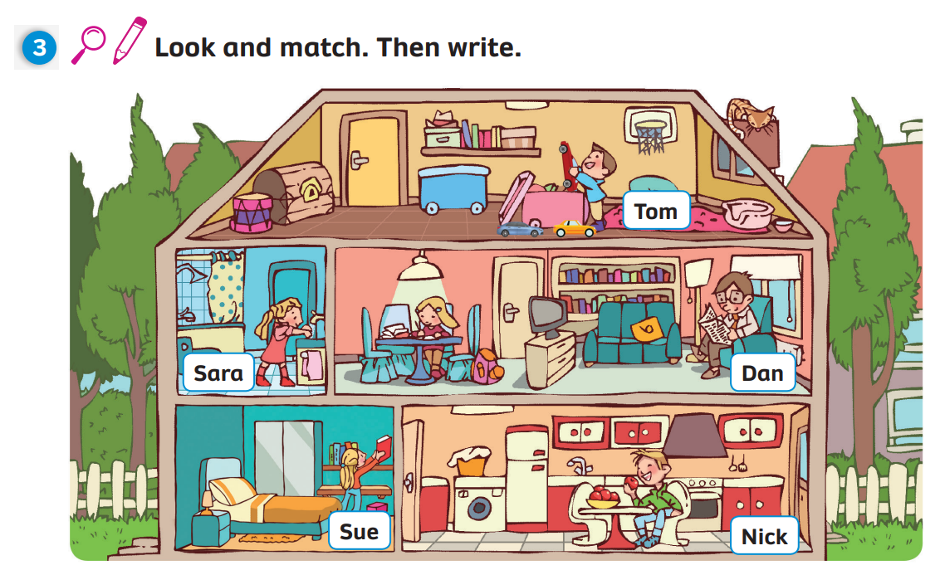
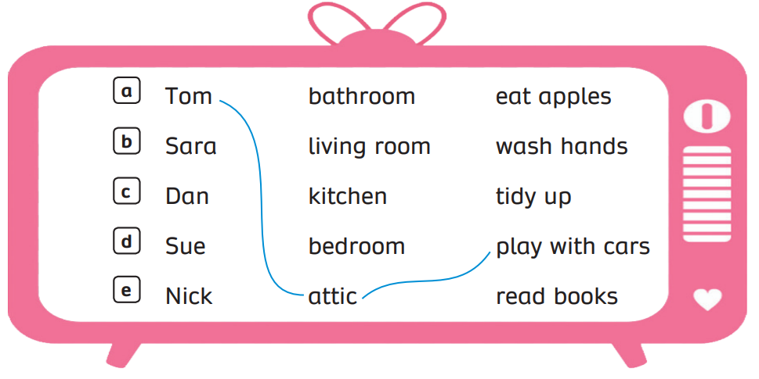
Pupils’ Book (p.125)

Slide 17
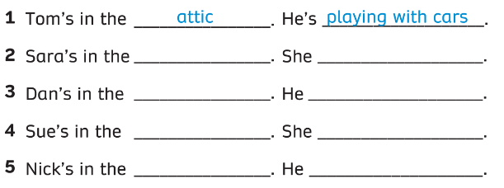
Pupils’ Book (p.125)
bathroom
‘s washing hands
living room
‘s reading books
bedroom
‘s tidying up
kitchen
‘s eating apples

Slide 18
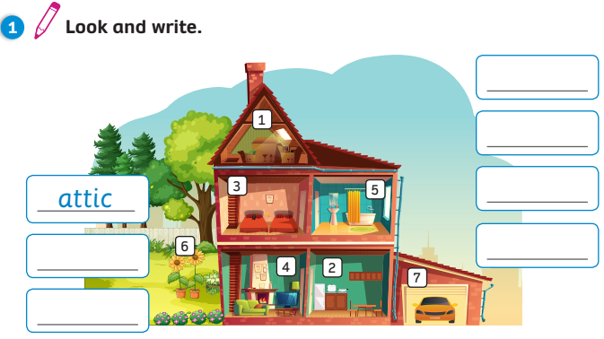
Activity Book (p.100)
living room
bathroom
garden
garage
hall
bedroom

Slide 19
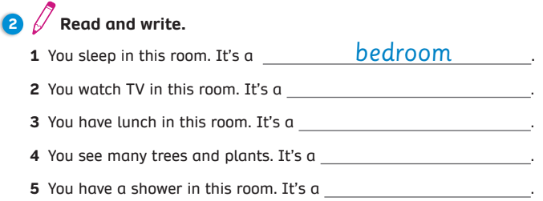
Activity Book (p.100)
living room
dining room
garden
bathroom

Slide 20
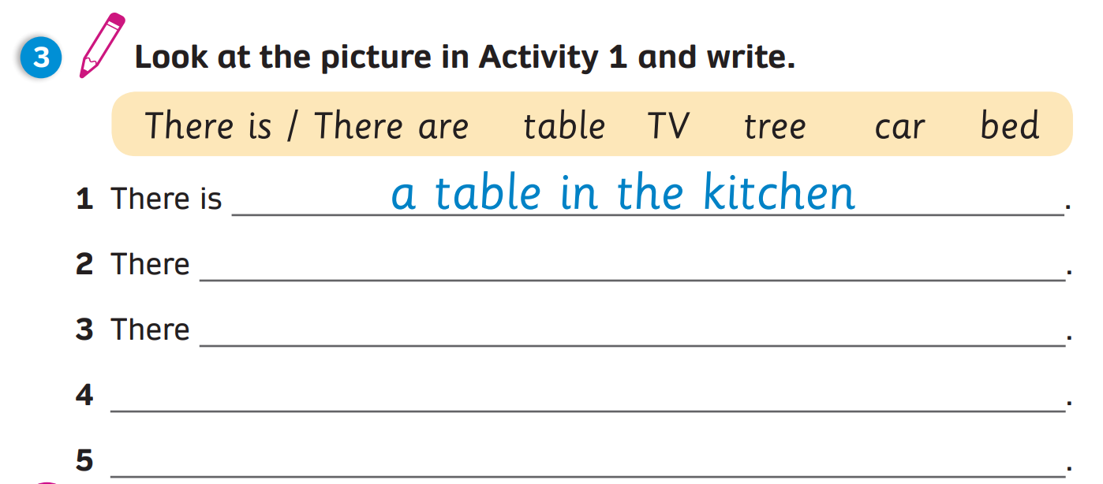
Activity Book (p.100)
is a TV in the living room
is a tree in the garden
There is a car in the garage
There are two beds in the bedroom

Slide 21
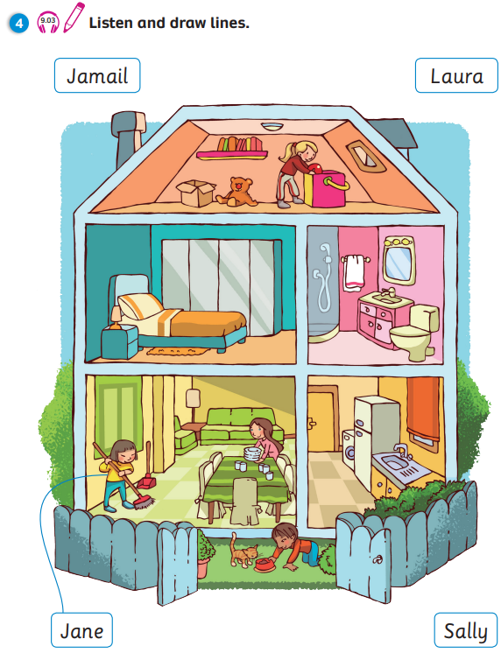
Activity Book (p.101)

Slide 22


UNIT 9: Lesson 9
We’ve reviewed…
Unit’s vocabulary and grammar

