Slide 1



PHÒNG GIÁO DỤC VÀ ĐÀO TẠO CẨM PHẢ
TRƯỜNG TIỂU HỌC THÁI BÌNH
PHÒNG GIÁO DỤC VÀ ĐÀO TẠO CẨM PHẢ
TRƯỜNG TIỂU HỌC THÁI BÌNH
UNIT 9: WHO’S AT HOME?
Lesson 5B
Teacher : La Thi Huong

Slide 2
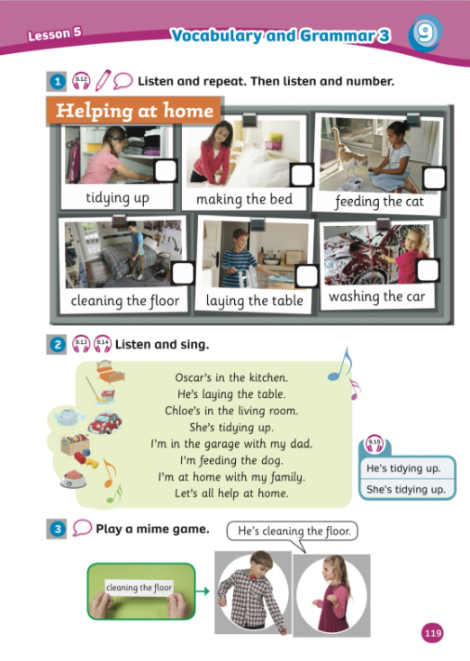
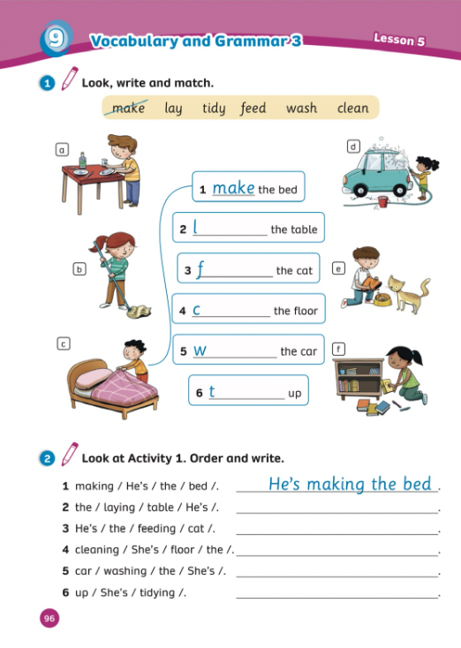
UNIT 9:WHO’S AT HOME?
We’re reviewing…
- Home
- PB p.119
- AB p.96

Slide 3


Song: Chores for kids
WARM-UP
All students stand up.
Listen to the song.
Dance along.

Slide 4
CHECK UP

Slide 5

START
JERRY’S CHORES
CHECK
Click to see the answer.
Click to see the chores.
What is he/she doing?

Slide 6

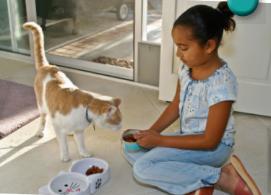
CHECK
What is she doing?
She’s feeding the cat.

Slide 7
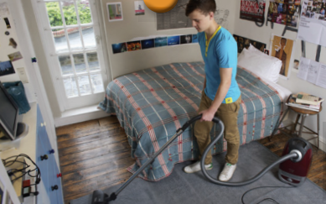
CHECK
What is he doing?
He’s cleaning the floor.

Slide 8

CHECK
What is she doing?
She’s making the bed.

Slide 9
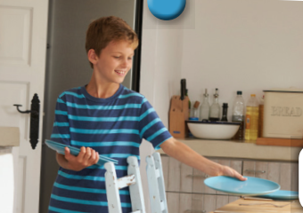
CHECK
What is he doing?
He’s laying the table.

Slide 10
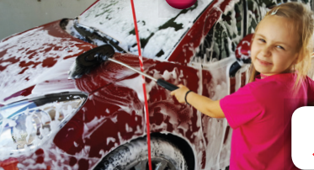
CHECK
What is she doing?
She’s washing the car.

Slide 11

CHECK
What is she doing?
She’s tidying up.

Slide 12
GRAMMAR

Slide 13
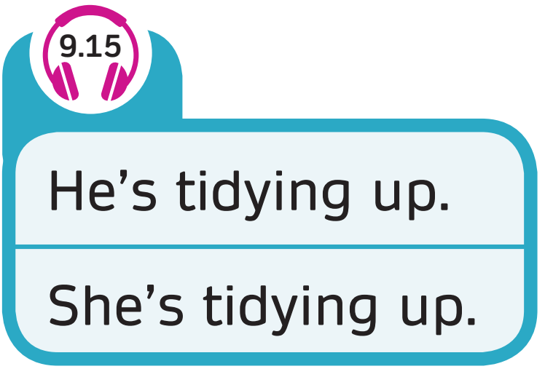

GRAMMAR

Slide 14
GAME TIME

Slide 15





Slide 16



What’s she doing?
ANSWER

Slide 17

She’s making the bed.

Slide 18

What’s he doing?
ANSWER

Slide 19
He’s laying the table.

Slide 20

What’s she doing?
ANSWER
Notes:
BÀI GIẢNG PPT SMART START 3
Author: Thao Nguyen
Điện thoại: 0905917335
Zalo: 0905917335
Fb: https://www.facebook.com/dn.thaonguyen/
Group chia sẻ tài liệu: https://www.facebook.com/groups/220848385841356
******Liên hệ chính chủ để được hỗ trợ nếu bài bị lỗi.

Slide 21
She’s cleaning the floor.

Slide 22

What’s he doing?
ANSWER

Slide 23
He’s playing yoyo.

Slide 24

What’s she doing?
ANSWER

Slide 25
She’s feeding the cat.

Slide 26
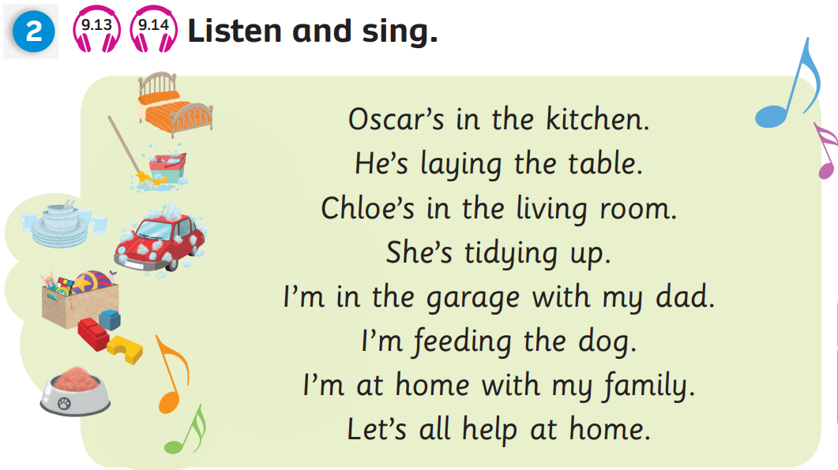
Pupils’ Book (p.119)

Slide 27
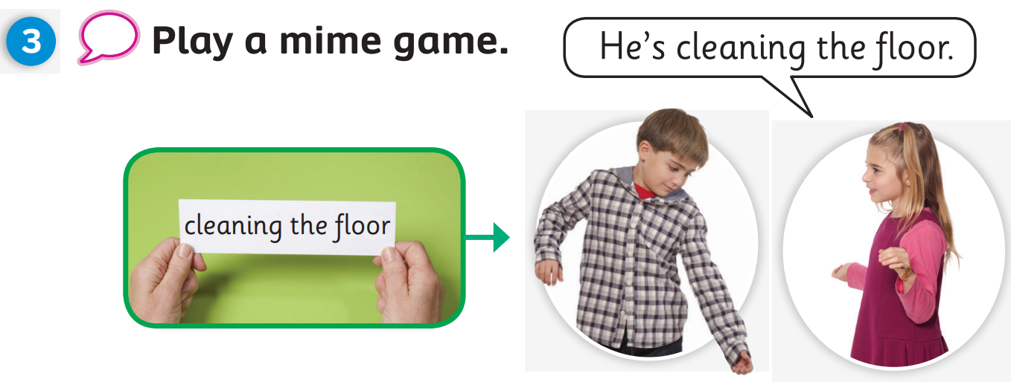
Pupils’ Book (p.119)

Slide 28
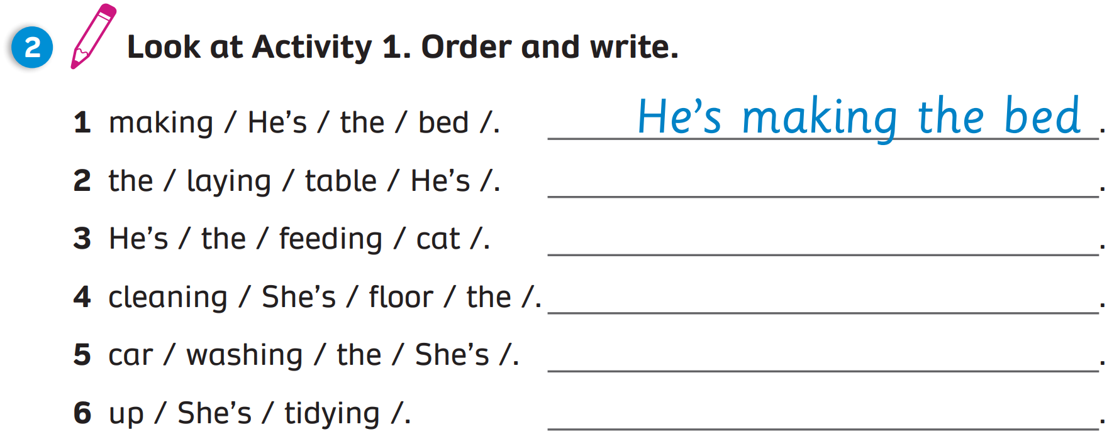
Activity Book (p.96)
He’s laying the table
He’s feeding the cat
She’s cleaning the floor
She’s washing the car
She’s tidying up

Slide 29

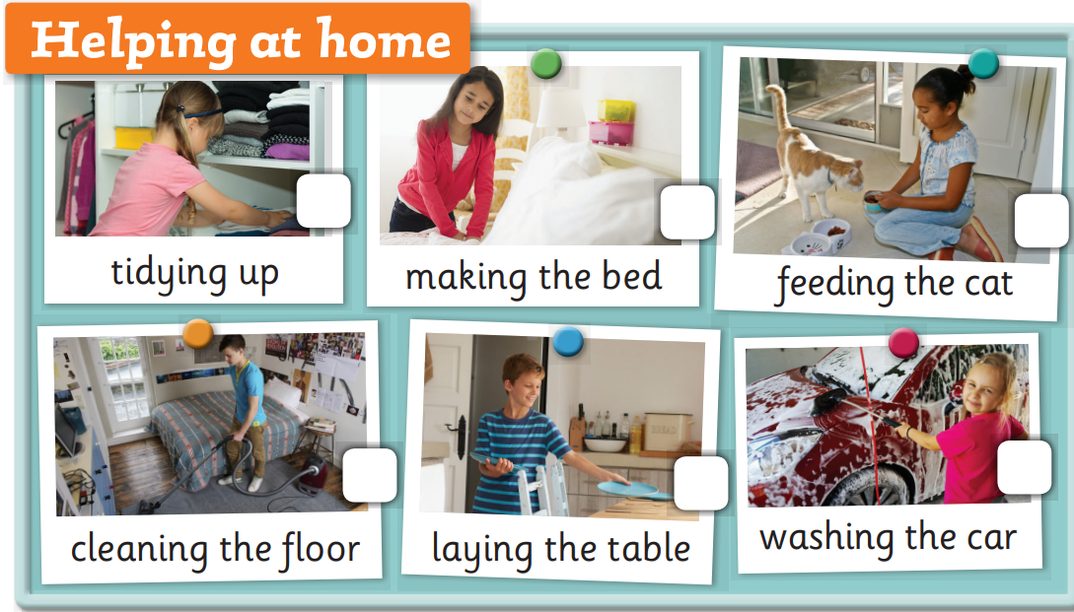

UNIT 9: Lesson 5
We’ve reviewed…

