Slide 1



PHÒNG GIÁO DỤC VÀ ĐÀO TẠO CẨM PHẢ
TRƯỜNG TIỂU HỌC THÁI BÌNH
PHÒNG GIÁO DỤC VÀ ĐÀO TẠO CẨM PHẢ
TRƯỜNG TIỂU HỌC THÁI BÌNH
UNIT 9: WHO’S AT HOME?
Lesson 1A
Teacher : La Thi Huong

Slide 2
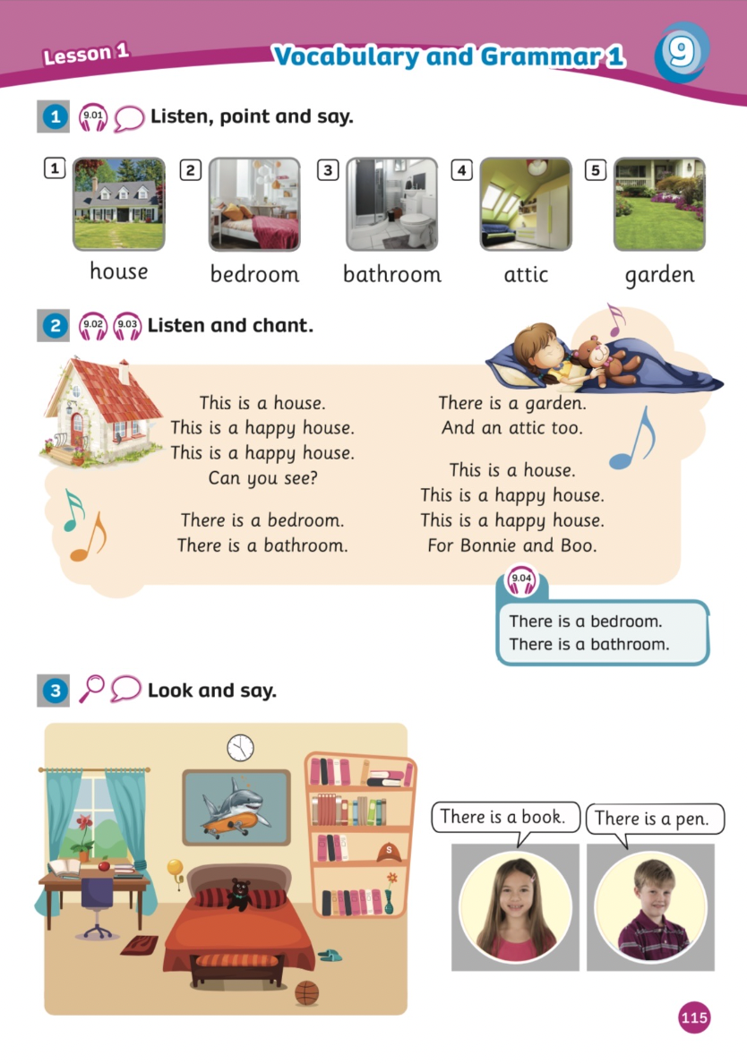
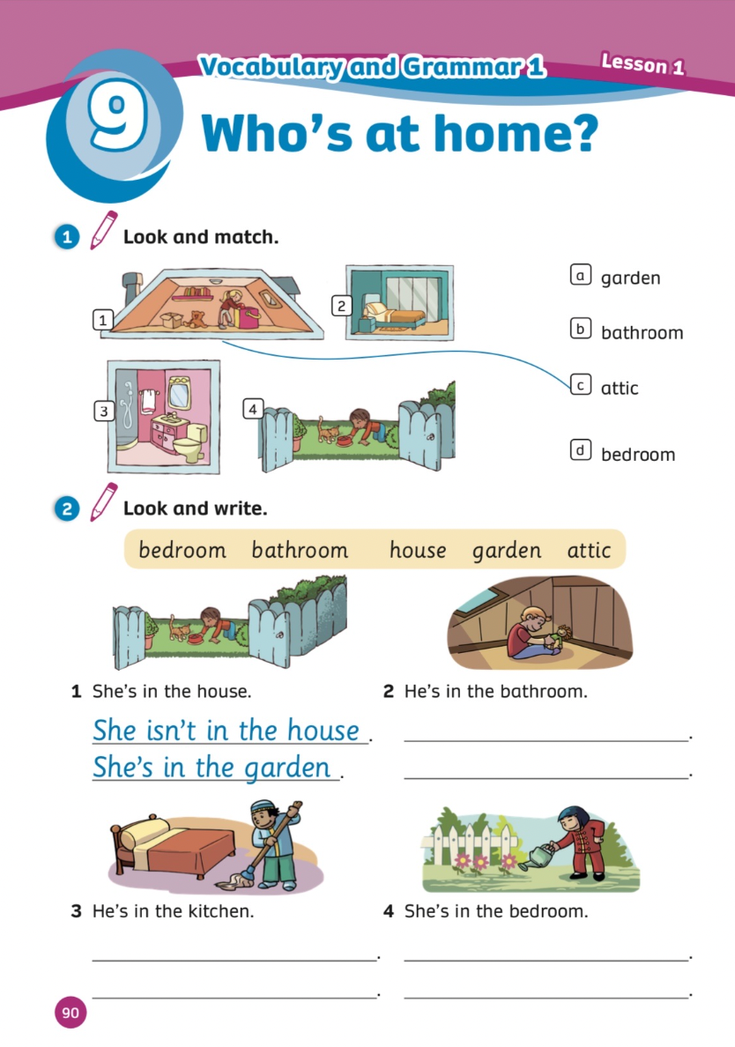
UNIT 9:WHO’S AT HOME?
We’re learning…
- Home
- PB p 115
- AB p.80

Slide 3

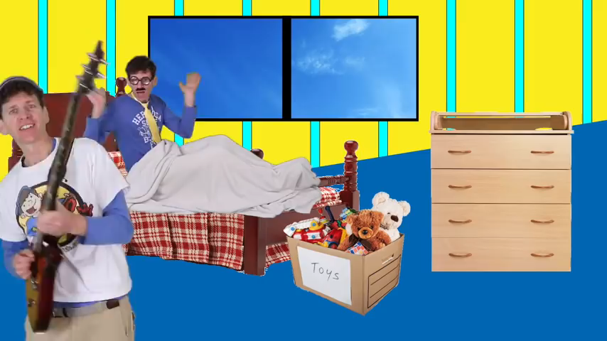
Song: Rooms of the house
WARM-UP
All students stand up.
Listen to the song.
Dance along.

Slide 4
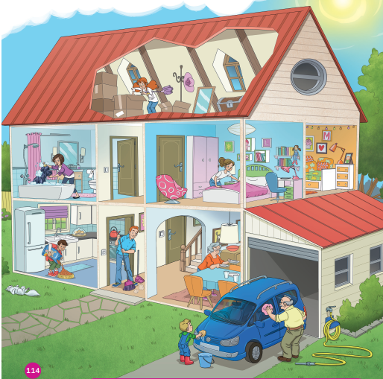
Pupils’ Book (p.114)
Look at the picture and answer the questions
1) Is this a house?
2) How many rooms are there?

Slide 5
Pupils’ Book (p.114)
Is this a house?
Yes, it is.
2) How many rooms are there?
There are 7 rooms.

Slide 6

Vocabulary

Slide 7

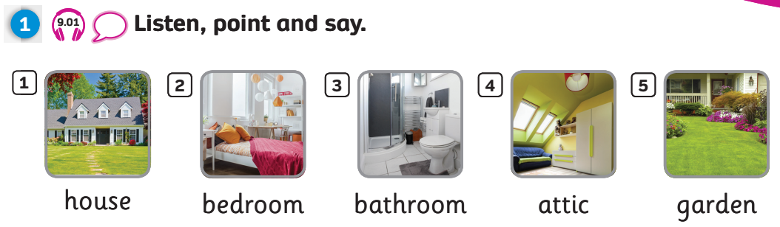
Pupils’ Book (p115)

Slide 8
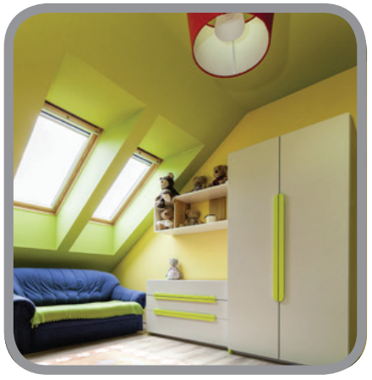
attic
Notes:
Click on the audio to listen to the sound.

Slide 9
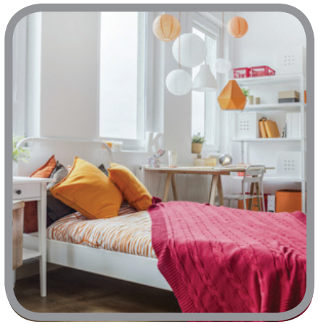
bedroom
Notes:
Click on the audio to listen to the sound.

Slide 10

house
Notes:
Click on the audio to listen to the sound.

Slide 11
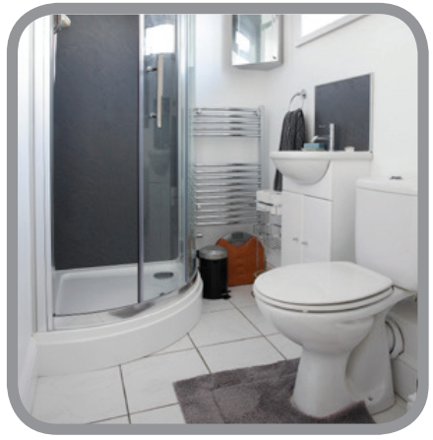
bathroom
Notes:
Click on the audio to listen to the sound.

Slide 12
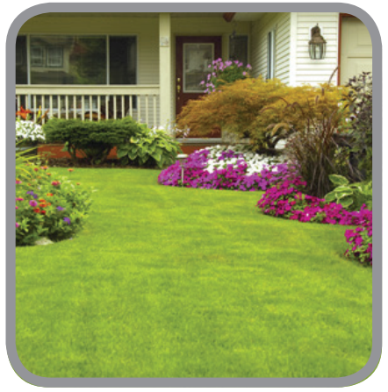
garden
Notes:
Click on the audio to listen to the sound.

Slide 13

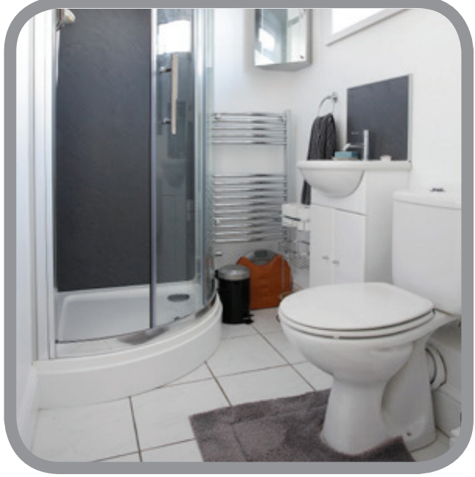
house
attic
bedroom
bathroom
garden

Slide 14
Check your memory
?

Slide 15



bedroom
bathroom
living room

Slide 16
kitchen
garden
house

Slide 17
bedroom
garden
attic

Slide 18
garden
bedroom
bathroom

Slide 19
garden
bathroom
bedroom

Slide 20


Slide 21
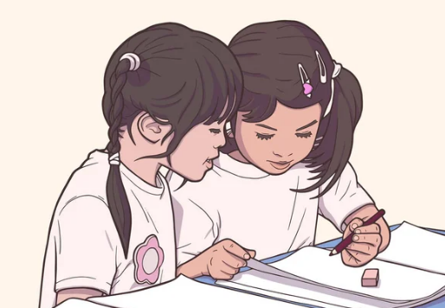


Slide 22
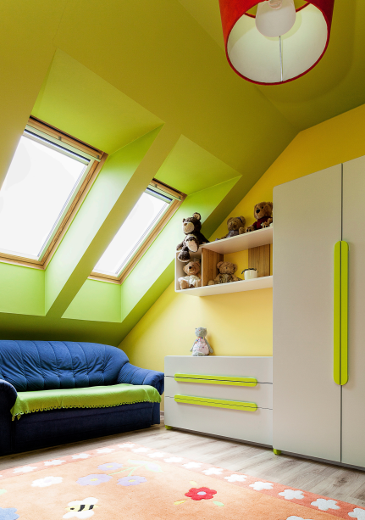

What is it?
It’s the attic.

Slide 23
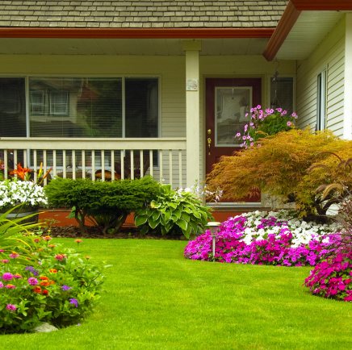
What is it?
It’s the garden.

Slide 24

It’s the house.
What is it?

Slide 25
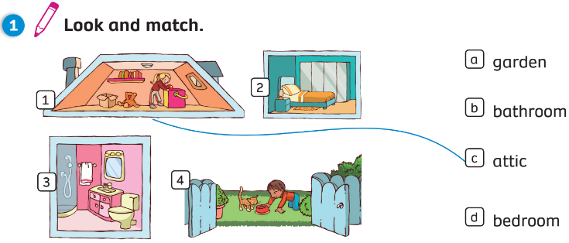
Further practice: Activity Book (p.90)

Slide 26





Wrap - up
attic
bedroom
house
bathroom
garden

Slide 27
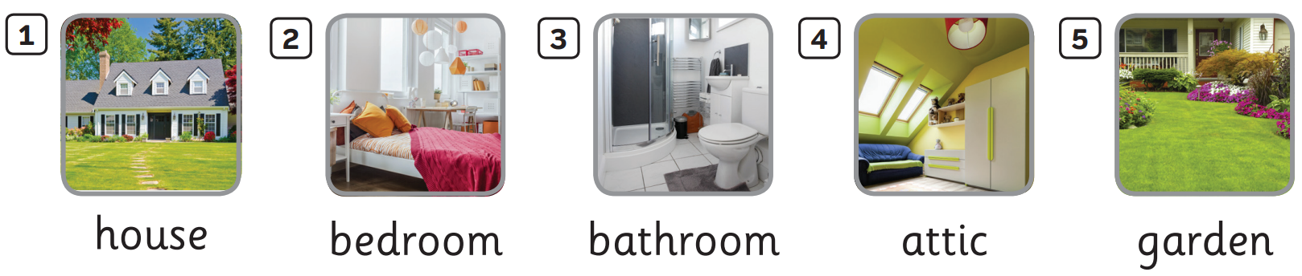

UNIT 9: Lesson 1A
We’ve learnt…

