Slide 1



PHÒNG GIÁO DỤC VÀ ĐÀO TẠO CẨM PHẢ
TRƯỜNG TIỂU HỌC THÁI BÌNH
PHÒNG GIÁO DỤC VÀ ĐÀO TẠO CẨM PHẢ
TRƯỜNG TIỂU HỌC THÁI BÌNH
UNIT 5: MEET MY FAMILY
Lesson 1A
Teacher : La Thi Huong

Slide 2
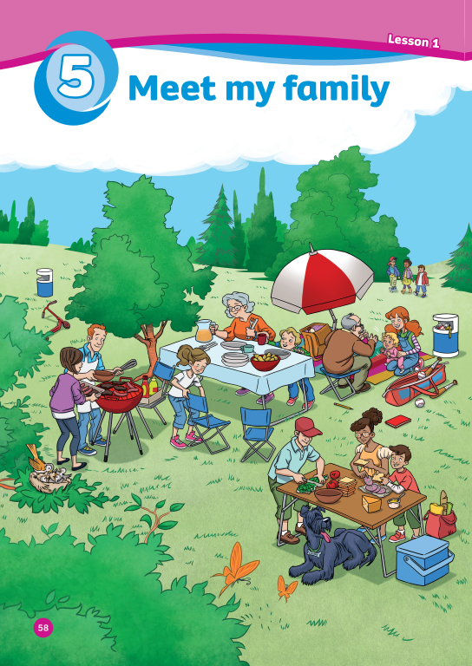
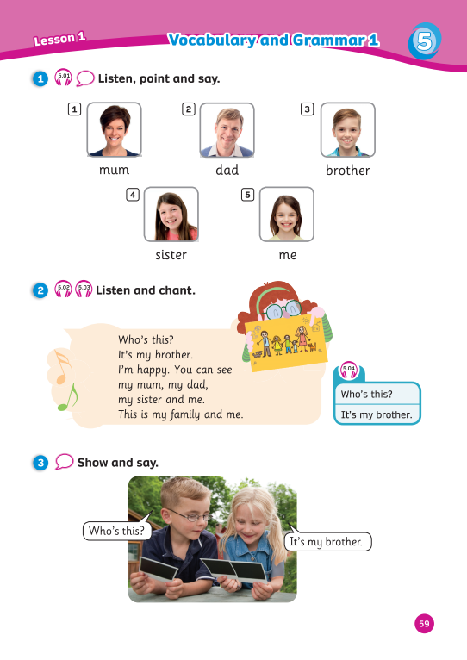
UNIT 5:
MEET MY FAMILY
We’re learning…
- family members
- to ask and answer about family members
- SB p.58 – 59
- AB p.48

Slide 3


Song: Finger Family Song
WARM-UP
All students stand up.
Listen to the song.
Dance along.

Slide 4
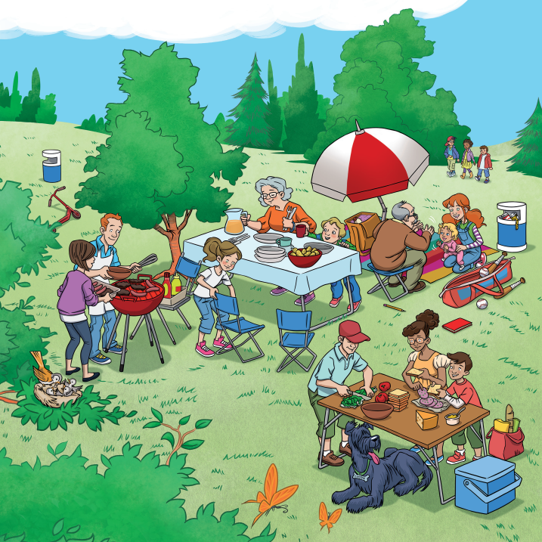
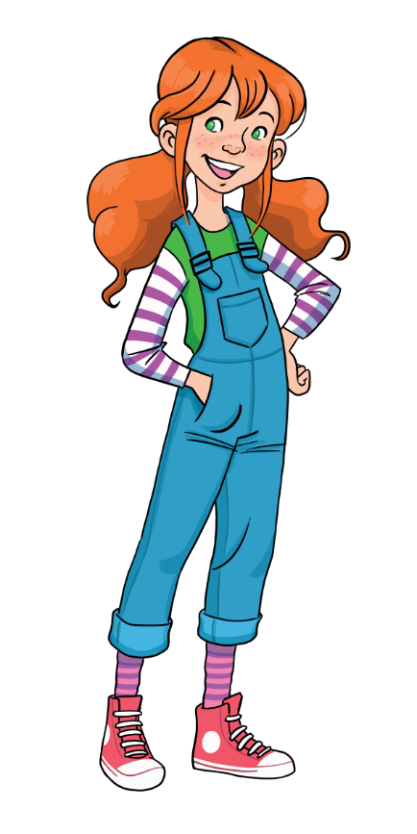
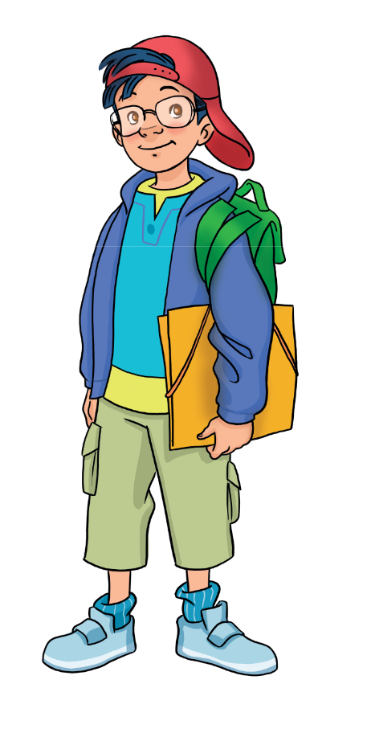
LEAD-IN
Where’s Einstein?
How many chairs?
Name the items you know.
Notes:
Ask Ss to look at the picture and locate/name the items they’ve learnt in the previous lessons (e.g. chair, table, bag, pencil, book, scooter, ball)
Ask Ss to look at the picture and locate “a book, a teddy and crayons.”
Place Ss in pairs. Tell them that they have 1 minute to answer the following questions:
+ Where’s Einstein?
+ How many chairs can you see?

Slide 5

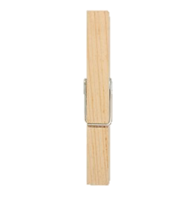



VOCABURALY: Family members
Who’s this?
This is my …
mum
Let’s spell!
m
u
m

Slide 6

VOCABURALY: Family members
Who’s this?
This is my …
dad
Let’s spell!
d
a
d

Slide 7
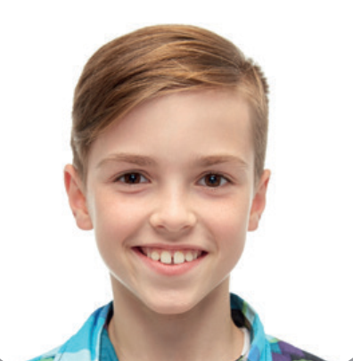
VOCABURALY: Family members
Who’s this?
This is my …
brother
Let’s spell!
b
r
o
t
h
e
r

Slide 8

VOCABURALY: Family members
Who’s this?
This is my …
sister
Let’s spell!
s
i
s
t
e
r

Slide 9


VOCABURALY: Family members
Who’s this?
This is …
me
Let’s spell!
m
e

Slide 10



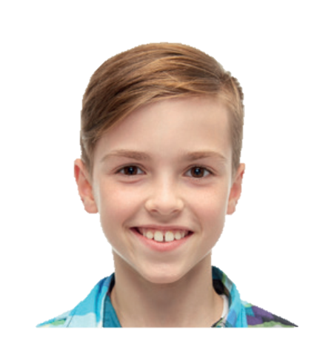

VOCABURALY: Family members
This is me!
This is my …
mum
dad
Who’s this?
sister
brother
me

Slide 11

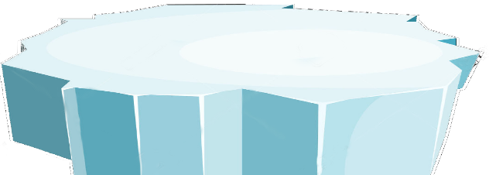



The little penguins
RULES
Students ask “Who’s this?”
Look at the picture and answer
1 correct answer = 2 points
PLAY

Slide 12
Who’s this?
SURFING
NEXT
STOP
This is me.

Slide 13
Who’s this?
SURFING
NEXT
STOP
This is my dad.

Slide 14
Who’s this?
SURFING
NEXT
STOP
This is my brother.

Slide 15
Who’s this?
SURFING
NEXT
STOP
This is my mum.

Slide 16
Who’s this?
SURFING
NEXT
STOP
This is my sister.

Slide 17
Game over!
EXIT

Slide 18


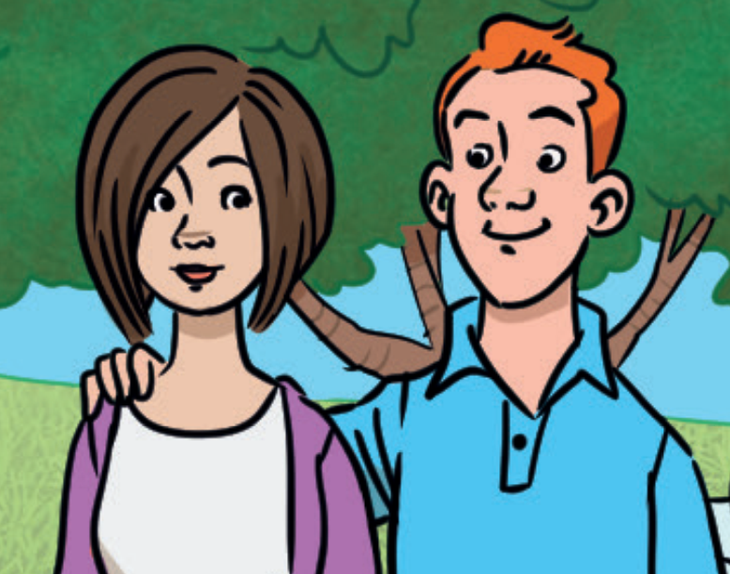


GRAMMAR: It’s my…
Who’s this?
It’s my mum.
And who’s this?
It’s my dad.
Notes:
Introduce to Ss that they are going to learn about how to introduce family members. Set the scene:
Remind Ss of Sam and Marie. Sam is at Marie house and he sees a photo of 2 people. Sam asks Marie about the 2 people in the photo.
Show the speech bubbles and have Ss say aloud.
Direct Ss’ attention to the structures used to ask about family members “Who’s this? – It’s my …”.

Slide 19
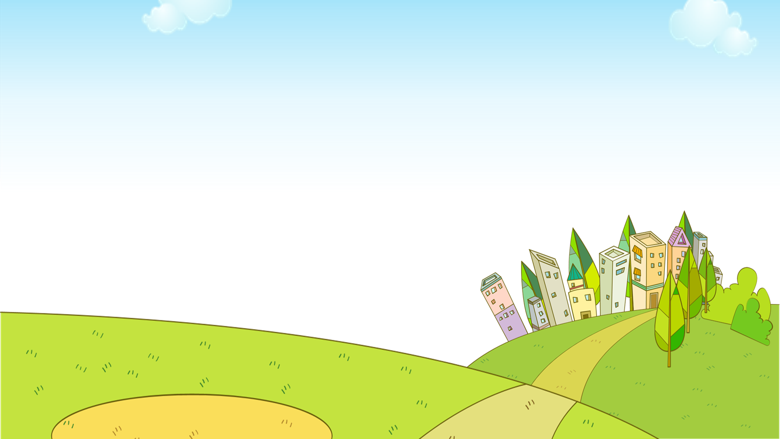

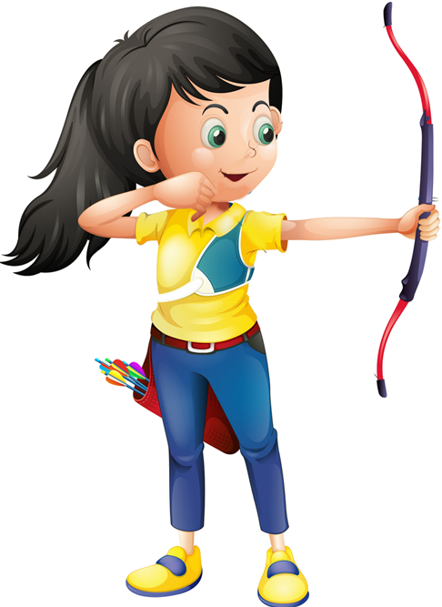





Slide 20
RULES
All students read the question and one student answers.
Students choose the correct answer by showing fingers.
1 correct answer = 1 point.
The whole class then says aloud the correct answer.

Slide 21




Who’s this?
It’s my sister.
It’s my brother.

Slide 22
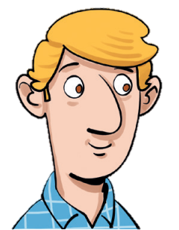
Who’s this?
It’s my mum.
It’s my dad.

Slide 23

Who’s this?
It’s my sister.
It’s my brother.

Slide 24

Who’s this?
It’s my mum.
It’s my dad.

Slide 25
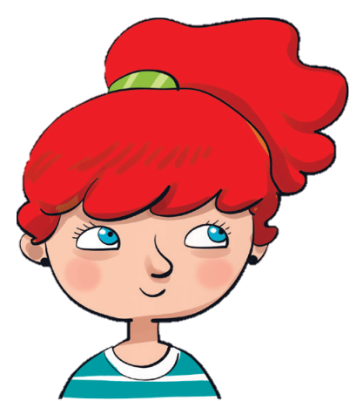
Who’s this?
It’s my me.
It’s me.

Slide 26

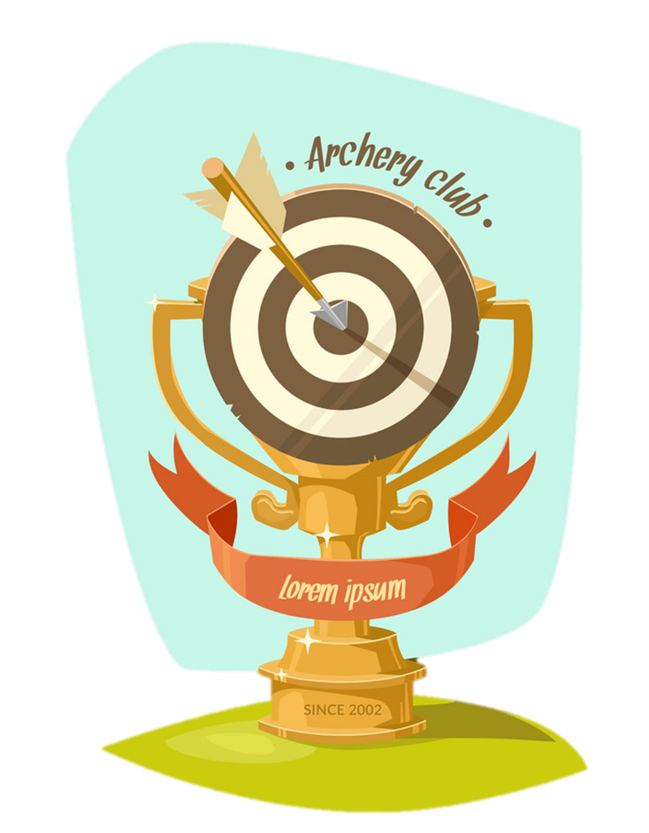
EXIT

Slide 27

Pupil’s Book (p.58)
Can you see …?
mum
dad
brother
sister
me
Notes:
Ask Ss to look at the poster, show the family members and ask them to find similar images in the poster
Circle the family members in the poster.
Point to the family members in the poster and say the words aloud.

Slide 28
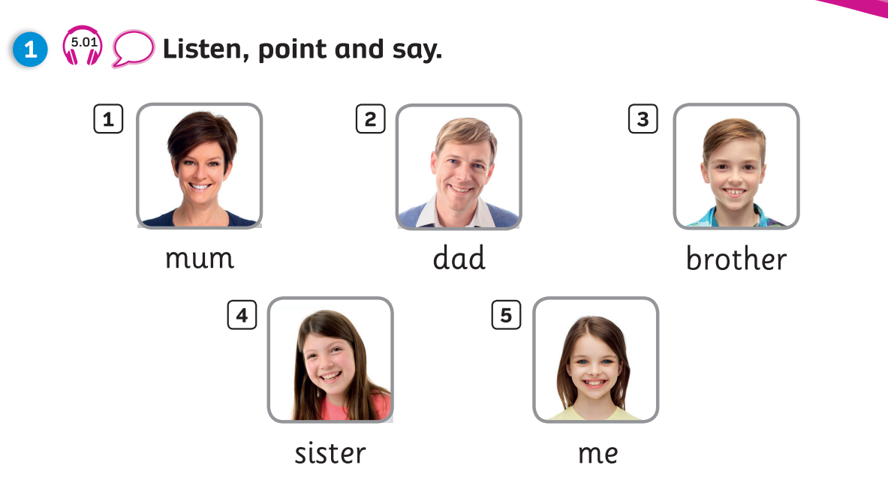
Pupils’ Book (p.33)

Slide 29
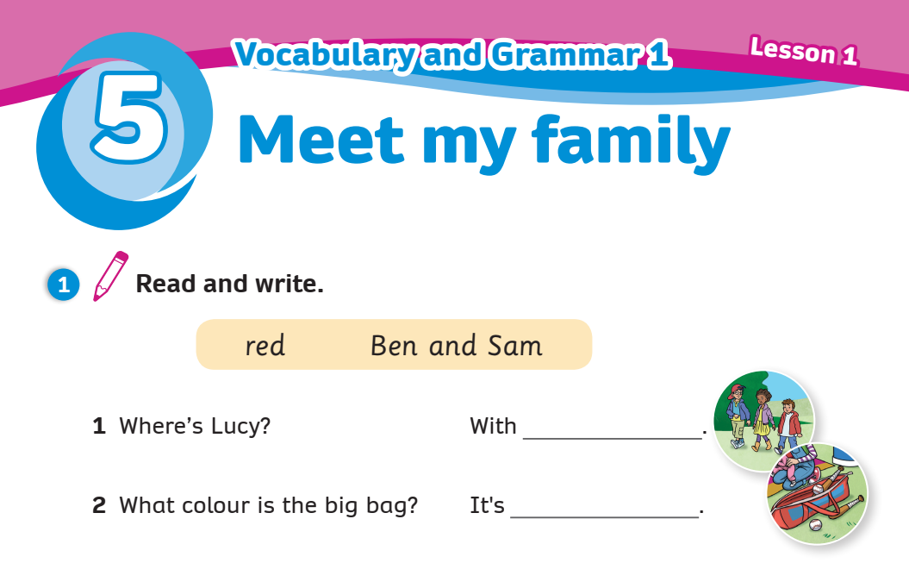
Activity Book (p.48)
Write
Ben and Sam
red
Click on “Write” to show the answers

Slide 30
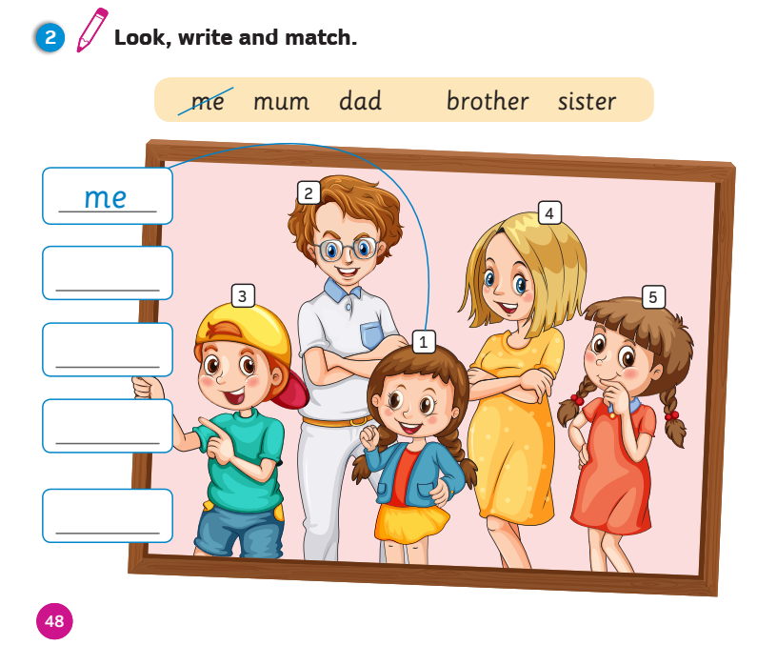
Activity Book (p.28)
Write
Match
dad
brother
mum
sister
Click on “Write, Match” to show the answers

Slide 31
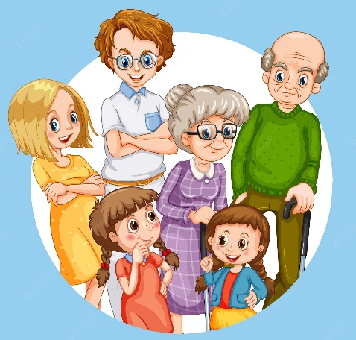
PRODUCTION
me
INSTRUCTIONS
Sit in groups of 5.
Get the 5 word cards (mum, dad, brother, sister, me) from the teacher.
Each student picks up a word card and spell the word. Other students need to say that word aloud.
Continue until there are no word cards left.
Shuffle the word cards and play again.
dad
sister
mum
brother
Notes:
Have Ss sit in small groups (4-5 Ss per group depending on the class size)
Give each group 5 pieces of paper which contain vocabulary for today’s lesson.
Give instructions: In small groups, each student chooses a word randomly and spells it and other students need to say that word aloud.

Slide 32
REVIEW: Family members
This is my …
This is me!
mum
dad
Who’s this?
sister
brother
me

Slide 33
GRAMMAR: It’s my…
Who’s this?
It’s my mum.
And who’s this?
It’s my dad.

Slide 34
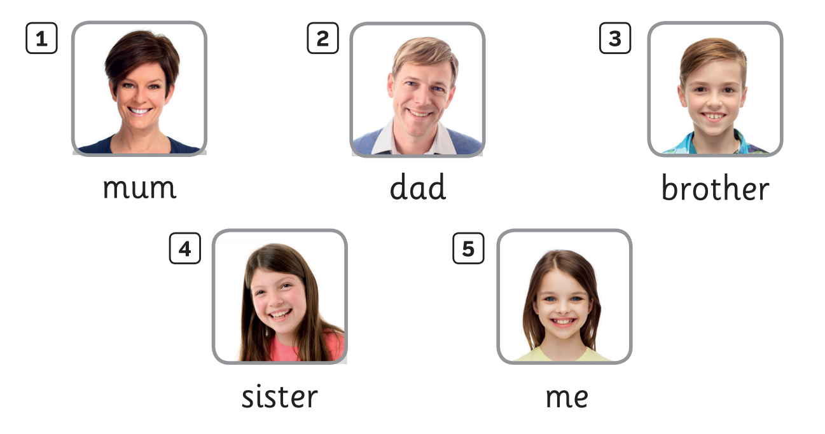

UNIT 5: Lesson 1A
We’ve learnt…

