Slide 1


Slide 2




Unit
10
ENERGY SOURCES
LESSON 4: COMMUNICATION
Unit
HOBBIES

Slide 3

LESSON 4: COMMUNICATION
WARM-UP
Game: Brainstorming

Slide 4
WARM-UP
hydro
solar
coal
TYPES OF ENERGY
natural gas
oil
wind

Slide 5

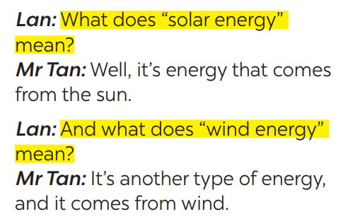

EVERYDAY ENGLISH
1
Listen and read the conversation. Pay attention to the highlighted questions.
Which tense do we use to ask and answer?
Which question word and verb do we use?

Slide 6
EVERYDAY ENGLISH
STRUCTURES
WHAT + DOES + S + MEAN…?
S + MEANS …
Which question word and verb do we use?

Slide 7

EVERYDAY ENGLISH
2
Work in pairs. Make similar conversations to ask for explanations.
What does solar energy mean?
It’s energy that comes from the sun. What does nuclear energy mean?
It’s energy that comes from nuclear power.

Slide 8

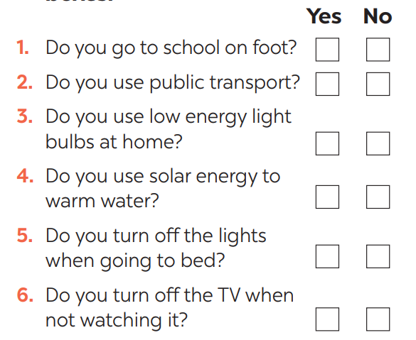
SAVING ENERGY
3
Work in pairs. Ask your partner the following questions and tick his or her answers in the boxes.

Slide 9

SAVING ENERGY
4
Work in groups. Tell the group how well your partner saves energy.
Example:
Mai saves a lot of energy. She often goes to school on foot and uses public transport. She always turns oﬀ the lights when going to bed.

Slide 10

SAVING ENERGY
5
Answer the questions in 3 on your own. Tell the class how well you save energy.
Example:
I don’t save much energy. I go to school on foot, but I don’t turn oﬀ the TV when not watching it.

Slide 11

CONSOLIDATION
1
WRAP-UP
In this lesson, we have learn to:
ask for explanations
talk about saving energy

Slide 12

CONSOLIDATION
2
HOMEWORK
Do exercises in the workbook.
Prepare for the next lesson: SKILLS 1.

Slide 13

Website: sachmem.vn
Fanpage: facebook.com/sachmem.vn/

