Slide 1


HOANG LAM SECONDARY SCHOOL
WELCOME TO OUR CLASS

Slide 2
WATCH A CARTOON

Slide 3


Slide 4
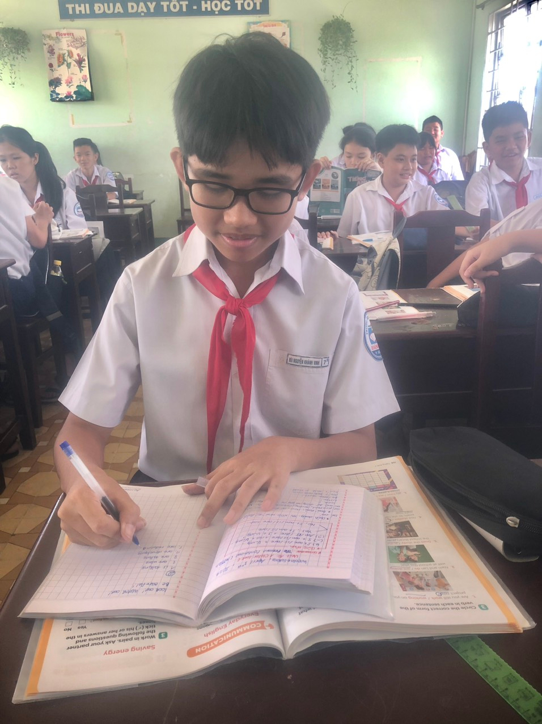
GRAMMAR:
THE PRESENT CONTINUOUS

Slide 5
Thursday, April 4th , 2024
UNIT 10: ENERGY SOURCES SOURC
Lesson 3: A closer look 2
GRAMMAR:
THE PRESENT CONTINUOUS

Slide 6
PRESENTATION
THE PRESENT CONTINUOUS
- She is learning English now.
(+) S + am/ is/are + V-ing.
- They are not using solar energy.
(-) S + am/ is/are + not + V-ing.
(?) Am/ Is/ Are + S + V-ing ?
- Are you working on your Project?
Yes, S + am/is/are.
Yes, I am.
No, I am not.
No, S + am/is/are + not.
* Cách dùng:
Thì HTTD diễn tả:
- Hành động đang xảy ra ngay lúc nói.
- Hành động quanh thời điểm hiện tại nhưng không nhất thiết tại thời điểm đang nói.
now, right now, at the moment, at present, at this time, today, nowadays, this week/ month.Look!Listen!keep quiet!...
*Dấu hiệu:

Slide 7

PRACTICE
1
Work in pairs. Tell your partner what the people in the pictures are doing.
a. She is teaching maths/ is writing on the board.
b. They are playing football/ soccer.

Slide 8
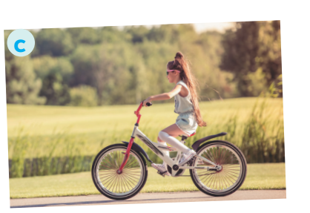

PRACTICE
1
Work in pairs. Tell your partner what the people in the pictures are doing.
c. She is riding her bike/ bicycle.
d. She is cooking.

Slide 9
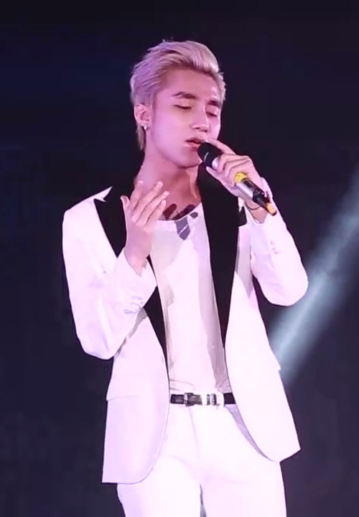
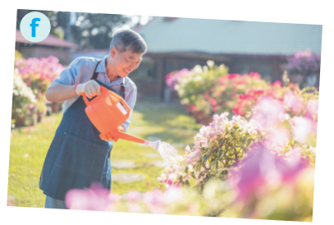
PRACTICE
1
Work in pairs. Tell your partner what the people in the pictures are doing.
e
e. He is singing.
f. He is watering the flowers./
He is doing gardening.

Slide 11
Quy tắc thêm -ing cho động từ:
-Động từ kết thúc bởi “-e” => bỏ “e” thêm “ing”
EX: have – having; make – making; write – writing; come – coming,...
-Động từ kết thúc bởi “ie”=> đổi “ie” thành “y” rồi thêm –ing.
EX: lie – lying ; die – dying,...
-Động từ kết thúc bởi “ee”, thêm –ing mà không bỏ “-e”
EX: see – seeing; agree – agreeing,...
-Động từ kết thúc bởi một trọng âm chứa 1 nguyên âm (a,i,e,o,u) + 1 phụ âm cuối rồi thêm “-ing”
EX: get – getting; travel – travelling,..

Slide 12
PRACTICE
2
Complete the sentences, using the present continuous form of the verbs in brackets.
1. Mai (talk) ____________ about types of energy sources now.
2. We (use) ____________ solar energy to replace energy from coal today.
3. Keep quiet! The students of Class 7C (take) ____________ a test.
4. Scientists (develop) ____________ new energy sources to protect the environment.
5. We (reduce) ____________ the use of nuclear energy nowadays.
is talking
are using
are taking
are developing
are reducing

Slide 13
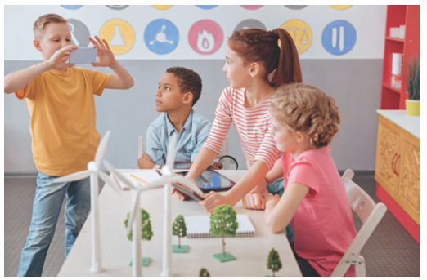

PRACTICE
3
Circle the correct form of the verb in each sentence.
1. Are you still work / working on your project now?
2. Nam and Lan do / are doing quite well at school this year.

Slide 14

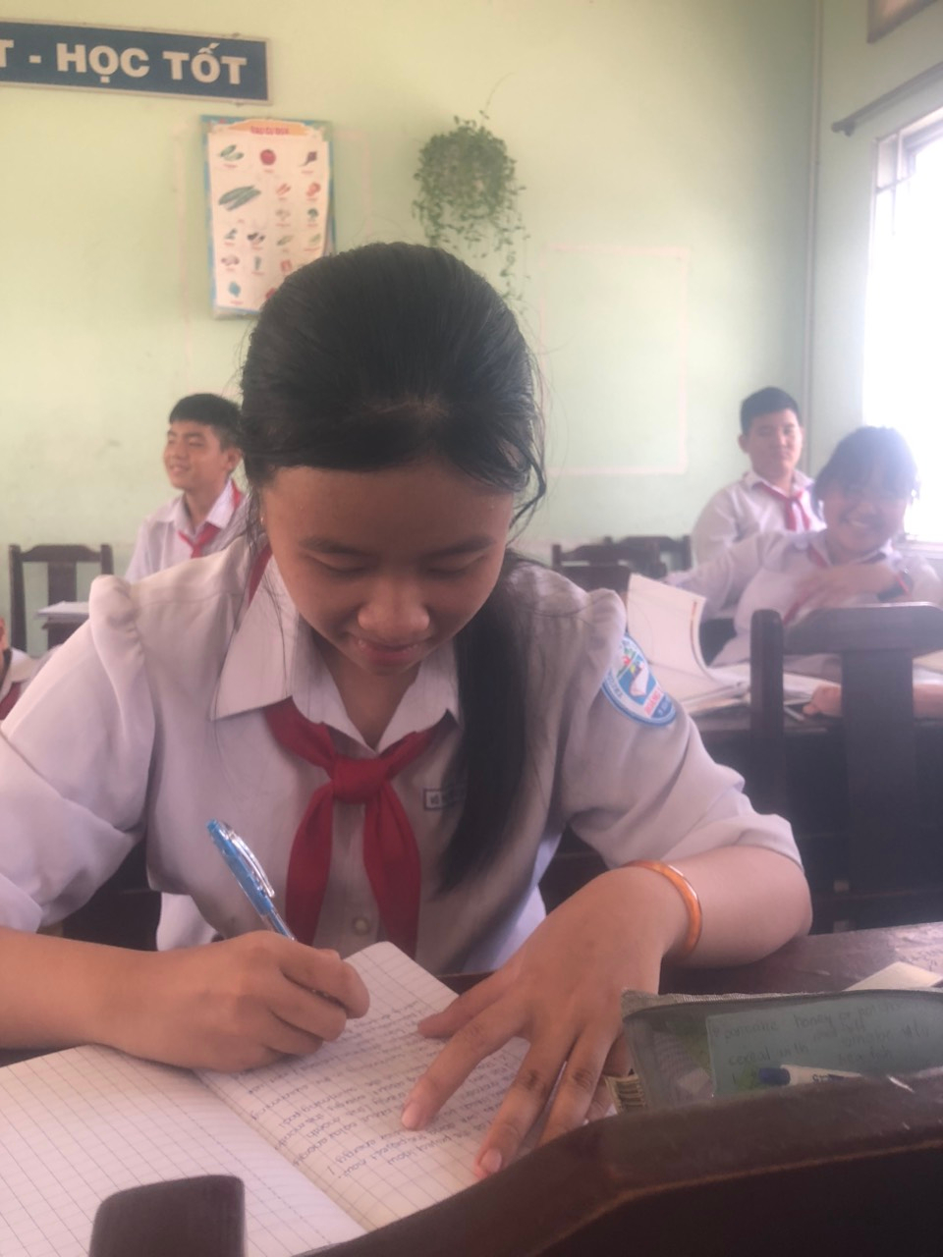
PRACTICE
3
Circle the correct form of the verb in each sentence.
3. Does she study / Is she studying at the school library at the moment?
4. Hoa studies / is studying for her exam, so she can’t come to the party right now.

Slide 15

PRACTICE
3
Circle the correct form of the verb in each sentence.
5. We have / are having English three times a week.

Slide 16

PRODUCTION
LUCKY FLOWERS
* Write sentences about what the people are doing or not doing, using the suggestions.
The students / do the project / now.
Mrs Lien / teach us about solar energy / at the moment
They / learn about energy / this month.
She / not swim / in the swimming pool / right now.
Nowadays, people in Iceland / not use energy from coal.

Slide 17


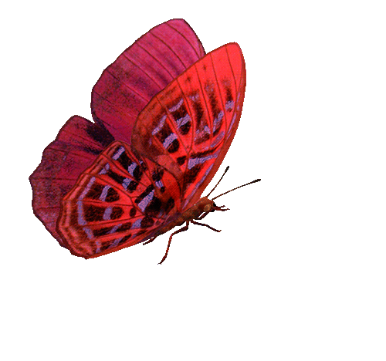











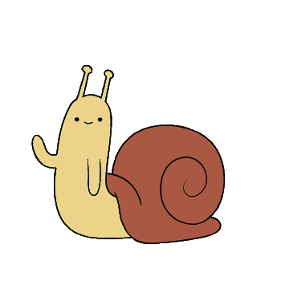

LUCKY FLOWERS
Nowadays, people in Iceland / not use energy from coal.
The students / do the project / now.
She / not swim / in the swimming pool / right now.
Lucky Flower !
Good luck !
Good luck!
Good luck!
They / learn about energy / this month.
Good luck!
Mrs Lien / teach us about solar energy / at the moment.
Nowadays, people in Iceland are not using energy from coal.
They are learning about energy this month.
The students are doing the project now.
Mrs Lien is teaching us about solar energy at the moment.
She is not swimming in the swimming pool right now.

Slide 18
PRODUCTION
* Write sentences about what the people are doing or not doing, using the suggestions.
1. The students / do the project / now.
_______________________________________________
2. Mrs Lien / teach us about solar energy / at the moment.
_______________________________________________
3. They / learn about energy / this month.
_______________________________________________
4. She / not swim / in the swimming pool / right now.
_______________________________________________
5. Nowadays, people in Iceland / not use energy from coal.
_________________________________________________
The students are doing the project now.
Mrs Lien is teaching us about solar energy at the moment.
They are learning about energy this month.
She is not swimming in the swimming pool right now.
Nowadays, people in Iceland are not using energy from coal.

Slide 19
NOTE: These verbs are not put in form V-ing
Senses: feel, hear, see, smell, taste, touch…
Example: I feel hot now.
Feelings: hate, hope, like, love, prefer, regret, want, wish…
Example: Thuy Duong wants to drink water at present.
Brain work: believe, know, think, understand…
Example: Now, I believe you.

Slide 20
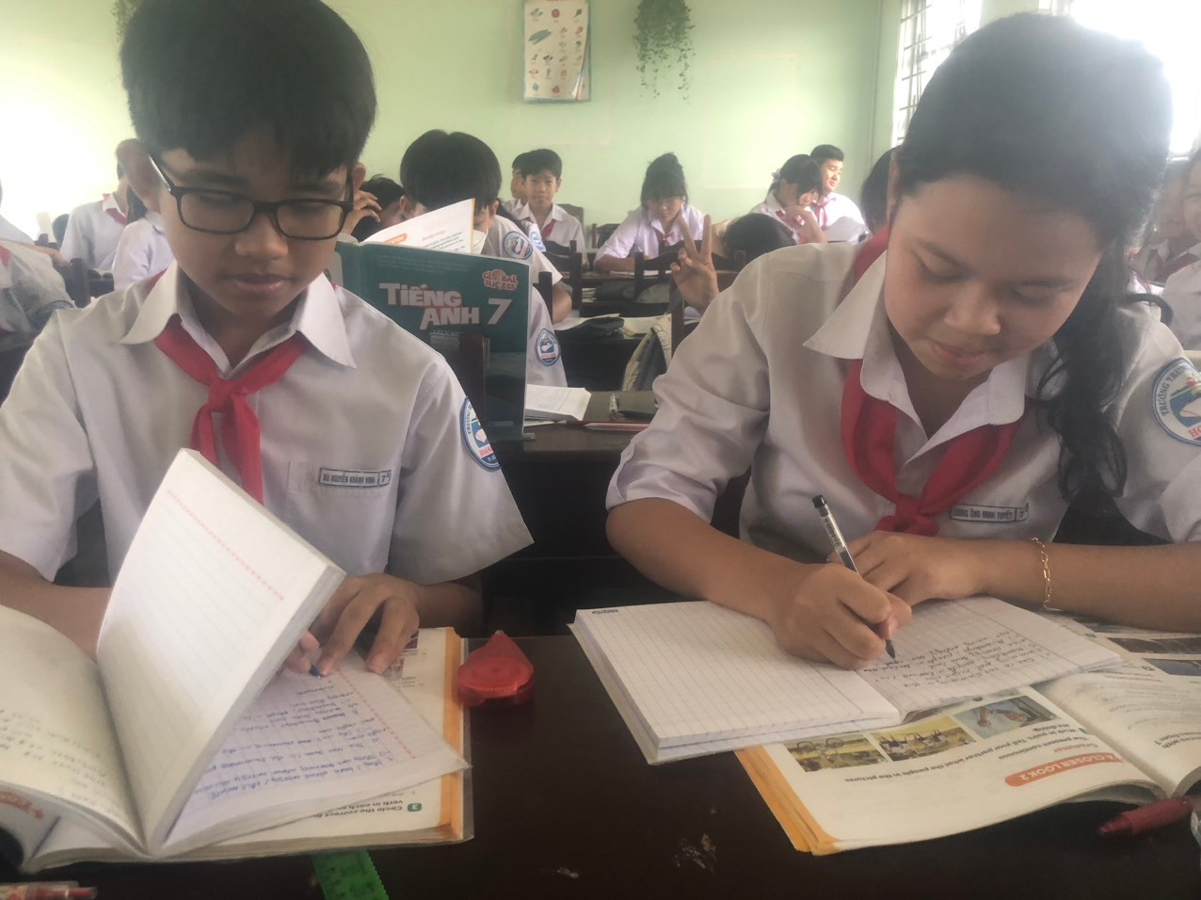
HOMEWORK
Learn the present continuous
Do exercises in the workbook.
Prepare : Comunication

