Slide 1


Slide 2



Unit
10
ENERGY SOURCES
LESSON 2: A CLOSER LOOK 1
VOCABULARY
PRONUNCIATION
Unit
HOBBIES

Slide 3

OBJECTIVES
By the end of the lesson, students will be able to gain:
- vocabulary about sources of energy.
- pronunciation: Stress in three-syllable words

Slide 4
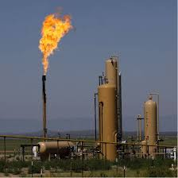
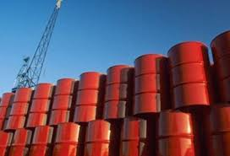

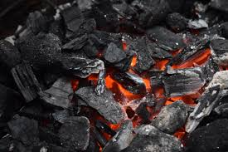

WARM-UP: CROSS WORDS
ENERGY
1
S
S
U
N
2
C
O
A
L
O
O
L
3
I
L
W
A
B
L
E
4
R
E
N
E
A
R
A
S
5
N
A
T
U
R
A
L
G
Notes:
Click the numbers to shows the 5 words in 5 rows. Click the star to show the secret word.

Slide 5

LESSON 2: A CLOSER LOOK 1
WARM-UP
Game: Crossword
Task 1: Match the types of energy with the energy sources.
Task 2: Write the phrases to label the pictures.
Task 3: Complete the sentences.
VOCABULARY
Aims of the stage:
To visually introduce some nouns related to the topic

Slide 6
Vocabulary :
- Hydro energy : Thủy điện, năng lượng nước
- Nuclear energy : Năng lượng hạt nhân
- Breeze : Gió nhẹ
- Solar paner : Pin Mặt Trời
- Pollute : Ô nhiễm
- Gorvenment : Chính phủ

Slide 7
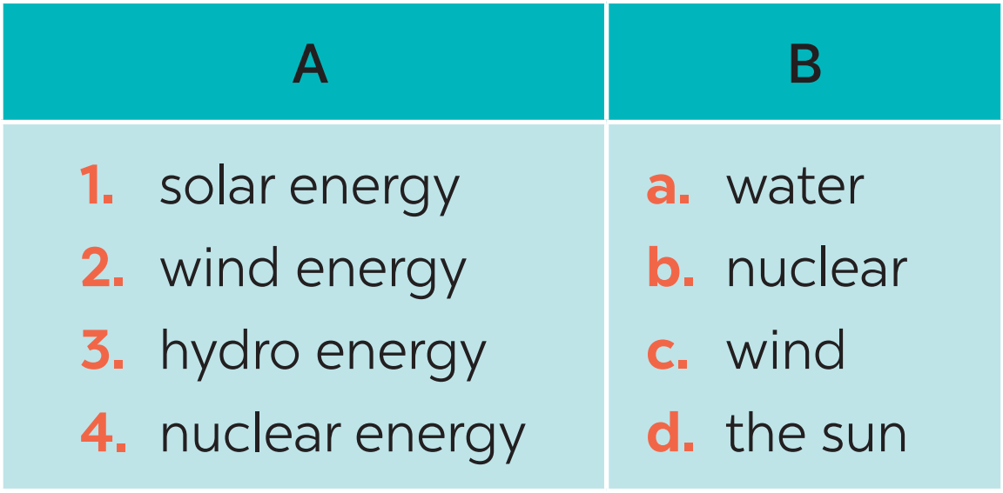
VOCABULARY
1
Match the types of energy in A with the energy sources in B.
1. d
2. c
3. a
4. b

Slide 8
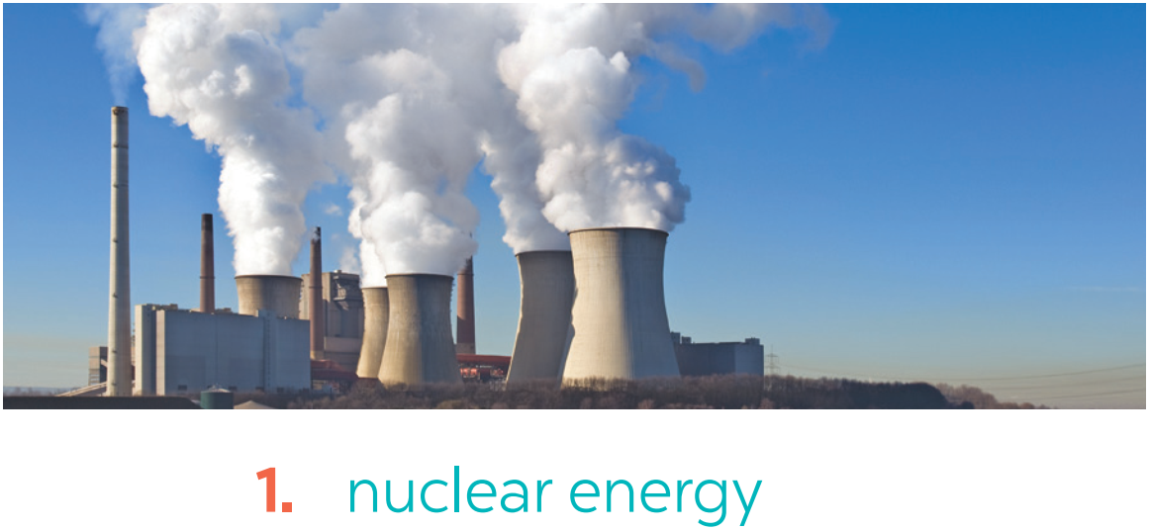
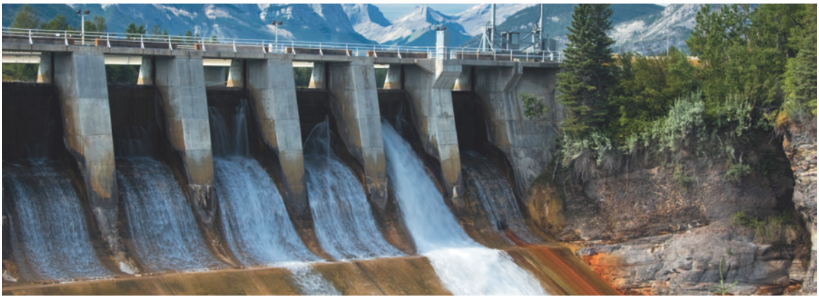
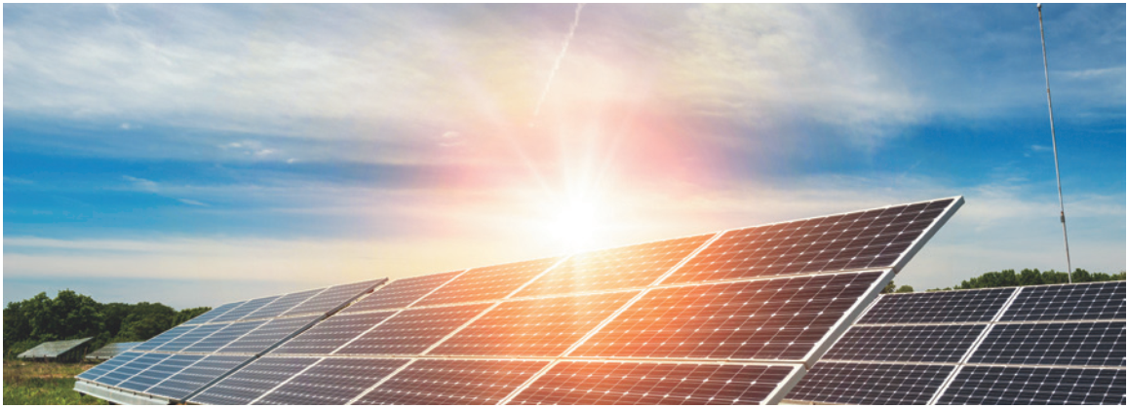
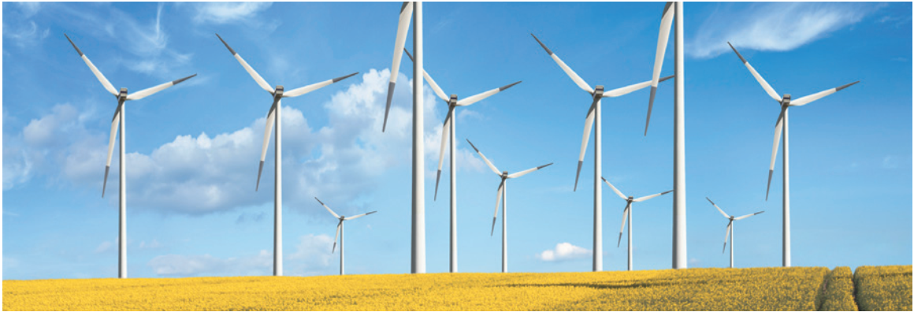
VOCABULARY
2
Write the phrases to label the pictures.
nuclear energy
hydro energy
2. ________________
solar energy
wind energy
3. ________________
4. ________________

Slide 9
VOCABULARY
3
Complete the sentences with the words and phrases from 1 or 2.
1. A good place to change _______________to energy is near the sea because of the sea breezes.
2. They are putting solar panels on the roof of our building to produce ________________.
3. When energy comes from ________________, we call it hydro energy.
4. They are reducing the use of________________because it is not safe to produce.
wind
solar energy
water
nuclear energy

Slide 10

PRONUNCIATION
4
Listen and repeat.
STRESS IN THREE-SYLLABLE WORDS
4
'energy re'cycle
'dangerous ex'pensive
'easily po'lluting
'government re'sources

Slide 11
PRONUNCIATION
5
Listen and repeat, paying attention to the stressed syllables in the underlined words.
1. Nuclear 'energy is 'dangerous and ex'pensive.
2. We should ride a bike when 'travelling short 'distances.
3. The word “re'cycle” has three 'syllables.
4. Burning coal is po'lluting our environment.
5. Our 'government is looking for new sources of 'energy to replace gas.

Slide 12
CONSOLIDATION
1
WRAP-UP
VOCABULARY
PRONUNCIATION

Slide 13

CONSOLIDATION
2
HOMEWORK
Do exercises in the workbook.
Prepare Lesson 2: A Closer look 2

Slide 14

Website: sachmem.vn
Fanpage: facebook.com/sachmem.vn/

Slide 15

VOCABULARY
solar energy (n. phr.)
/ˈsəʊlə(r) ˈenədʒi/
năng lượng mặt trời

Slide 16

VOCABULARY
hydro energy (n. phr.)
/ˈhaɪdrəʊ ˈenədʒi/
năng lượng nước

Slide 17
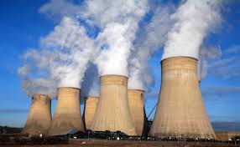
VOCABULARY
nuclear energy (n.phr)
/njuːklɪər ˈenədʒi/
năng lượng hạt nhân

Slide 18
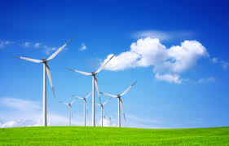
VOCABULARY
wind energy (n.phr)
/wind ˈenədʒi/
năng lượng gió

Slide 19
VOCABULARY
New words | Pronunciation | Meaning
1. solar energy | /ˈsəʊlə(r) ˈenədʒi/ | năng lượng mặt trời
2. hydro energy | /ˈhaɪdrəʊ ˈenədʒi/ | năng lượng nước
3. nuclear energy | /njuːklɪər ˈenədʒi/ | năng lượng hạt nhân
4. wind energy | /wind ˈenədʒi/: | năng lượng gió

