Slide 1
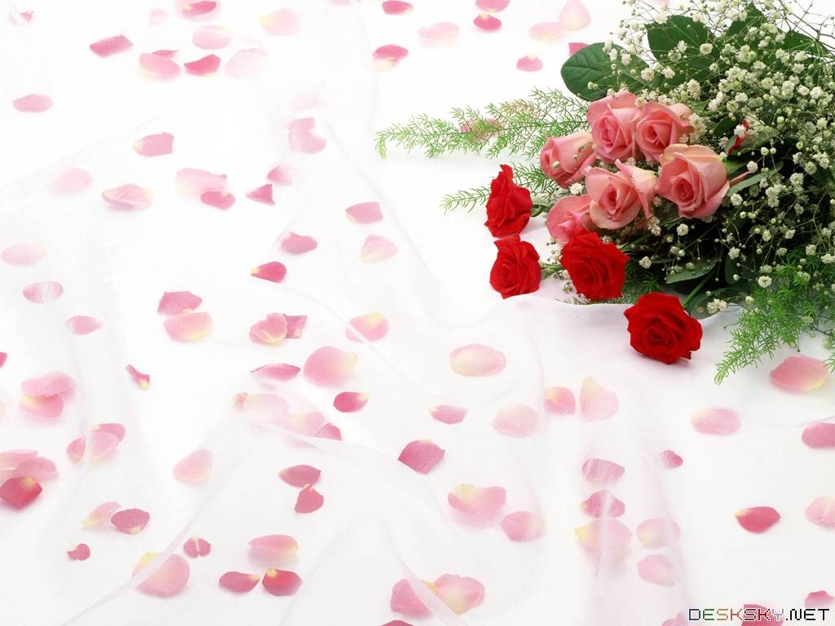
ENGLISH 6
HELLO EVERY ONE !!!

Slide 2

WELCOME TO
OUR CLASS TODAY

Slide 3
REVISION: Ôn tập
1. WILL
Form:
[+] S+ will+ V-inf+ …..
[-] S+ will not/ won’t + V-inf +…
[?] (Wh/H Questions) + will + S+ V-inf+…?
- để diễn tả hành động, sự việc sẽ xảy ra trong tương lai
2. MIGHT
Form:
[+] S+ might+V-inf + ….
[-] S+ might not + V-inf+….
- để phỏng đoán hành động, sự việc sẽ xảy ra trong tương lai

Slide 4
1. GAME a. Matching
Future
Present
A. take pictures with our watches
B. go on holiday to the Moon
C. send video cards to friends
D. call friends on our computers
E. study on computers at home
F. watch films on smart phones
1. go to school
2. take pictures with our cameras
3. have telephones at home
4. go on holiday to the beach
5. watch new films in the cinema
6. send postcards to friends

Slide 5
1
Go to school - Study on computers at home
In the future, we won’t go to school but we might study on computers at home.
BACK

Slide 6
2
Take pictures with our cameras – Take pictures with our watches
In the future, we won’t take pictures with our cameras but we might take pictures with our watches.
Back

Slide 7
3
Have telephones at home –
Call friends on our computers
In the future, we won’t have telephones at home but we might call friends on our computers.
BACK

Slide 8
4
Go on holiday to the beach –
Go on holiday to the Moon
In the future we won’t go on holiday to the beach but we might go on holiday to the Moon.
BACK

Slide 9
5
Watch new films in the cinema–
Watch films on smart phones
In the future, we won’t watch new films in the cinema but we might watch films on smart phones.
BACK

Slide 10
6
Send postcards to friends –
Send video cards to friends
In the future, we won’t send postcards to friends but we might send video cards to friends
BACK

Slide 11

I. Vocabulary:
ENGLISH 6
1. Go on holiday: đi nghỉ , đi du lịch
2. Take pictures= Take photos: chụp ảnh
3. Send (sth to sb): gửi (cái gì cho ai)
4. Receive (sth from sb): nhận (cái gì từ ai)

Slide 12
5. 6. 7. 8. 9. | future solar energy hi-tech fly take care of = | /ˈfjuːtʃə(r)/ /hai - tek/ /flai/ look after | (n): tương lai (np): năng lượng mặt trời công nghệ cao bay chăm sóc
10. 11. 12. 13. 14. 15. 16. 17 | in the sea in the city in the town in the mountains in the countryside on the Moon in the sky in the ocean |  | (ở biển) (trong thành phố) (trong thị trấn) (trên núi) (ở nông thôn) (trên mặt trăng) (trên bầu trời) (trong đại dương)

Slide 13




How do they feel?
They are surprised
How can we express surprise?

Slide 14


Everyday English
Expressing surprise

Slide 15
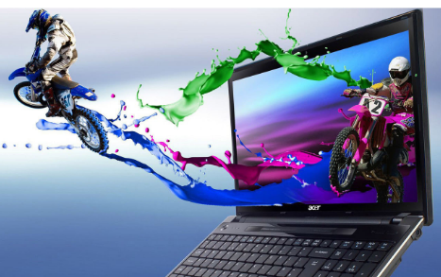
The structure to express surprise
* Wow! Is that + object?
* It looks + adjective.
computer
/ great

Slide 16



Listen and read the conversation. Pay attention to the highlighted sentences.
David: John! Hello!
John: Oh, hi, David. Wow! Is that your computer? It looks great.
David: Yes, it’s my new computer. My parents gave it to me for my birthday.

Slide 17

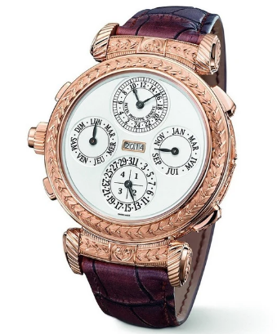
Work in pairs. Express your surprise when you see your partner’s new watch, TV, mobile phone, etc.
E.g. A: Wow! Is that your mobile phone? It looks great.
B: Yes, it’s my new mobile phone. My grandparents
gave it to me for my birthday.
watch
/ beautiful and modern

Slide 18
Houses and appliances in the future

Slide 19

Read the questions in the class survey below.
Tick () Y (Yes) or N (No).
 | Y | N
1. Will you live in a hi-tech house?
2. Will your house be in space?
3. Will you have a lot of trees and ﬂowers around your house?
4. Will you have a fridge that can cook your meals?
5. Will you have a robot that can look after your children?
6. Will you have a car that can ﬂy?
✓
✓
✓
✓
✓
✓
✓
✓
✓
✓
✓
✓

Slide 20

Work in pairs. Use the questions in 3 to interview your partner.
Example:
You: Hi, Nam. Will you live in a hi-tech house in the future?
Nam: Yes, I will.
You: Will your house be in space?
Nam: Oh, no. It won’t.
You: So where will it be?
Nam: I’m not sure. It might be by the sea.
Notes:
City landmarks phải ở trên mục 3

Slide 21
 | Y | N
1. Will you live in a hi-tech house?
2. Will your house be in space?
3. Will you have a lot of trees and ﬂowers around your house?
4. Will you have a fridge that can cook your meals?
5. Will you have a robot that can look after your children?
6. Will you have a car that can ﬂy?
Yes, I will. No, I won’t
Yes, It will. No, It won’t
Yes, I will. No, I won’t
Yes, I will. No, I won’t
Yes, I will. No, I won’t
Yes, I will. No, I won’t

Slide 22
Will you live in a hi-tech house?
2. Will your house be in space?
3. Will you have a lot of trees and flowers around your house?
4. Will you have a fridge that can cook your meals?
5. Will you have a robot that can look after your children?
6. Will you have a car that can fly?
I will live in a hi-tech house
I won’t live in a hi-tech house
My house will be in space
My house won’t be in space
I will have a lot of trees and flowers around my house
I won’t have a lot of trees and flowers around my house
I will have a fridge that can help me to cook meals
I won’t have a fridge that can help me to cook meals
I will have a robot that can help me to look after my children
I won’t have a robot that can help me to look after my children
I will have a car that can fly
I won’t have a car that can fly

Slide 23

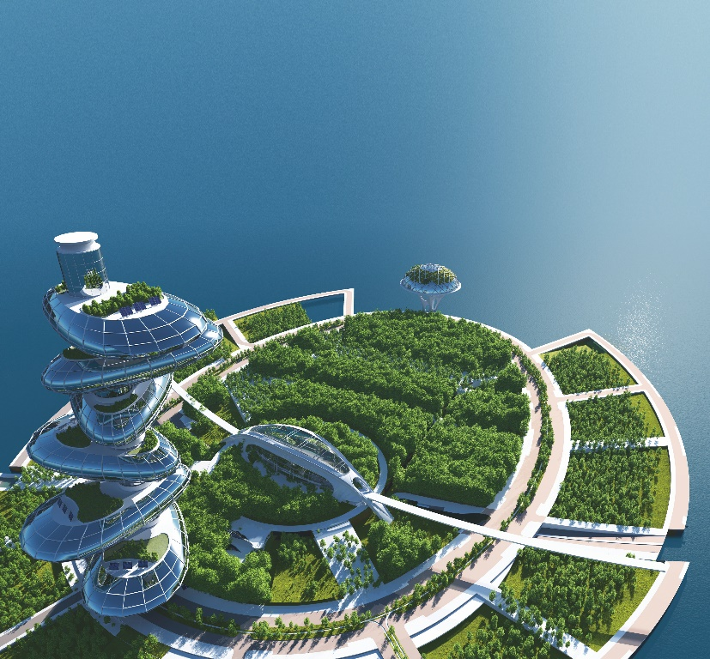
Tell the class about your interview.
Example:
In the future, Nam will live in a hi-tech house.
It won’t be in space. It might be by the sea.
He might have a robot to help him with his home.

Slide 24







