Slide 2
12
LESSON 1: GETTING STARTED
Unit
What will you do
in the future?
CAREER CHOICES

Slide 3
LESSON 1: GETTING STARTED
LESSON 1: GETTING STARTED
WARM-UP
Option 1: Think!
Option 2: Future Vision
PRESENTATION
Vocabulary
Task 1: Listen and read.
Task 2: Read the conversation again and answer the following questions.
Task 3: Match the words and phrases in the conversation with their pictures.
Task 4: Choose the correct answer A, B, C, or D to complete each sentence.
PRACTICE
PRODUCTION
Task 5: Game: Guess my jobs.
CONSOLIDATION
Wrap-up
Homework

Slide 4
WARM-UP
OPTION 1
Look at the pictures and name the jobs.
THINK!

Slide 5
WARM-UP
OPTION 1
HA LONG BAY
IT ENGINEER

Slide 6
WARM-UP
OPTION 1
HA LONG BAY
BANKER

Slide 7
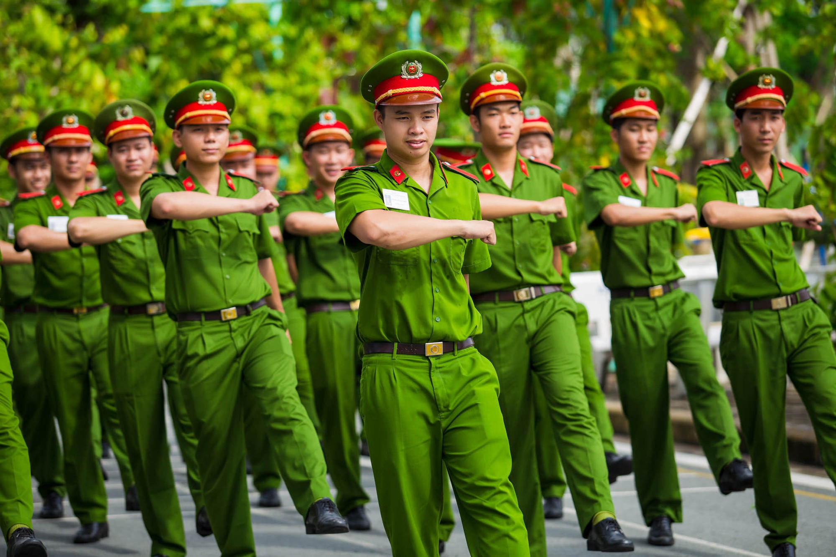
WARM-UP
OPTION 1
HA LONG BAY
POLICE

Slide 8
WARM-UP
OPTION 1
HA LONG BAY
TEACHER

Slide 9
WARM-UP
OPTION 1
Which jobs do you think will still be popular
in the future?

Slide 10
WARM-UP
OPTION 2
Future Vision

Slide 11
WARM-UP
OPTION 2
Imagine yourselves ten years from now
in your ideal job.
Questions:
- What does your daily routine look like?
- What skills do you need to get there?
- What challenges and rewards do you face?
- Describe your future job in detail.
Future Vision

Slide 12
PRESENTATION
career (n)
/kəˈrɪə(r)/
sự nghiệp

Slide 13
PRESENTATION
orientation (n)
/ˌɔːriənˈteɪʃn/
sự định hướng

Slide 14
PRESENTATION
vocational (adj)
providing knowledge and skills that prepare you for a particular job
/vəʊˈkeɪʃənl/
Ex: The school offers vocational programs in electrical work.
thuộc về nghề nghiệp, hướng nghiệp

Slide 15
PRESENTATION
garment worker (n)
/ˈɡɑːmənt ˈwɜːkə(r)/
công nhân may

Slide 16
PRESENTATION
bartender (n)
/ˈbɑːtendə(r)/
thợ pha chế
đồ uống có cồn

Slide 17
PRESENTATION
theoretical (adj)
based on the ideas that relate to a subject, not the practical uses of that subject.
/ˌ θɪəˈretɪkl/
(thuộc) lý thuyết
Ex: theoretical physics

Slide 18
PRESENTATION
New words | Pronunciation | Meaning
1. career (n) | /kəˈrɪə(r)/ | sự nghiệp
2. orientation (n) | /ˌɔːriənˈteɪʃn/ | sự định hướng
3. vocational (adj) | /vəʊˈkeɪʃənl/ | thuộc về nghề nghiệp, hướng nghiệp

Slide 19
PRESENTATION
New words | Pronunciation | Meaning
4. garment worker | /ˈɡɑːmənt ˈwɜːkə(r)/ | công nhân may
5. bartender (n) | /ˈbɑːtendə(r)/ | thợ pha chế đồ uống có cồn
6. theoretical (adj) | /ˌθɪəˈretɪkl/ | (thuộc) lý thuyết

Slide 20
PRACTICE
- The girls and the boys are thinking about their career.
Questions:
1. Who can provide the girl with advice?
2. What did they do yesterday?
Suggested answers:
1. parents, teachers at their school, brothers / sisters, friends, consultants, teachers at vocational schools, etc.
2. Mi attended a career orientation session and Nick did his project.

Slide 21
PRACTICE
1
Listen and read.
Mi: Did you attend the career orientation session yesterday?
Nick: No, I didn’t. I had to complete my project. How was it?
Mi: It was really informative. There were three guest speakers from vocational colleges. They introduced their job training courses for lower secondary leavers.
Nick: My teacher told us that if we didn’t like academic subjects, we should apply for courses which would prepare us for a job such as mechanic, hairdresser, or garment worker. That way, we could start working and earn a living earlier.
Mi: My cousin did that. He learnt bartending after finishing grade 9. Now he’s a skillful bartender and makes lots of money.

Slide 22
PRACTICE
1
Listen and read.
Nick: And you? What will you be in five years from now?
Mi: Well, I’ll be studying at a teachers’ college because I want to be a teacher.
How about you?
Nick: I’ll be a fashion designer.
Mi: You really want to be a fashion designer?
Nick: Yeah. My art teacher says I have such a good sense of style that I should get formal training in fashion design after high school.
Mi: Hope you’ll achieve your dream.
Nick: Thanks. I think we should know our passions and abilities to make a good career choice.

Slide 23
PRACTICE
2
Read the conversation again and answer the following questions.
1. Where did the guest speakers come from?
2. According to Nick’s teacher, who should apply for vocational courses?
3. What did Mi’s cousin do after finishing grade 9?
Vocational colleges.
Students who don’t like academic subjects.
Learnt bartending.

Slide 24
PRACTICE
2
Read the conversation again and answer the following questions.
4. What quality does a fashion designer need to have?
5. What do we need to know to make a good career choice?
A good sense of style.
Our passions and abilities.

Slide 25
PRACTICE
3
Match the words and phrases in the conversation with their pictures.

Slide 26
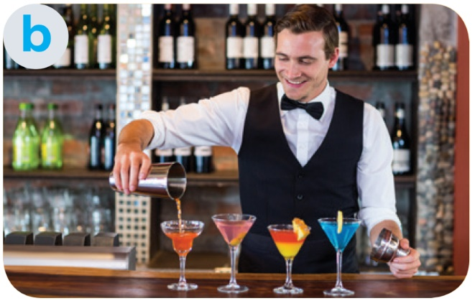
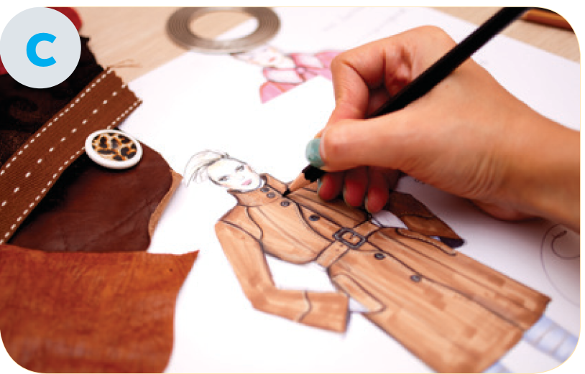
1. bartender
2. fashion designer
3. garment worker
4. hairdresser
5. mechanic

Slide 27
PRACTICE
4
Choose the correct answer A, B, C, or D to complete each sentence.
1. Subjects like maths, physics, English, and literature are called ______ subjects.
A. theoretical
C. academic
B. art
D. physical
2. She earns a ______ by selling home-made foods.
A. life
C. money
B. salary
D. living

Slide 28
PRACTICE
4
Choose the correct answer A, B, C, or D to complete each sentence.
3. He went to college to get ______ training in business management.
A. life-long
C. formal
B. informal
D. online
4. Finding a ______ job in big cities is rather difficult.
A. teacher
C. taught
B. teaching
D. teach

Slide 29
PRACTICE
4
Choose the correct answer A, B, C, or D to complete each sentence.
5. Career ______ programmes are useful because they help students make good decisions about their future jobs.
A. orientation
C. tradition
B. pressure
D. income

Slide 30
PRODUCTION
5
GAME: Guess my job. Work in two groups. Take turns to explain and guess the jobs the teacher shares. The group with more correct answers wins.
E.g:
Group members: This person works in a garage. He repairs cars or motorbikes.
Student A: A mechanic.

Slide 31
CONSOLIDATION
1
Wrap-up
What have we learnt in this lesson?
identify the topic of the unit.
use lexical items related to career choices.
identify the language features that are covered
in the unit.

Slide 32
CONSOLIDATION
2
Homework
- Do exercises in the workbook.
- Start prepare for the unit project

Slide 33
Website: hoclieu.vn
Fanpage: www.facebook.com/tienganhglobalsuccess.vn/

