Slide 2
Unit
10
CAREER CHOICES
LESSON 3: A CLOSER LOOK 2

Slide 3
Unit
10
PLANET EARTH
LESSON 3: A CLOSER LOOK 2

Slide 4
OBJECTIVES
By the end of the lesson, students will be able to:
Use non-defining relative clauses.

Slide 5
LESSON 3: A CLOSER LOOK 2
LESSON 1: GETTING STARTED
WARM-UP
Option 1: Quiz
Option 2: Planet Earth Pictionary
Grammar Explanation
Task 1: Complete the sentences with correct relative pronouns.
Task 2: Underline the relative clauses. Tick (√) if the relative clause can be omitted.
Task 3: Complete each sentence with a non-defining relative clause (A-E).
PRESENTATION
PRACTICE
Task 4: Combine the two sentences into one, using a non-defining relative clause.
Task 5: Work in two groups. Take turns to say aloud one the places in the table. The other group explains or gives more information about it. The team that has the most corrected sentences wins.
PRODUCTION
CONSOLIDATION
Wrap-up
Homework

Slide 6
The man ______ taught us science last year was Mr. Nam.
WARM-UP
OPTION 1

Slide 7
WARM-UP
OPTION 1
The man ______ taught us science last year was Mr. Nam.
when
what
which
who
We are playing a game ______ was designed by our teacher.

Slide 8
The man ______ taught us science last year was Mr. Nam.
WARM-UP
OPTION 1
We are playing a game ______ was designed by our teacher.
who
where
which
how
The woman ______ we visited last summer is my former English teacher.

Slide 9
We are playing a game ______ was designed by our teacher.
WARM-UP
OPTION 1
The woman ______ we visited last summer is my former English teacher.
which
who
when
whose

Slide 10
The woman ______ we visited last summer is my former English teacher.
WARM-UP
OPTION 1
We are learning about the planet ______ has green trees and living things.
where
who
which
whose

Slide 11
We are learning about the planet ______ has green trees and living things.
WARM-UP
OPTION 1
I go to the school ______ my mother went to when she was small.
where
how
who
which

Slide 12
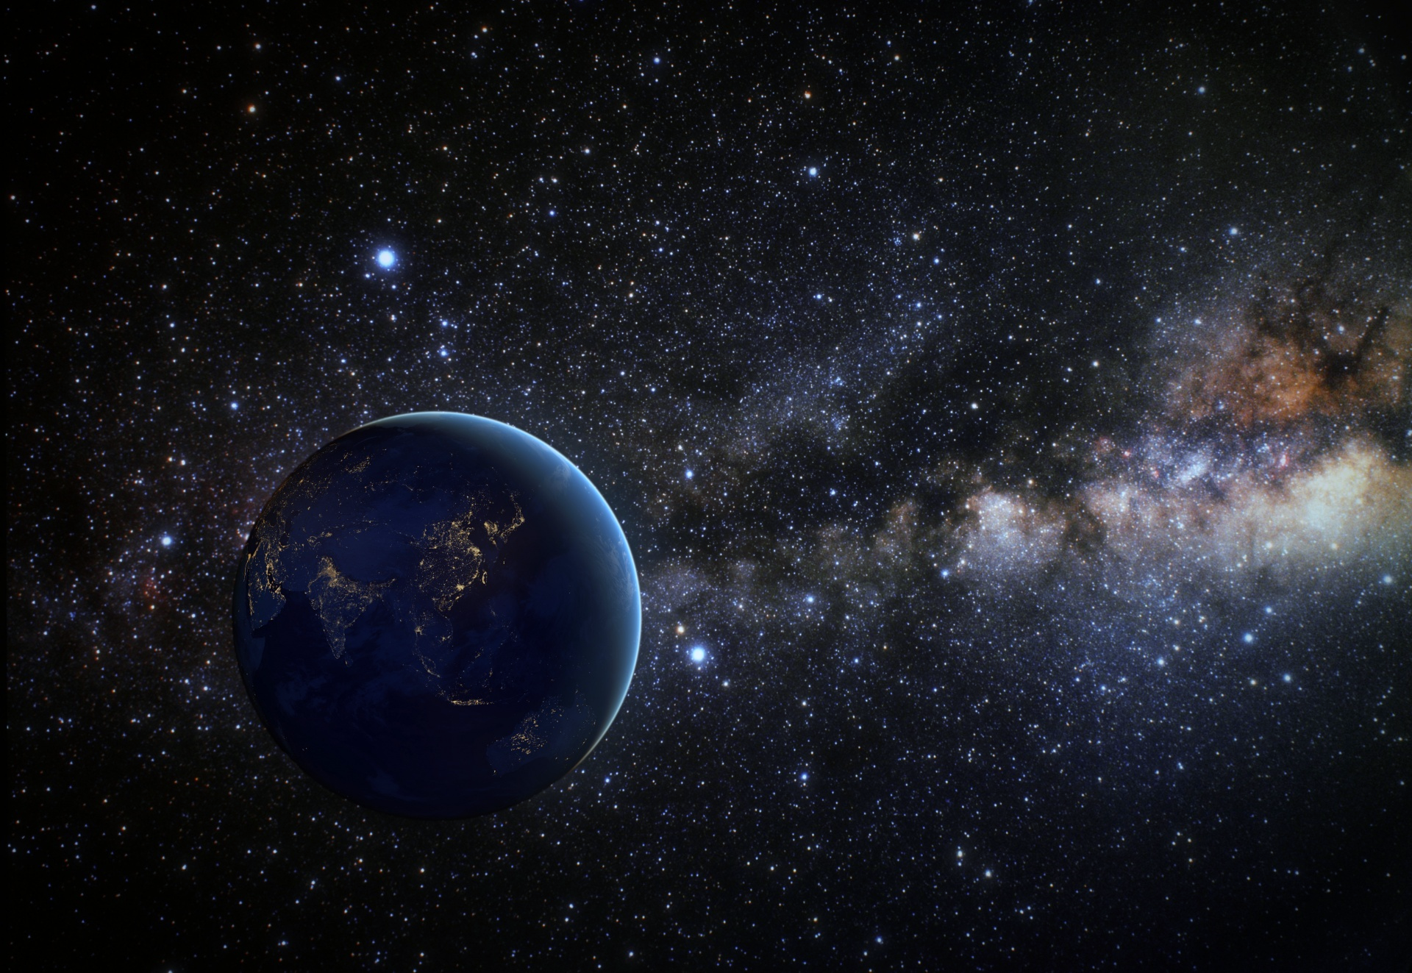
WARM-UP
OPTION 2
Planet Earth Pictionary

Slide 13
WARM-UP
OPTION 2
- Work in pairs
- One student in each pair secretly draws a picture of a natural phenomenon or geographical feature related to Earth.
HOW TO PLAY
- The other student, using relative clauses, must describe the picture to their partner without explicitly naming it.
- The partner guesses the phenomenon or feature within the set time limit.
- Most correct guesses within the time limit wins!

Slide 14
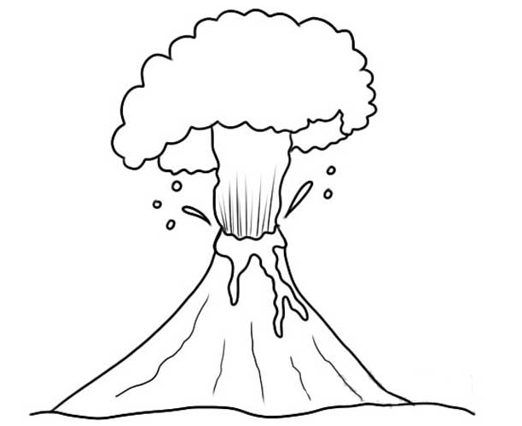
WARM-UP
OPTION 2
An area of coral, the top of which can sometimes be seen just above the sea.
EXAMPLE

Slide 15
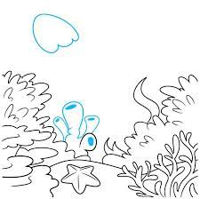
WARM-UP
OPTION 2
A tall, sleeping mountain that is covered in green forests and dotted with fluffy white clouds. But sometimes, this mountain wakes up in a very dramatic way!
EXAMPLE

Slide 16
WARM-UP
OPTION 2
LET’S PLAY

Slide 17
PRESENTATION
– We use non-defining relative clauses to add extra information.
Example: Earth, which is the third planet from the Sun, depends much on the Sun for its energy.
– If we remove the non-defining relative clause, the sentence still makes sse. en
Example: Earth depends much on the Sun for its energy.
– We use comma(s) with non-defining relative clauses.
– Relative pronouns cannot be omitted in non-defining relative clauses

Slide 18
PRESENTATION
Look at the examples and underline the relative clauses:
She gave me the cupcake that was red velvet flavoured.
She gave me a cupcake, which was red velvet flavoured.

Slide 19
PRESENTATION
1
Complete the sentences with correct relative pronouns.
which
1. Planet Earth, ______ is also called the Blue Planet, is covered with water and land.
who
2. Peter Molnar, ______ has done many studies on climate change, is one of the best-known Earth scientists.
whose
3. Neil Armstrong, ______ trip to the moon marked a giant leap for mankind, was the first to walk on the moon.
which
4. Suoi Thau, ______ is in Ha Giang, is one of the most gorgeous grasslands in Viet Nam.
5. People often do green things to protect Earth on the Earth Day, ______ is celebrated on 22nd April.
which

Slide 20
PRACTICE
2
Underline the relative clauses. Tick (√) if the relative clause can be omitted.
√
1. ______ The second planet from the Sun is Venus, which is sometimes called the Earth’s sister.
√
2. ______ The ocean, which is the body of salt water, contains 97% of Earth’s water.
3. ______ Landforms make up the areas which include mountains, hills, plains, and plateaus

Slide 21
PRACTICE
2
Underline the relative clauses. Tick (√) if the relative clause can be omitted.
A. which is a Germanic word
B. which is also called the Red Planet
C. whose radius is nearly 4 million miles
D. who explained ecological balance to us
E. which has a large collection of animals,
birds and reptiles, and unique plants
√
4. ______ One of the world’s most famous Earth scientists is James Hutton, who is a British geologist.
√
5. ______ Arctic Ocean ice and water make up a habitat for polar bears, whose main food is seals.

Slide 22
PRACTICE
3
Complete each sentence with a non-defining relative clause (A-E).
A. which is a Germanic word
B. which is also called the Red Planet
C. whose radius is nearly 4 million miles
D. who explained ecological balance to us
E. which has a large collection of animals,
birds and reptiles, and unique plants
B
1. Mars, ______, is very much similar to Earth.
2. Earth, ______, is the fifth largest planet in our solar system.
C
3. The name of our planet, ______, simply means “the ground”.
A

Slide 23
PRACTICE
3
Complete each sentence with a non-defining relative clause (A-E).
A. which is a Germanic word
B. which is also called the Red Planet
C. whose radius is nearly 4 million miles
D. who explained ecological balance to us
E. which has a large collection of animals,
birds and reptiles, and unique plants
E
4. Cat Ba National Park, ______, is one of the most famous tropical rainforests in Viet Nam.
5. We were interested in the talk by Mr An, ______.
D

Slide 24
LESSON 3: A CLOSER LOOK 2
LESSON 1: GETTING STARTED
WARM-UP
Option 1: Quiz
Option 2: Planet Earth Pictionary
Grammar Explanation
Task 1: Complete the sentences with correct relative pronouns.
Task 2: Underline the relative clauses. Tick (√) if the relative clause can be omitted.
Task 3: Complete each sentence with a non-defining relative clause (A-E).
PRESENTATION
PRACTICE
Task 4: Combine the two sentences into one, using a non-defining relative clause.

Slide 25
PRACTICE
4
Combine the two sentences into one, using a non-defining relative clause.
1. The Moon is Earth’s only natural satellite. Its surface is dark.
The Moon, whose surface is dark, is Earth's only natural satellite.
_____________________________________________________.
2. Moonquakes are much weaker than Earthquakes. Moonquakes can last up to half an hour.
Moonquakes, which can last up to half an hour, are much weaker than Earthquakes.
_____________________________________________________
_____________________________________________________.

Slide 26
PRACTICE
4
Combine the two sentences into one, using a non-defining relative clause.
3. Mars has mountains and canyons on its surface. It is a rocky planet like Earth.
Like Earth, Mars is a rocky planet, which has mountains and canyons on its surface.
__________________________________________________________________________________________________________.
4. Venus is considered the twin sister of Earth. Venus has a similar size and structure as Earth.
Venus, which has similar size and structure with Earth, is considered twin sister of Earth.
_____________________________________________________
_____________________________________________________.

Slide 27
PRACTICE
4
Combine the two sentences into one, using a non-defining relative clause.
5. We should protect rivers and lakes. Rivers and lakes provide humans with their main sources of fresh water.
We should protect rivers and lakes, which provide humans with their main sources of fresh water.
__________________________________________________________________________________________________________.

Slide 28
EXTRA ACTIVITIES
Find the mistakes in the sentences and correct them.
when
1. Earth Day is the day where people celebrate the wonder of Earth.
x
2. Polar habitats, what include the North and the South Poles, are extremely cold.
which
x
3. The Pacific Ocean, that is the largest and deepest one on Earth, is being polluted.
which
x
4. Earth planet, where has a solid and active surface, has various habitat types.
which
x
5. Climate change has caused the changes in the colour of the Oceans, what is so worrying.
which
x

Slide 29
LESSON 3: A CLOSER LOOK 2
LESSON 1: GETTING STARTED
WARM-UP
Option 1: Quiz
Option 2: Planet Earth Pictionary
Grammar Explanation
Task 1: Complete the sentences with correct relative pronouns.
Task 2: Underline the relative clauses. Tick (√) if the relative clause can be omitted.
Task 3: Complete each sentence with a non-defining relative clause (A-E).
PRESENTATION
PRACTICE
Task 4: Combine the two sentences into one, using a non-defining relative clause.
Task 5: Work in two groups. Take turns to say aloud one the places in the table. The other group explains or gives more information about it. The team that has the most corrected sentences wins.
PRODUCTION
CONSOLIDATION
Wrap-up
Homework

Slide 30
PRODUCTION
Work in two groups. Take turns to say aloud one the places in the table. The other group explains or gives more information about it. The team that has the most corrected sentences wins.
5
- Work independently and prepare for your performance.
-Take turns to say aloud one of the places (the Nile, Pacific Ocean, Viet Nam, the Sahara, Mount Fansipan) and the other explains or gives more information about the places.
Example:
The Nile
The Nile, which is the longest river, flows into the Mediterranean Sea.

Slide 31
PRODUCTION
PLACE | FEATURE | FEATURE
The Nile | longest river | flows into the Mediterranean Sea
Pacific Ocean | covers 30% of planet surface | largest ocean
Viet Nam | has the shape of letter S | has a long coastline
The Sahara | largest desert | has almost no rainfall
Mount Fansipan | highest peak in Viet Nam | also called the ‘Roof of Indochina’

Slide 32
LESSON 3: A CLOSER LOOK 2
LESSON 1: GETTING STARTED
WARM-UP
Option 1: Quiz
Option 2: Planet Earth Pictionary
Grammar Explanation
Task 1: Complete the sentences with correct relative pronouns.
Task 2: Underline the relative clauses. Tick (√) if the relative clause can be omitted.
Task 3: Complete each sentence with a non-defining relative clause (A-E).
PRESENTATION
PRACTICE
Task 4: Combine the two sentences into one, using a non-defining relative clause.
Task 5: Work in two groups. Take turns to say aloud one the places in the table. The other group explains or gives more information about it. The team that has the most corrected sentences wins.
PRODUCTION
CONSOLIDATION
Wrap-up
Homework

Slide 33
CONSOLIDATION
1
Wrap-up
What have we learnt in this lesson?
Use non-defining relative clauses.

Slide 34
CONSOLIDATION
2
Homework
- Do exercises in the workbook.

Slide 35
Website: hoclieu.vn
Fanpage: facebook.com/www.tienganhglobalsuccess.vn/

