Slide 1


Slide 2




Unit
12
ENGLISH-SPEAKING COUNTRIES
LESSON 4: COMMUNICATION
Unit

Slide 3

OBJECTIVES
By the end of the lesson, students will be able to:
express amazement
know interesting facts about English-speaking countries

Slide 4

WARM-UP

Slide 5

EVERYDAY ENGLISH
1
Listen and read the conversations, paying attention to the highlighted parts.
2 ways to express amazement:
  Wow ... I didn’t know that!
  Amazing!

Slide 6
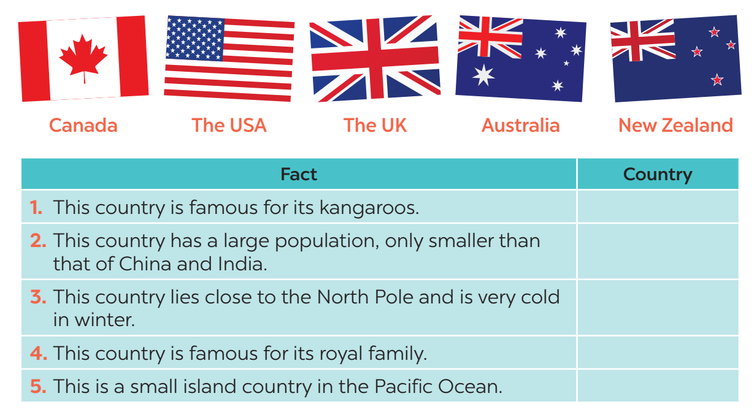
INTERESTING FACTS ABOUT ENGLISH-SPEAKING COUNTRIES
3
Work in groups. Discuss and write the name of the country next to the fact.
Australia
The USA
Canada
The UK
New Zealand

Slide 7
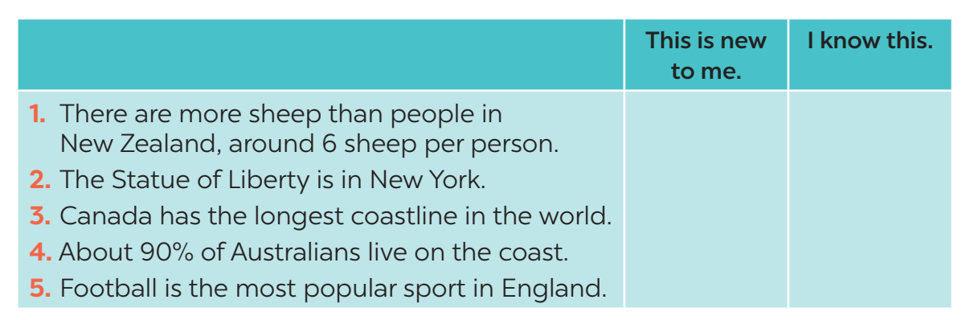
INTERESTING FACTS ABOUT ENGLISH-SPEAKING COUNTRIES

Slide 8

INTERESTING FACTS ABOUT ENGLISH-SPEAKING COUNTRIES
5
Work in groups. Share with your group some interesting facts you know about English-speaking countries. The group takes notes and presents its findings to the class.

Slide 9

CONSOLIDATION
1
WRAP-UP
In this lesson, we have learn to:
express amazement
know interesting facts about English-speaking countries

