Slide 1


Hello everyone !!!

Slide 2

Unit
11
SCIENCE AND TECHNOLOGY
LESSON 4: Communication

Slide 3
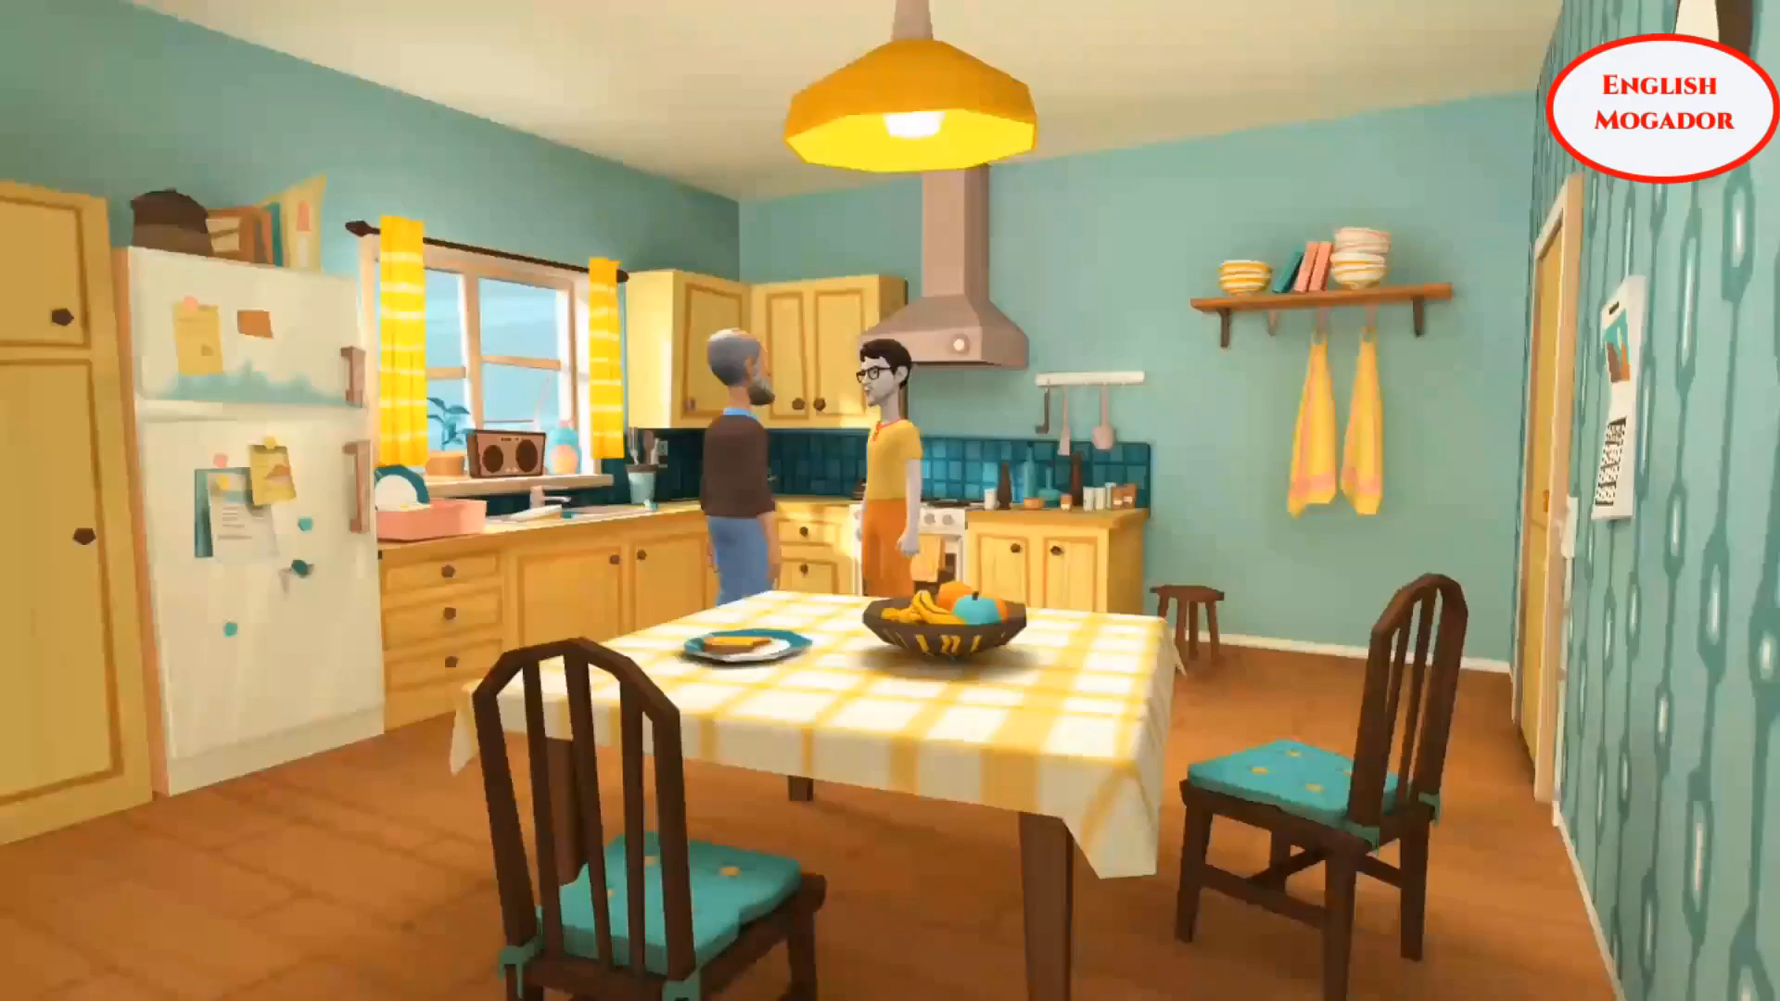
* WARM-UP
CLIP WATCHING
What is the clip about?
Giving and responding to good news

Slide 4

PRACTICE
EVERYDAY ENGLISH:
Giving and responding to good news
1
Listen and read the conversation, paying attention to the highlighted parts.
Nick: Great news for us. We’ll have school clouds so we won’t have to carry lots of books to school.
Mi: Great!
Nick: And my dad promised to give me a new Ipad to read books from the school clouds.
Mi: Congratulations!
Giving good news | Responding to good news
- Great news for us. - (Tell the news) | Great!: if good news is general and good for every one. Congratulations!: if the news is good for the speaker only

Slide 5


EVERYDAY ENGLISH:
Giving and responding to good news
2
Work in pairs. Give news and respond to the news in the following situations.
You tell your classmate about the new vending machine at your school.
2. You tell your classmate about a new laptop that your dad gave you on your birthday.
Máy bán hàng tự động

Slide 6
EVERYDAY ENGLISH:
Giving and responding to good news
2
Work in pairs. Give news and respond to the news in the following situations.
You tell your classmate about the new vending machine at your school.
A: Great news for us. Our school has the new vending machine
B: Great! That's awesome! What kind of food does it have?
A: Well, there are snacks, cookies, and even some healthy options like fruit cups and yoghurt.
B: That's fantastic! I'm looking forward to trying it out.

Slide 7
EVERYDAY ENGLISH:
Giving and responding to good news
2
Work in pairs. Give news and respond to the news in the following situations.
2. You tell your classmate about a new laptop that your dad gave you on your birthday.
A: I have some exciting news! On my birthday, my dad surprised me with a new laptop.
B: Wow, that's amazing! What are you planning to do with your new laptop?
A: Well, I will use it for schoolwork and projects.
B: That sounds fantastic!

Slide 8

LEARNING ONLINE
3
Work in pairs. Read the posts from some students about online learning and complete the table.
Mi: Our teacher uses Zoom to teach. But some students don’t have computers or smart phones. Others complain about the poor connection. I also feel more stressed when learning online.
Phong: We use Microsoft Teams. I don’t like online learning. My eyes get tired. I can’t concentrate well. But online learning helps us become more independent.
Tom: Our teacher uses Google Meet for video conferencing. It’s quite convenient, and we don’t have to get up early. Still, I prefer to study face-to-face. I want to see my classmates.
Nick: We use Zoom to discuss and share ideas. We interact in breakout rooms. It also helps us avoid traffic jams. But I’m not happy about the Internet connection at times.

Slide 9
LEARNING ONLINE
PRACTICE
3
Work in pairs. Read the posts from some students about online learning and complete the table.
Benefits | Problems
It’s convenient. ________________________________________________ ________________________________________________ ________________________________________________ | Some students don’t have computers or smart phones. _______________________________________ _______________________________________ _______________________________________ _______________________________________ _______________________________________ _______________________________________
Students don’t have to get up early.
The Internet connection is poor.
It helps students become more independent.
It makes some students feel more stressed when learning online.
It helps students avoid traffic jams.
Students can’t meet their classmates.
Some students get tired eyes and can’t concentrate well

Slide 10





LEARNING ONLINE
4
Work in groups. Talk about a platform you use for your online classes or one you know about. What are the benefits and problems of using it?
nền tảng

Slide 11
LEARNING ONLINE
4
Work in groups. Talk about a platform you use for your online classes or one you know about. What are the benefits and problems of using it?
Flatform: Zoom meeting
Benefits | Problems
user-friendly multi-functional : screen sharing, room breaking...) high security possible for large-sized class | limit time chargeable

Slide 12
5
Report the answers of one of your group members to the class.
You can conclude:
The name of the platform you use for your online classes or one you know about.
Its benefits
Its problems
Example:
Lan said that her extra class used Microsoft Teams. She said that she and her classmates found it difficult to use. However, it is convenient to have online classes on Microsoft Teams when the weather is bad.

Slide 13
5
Report the answers of one of your group members to the class.
Lan said that her extra class used Zoom. She said that It’s quite convenient and it is easy to use. It’s user-friendly,… However, one problem reported is that the users have to pay fee to have meetings without the time limitation.

Slide 14

* CONSOLIDATION
* What have we learnt in this lesson?
Giving and responding to good news.
Some benefits and problems of online learning.

Slide 15

* Homework
Learn the ways of giving and responding to good news.
Write a paragraph of 50-70 words about the benefits and problems of a platform you use for your online classes.
Do Exercises in the Workbook

Slide 16


Thank you!
Goodbye!

