Slide 1
Welcome to class 7/3
Teacher: Mrs Nguyet

Slide 2
Unit 8: Shopping
Looking back & project

Slide 3

KIM’S GAME
WARM-UP
https://www.youtube.com/watch?v=E0jqZMbQle4

Slide 4
KIM’S GAME
WARM-UP
shops
Newsagent shop
Chemist shop
fishmonger
baker
Green grocer
grocer
Opician shop
Hardware shop
Music shop
Stationery shop
Jewellery shop
florist

Slide 5

VOCABULARY
1
Match the words and phrases (1-5) with the meanings (a-e)
during sales
browsing
online shopping
wide range of products
shopaholic
the other action of using the Internet to order food or goods.
a time when many things in a shop are at lower prices than usual
a person who is addicted to shopping
going round and looking at the things on display
a great number of goods.

Slide 6
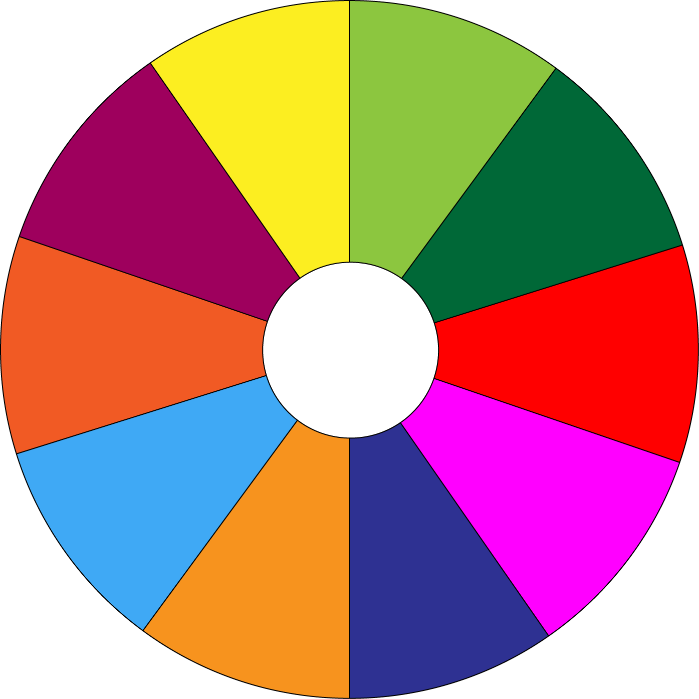
The Big Wheel
15
45
35
50
25
10
-15
-20
05
55
Play

Slide 7
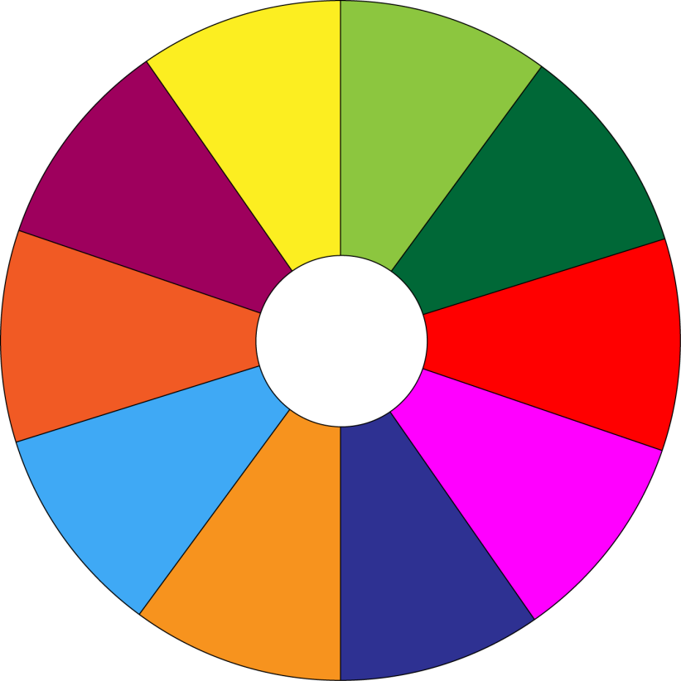
THE BIG WHEEL GAME
QUESTIONS
10
40
Q1
Q5
Q9
30
50
Q2
Q6
10
SPIN
20
10
Q3
Q7
11
-15
-20
Q4
Q8
05
60

Slide 8


This item has a price tag, so you cannot ___________.
A.bargain
C.on sale
A.bargain
B.offline

Slide 9
Look! These sports shoes are __________. They are 30% off.
C.on sale
A.bargain
B.offline
C.on sale

Slide 10
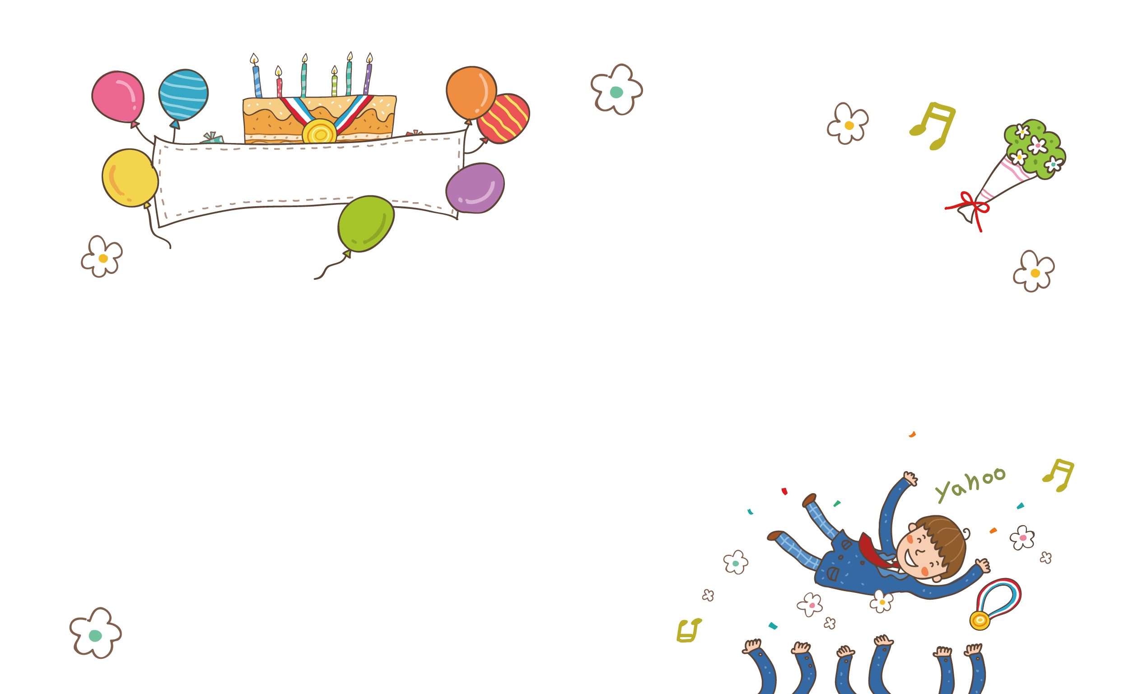
Do you have ______________ here? I want to check my email.
A.bargain
B.Internet access
C.home grown
B.Internet access

Slide 11


We ( use)__________ these vouchers for the next shopping.
A. Can you
A. Can you
b. Does use
C.. Is using

Slide 12
Mum, what time (be)________ the show tonight?
- Let me check.
A. are
B. is
B. is
C. was

Slide 13

My mother always shops __________. She never shops online.
B.offline
C.on sale
A.bargain
B.offline

Slide 14
We (not have)_________ home economics next semester. We have music instead.
A. don’t have
A. don’t have
B. doesn’t have
C. isn’t have

Slide 15

When you visit a farmers’ market, you will find a lot of ______.
fruit and vegetables.
A. On sale
C.home grown
B.offline
C.home grown

Slide 16



Slide 17

Lucky number

Slide 18
The shuttle bus (leave)__________every 15 minutes to take customers to the parking lot.
A. leave
B.Can leaves
C.leaves
C.leaves

Slide 19
GRAMMAR
3
Complete each sentence with a suitable adverb of frequency.
My sister __________watches the Junior Master Chef programme. She never misses an episode.
My mom________________ shops at the supermarket. But I don’t go there often.
My father __________ goes to a dollar store. He says there’s nothing worth buying there.
We don’t _____________ go to the supermarket. It’s far from our home.
Theses brands are _________ on sale, just once or twice a year.
always
always/ usually
never
often/ usually
rarely

Slide 20

GRAMMAR
4
Use the correct tense and form of the verbs in brackets to complete the sentences.
The shuttle bus (leave)__________every 15 minutes to take customers to the parking lot.
- Mum, what time (be)________ the show tonight?
- Let me check.
3. We (can use)__________ these vouchers for the next shopping.
4. The announcement says that the sale (last)________for just two hours, from 17:00 to 19:00 tomorrow.
5. We (not have)_________ home economics next semester. We have music instead.
leaves
is
can use
lasts
rarely

Slide 21
VOCABULARY
2
Complete the sentences with the words and phrases from the box.
Internet access
offline
home-grown
bargain
on sale
1. Look! These sports shoes are __________. They are 30% off.
2. This item has a price tag, so you cannot ___________.
3. Do you have ______________ here? I want to check my email.
4. When you visit a farmers’ market, you will find a lot of ___________.
fruit and vegetables.
5. My mother always shops __________. She never shops online.

Slide 22


PROJECT
YOUR DREAM SHOPPING PLACE
1
Imagine a shopping place you would like to have in your neighbourhood.

Slide 23
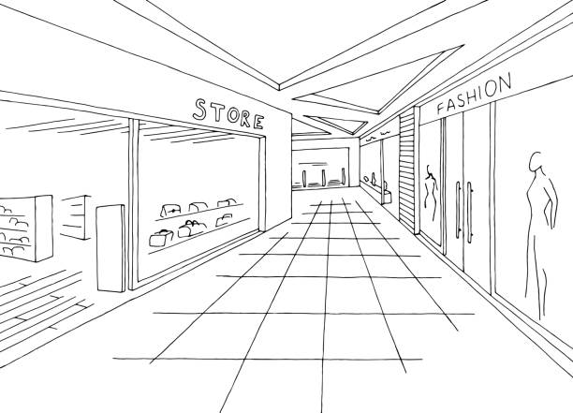
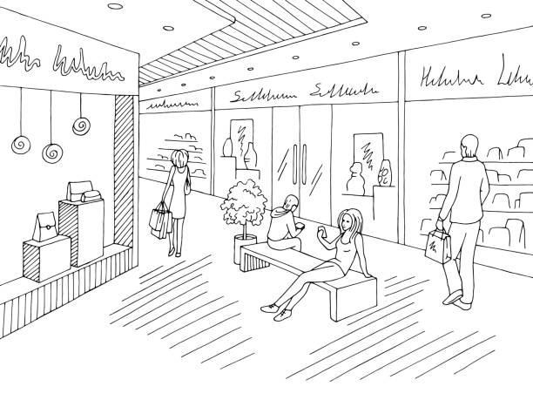
PROJECT
YOUR DREAM SHOPPING PLACE
2
Draw it or find a picture similar to it.

Slide 24

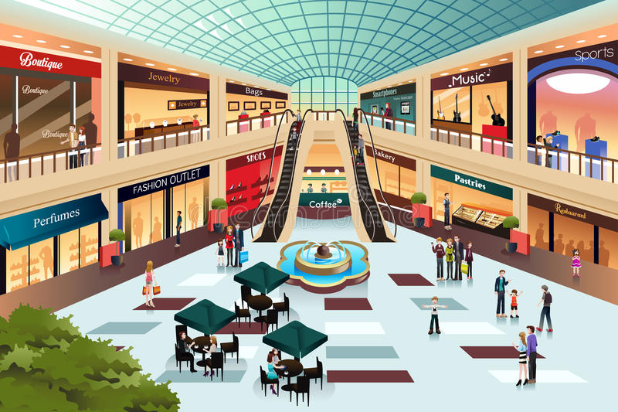
PROJECT
YOUR DREAM SHOPPING PLACE
3
Present it to the class.
You can include:
The name of the shopping place.
How beautiful/convenient it is.
Range of products/ services/ entertainment it offers.
What is special about it.

Slide 25
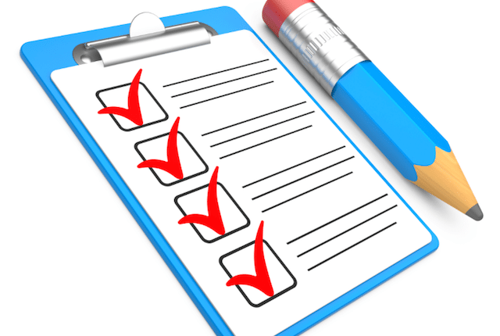
CONSOLIDATION
1
Wrap-up
What have we learnt in this lesson?
Reviewing vocabulary in Unit 8
Reviewing present simple and adverbs of frequency

Slide 26

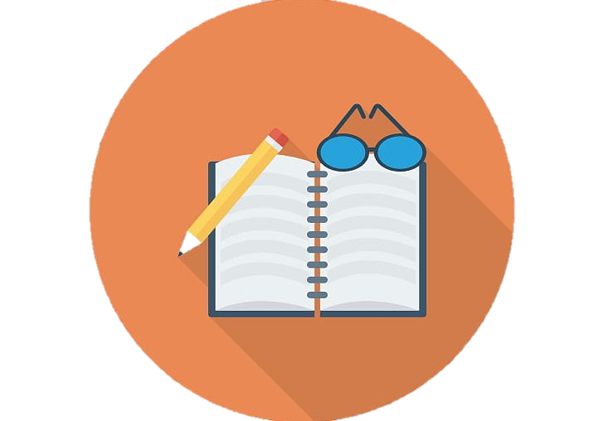
CONSOLIDATION
2
Homework
Do Exercise ………..page ……Unit 8/Workbook

Slide 27


