Slide 1


Slide 2

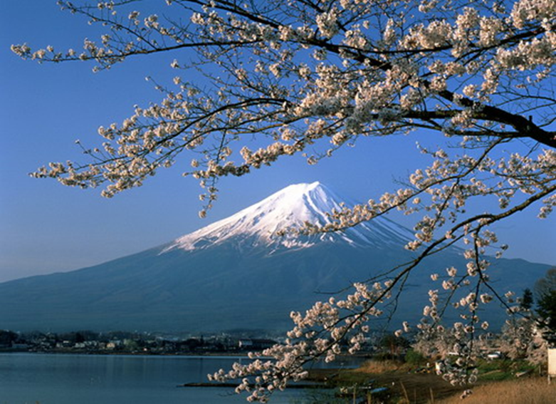
Muong Mun Secondary School
WELCOME TO MY CLASS
Teacher: Ca Thi Thuy

Slide 3

What types of energy do you know?
ENERGY

Slide 4
What types of energy do you know?
coal
solar
ENERGY SOURCE
wind
electricity
hydro
Nuclear
Natural gas
Water

Slide 5



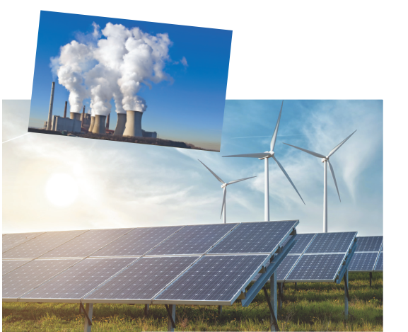
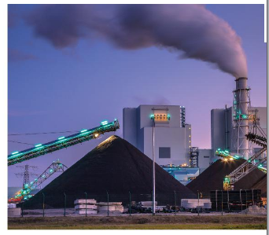
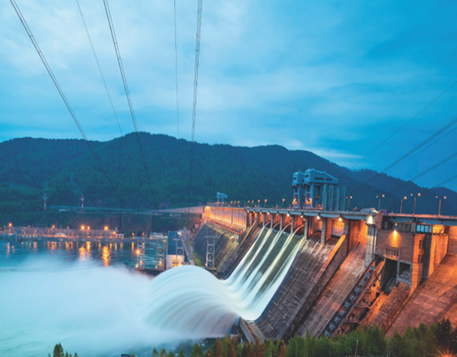
Unit
10
ENERGY SOURCES
LESSON 1: GETTING STARTED
HOBBIES

Slide 6

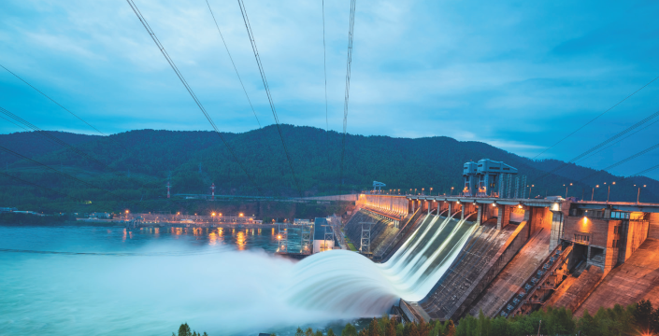
I. LISTEN AND READ
Lan: Hi, Dad.
Mr Tan: Lan, what are you doing? It’s pretty late now.
Lan: I’m doing a project on energy sources. But I don’t quite understand what energy is.
Mr Tan: Well, it’s power that we use to provide us with light, heat or electricity.
Lan: Oh. Where does it come from?
Mr Tan: It comes from many diﬀerent sources like coal, oil, natural gas, … We call them non-renewable sources.
Lan: Can it come from the sun, wind or water too?
Mr Tan: Yes, it can. We call those types of energy renewable sources because we cannot run out of them. Renewable means we can easily replace them.
Lan: I get it now.
Mr Tan: You know, some types of energy are cheap and easy to use, but others are more expensive and harder to find …

Slide 7
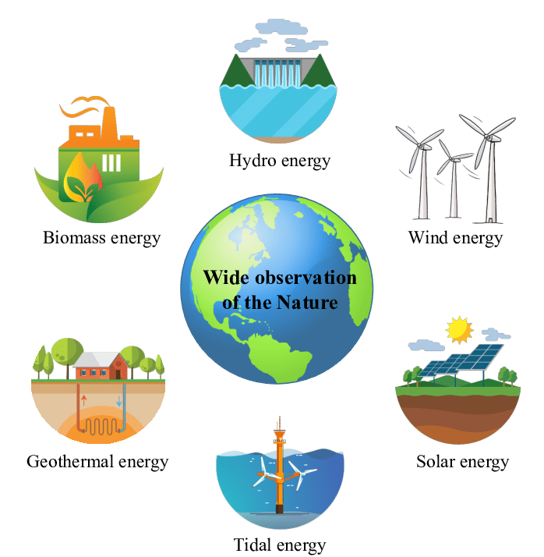
* VOCABULARY:
energy source (n)
/ˈenədʒi sɔːs/
nguồn năng lượng

Slide 8

* VOCABULARY:
coal (n)
/kəʊl/
than đá

Slide 9
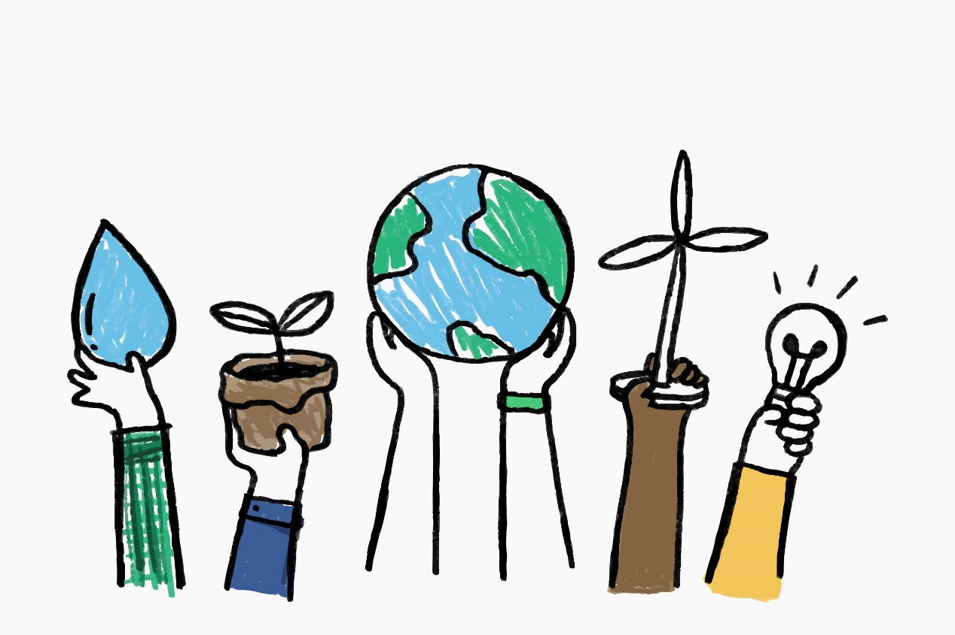
* VOCABULARY:
renewable (a)
/rɪˈnjuːəbl/
có thể tái tạo được

Slide 10
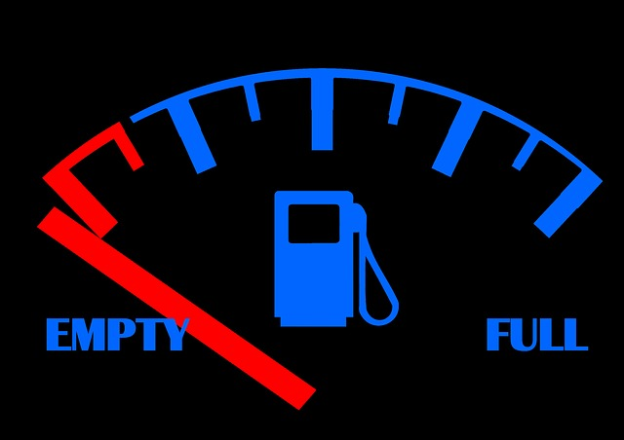
* VOCABULARY:
run out (phr. v)
/rʌn aʊt/
cạn kiệt

Slide 11
* VOCABULARY:
Replace (v)
/ri’pleis/
thay thế

Slide 12
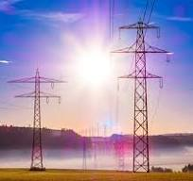
* VOCABULARY:
electricity (v)
/i,lek’trsiti/
điện năng

Slide 13

* Matching
renewable
coal
energy source
electricity
run out

Slide 14
I. LISTEN AND READ
Lan: Hi, Dad.
Mr Tan: Lan, what are you doing? It’s pretty late now.
Lan: I’m doing a project on energy sources. But I don’t quite understand what energy is.
Mr Tan: Well, it’s power that we use to provide us with light, heat or electricity.
Lan: Oh. Where does it come from?
Mr Tan: It comes from many diﬀerent sources like coal, oil, natural gas, … We call them non-renewable sources.
Lan: Can it come from the sun, wind or water too?
Mr Tan: Yes, it can. We call those types of energy renewable sources because we cannot run out of them. Renewable means we can easily replace them.
Lan: I get it now.
Mr Tan: You know, some types of energy are cheap and easy to use, but others are more expensive and harder to find …

Slide 15
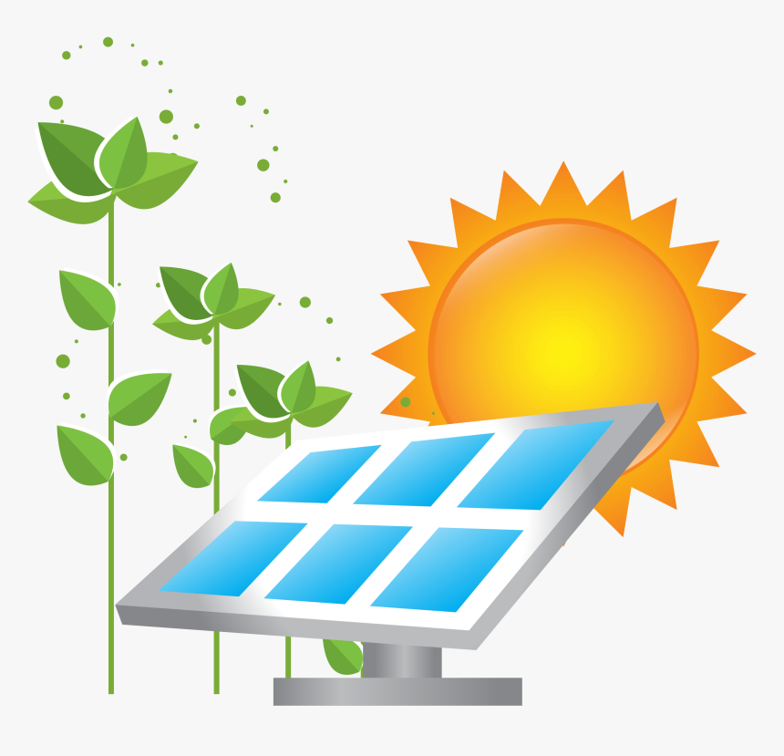
II. PRACTICE
1
What are Lan and her father talking about?
A. Energy
B. Sources
C. Energy sources

Slide 16





Who's a milionaire?
Questions
50:50
A.
B.
C.
D.
L
F

Slide 17
Who's a milionaire?
What is Lan doing?
1
50:50
A. She is doing housework
B. She is watching TV.
C. She is reading a story.
D. She is doing a project on ES
D. She is doing a project on ES
L
F

Slide 18
Who's a milionaire?
What does energy mean?
L
F
2
50:50
50:50
A. It’s power that we use to provide
us with light or electicity.
B. It’s power that we use to provide
us with light or electicity.
C. It’s power that we use to provide
us with light, heat or electicity.
D. It’s power that we use to provide
us with lelecticity
C. It’s power that we use to provide
us with light, heat or electricity

Slide 19
Who's a milionaire?
Where does energy come from?
3
50:50
A. two different souces
B. many different souces
B. many different souces
C. ten different souces
D. Seven different souces
L
F

Slide 20
Who's a milionaire?
4. What are renewable sources?
4
50:50
50:50
A. from the sun, wind and water.
A. from the sun, wind and water.
B. from the wind and water.
C. from the sun
D. from the sun and water.
L
F

Slide 21
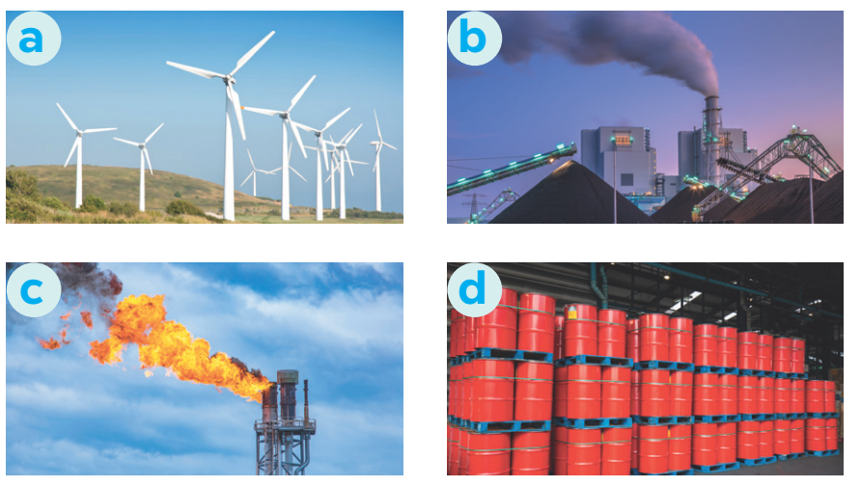
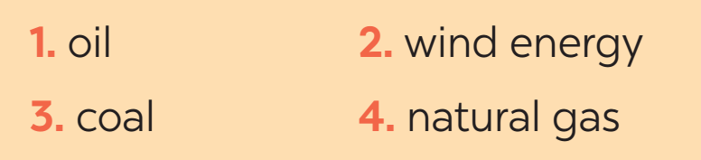
II. PRACTICE
3
Match the words / phrases in the box with the correct pictures.

Slide 22
II. PRACTICE
4
Complete each of the sentences with the correct word from the conversation
1. Energy is ______ that we use to provide us with light, heat or electricity.
2. When energy comes from the ______, wind and water, we call it renewable energy.
3. When energy comes from wind, we call it _______________ energy.
4. We cannot ______ out of renewable energy.
5. Some types of energy are ______ and easy to use.
power
sun
renewable/ wind
run
cheap

Slide 23

PRODUCTION
GROUP DISCUSSION
1. What is the best source of energy?
2. Why do you think it is the best one?

Slide 24
CONSOLIDATION
1
WRAP-UP
ENERGY SOURCES
TYPES OF ENERGY
SOURCES OF ENERGY
Topic of the unit
Vocabulary

Slide 25

CONSOLIDATION
2
HOMEWORK
Do exercises in your workbook.
Prepare the vocabulary for the next lesson: A closer look 1.

Slide 26

Website: sachmem.vn
Fanpage: facebook.com/sachmem.vn/

