Slide 1
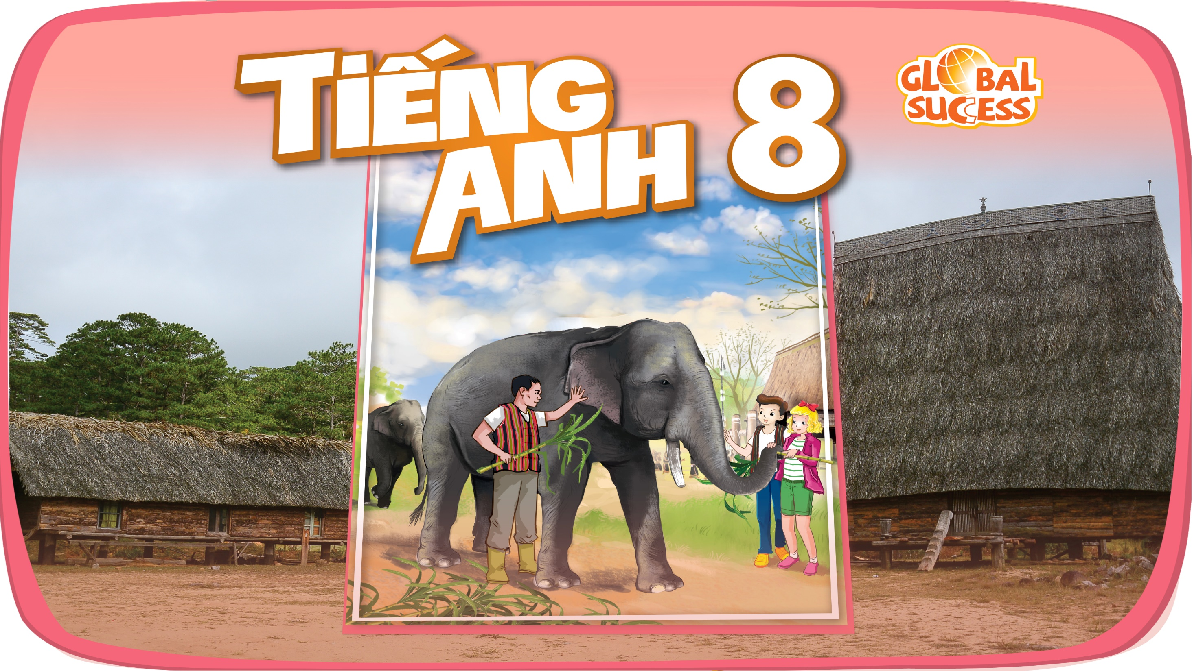

Slide 2



Unit
12
LIFE ON OTHER PLANETS
LESSON 6: SKILLS 2
1
Unit
LISTENING
WRITING

Slide 3
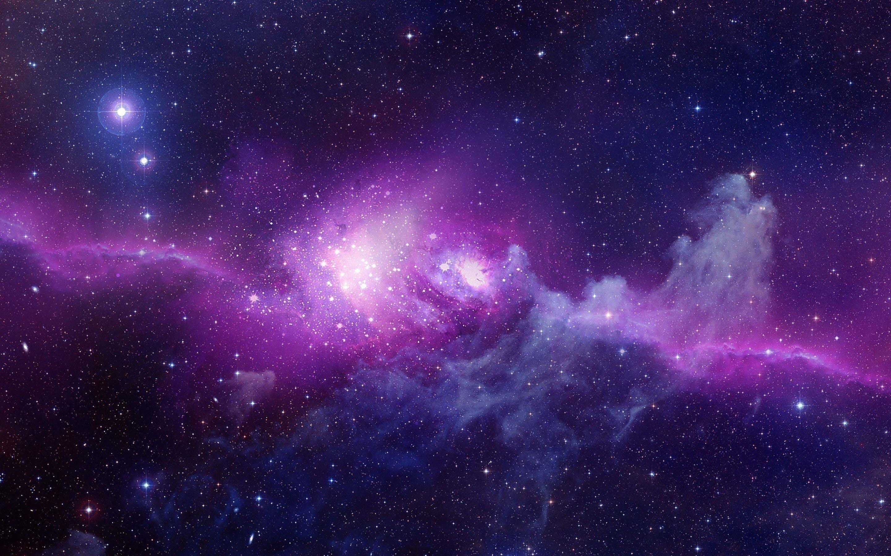
WARM UP
Draw the picture in 3 minutes about the alien you like:
What does it look like?
Where does it live?

Slide 4
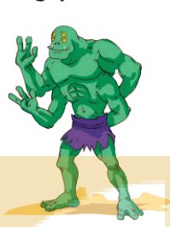
LISTENING
1
Work in pairs. Look at the picture and answer the following questions.
1. Where do you think this creature is from?
2. What do you think it can do?
It is from another planet/Mars/Venus….
It can jump. It can catch 4 fish at the same time with his hands. It can do handstand….

Slide 5

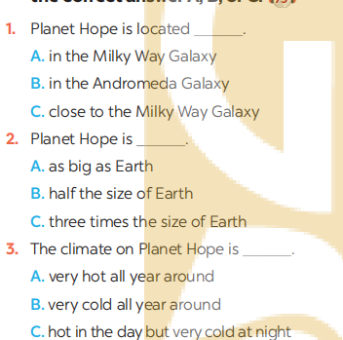
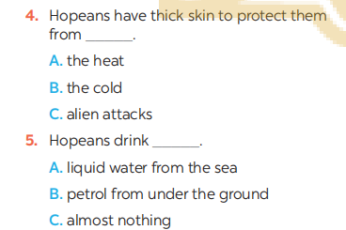
LISTENING
2
You will hear a student talking about an imaginary planet that supports life. Listen and choose the correct answer A, B, or C.

Slide 6
LISTENING
3
Read the following information about Hopeans. Listen again and fill in each blank with ONE word or number that you hear
Name | Hopeans
Living place | Planet Hope in the Milky Way Galaxy
Apperance | – have a big head, (1) _____ eyes, two legs, and (2)_____ arms. – have thick skin to protect them from the heat.
Behaviour | – friendly and (3) ______. – only (4) ______ to people who try to attack them.
Lifestyle | – eat special (5) ______ and drink petrol from under the ground. – travel by (6) ______ at very high speeds.
4 (four)
4 (four)
hospitable
dangerous
plants
rockets

Slide 7
Good morning, everyone. Today I’d like to tell you about life on a planet called Planet Hope.
Planet Hope is in the Milky Way Galaxy. It is three times bigger than Earth. It has three suns and four moons, so the weather is hot all year round, and its surface is quite dry. Planet Hope has only one season. The creatures living there are Hopeans, and they don’t look like us. They have a big head, four eyes, two legs and four arms. They have thick skin to protect them from the heat. They are very friendly and hospitable. They are only dangerous to people who try to attack them. Hopeans grow special plants for food. They don’t drink liquid water; they drink a type of petrol from under the ground. Hopeans use rockets to travel at very high speeds. That is my description of Planet Hope and the creatures living on it. I hope you enjoyed it and thank you for listening.

Slide 8
WRITING
4
Work in pairs. Use your imagination to make notes in the table below about what aliens living on another planet would be like.
Name
Living place
Apperance
Behaviour
Lifestyle
LUCKY
LUCKY PLANET
– have a small head, one small eyes, two legs, two wings and six arms. – have green skin.
– friendly and hospitable. – only dangerous to people who try to attack them.
– eat special meat and drink alcohol. – fly with their wings.

Slide 9
WRITING
5
Write a paragraph (80 - 100 words) describing aliens living on another planet. Use your notes in .
4
Creatures living on Lucky Planet are called Lucky.
They have a small head, one small eyes, two legs, two wings and six arms. They also have green skin. They are friendly and hospitable. They’re only dangerous to people who try to attack them. Their favorite food is special meat. They always drink alcohol. They can travel in high speed by flying.
Creatures living on ________________
are called ______________________
______________________________
______________________________

Slide 10

CONSOLIDATION
1
Wrap-up
What have we learnt in this lesson?
Listen about an imaginary planet and its creatures.
Write a paragraph to describe imaginary planet and its creatures.

Slide 11

CONSOLIDATION
2
Homework
Rewrite the paragraph on the notebook.

Slide 12

Website: hoclieu.vn
Fanpage: facebook.com/sachmem.vn/

