Slide 1

Hello everyone !!!

Slide 2
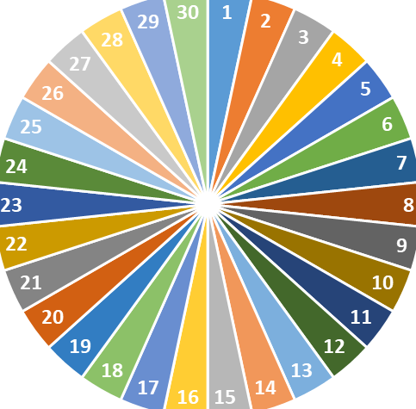
Check out the old lesson by spinning the wheel to call out the name
- GV copy ds hs lớp mình và dán vào, hoặc là theo số thứ tự vẫn ok
- Nếu lớp có số lượng khác thì Nhắn fb: Côi Nguyễn (Mrs Thu Ba) tạo giúp cho vòng quay khác : Liên hệ số Zalo 0837939997

Slide 3

* CHECK-UP
What we have learnt in this unit:
Vocabulary
Pronunciation
Grammar
Communication
technology
- Stress words that
ending in -ese
and -ee
  - Prepositions of place and time
  - Possessive pronouns

Slide 4


Unit
10
COMMUNICATION IN THE FUTURE
LESSON 7: LOOKING BACK & PROJECT
1

Slide 5
* VOCABULARY
1
Circle the correct option to complete each sentence below.
1. My classmates connect with each other on a(n) social network / emoji called Friends-connect.
2. Holography / Telepathy helps people communicate by thoughts.
3. Sending voice messages / text messages is convenient because you don’t have to type.
4. In the future, everyone can carry a human translator /
translation machine with them whenever they go abroad.
5. If you have a high-speed Internet connection, making a group call / meeting face to face is a piece of cake.

Slide 6
2
Fill in each gap with a word from the box to complete the passage.
text instantly language real social
In 30 years, social robots will become popular. This kind of robot is special because it can perform many human tasks. For example, it can send a (1) ______ message to its owner to remind them of dinner time. Some social robots may even have (2) ______ network accounts and interact with other users in (3) ______ time. For these robots, (4) ________ barriers are not a problem, so they can
(5) ________ reply to comments or messages in any language. It might be frightening because we won’t know whether we are chatting with a human or a robot online!
text
social
real
language
instantly

Slide 7

* GRAMMAR
3
Complete the sentences with the prepositions from the box.
Tick the sentences which have prepositions of time.
in on for by opposite
1. I talk to my mum ______ the phone every weekend.
2. Maria texted me that she would be home ______ 10 minutes.
3. Phong waited ______ an hour. Then he called Ann and said that he had to leave.
4. Where’s Ms Lan? – She’s in the ________ room. She’s having
a video conference.
5. Telepathy might be the most popular way to communicate ______ 2050.
on
in
for
opposite
by

Slide 8
4
Which of the underlined parts in each question is incorrect? Find and correct it.
1. A friend of my cannot connect her phone to the Internet.
A B C
2. Trang and Linda will be at television this evening to talk about future
communication. A B C
3. Three of ours cousins are studying in the same class.
A B C
4. I’m putting aside some money because I want to buy a new car on two years.
A B C
5. Please send the homework to your teacher via email in Thursday.
A B C
mine
on
our
in
by/on

Slide 9

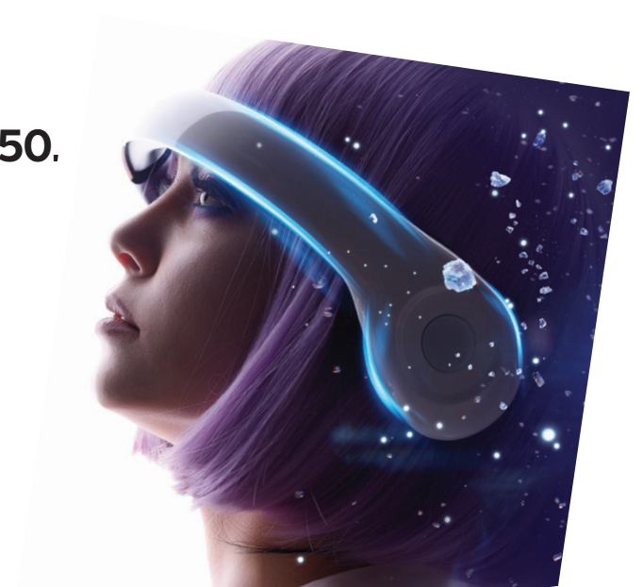

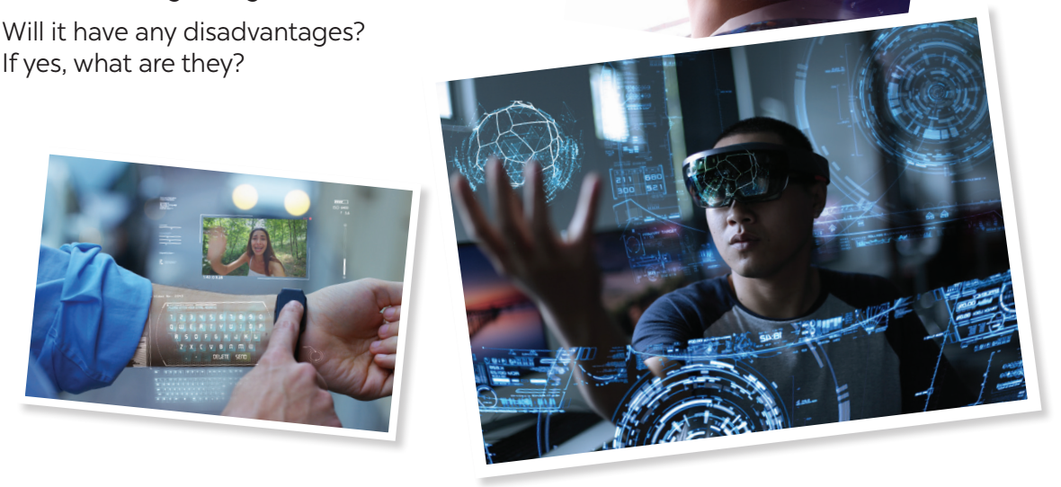
* PROJECT

Slide 10
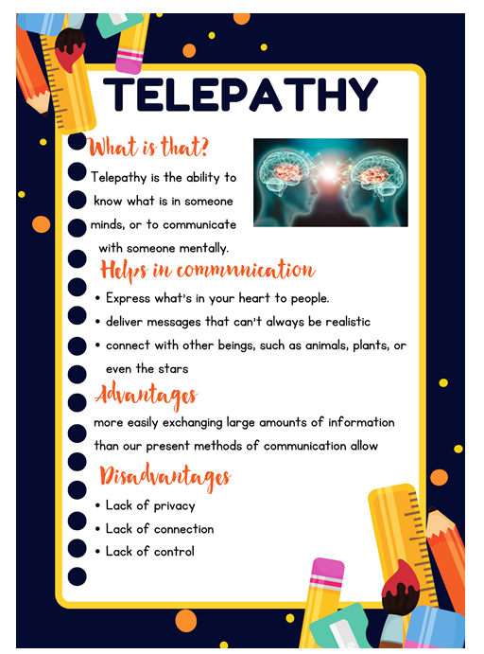
* PROJECT
Imagine a means of communication in 2050
Describe that means of communication
- What is it?
- How will it help you communicate?
- What advantages might it have?
- Will it have any disadvantages? If yes, what are they?
Present your idea to the class. You can make a poster or create a model for your presentation.

Slide 11
* CONSOLIDATION
What have we learned in this lesson?
Review vocabulary related to communication technology
Review prepositions of place and time and possessive pronouns
Project: Communication in the future

Slide 12

* Homework
Do exercises in the workbook.
Prepair Unit 11 (Getting started)

Slide 13


Thank you!
Goodbye!

