Slide 1

Hello everyone !!!

Slide 2
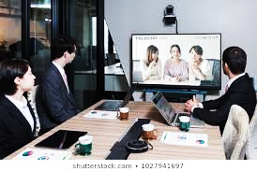
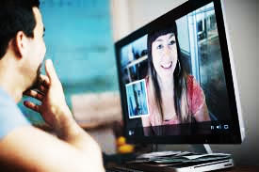



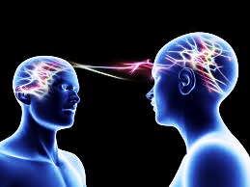
* WARM-UP:
Match the word and picture .
1. emailing
a
d
2. video chatting
3. using telepathy
4. using social
media
b
e
5. having a video conference
6. meeting face-to-face
c
f

Slide 3
* WARM-UP:
Match the word and picture .
a
b
c
5. having a video conference
4. using social
media
1. emailing
d
e
f
2. video chatting
6. meeting
face-to-face
3. using telepathy

Slide 4

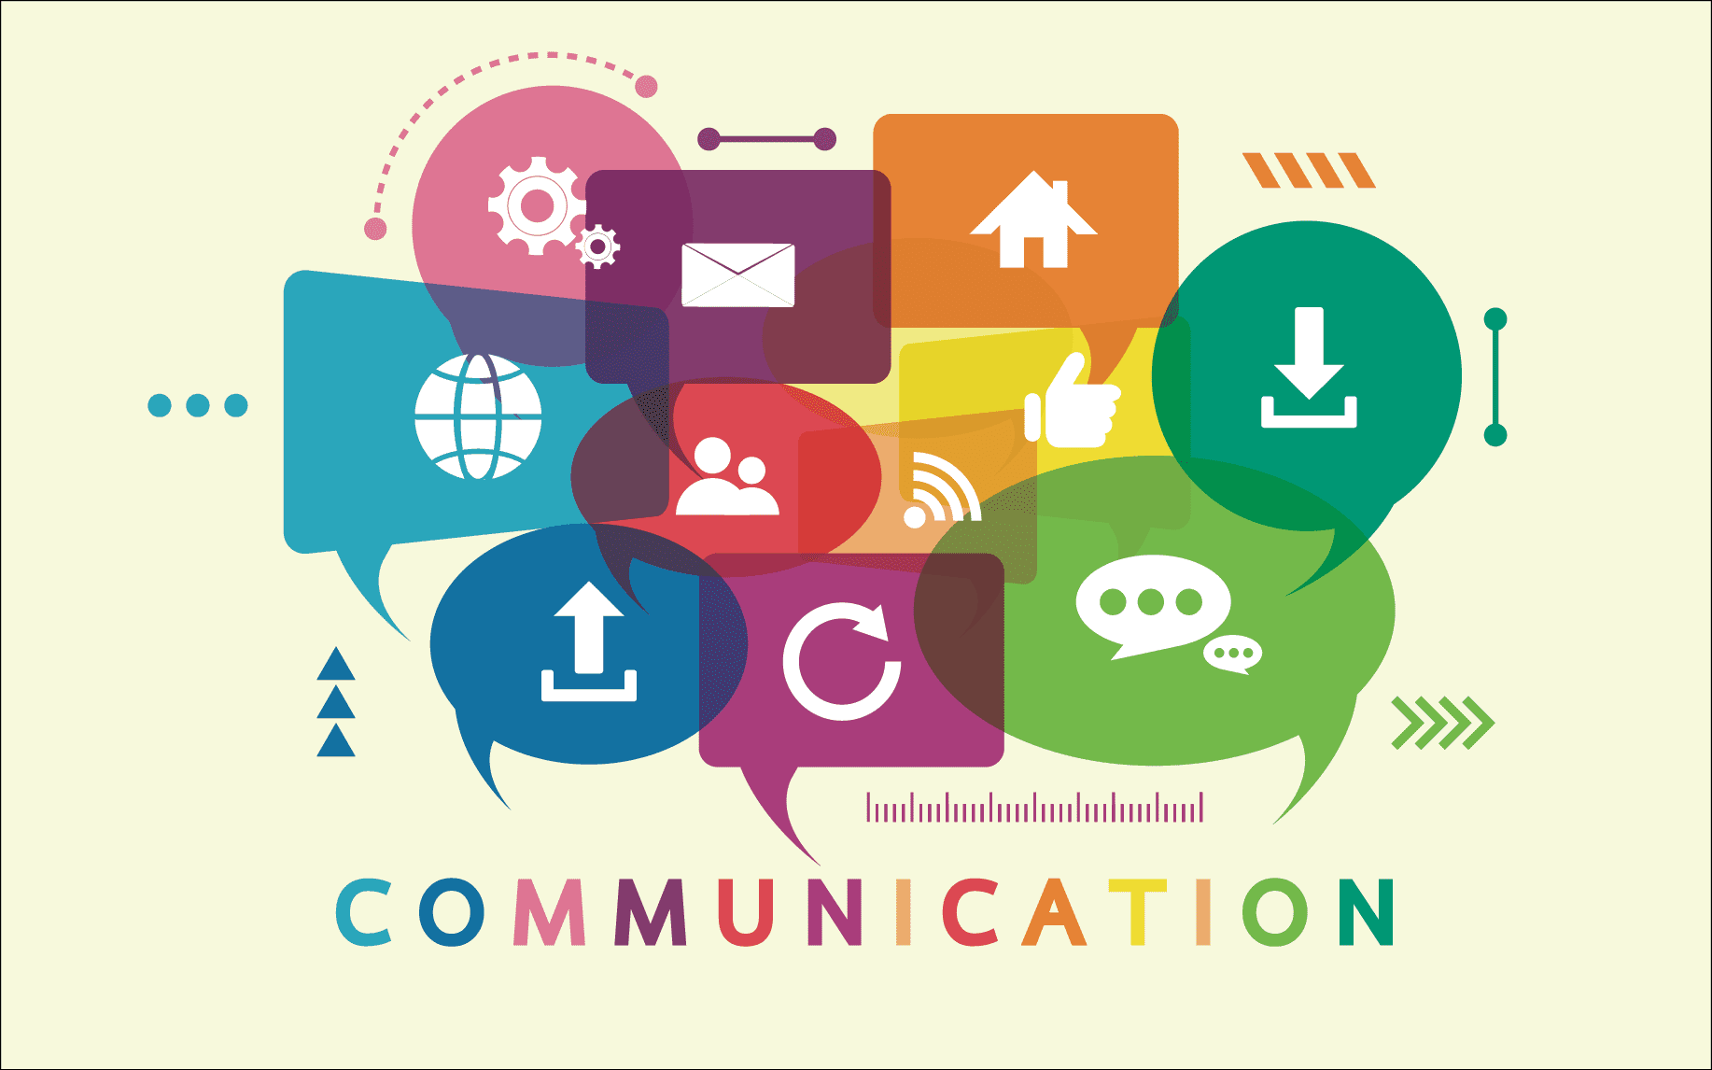
Unit
10
COMMUNICATION IN THE FUTURE
LESSON 6: SKILLS 2

Slide 5
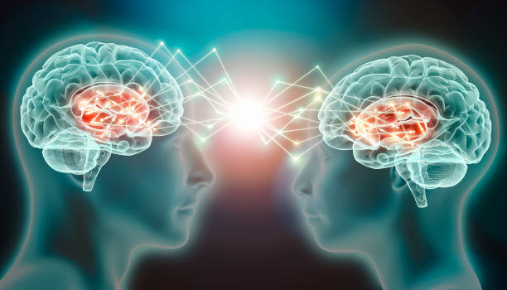
I. LISTENING

Slide 6

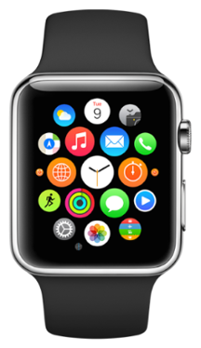
1
Look at the pictures. Complete the word / phrase for each picture.
1. c_____ pigeon
2. s____________
carrier
smartwatch

Slide 7
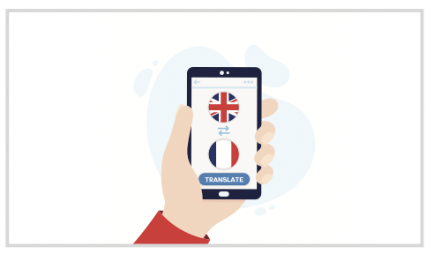
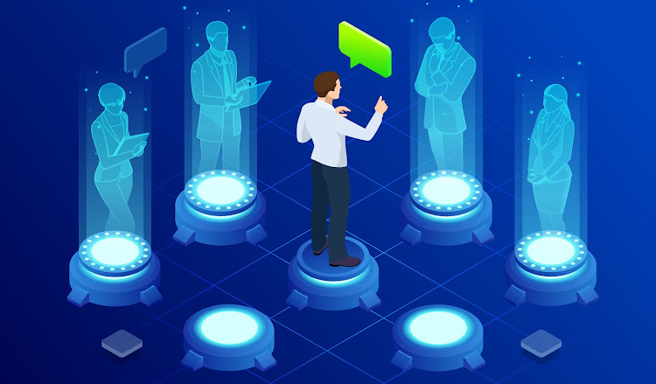
1
Look at the pictures. Complete the word / phrase for each picture.
3. t_______ machine
4. h_________
translation
holography

Slide 8

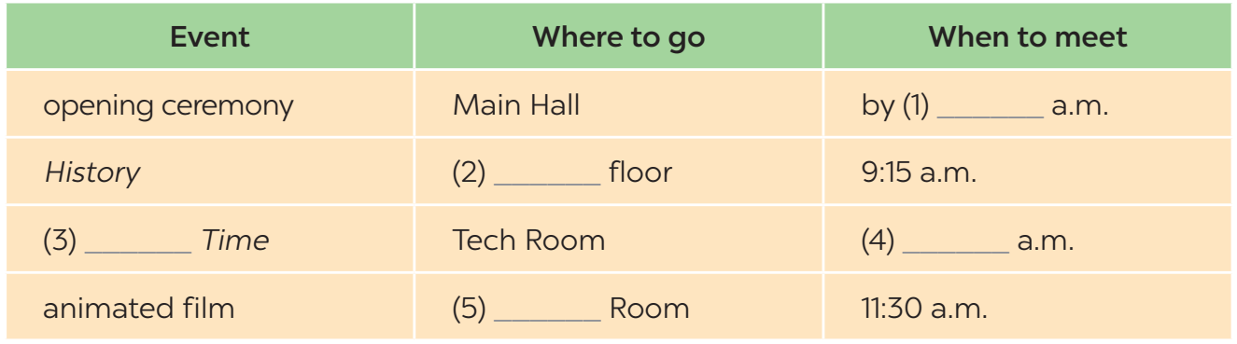


2
Listen to an announcement about an exhibition. Complete each gap in the agenda with ONE word or a number.
8:20
First
Modern
10:15
Cinema

Slide 9
3
Listen again. Circle the correct answer A, B, or C.
1. Who is making the announcement?
A. A teacher. B. A student C. Dr Lam.
2. What is in the History section?
A. An introductory talk. B. A documentary. C. Many pictures.
3. What is NOT true about the Modern Time section?
A. Students won’t like this section.
B. It shows smart devices.
C. They will be there for one hour.

Slide 10
3
Listen again. Circle the correct answer A, B, or C.
4. What will the film in the Cinema Room be about?
A. Super smartwatches.
B. Translation devices for personal use.
C. Telepathy machines.
5. In general, what does the exhibition show?
A. Problems of modern technology.
B. History of smartphones.
C. Means of communication.

Slide 11
Tapescript
Hi students! Here's our plan for the exhibition tomorrow morning.First, the opening ceremony is at the Main Hall. We'll listen to Dr. Lam introduce the exhibition. The ceremony starts at 8:30 am, so remember to meet me at the Main Hall by 8:20. Next, we'll visit the "History” section. It's on the first floor. You'll see pictures of different ways people communicated in the past, such as smoke signals and carrier pigeons. We'll be there from 9:15 to 10:00.Then, we'll move to the "Modern Time” section. It's in the Tech Room. You will see devices with internet connections, like smartphones and smartwatches. I'm sure you'll like it very much but we can only spend an hour there from 10:15 to 11:15.Finally, we'll watch an animated film in the Cinema Room. The film is about communication devices in the future, like personal translation machines and holography. We must be at the Cinema Room by 11:30 am
Now...

Slide 12

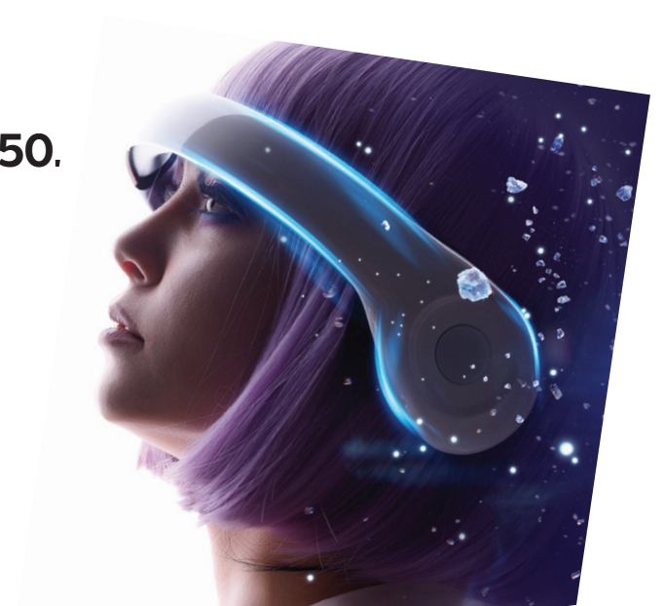

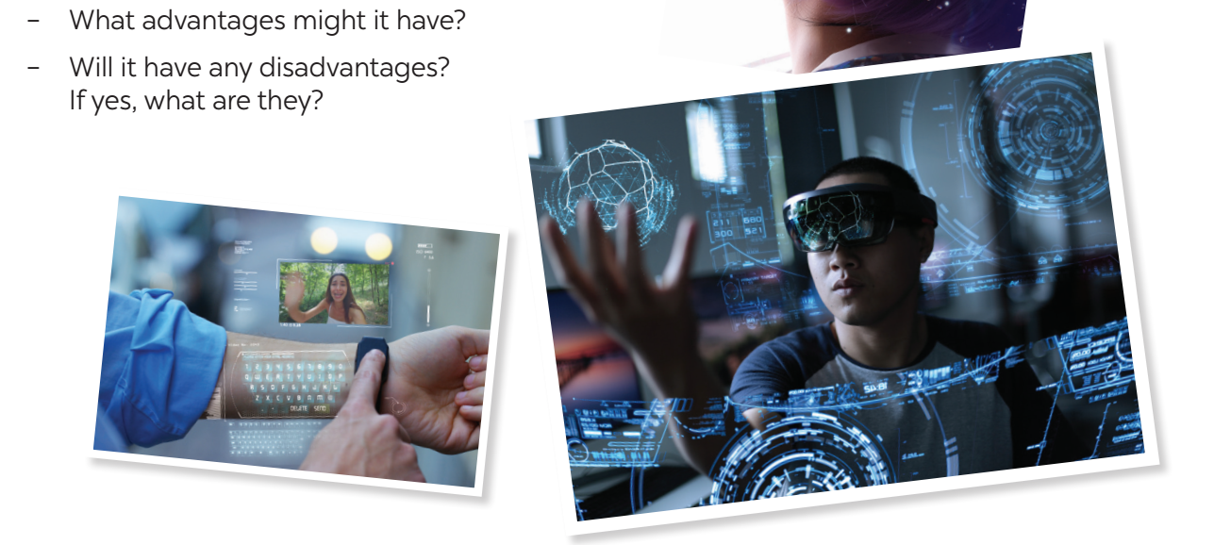
II. WRITING

Slide 13
4
Work in pairs. Match the ideas (a - h) with parts of an outline (1 - 4) for a paragraph about a video call.
a phone call using Internet connection
needs a high-speed Internet access
saves time because people needn’t travel to meet
transmits live images of the speakers with a webcam or camera on smart devices
may spend too much time chatting with each other
can be useful for family members and business partners
will still be a common tool of communication
can see and hear each other in real time
1. What is it?
2. What are its advantages?
3. What are its disadvantages?
4. Will people use it in the future?
a, d
c, f ,h
b, e
g

Slide 14
WRITING
5
Write a paragraph (80 – 100 words) to describe a way of modern communication. You can use the ideas in 4 or your own ideas.

Slide 15
5
Write a paragraph (80 – 100 words) to describe a way of modern communication. You can use the ideas in 4 or your own ideas.
Suggested answer:
Making a video call is a modern way of communication. A video call is a phone call via the Internet. It transmits live images of the speakers with a webcam or camera on smart devices. Video calls are time-saving because people do not need to travel to meet and still see and hear each other in real time. They help both family members and business partners keep contact with each other regardless of geographic distances. However, video calls require high-speed Internet access, so not all the time people can make one. I believe that when the Internet becomes better in the future, video calls will be an even more common tool of communication.

Slide 16
Suggested answer:
Have you ever asked yourself what ways of communication you will be using in the future? I strongly believe there will be huge changes in the way we communicate. Presently, we often meet face-to-face, send emails or chat online to work on our group projects. But it’s possible that in the year 2030, we’ll be having video conferences with 3D images and Hololens Virtual Reality Glasses to interact with these people. When we want to ask our friends to get some drinks, we often contact them by phone or social media.
However, in 20 years, super-smart phones, which can read your thoughts and automatically transfer them into text or voice messages, will be replacing those methods. Besides, I guess telepathy will be especially popular then. And I bet in 40 years, we will be able to understand what our pets are thinking with the help from some smart devices. That will certainly be very amazing!

Slide 17
* CONSOLIDATION
* What have we learnt in this lesson?
Listen to an announcement for an exhibition
Write a paragraph to describe a way of communication

Slide 18

- Rewrite the email on the notebook.
- Prepare for Lesson 7 – Looking back & Project.

Slide 19
* Homework:
Do exercise in the workbook.
Rewrite the paragraph in the notebook.
Prepare “ Looking back and project”

Slide 20




Slide 21
