Slide 1

Hello everyone !!!
English 8

Slide 2


Unit
10
COMMUNICATION IN THE FUTURE
LESSON 4: COMMUNICATION
1

Slide 3
* WARM-UP
Ask and answer.
Question: How do you see you in 10 years?
Answer: I will _________________.
Your future
Hold on. Can you repeat that, please?

Slide 4


* EVERYDAY ENGLISH
1
Listen and read the conversations below. Pay attention to the highlighted parts.
Mark: Now, about the video conference ... Everyone must be here at 9:30 a.m., and ...
Trang: Sorry for interrupting, but I think we should meet at 9:00 a.m. We need to test the devices.
1
Nick: This webcam is easy to handle. You click these buttons to move it up or down and these to ...
Lan: Hold on. Can you repeat that, please?
2
Structure | Examples
How to interrupt politely | Sorry for interrupting, but Hold on.

Slide 5
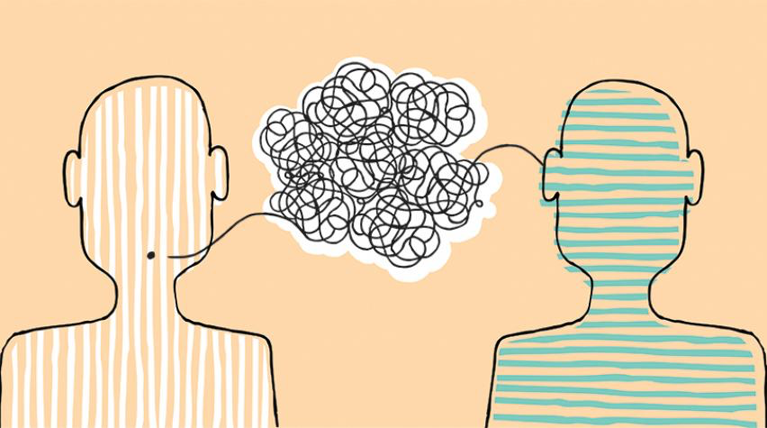
* EVERYDAY ENGLISH
2
Work in pairs. Make similar conversations with the following situations.
1. Student A is telling student B how to make a video call. Student B interrupts student A to ask for clarification.
2. Student A is telling student B the place for their next meeting. Student B interrupts student A to suggest another place.

Slide 6
* EVERYDAY ENGLISH
2
Work in pairs. Make similar conversations with the following situations.
1. Student A is telling student B how to make a video call. Student B interrupts student A to ask for clarification.
* Example:
A: First, you open Facetime application on your laptop. And then you select from your contacter or you type their phone number ...
B: Hold on. Can you repeat, please?

Slide 7
* EVERYDAY ENGLISH
2
Work in pairs. Make similar conversations with the following situations.
2. Student A is telling student B the place for their next meeting. Student B interrupts student A to suggest another place.
* Example:
A: Well, the meeting is 9 a.m tomorrow morning. We will hold a meeting in Communication room which is on floor ...
B: Sorry for interupting, but that room this occupied by the other class. We can hold a meeting in Room 401.

Slide 8
THE FUTURE OF LANGUAGE
3
Work in pairs. Read Mark’s prediction about a popular means of communication in the near future. Then ask and answer the questions.
Mark: In 20 years, people of all ages will be using emojis even more than now. Emojis help people communicate their emotions effectively regardless of the language they speak. For example, a smiley face expresses the same meaning everywhere. An emoji can replace words to a certain extent. One day, we might receive an email that contains only emojis!

Slide 9
3
Work in pairs. Read Mark’s prediction about a popular means of communication in the near future. Then ask and answer the questions.
1. What means of communication is Mark talking about?
2. When will emojis become more commonly used?
3. Who will be using them?
4. How will they help in communication?
5. Why will they become more popular?
Game

Slide 10














Game
Gift box secret game

Slide 11








1. What means of communication is Mark talking about?
→ Emojis
You are given 3 candies
GO HOME

Slide 12
2. When will emojis become more commonly used?
→ In 20 years
You are given 2 candies
GO HOME

Slide 13
3. Who will be using them?
→ People of all ages
You are given 10 mark
GO HOME

Slide 14
4. How will they help in communication?
→ Emojis help people communicate their emotions effectively regardless of the language they speak.
You are given 5k
GO HOME

Slide 15
5. Why will they become more popular?
→ Because an emoji can replace words to a certain extent.
You are given 5k
GO HOME

Slide 16
3
Work in pairs. Read Mark’s prediction about a popular means of communication in the near future. Then ask and answer the questions.
1. What means of communication is Mark talking about?
2. When will emojis become more commonly used?
3. Who will be using them?
Emojis
In 20 years
People of all ages
4. How will they help in communication?
5. Why will they become more popular?
Emojis help people communicate their attitudes effectively regardless of the language they speak.
Because an emoji can replace words to a certain extent.

Slide 17
THE FUTURE OF LANGUAGE
4
Work in pairs. Choose one means of communication below. Ask and answer questions about it.
1. Automatic translation function
– When: in 10 years
– Who: social network users
– How: translate comments and private messages in all languages
– Why: remove language barriers
2. Chatbot
– When: in 10 years
– Who: sellers of online shops
– How: instantly reply to customers in all languages
– Why: help sell more products to customers from other countries

Slide 18
PRODUCTION
5
Report your pair’s conversation to the class by making a similar talk to Mark’s prediction in 3.
Mark: In 20 years, people of all ages will be using emojis even more than now. Emojis help people communicate their emotions effectively regardless of the language they speak. For example, a smiley face expresses the same meaning everywhere. An emoji can replace words to a certain extent. One day, we might receive an email that contains only emojis!

Slide 19

* CONSOLIDATION
What have we learnt in this lesson?
How to interrupt politely
The future of language

Slide 20

* Homework:
- Do exercise in WB
- Prepare the next lesson: Unit 10- Skills 1.

Slide 21




