Slide 1


Hello everyone !!!

Slide 2
* WARM-UP
1. devio receonnfc
2. atlbet
3. tinerent neitonccon
4. oomz ni
5. cebwam
→ video conference
→ tablet
JUMBLED WORDS
→ internet connection
→ zoom in
→ webcam

Slide 3


Unit
10
COMMUNICATION IN THE FUTURE
LESSON 2: A CLOSER LOOK 1

Slide 4


* VOCABULARY
social network (n)
/ˌsəʊʃl ˈnetwɜːk/
mạng xã hội

Slide 5
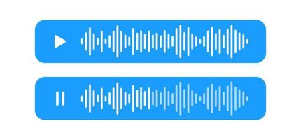
* VOCABULARY
voice message (n)
/ˈvɔɪs mesɪdʒ/
tin nhắn thoại

Slide 6
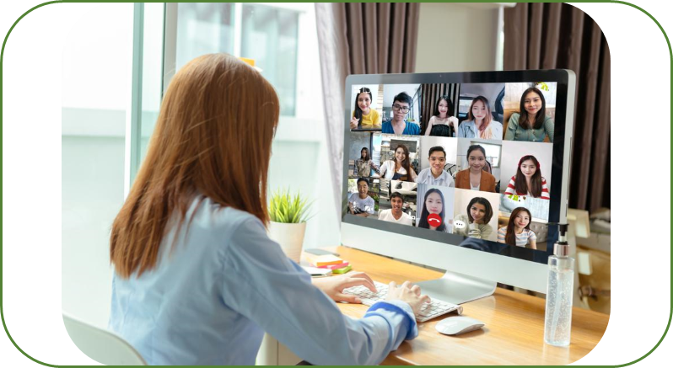
* VOCABULARY
group call (n)
/ɡruːp kɔːl/
cuộc gọi nhóm

Slide 7

* VOCABULARY
smartphone (n)
/ˈsmɑːtfəʊn/
điện thoại thông minh

Slide 8

* VOCABULARY
- emoji (n)
/ɪˈməʊdʒi/
biểu tượng cảm xúc

Slide 9
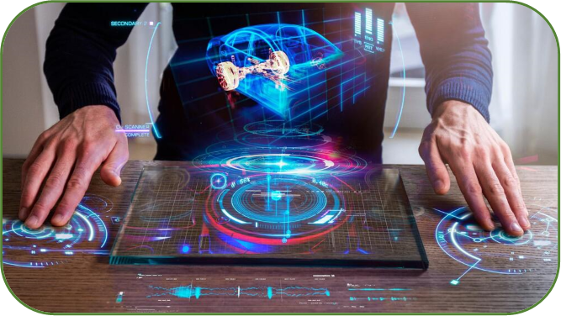

* VOCABULARY
holography (n)
/hɒlˈɒɡrəfi/
hình chiếu 3 chiều

Slide 10

* VOCABULARY
instantly
= right now
/ˈɪnstəntli/
ngay lập tức

Slide 11

* VOCABULARY
private
/'praivit/
bí mật, riêng tư

Slide 12
* VOCABULARY
New words | Pronunciation | Meaning
1. social network (n) | /ˌsəʊʃl ˈnetwɜːk/ | mạng xã hội
2. voice message (n) | /ˈvɔɪs mesɪdʒ/ | tin nhắn thoại
3. group call (n) | /ɡruːp kɔːl/ | cuộc gọi nhóm
4. smartphone (n) | /ˈsmɑːtfəʊn/ | điện thoại thông minh
5. emoji (n) | /ɪˈməʊdʒi/ | biểu tượng cảm xúc
6. holography (n) | /hɒlˈɒɡrəfi/ | hình chiếu 3 chiều
7. instantly (adv) | /ˈɪnstəntli/ | ngay lập tức
8. private (adj) | /'praivit/ | bí mật , riêng tư

Slide 13
* Checking vocab:
New words | Meaning
1. | mạng xã hội
2. | tin nhắn thoại
3. | cuộc gọi nhóm
4. | điện thoại thông minh
5. | biểu tượng cảm xúc
6. | hình chiếu 3 chiều
social network (n)
voice message (n)
group call (n)
smartphone (n)
emoji (n)
holography (n)
7. | ngay lập tức
8. | bí mật, riêng tư
instantly (adv)
private (adj)

Slide 14
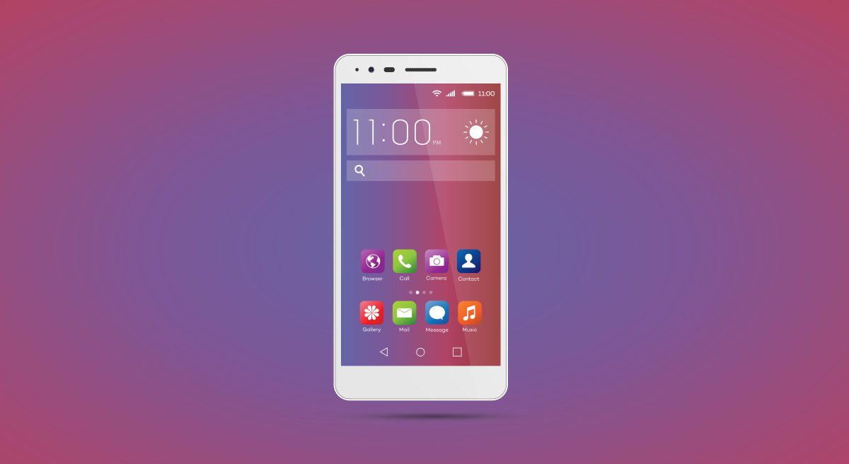
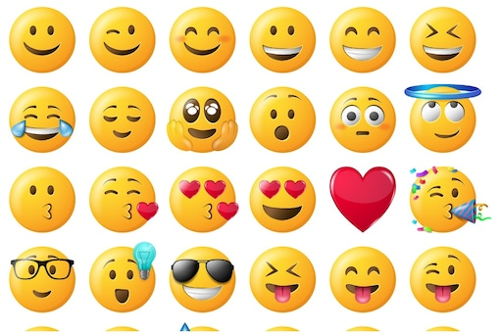
* VOCABULARY
1
Write the correct word or phrase from the box under each picture.
voice message smartphone social network
emojis group call holography
1. ___________
emojis
smart phone
2. ___________

Slide 15
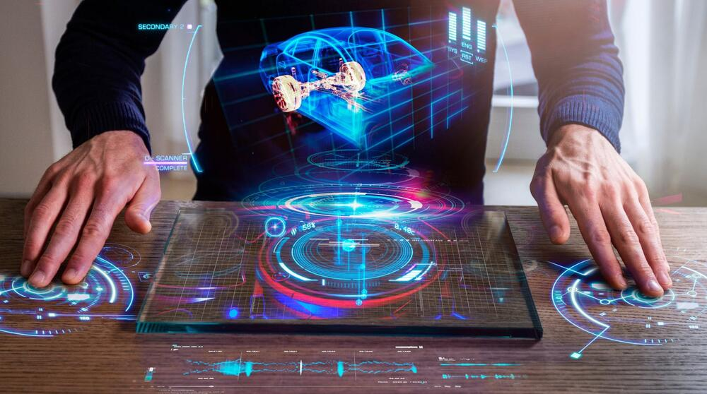
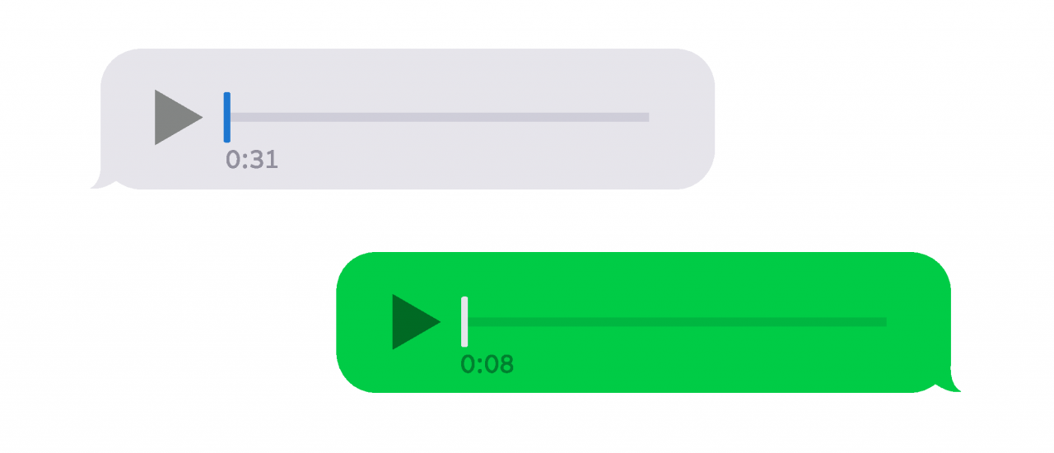
* VOCABULARY
1
Write the correct word or phrase from the box under each picture.
voice message smartphone social network
emojis group call holography
3. _____________
4. ___________
voice message
holography

Slide 16

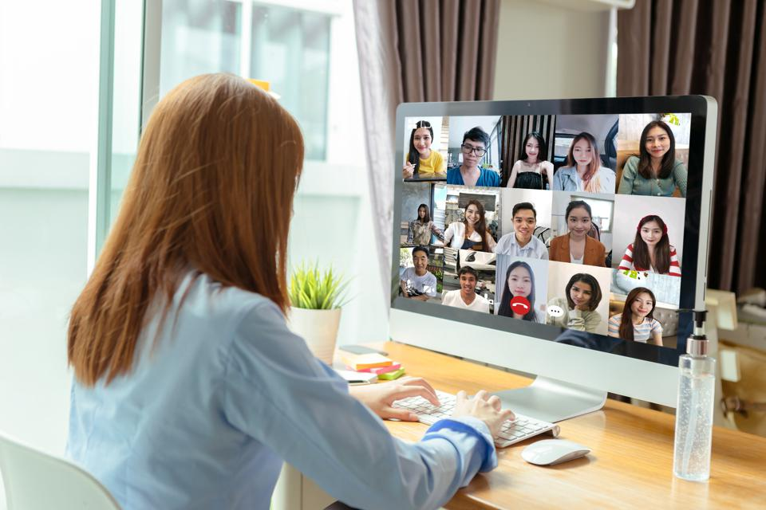
* VOCABULARY
1
Write the correct word or phrase from the box under each picture.
voice message smartphone social network
emojis group call holography
5. ___________
Social network
6. ___________
group call

Slide 17
* VOCABULARY
2
Choose the correct answer A, B, or C.
1. Many people add ______ to their text messages to express their feelings.
A. emojis B. words C. letters
2. I send ______ messages when I don’t feel like typing.
A. group B. text C. voice
3. Many teenagers like to meet on social ______ rather than face to face.
A. television B. networks C. projects

Slide 18
* VOCABULARY
2
Choose the correct answer A, B, or C.
4. In a ______, people in different places can join the conversation.
A. voice message B. group call C. system of emojis
5. By using ______, you can attend a meeting with your 3D image instead of being there in person.
A. holography B. voice messages C. social networks

Slide 19
3
Complete the sentences with the words from the box.
translation real language instantly private
1. Do you often send _______ messages to your friends?
2. Can learning English help you overcome the _________ barrier when living abroad?
3. Telephone helps you communicate in _______ time.
4. Do you think translators will lose their jobs when ___________ machines become popular?
5. Many people reply to messages _________, but others take a long time to respond.
private
language
real
translation
instantly

Slide 20

* PRONUNCIATION
How to stress in words ending in -ese and -ee

Slide 21
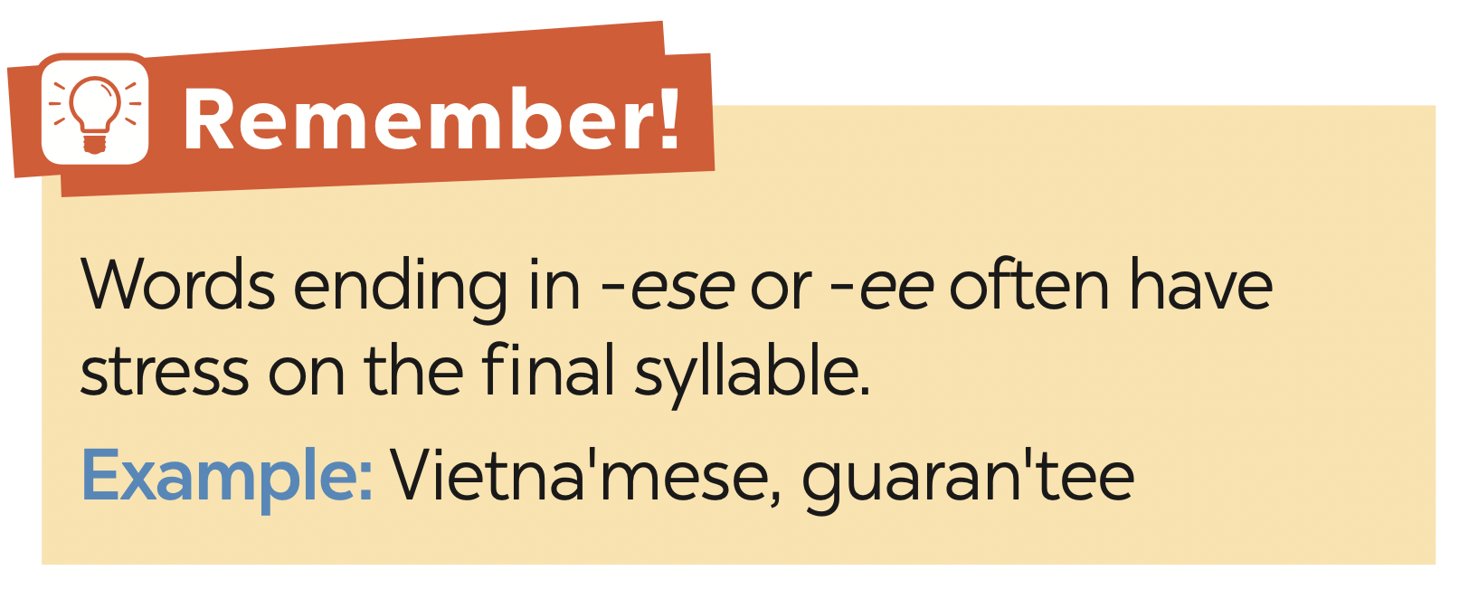
* PRONUNCIATION

Slide 22
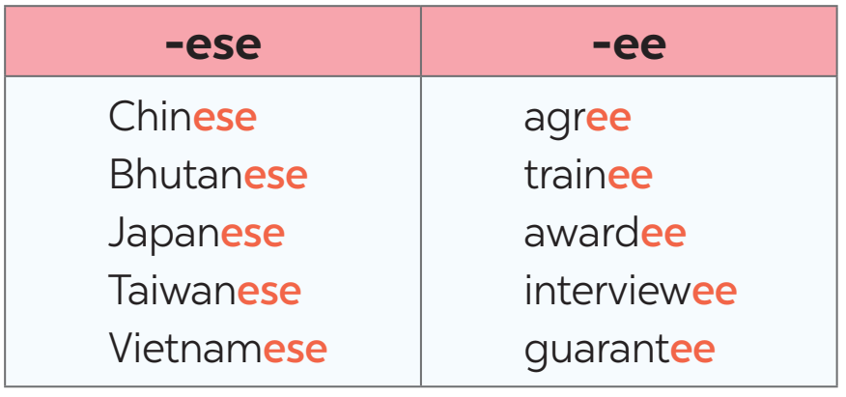
4
Listen and repeat the words. Pay attention to the word stress.

Slide 23
5
Mark the stress in the underlined words. Then listen and repeat the sentences.
1. The interviewees said that they were Taiwanese.
2. Joe agrees with me that learning Chinese is difficult.
3. She obtained a bachelor’s degree in Japanese.
4. The Taiwanese company gave each awardee a smartphone.
5. The Japanese teacher sent a video to the absentees on Monday.
‘
‘
‘
‘
‘
‘
‘
‘
‘
‘

Slide 24

* CONSOLIDATION
What have we learnt in this lesson?
Vocabulary: The lexical items related to Communication
Pronunciation: How to correctly stress words that ending in -ese and -ee

Slide 25

* Homework
- Learn by heart all the new words.
- Do exercises in workbook.
- Prepare lesson 3 ( A closer look 2).

Slide 26




