Slide 1

Hello everyone !!!

Slide 2

* WARM-UP
Who knows more?
Work in groups in 2 minutes and list the names of social networks that you know.
The group with the most correct answers is the winner.
Instagram.
YouTube.
Facebook.
Twitter.
TikTok.
weibo.
wechat.
Viber.
TECHNOLOGY

Slide 3
TECHNOLOGY
Nowadays we can communicate with each other without meeting face to face .
We can keep in contact with each other easily thanks to communication technologies.
Instagram.
YouTube.
Facebook.
Twitter.
TikTok.
weibo.
wechat.
Viber.
Zalo.

Slide 4


Unit
10
COMMUNICACTION IN THE FUTURE
LESSON 1: GETTING STARTED
At the technology club

Slide 5
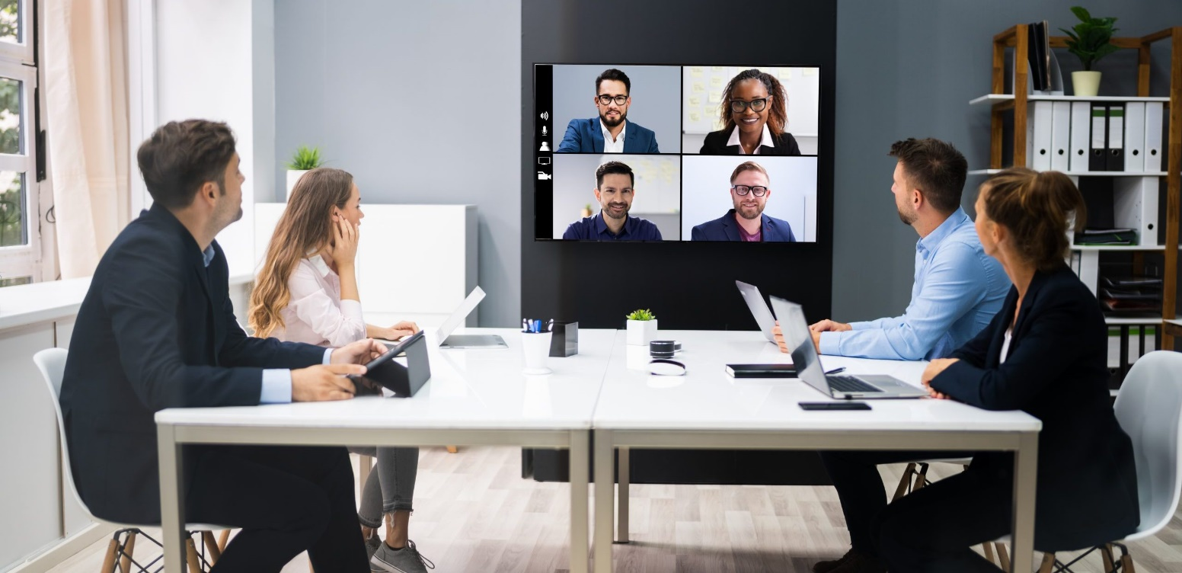

* VOCABULARY
- video conference (n)
/ˈvɪdiəʊ ˌkɒnfərəns/
họp trực tuyến

Slide 6

* VOCABULARY
webcam (n)
/ˈwebkæm/
thiết bị ghi hình kĩ thuật số

Slide 7

* VOCABULARY
zoom in (v)
/zuːm ɪn/
phóng to

Slide 8
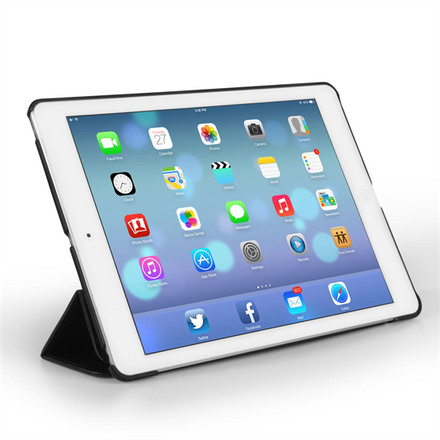
* VOCABULARY
tablet (n)
/ˈtæblət/
máy tính bảng

Slide 9

* VOCABULARY
internet connection (n)
/ˈɪntənet kəˈnekʃn/
kết nối mạng

Slide 10
* VOCABULARY
New words | Pronunciation | Meaning
1. video conference (n) | /ˈvɪdiəʊ ˌkɒnfərəns/ | họp trực tuyến
2. webcam(n) | /ˈwebkæm/ | thiết bị ghi hình kĩ thuật số
3. zoom in (v) | /zu:m ɪn/ | phóng to
4. tablet (n) | /ˈtæblət/ | máy tính bảng
5. internet connection (n) | /ˈɪntənet kəˈnekʃn/ | kết nối mạng

Slide 11
* Checking vocabulary
Say words in English
họp trực tuyến
kết nối mạng
video conference
internet connection
máy tính bảng
tablet
thiết bị ghi hình kĩ thuật số
webcam
phóng to
zoom in

Slide 12
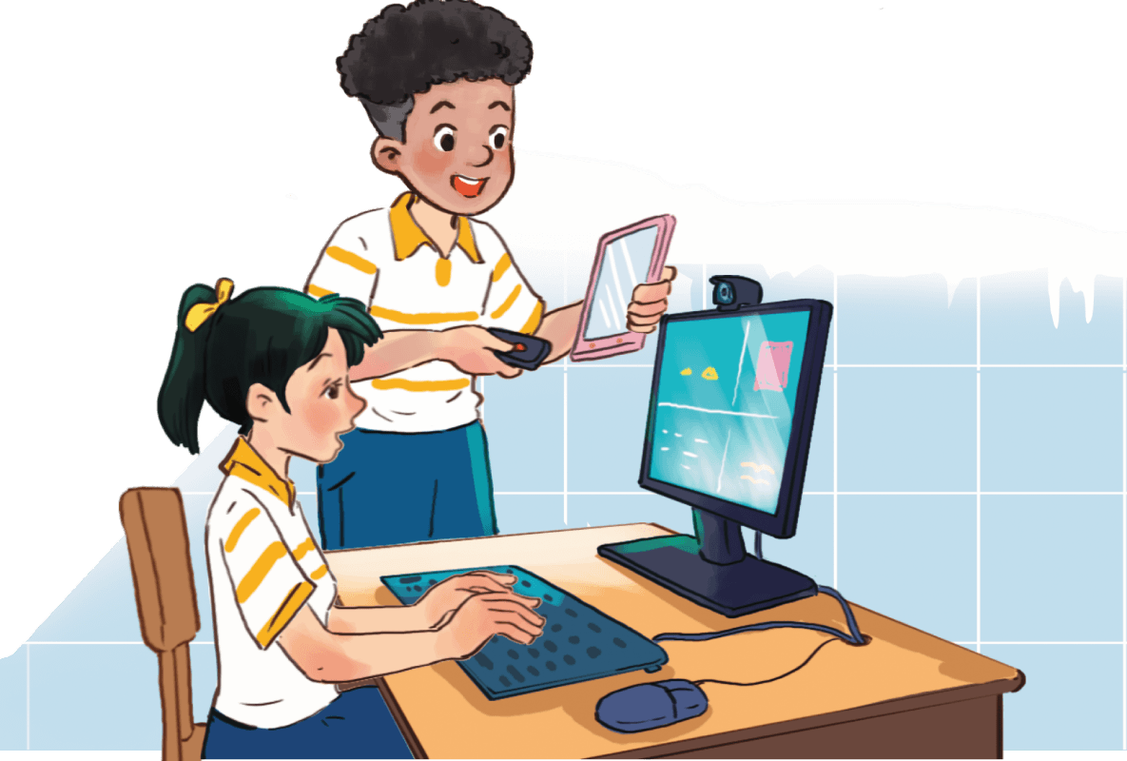
1
Listen and read.
a. Who are they?
Trang and Mark
b. What are they doing?
They are preparing for a video conference.

Slide 13
1
Listen and read.
Trang: Mark, we’re having a video conference with Tech Savvy next Thursday, but ...
Mark: Hold on. Is that the technology club at the Japanese school?
Trang: Exactly. But I’m a bit worried. I’ve never had a video conference call.
Mark: You’re kidding! Who doesn’t know how to make a video call? Alright, let’s do a practice call now.
Trang: Hmm, what do I need to do first?
Mark: It’s a piece of cake, Trang. Now, you sit in front of the computer. I’ll connect with you via one of my tablets and ...
Trang: Sorry, but how can I adjust this webcam? It’s focusing on my forehead.
Mark: Use this button to move it up or down, and this to zoom in or out.
Trang: Thanks. And can you see me clearly on your tablet?
Mark: Yes, of course. We have a high-speed Internet connection here.
Trang: I hope the conference goes smoothly.
Mark: I’m sure it will. We should hold more video conferences like this in the future.
Trang: That’s exactly how I feel.

Slide 14
2
Read the conversation again and circle the correct answer A, B, or C.
1. What are Trang and Mark doing?
A. Practising a video call.
B. Making a call with Tech Savvy.
C. Learning how to use a tablet.
2. What device does Trang need help with?
A. The tablet. B. The computer. C. The webcam.
3. Mark says that they should ______ in the future.
A. have more video conferences
B. do more practice calls
C. have a high-speed Internet connection

Slide 15
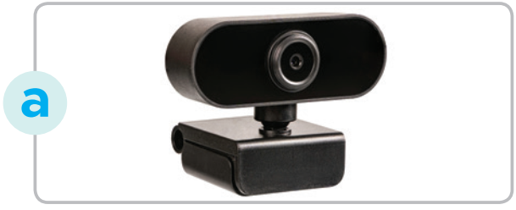

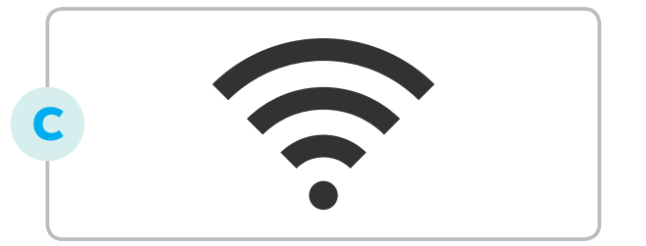
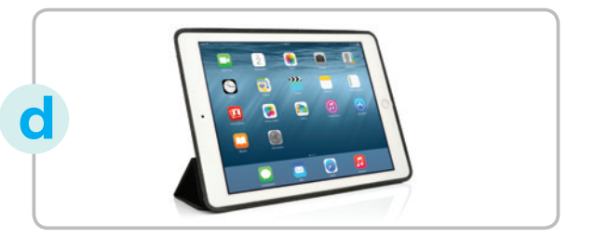

3
Match the words and phrases in the conversation with their pictures.
1. tablet
2. webcam
3. zoom in
4. video conference
5. internet connection

Slide 16
4
Circle the words/ phrases which are CLOSEST in meaning to the underlined words/ phrases.
1. Our English exam was a piece of cake. I got full marks on it.
A. easy B. difficult
2. You’re kidding! I can’t believe Ms Mai and you are sisters.
A. serious B. joking
3. I can’t read the text on the computer screen. Can you zoom in on it?
A. make it bigger B. make it smaller
4. We need a high-speed Internet connection to make video calls.
A. fast B. slow
5. That’s exactly how I feel. It’s true that video conferences are very convenient.
A. I don’t think so. B. You are absolutely right.

Slide 17
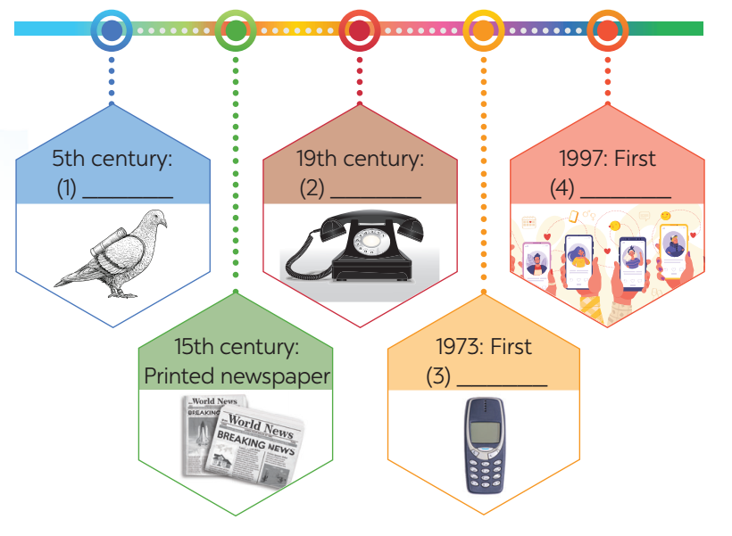
5
Work in groups. Complete the diagram of the history of communication technology with the words and phrases from the box.
carrier pigeon mobile phone
telephone social network
* Answer:
1. carrier pigeon
2. telephone
3. mobile phone
4. social network
“Sixdegree”
Facebook : 2005

Slide 18

* CONSOLIDATION
What have we learnt in this lesson?
Some new words related to communication in the future.
Read and practice the conversation .

Slide 19

* Homework
Learn by heart all the words .
Do exercises in the workbook.
Prepare for Lesson 2 - A closer look 1

Slide 20

Goodbye.
See you again

