Slide 1
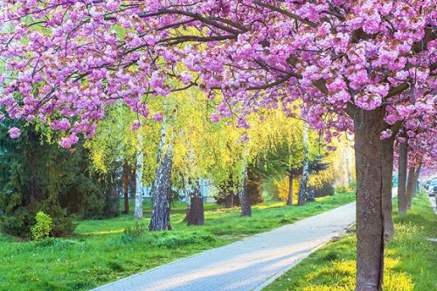
Hello everyone !!!

Slide 2
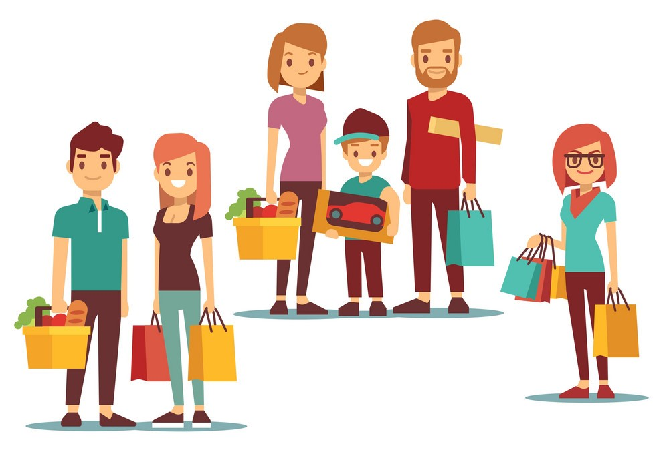
* WARM-UP
CHATTING
Do you like shopping?
How often do you go shopping?
Why do you go to shopping centers?

Slide 3

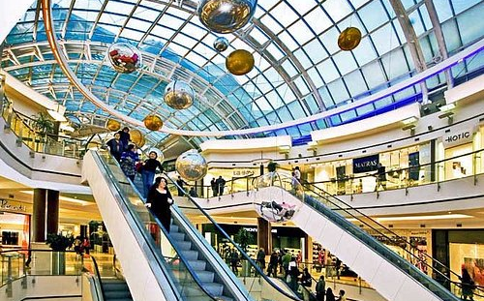
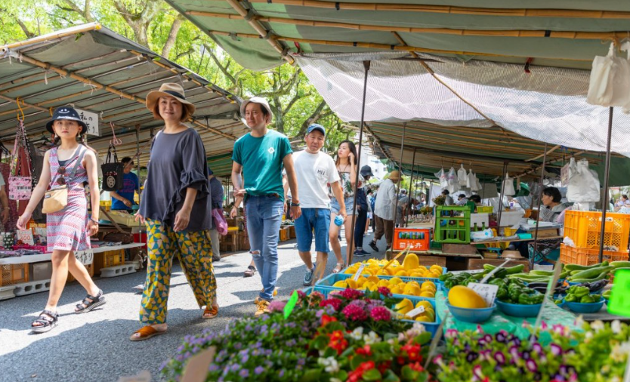
Unit
8
SHOPPING
LESSON 5: SKILLS 1
1
HOBBIES
READING
SPEAKING

Slide 4

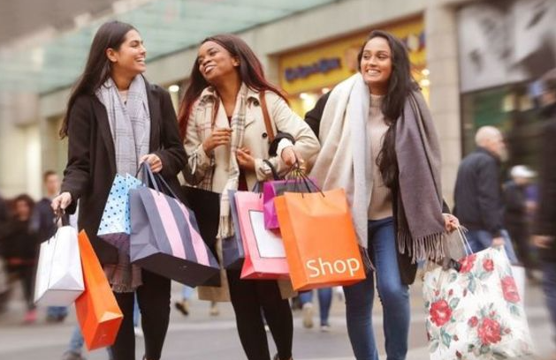
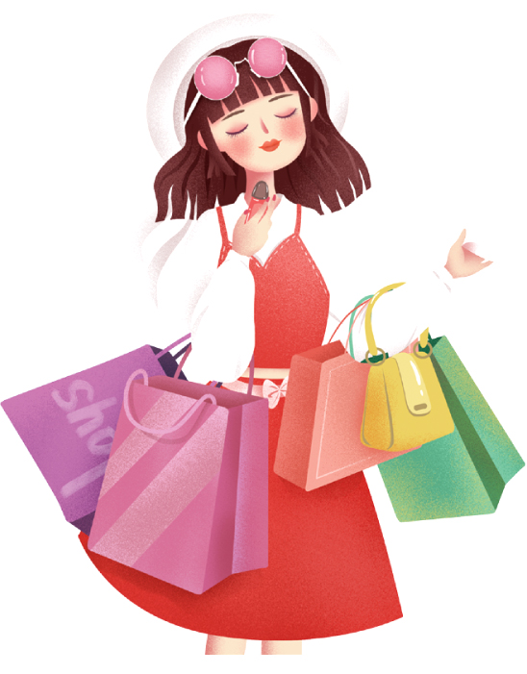
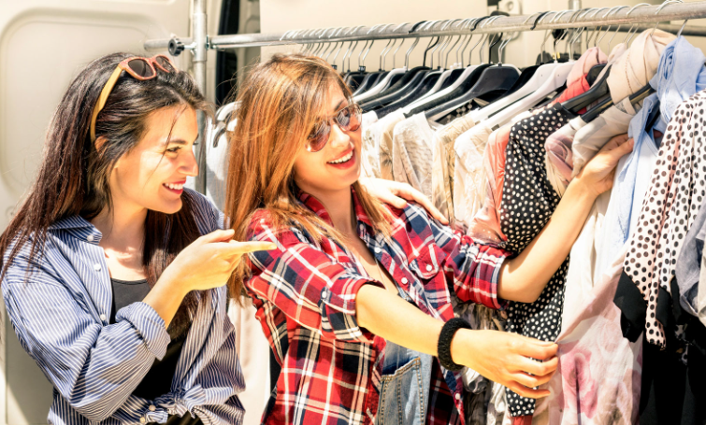
I.READING
1
Read the list below and tick the most common reason(s) why you go shopping.
Hanging out with friends
Reducing stress
Buying goods
Exercising
Browsing

Slide 5
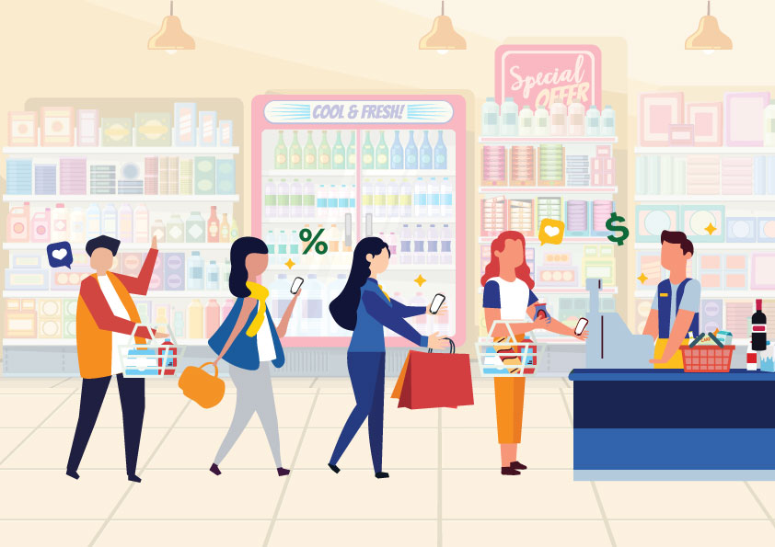

* Vocabulary
customer (n):
khách hàng
/ˈkʌstəmə/

Slide 6
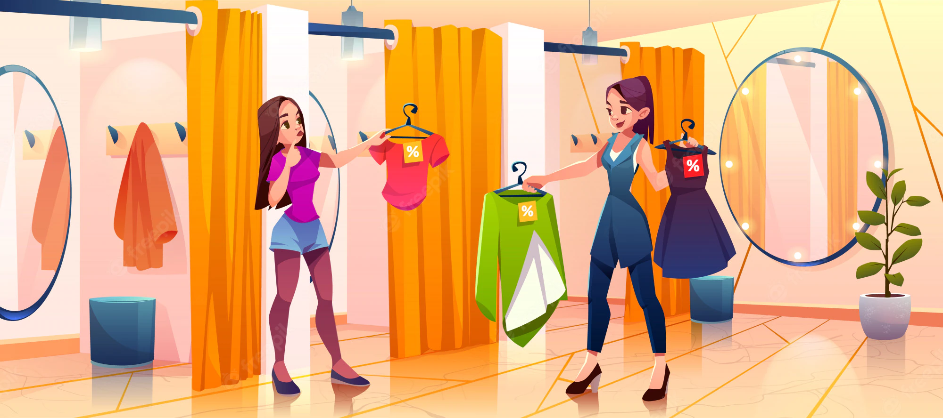
* Vocabulary
- try on (v):
thử (quần áo, giày dép)
/traɪ ɒn/

Slide 7
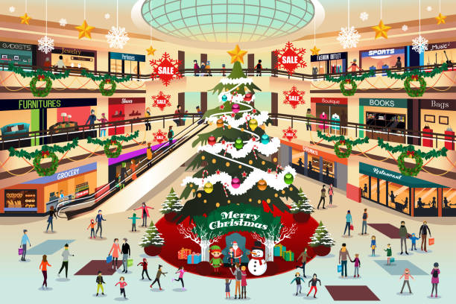
* Vocabulary
- decoration (n):
đồ trang trí
/ˌdekəˈreɪʃn/

Slide 8

* Vocabulary
- wander (v):
đi lang thang, thả bộ
/ˈwɑːndər/

Slide 9
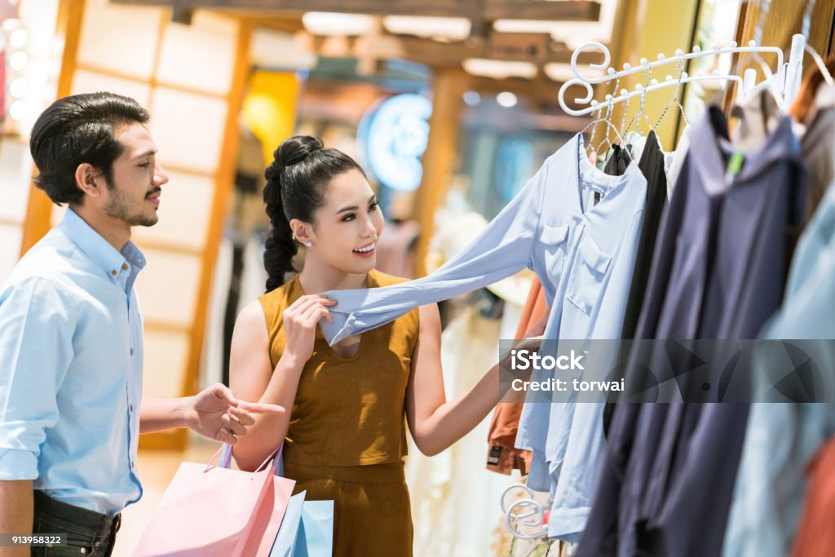
* Vocabulary
Customers can touch the products.
Touch (v):
chạm
/tʌtʃ/

Slide 10
* VOCABULARY
New words | Pronunciation | Meaning
1. customer (n) | /ˈkʌstəmə/ | Khách hàng
2. try on (v) | /traɪ ɒn/ | Thử quần, áo
3. decoration (n) | /ˌdekəˈreɪʃn/ | Đồ trang trí
4. wander (v) | /ˈwɑːndər/ | Đi lang thang
5. Touch (v) | /tʌtʃ/ | Chạm, sờ

Slide 11
* Checking vocabulary
New words | Meaning
1. | Khách hàng
2. | Thử quần, áo
3. | Đồ trang trí
customer (n)
try on (v)
decoration (n)
4. | Đi lang thang
5. | Chạm, sờ
wander (v)
Touch (v)

Slide 12
2
Read the passage and choose the correct answer A, B, or C.
Why We Go to Shopping Centres
Shopping centres attract a lot of customers, especially at the weekend, on holidays, or during sales. People go there to shop. Shopping centres offer a wide range of products to choose from. Customers can touch the products and try on clothes and shoes. This makes them feel more comfortable when they decide to buy something.
However, people also go to shopping centres for many other reasons. Some people go there for entertainment. These centres often offer year-round free entertainment for customers of all ages such as live music and special performances. During holidays, shoppers can see decorations and join in the holiday excitement. It’s a good way to relax. Some people go there just to hang out with friends. They go browsing and chat while wandering through the shopping malls. Others visit shopping centres to get exercise. They enjoy walking for one or two hours in clean and well-lit areas. Some people even go there to avoid the heat or cold outside. Shopping centres offer free air conditioning and heating.

Slide 13
2
Read the passage and choose the correct answer A, B, or C.
1. People go to a shopping centre ______.
A. only for shopping
B. mainly to hang out
C. for many reasons
However, people also go to shopping centres for many other reasons. Some people go there for entertainment. These centres often offer year-round free entertainment for customers of all ages such as live music and special performances.

Slide 14
2
Read the passage and choose the correct answer A, B, or C.
2. At shopping centres, customers can ______.
A. touch the product
B. bargain to get lower prices
C. pay to watch live performances.
Shopping centres offer a wide range of products to choose from. Customers can touch the products and try on clothes and shoes. This makes them feel more comfortable when they decide to buy something.

Slide 15
2
Read the passage and choose the correct answer A, B, or C.
3. A kind of entertainment at a shopping centre is _______.
A. fashion contests
B. live music
C. painting exhibitions
However, people also go to shopping centres for many other reasons. Some people go there for entertainment. These centres often offer year-round free entertainment for customers of all ages such as live music and special performances.

Slide 16
2
Read the passage and choose the correct answer A, B, or C.
4. Some people exercise at a shopping centre because they like its ______.
A. crowds B. well-lit areas C. shops
They enjoy walking for one or two hours in clean and well-lit areas. Some people even go there to avoid the heat or cold outside. Shopping centres offer free air conditioning and heating.

Slide 17
2
Read the passage and choose the correct answer A, B, or C.
5. The word “year-round” in paragraph 2 is similar in meaning to ______.
A. always B. sometimes C. rarely
However, people also go to shopping centres for many other reasons. Some people go there for entertainment. These centres often offer year-round free entertainment for customers of all ages such as live music and special performances.

Slide 18
3
Fill in each blank with ONE word from the passage.
Shopping centres
1. attract a lot of customers during _______. 2. allow customers to _______ on clothes and shoes. 3. allow customers to _______ the products . 4. offer free ______________ for customers of all ages. 5. are full of ___________ during holidays. 6. offer ______ air conditioning and heating.

Slide 19
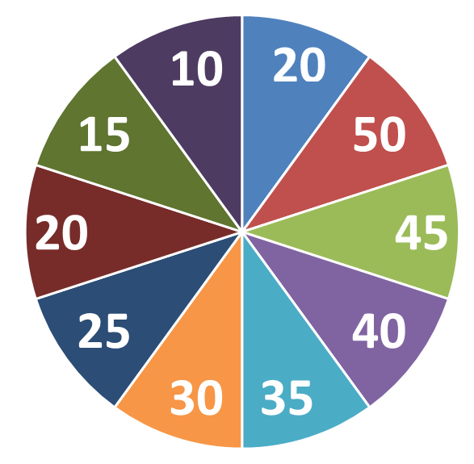
3
Fill in each blank with ONE word from the passage.
QUESTIONS
1
4
2
5
3
6

Slide 20
3
Fill in each blank with ONE word from the passage.
Shopping centres
1. attract a lot of customers during _______.
sales

Slide 21
3
Fill in each blank with ONE word from the passage.
Shopping centres
2. allow customers to _______ on clothes and shoes.
try

Slide 22
3
Fill in each blank with ONE word from the passage.
Shopping centres
3. allow customers to _______ the products .
touch

Slide 23
3
Fill in each blank with ONE word from the passage.
Shopping centres
3. offer free ______________ for customers of all ages.
entertainment

Slide 24
3
Fill in each blank with ONE word from the passage.
Shopping centres
4. are full of ___________ during holidays.
decorations

Slide 25
3
Fill in each blank with ONE word from the passage.
Shopping centres
5. offer ______ air conditioning and heating.
free

Slide 26
3
Fill in each blank with ONE word from the passage.
Shopping centres
1. attract a lot of customers during _______. 2. allow customers to _______ on clothes and shoes. . allow customers to _______ the products . 3. offer free ______________ for customers of all ages. 4. are full of ___________ during holidays. 5. offer ______ air conditioning and heating.
sales
try
touch
entertainment
decorations
free

Slide 27
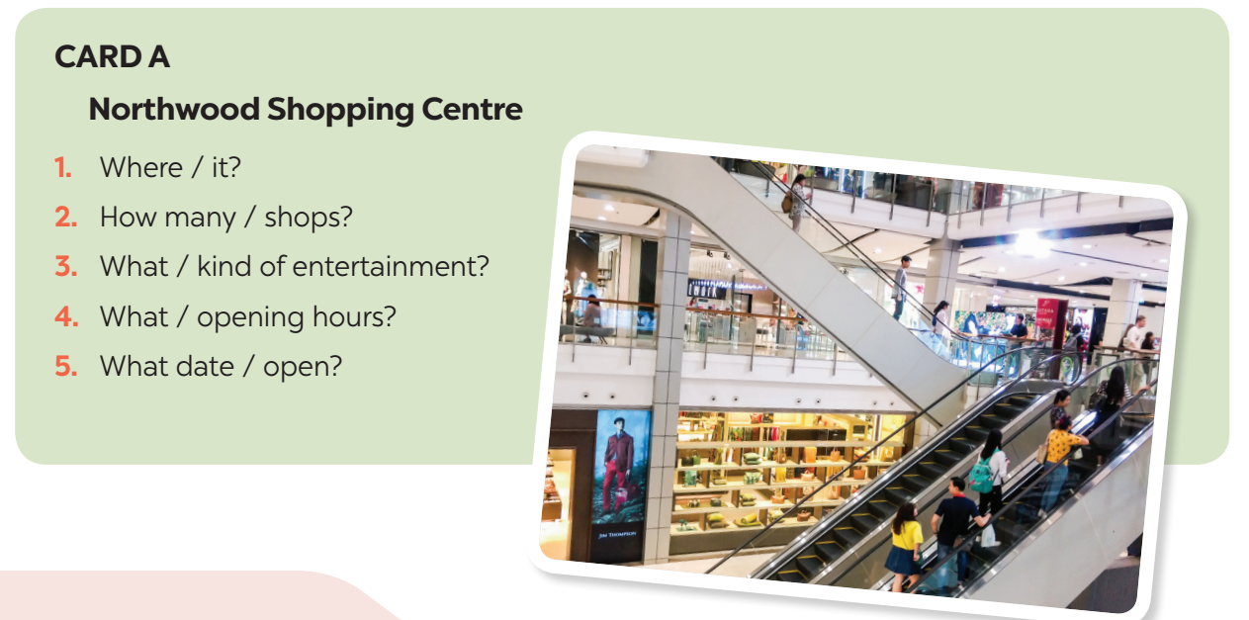

II.SPEAKING
4
Work in pairs. Ask and answer about a new shopping centre.
Student A reads the suggestions for questions on card A
Student B reads the information about the new shopping centre on card B (page 91)

Slide 28
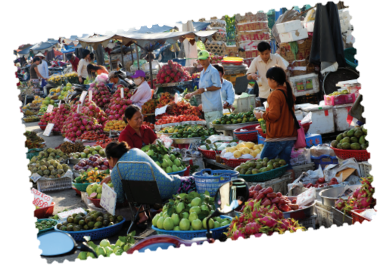
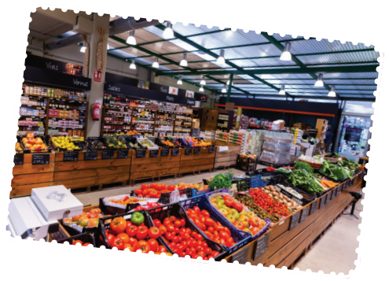
II.SPEAKING
5
Work in pairs. Ask and answer about a shopping centre, a supermarket, or an open-air market in your area. Take notes of your partner’s answers and report them to the class.
You can use the suggestions below:
where it is
how you get there
what its opening hours are
what you do there
what you like/ don’t like about it.

Slide 29
1. Where do you like shopping?
Where is it?
2. How do you get there?
3. What are its opening hours?
4. What do you do there?
5. What do you like/ don’t like about it?

Slide 30
Where is it?
It is in Northwood, 8 km from the city centre.
2. How do you get there?
I get there by bike/bus…..
3. How many shops are there?
There are more than 60 shops, 4 restaurants, 2 cafes, a cinema and a playground for children.
4. What are its opening hours?
It opens from 9 a.m to 21 p.m.
5. What do you do there?
I shop, wander and exercise in the shopping centre.
6. What do you like/ don’t like about it?
I like it because it is convenient and it offers a wide range of products.

Slide 31
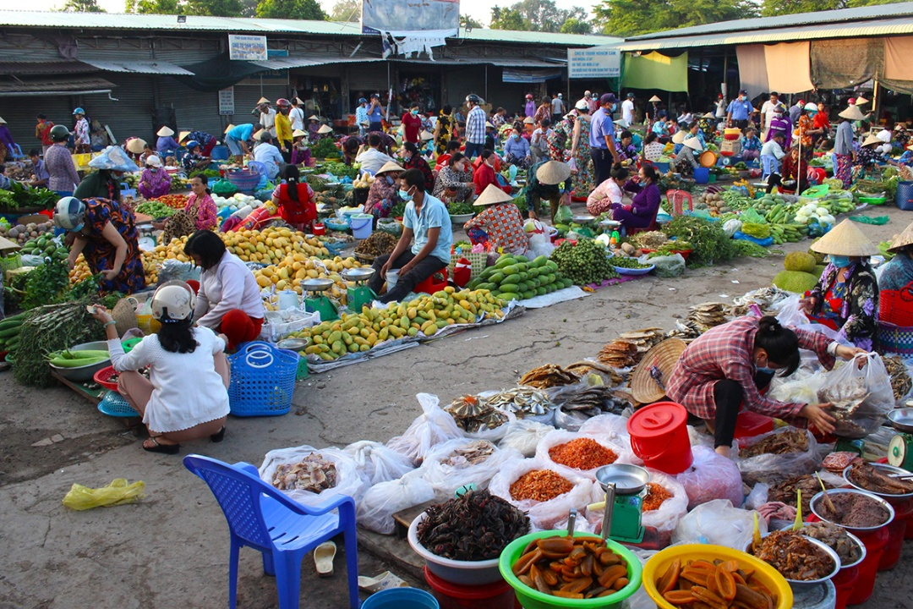
II.SPEAKING
5
Work in pairs. Ask and answer about a shopping centre, a supermarket, or an open-air market in your area. Take notes of your partner’s answers and report them to the class.
A: Have you ever been to the open-air market in my area?
B: No, I haven’t. Where is it located?
A: It's in the town square. I usually take the bus there.
B: Nice! What are the opening hours?
A: The market is open every Saturday and Sunday from 8 AM to 4 PM.
B: That's great! So, what do you usually do there?
A: Oh, I love exploring all the stalls and shops. They have fresh fruits and vegetables, handmade crafts, and even some local musicians performing.
B: That sounds like a lot of fun. What do you like the most about the market?
A: Well, I really enjoy the atmosphere. It's so lively and colorful.
B: That's awesome! Is there anything you don't like about it?
A: Well, sometimes it can get really crowded, especially during peak hours. But overall, I think it's a fantastic place to spend the weekend.

Slide 32
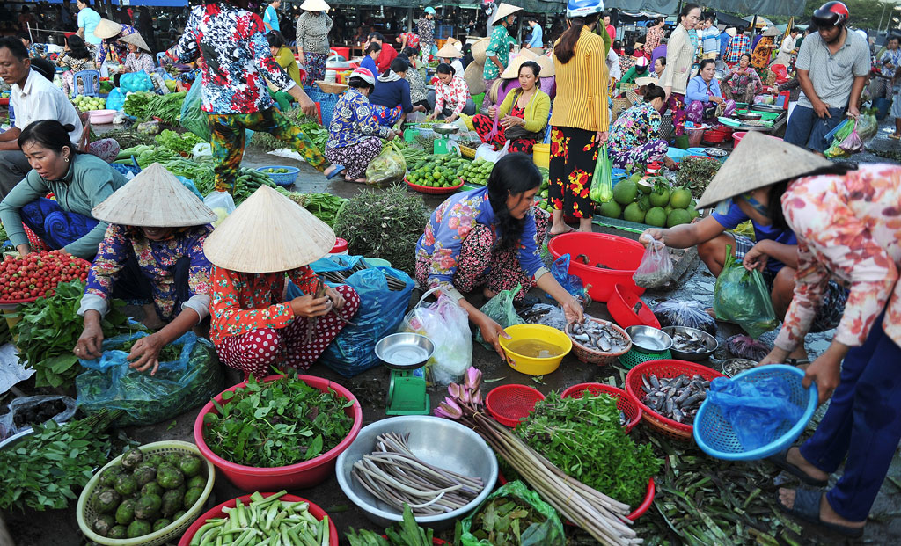
II.SPEAKING
* Talk about a shopping centre, a supermarket, or an open-air market in your area.
Hello everyone, I wanted to tell you about the open-air market in our area. It's located in the town square, and I usually take the bus to get there. It's open every Saturday and Sunday from 8 AM to 4 PM. When I visit, I love exploring the stalls, trying out fresh produce, and checking out the hand-made crafts. The atmosphere is lively, and sometimes there are local musicians performing. However, it can get crowded, especially on weekends. Overall, it's a fun and great place to spend some time!

Slide 33

* CONSOLIDATION
What have we learnt in this lesson?
Reasons why we go to shopping centres.
Information about new shopping centres.

Slide 34

* Homework
Learn the new words by heart.
Make a speech introducing a new shopping centre in your city.
Do exercise in the Workbook

Slide 35


Thank you!
Goodbye!

