Slide 1
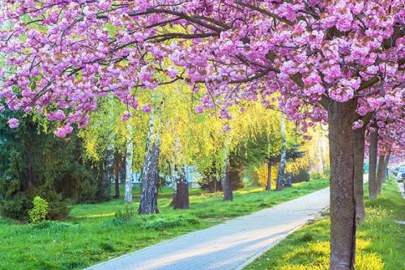
Hello everyone !!!

Slide 2
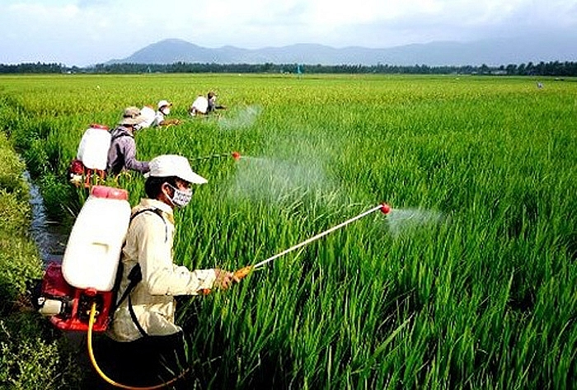
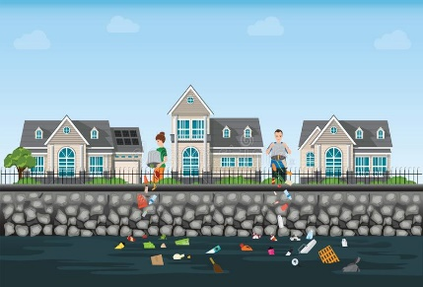

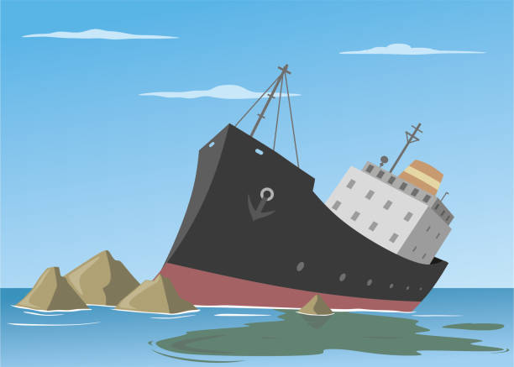
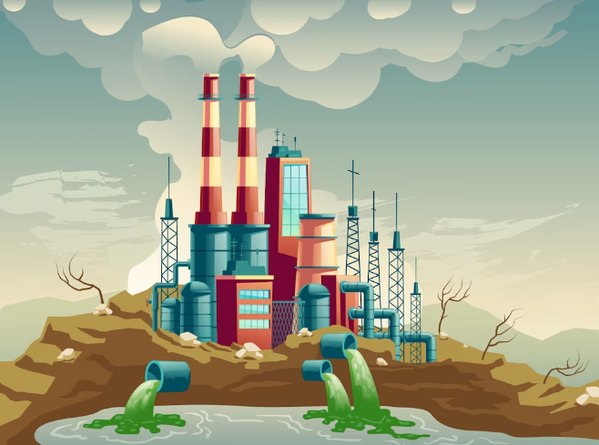
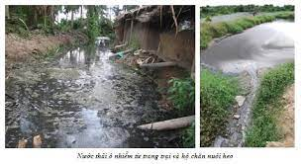
* Warm up:
Task 1: Work in groups. Make a list of some activities that cause water pollution
A
B
C
D
E
F

Slide 3
* Warm up:
Task 1: Work in groups. Make a list of some activities that cause water pollution
A
B
C
1. throwing rubbish into
rivers and lakes
2. spilling fuel.
3. pouring industrial wastes
4. using chemicals and pesticides in soil
5. pouring domestic wastes
6. Waste from households
D
E
F

Slide 4
* Warm up:
Task 1: Work in groups. Make a list of some activities that cause water pollution
A
B
C
4. using chemicals and
pesticides in soil
5. pouring domestic wastes
1. throwing rubbish into
rivers and lakes
D
E
F
2. spilling fuel.
3. pouring industrial wastes
6. Waste from households

Slide 5

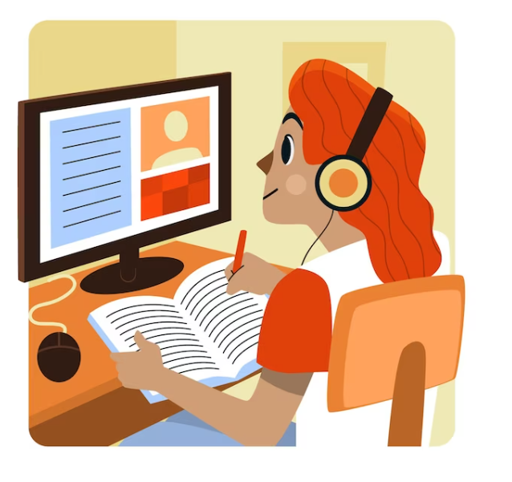
Unit
7
ENVIRONMENTAL PROTECTION
LESSON 6: SKILLS 2

Slide 6

* LISTENING
2
Listen to a talk and choose the correct word to complete each sentence.
1. Polluted water is unsafe for drinking / cooking and for other uses.
2. Sometimes toxic substances ﬂow into rivers from factories / hospitals.
3. Water pollution has a dangerous / harmful eﬀect on our life.
4. We couldn’t / shouldn’t throw litter into rivers and lakes.

Slide 7
* LISTENING
3
Listen again and give short answers to the following questions. Use no more than THREE words.
1. What is the listening text about?
2. How many sources of water pollution are there?
3. What are two common sources of drinking water?
4. What type of eﬀect does water pollution have on our life?
5. What products can we use to reduce water pollution?
Game

Slide 8







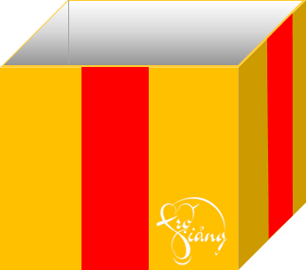
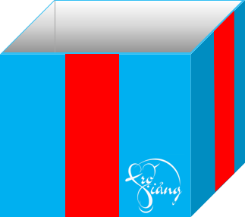

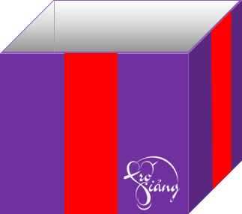


Game
Gift box secret game

Slide 9

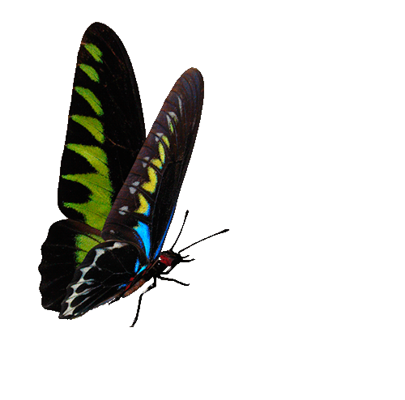

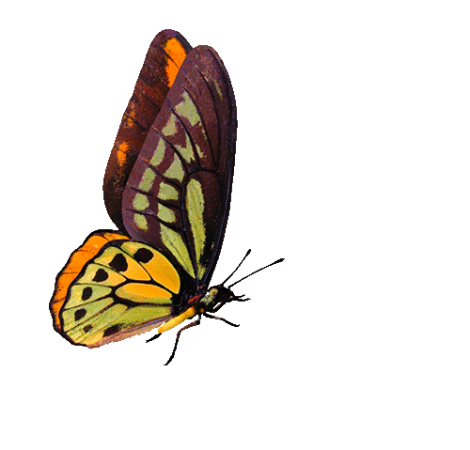




1. What is the listening text about?
Water pollution
You are given 3 candies
GO HOME

Slide 10
2. How many sources of water pollution are there?
Two
You are given 2 candies
GO HOME

Slide 11
3. What are two common sources of drinking water?
Rivers and lakes
You are given 10 mark
GO HOME

Slide 12
4. What type of eﬀect does water pollution have on our life?
A harmful effect
You are given 5k
GO HOME

Slide 13
5.What products can we use to reduce water pollution?
Green products
những sản phẩm xanh
You are given 5k
GO HOME

Slide 14
* LISTENING
3
Listen again and give short answers to the following questions. Use no more than THREE words.
1. What is the listening text about?
2. How many sources of water pollution are there?
3. What are two common sources of drinking water?
4. What type of eﬀect does water pollution have on our life?
5. What products can we use to reduce water pollution?
Water pollution
Two
Rivers and lakes
A harmful effect
Green products

Slide 15
Tapescript
All living things need water but water pollution has become a serious problem. Polluted water is unsafe for drinking and for other uses.
Water pollution happens when wastes and toxic substances make the water unsafe. There are two sources of water pollution: man-made and natural. Man-made substances pollute water when they flow into the water from factories and homes. Natural pollution occurs when rainwater with toxic chemicals flows into rivers or lakes. These rivers and lakes are a source of drinking water for humans. Water pollution has a harmful effect on our lives. But there are ways we can reduce water pollution. The first thing we can do is to treat water from factories and households. We should abo stop littering, especially dumping waste into rivers and lakes Finally, we can reduce water pollution by using green products and avoiding single-use products like plastic bags

Slide 16
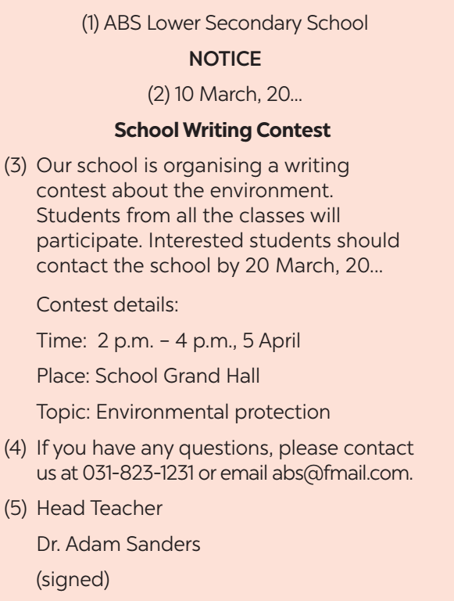
* WRITING
4
Work in pairs. Read the notice and match the headings (a – e) below with the numbers (1 – 5).
a. Name of institution or organisation
(School, etc.)
c. Date of writing the notice
b. Body (date / time / duration / place, etc.)
e. Contact details
d. Author’s name and signature

Slide 17
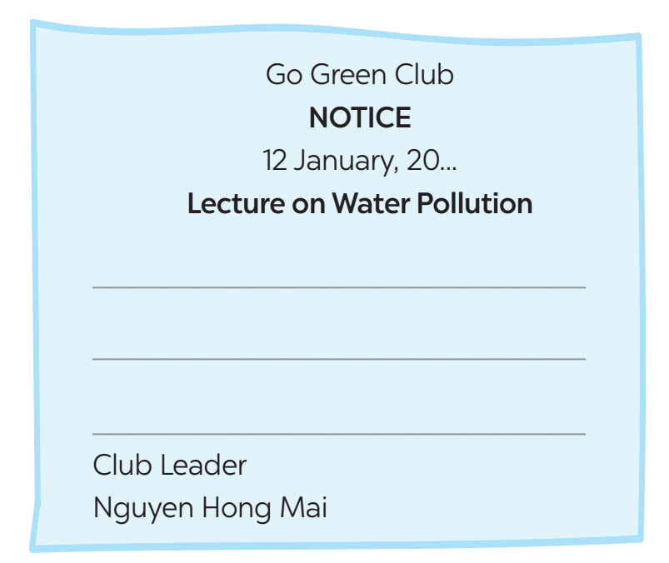
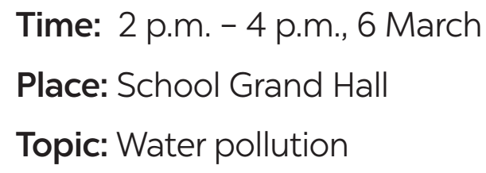
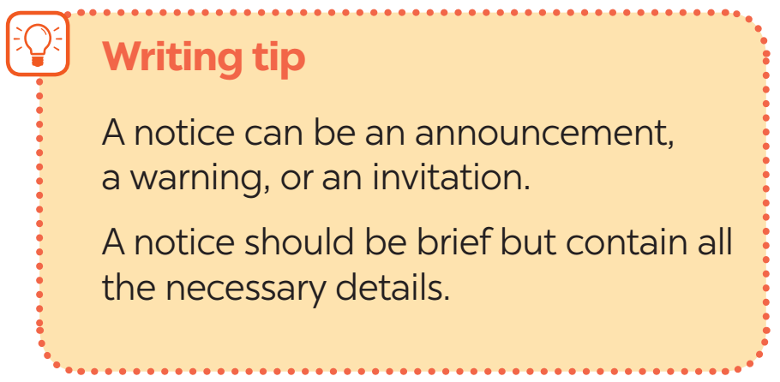
5
Write a notice for the Go Green Club leader to invite students to attend a lecture on water pollution. Use the following details.

Slide 18
5
Write a notice for the Go Green Club leader to invite students to attend a lecture on water pollution.
Go Green Club
NOTICE
12 January, 2024
Lecture on Water Pollution
All students of our school are invited to attend a lecture on water pollution next week. Interested students should contact the club by 17 February, 2024.
Details:
Time: 2 p.m – 4 p.m, 6 March
Place: School Grand Hall
Topic: Water pollution
If you have any questions, please contact us at 012-3476-789 or email gogreen@fmail.com
Club Leader
Nguyen Hong Mai

Slide 19
NINH THANH SECONDARY SCHOOL
NOTICE
23 January, 2024
EXTRACURRICULAR ACTIVITIES.
All students of our school are invited to attend an extracurricular activity meeting next week. Interested students should contact the school by 25 January, 2024.
Details: Time: 7 a.m – 9 a.m, 1 February.
Place: School Grand Hall
Topic: EXTRACURRICULAR ACTIVITIES
If you have any questions, please contact us at 012-3476-789 or email ninhthanhschool@fmail.com
Head teacher
Hoang Thi Thanh Hoa

Slide 20

* CONSOLIDATION
What have we learnt in this lesson?
Listening about water pollution
Writing a notice

Slide 21
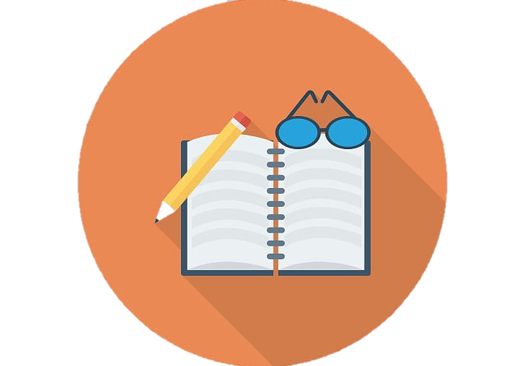
* Homework
Do exercises in the workbook.
Prepair lesson 7 – Looking back.

Slide 22


Thank you!
Goodbye!

Slide 23
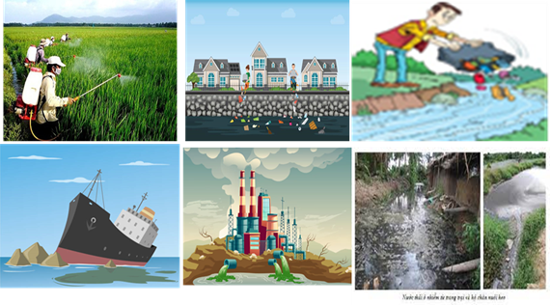
throwing rubbish into rivers and lakes
throwing rubbish (vứt rác)
domestic waste (rác thải sinh hoạt)
spilling fuel (đổ, tràn xăng, dầu)
industrial waste (chất thải công nghiệp).

Slide 25
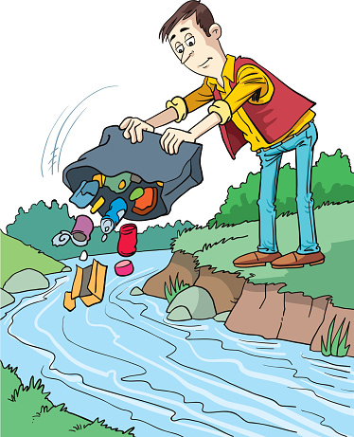
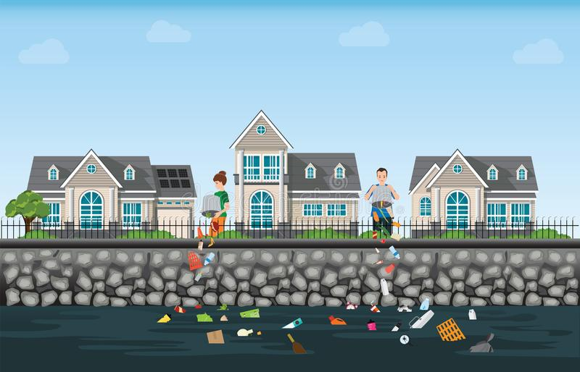
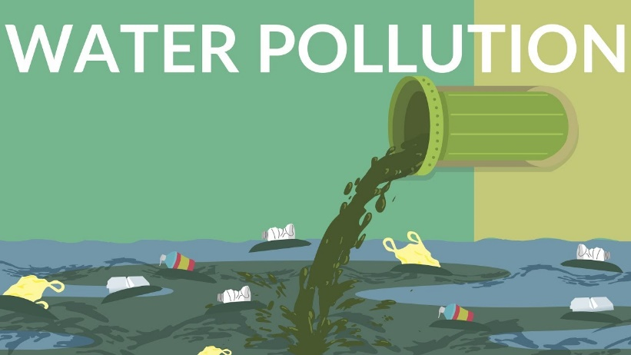
WARM-UP
1
Work in groups. Make a list of some activities that cause water pollution.
THROWING RUBBISH
DOMESTIC WASTE
INDUSTRIAL WASTE
SPILLING FUEL

