Slide 1
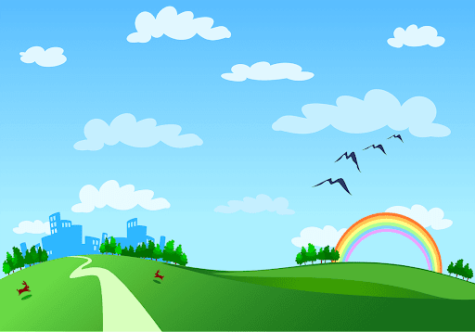

Hello everyone!!!

Slide 2


Unit
7
ENVIRONMENTAL PROTECTION
LESSON 3: A CLOSER LOOK 2

Slide 3
* Grammar:
Complex sentences with adverb clauses of time
– A complex sentence contains one independent clause and at least one dependent clause.
Example:
The roads were slippery when it rained.
independent clause : IC dependent clause: DC
– An adverb clause is a dependent clause.
– An adverb clause of time shows when something happens. It is usually introduced by time connectors: before, after, when, while,
till/until, as soon as, …

Slide 4
1.The roads were slippery when it rained. independent clause : IC dependent clause: DC
2.When it rained, the roads were slippery. dependent clause: DC independent clause : IC
Before: Trước khi
after: Sau khi
when: Khi
while : Trong khi
till/until: cho đến khi
as soon as: ngay sau khi

Slide 5
* Grammar:
Complex sentences with adverb clauses of time
(Câu phức với mệnh đề trạng ngữ chỉ thời gian)
- A complex sentence contains one independent clause and at least one dependent clause.
(Một câu phức chứa một mệnh đề độc lập và ít nhất một mệnh đề phụ thuộc.)
* Example:
The roads were slippery when it rained.
independent clause
dependent clause
+ An adverb clause is a dependent clause.
- Mệnh đề trạng ngữ là mệnh đề phụ thuộc.

Slide 6
– An adverb clause of time shows when something happens.
- It is usually introduced by time connectors: before, after, when, while, till / until, as soon as, …
- Mệnh đề trạng ngữ thời gian cho thấy khi nào sự việc xảy ra.
- Nó thường được giới thiệu bằng liên từ chỉ thời gian:
+ before : trước khi
+ after : sau khi
+ when : khi
+ while : trong khi
+ till/ until : cho đến khi
+ as soon as : ngay khi
+ …

Slide 7
1
Read the sentences and write I.C if the underlined clause is an independent clause or D.C if it is a dependent clause
I.C
1. I’ll wait for you here until you get back.
2. Make sure you lock the door when you go out.
3. You must get a permit before you build a campfire at a national park.
4. Don’t use too much water while you are having a shower.
5. As soon as my friends come, we will pick up rubbish on the beach.
D.C
I.C
D.C
D.C

Slide 8
* PRACTICE
2
Choose A, B, or C to complete each sentence.
1. I was not at home ______ he came to see me yesterday.
A. when B. until C. as soon as
2. We called the forest guard unit ______ we saw the bush fire.
A. as soon as B. while C. until
3. I went straight to the gym ______ I left home.
A. while B. before C. after
4. You can stay with us ______ you find a suitable place to stay.
A. as soon as B. before C. until
5. We cleaned up everything at the campsite ______ we left.
A. until B. before C. while

Slide 9
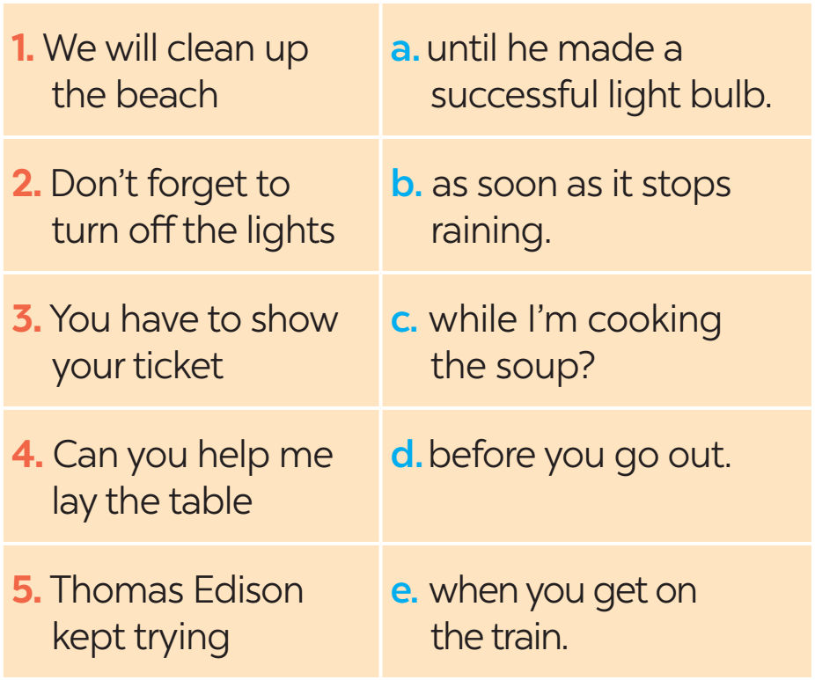
3
Match the clauses in the two columns to form complex sentences.

Slide 10
PRACTICE
4
Combine each pair of sentences, using the conjunction in brackets.
1. I arrive at the station. I will call you right after. (as soon as)
________________________________________________________
________________________________________________________
2. Many Vietnamese women wear conical hats. They work in the field. (when)
___________________________________________________________
3. My father taught me how to use the computer. Then he bought one for me. (before)
_______________________________________________________________
_______________________________________________________________
I will call you as soon as I arrive at the station.
As soon as I arrive at the station, I will call you.
Many Vietnamese women wear conical hats when they work in the field.
When many Vietnamese women work in the field, they wear conical hats.
My father taught me how to use the computer before he bought one for me.
Before my father bought me a computer, he taught me how to use it.

Slide 11
PRACTICE
4
Combine each pair of sentences, using the conjunction in brackets.
4. Nick is reading a novel. Jack is reading a cartoon. (while)
________________________________________________________
________________________________________________________
5. The tornado hit. There were only a few houses left standing. (after)
________________________________________________________
________________________________________________________
Nick is reading a novel while Jack is reading a cartoon.
While Nick is reading a novel, Jack is reading a cartoon.
After the tornado hit, there were only a few houses left standing.
There were only a few houses left standing after the tornado hit.

Slide 12

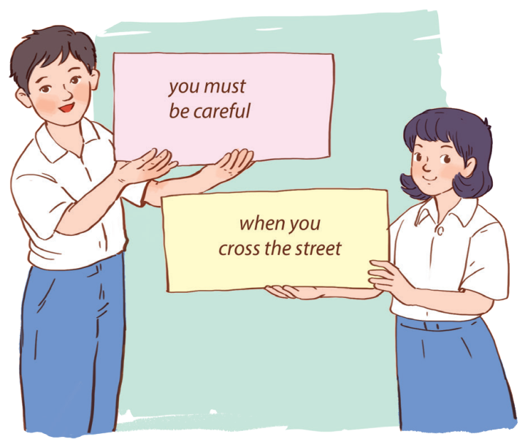
* PRODUCTION
5
Matching game:
Work in two groups, A and B.
Group A:
write main clauses
Group B:
write adverb clauses of time

Slide 13
* Game: Sentence puzzling
I / take a bath /always/ I go to bed./ before/
2. you/ Will / wait here / I am / until/ ready?
3. I / was not/ at home / he / to see / when / came / me.
4. I/ will / get home / you / call / as soon as/ I
→ I always take a bath before I go to bed.
→ Will you wait here until I am ready?
→ I was not at home when he came to see me.
I will call you as soon as I arrive at the station.

Slide 14

* Game: Sentence puzzling
1. I always take a bath before I go to bed.
2. Will you wait here until I am ready?
ADVERB CLAUSES OF TIME
3. I was not at home when he came to see me.
4. I will call you as soon as I arrive at the station.

Slide 15

* CONSOLIDATION
What have we learnt in this lesson?
use the Complex sentences with adverb clauses of time;

Slide 16

Homework
Do exercise in the workbook.
Prepair lesson 4 – Communication

Slide 17

Thanks for your atendance!
Goodbye. See you again
Notes:
17

