Slide 2



Unit
4
MY NEIGHBOURHOOD
LESSON 4: COMMUNICATION
1

Slide 3
LESSON 4: COMMUNICATION
LESSON 1: GETTING STARTED
WARM-UP
Guessing game
Task 1: Listen and read the conversations.
Task 2: Make similar conversations.
EVERYDAY ENGLISH
Task 3: Listen and fill in the blanks.
Task 4: Create an audio guide.
Task 5: Present your audio guide.
AN AUDIO GUIDE TO A PLACE
CONSOLIDATION
Wrap-up
Homework

Slide 4
WARM-UP
LOOK AT THE PHOTOS
GUESSING
GAME
WHERE IS THIS?

Slide 5
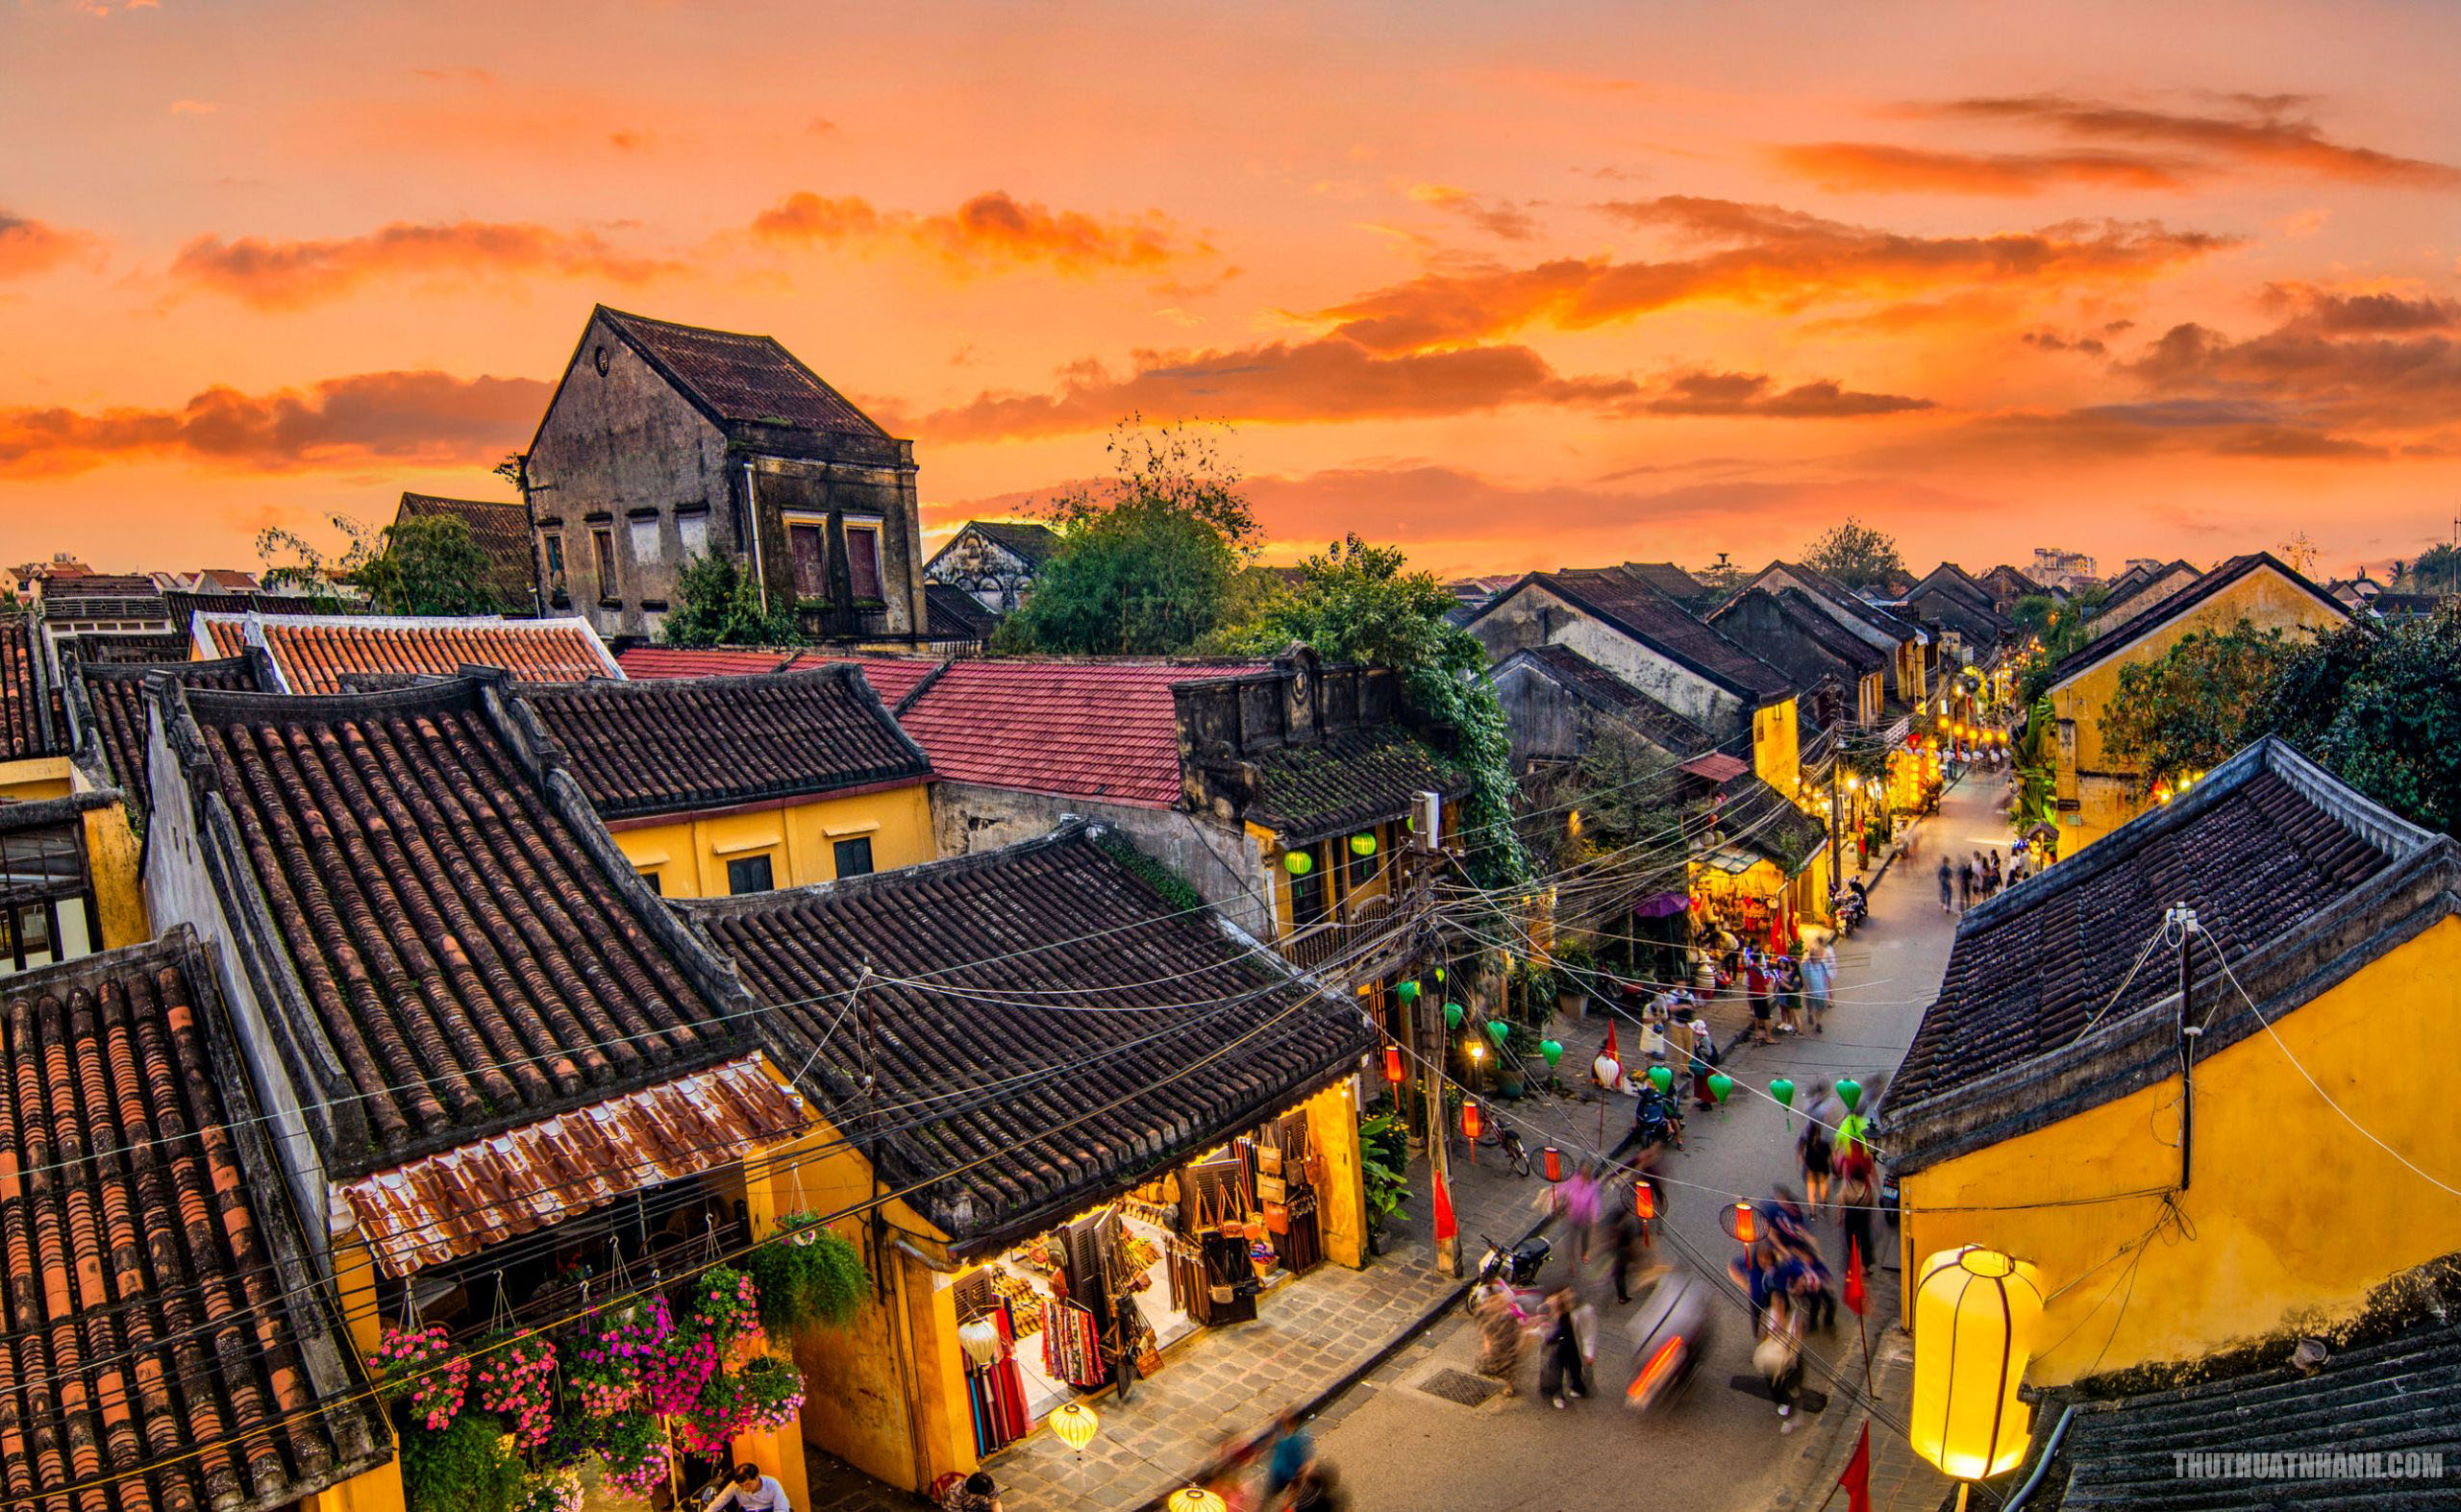
WARM-UP

Slide 6
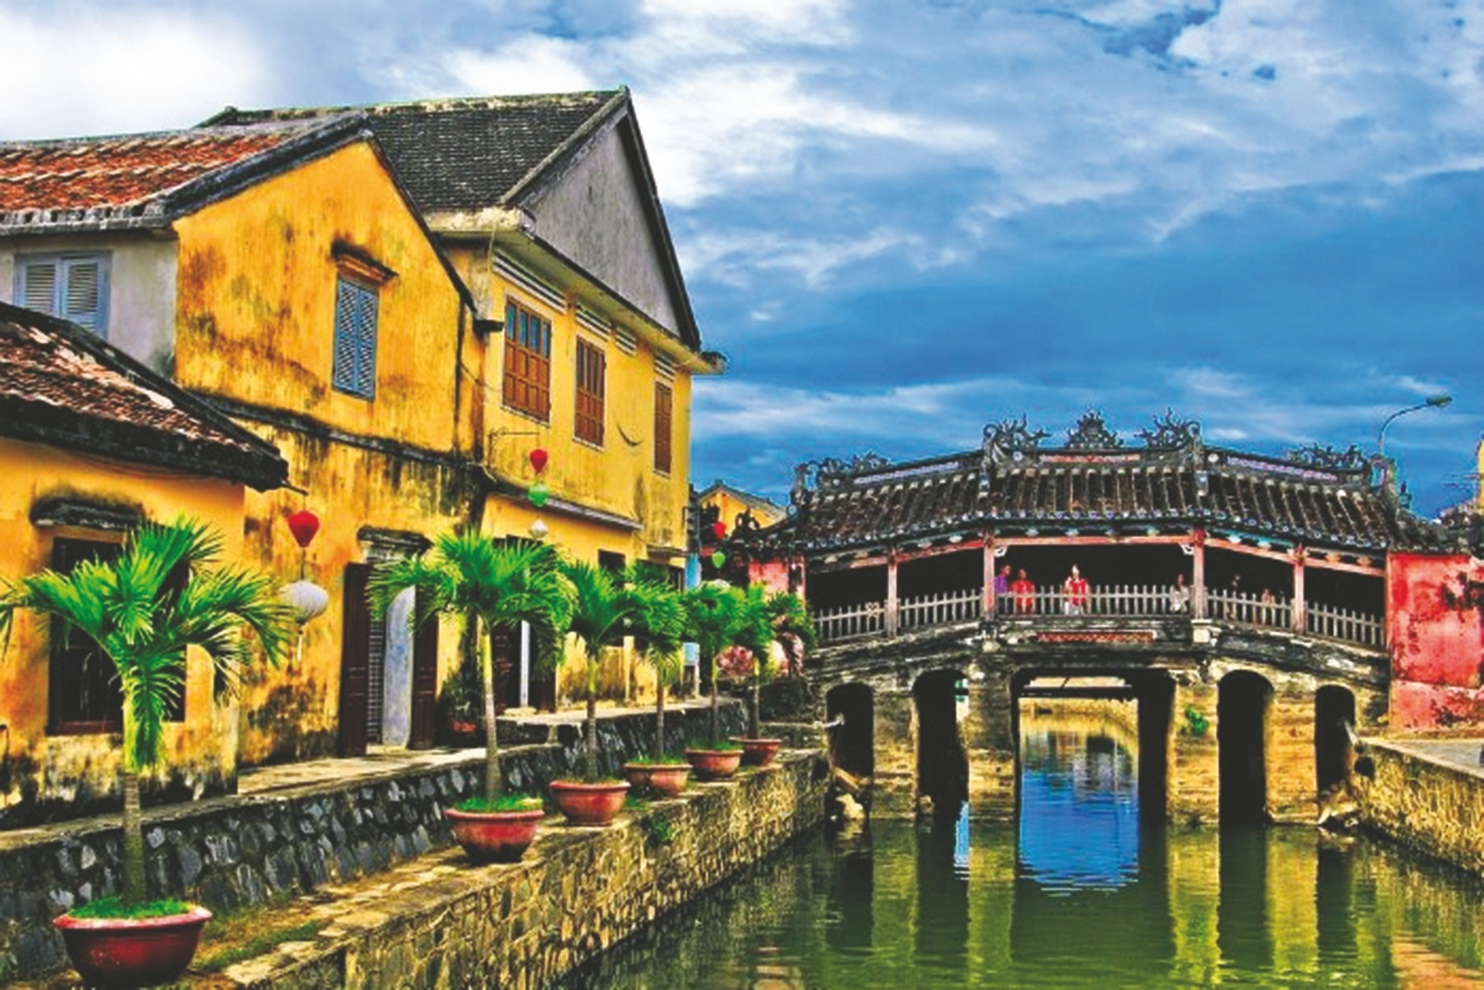
WARM-UP

Slide 7
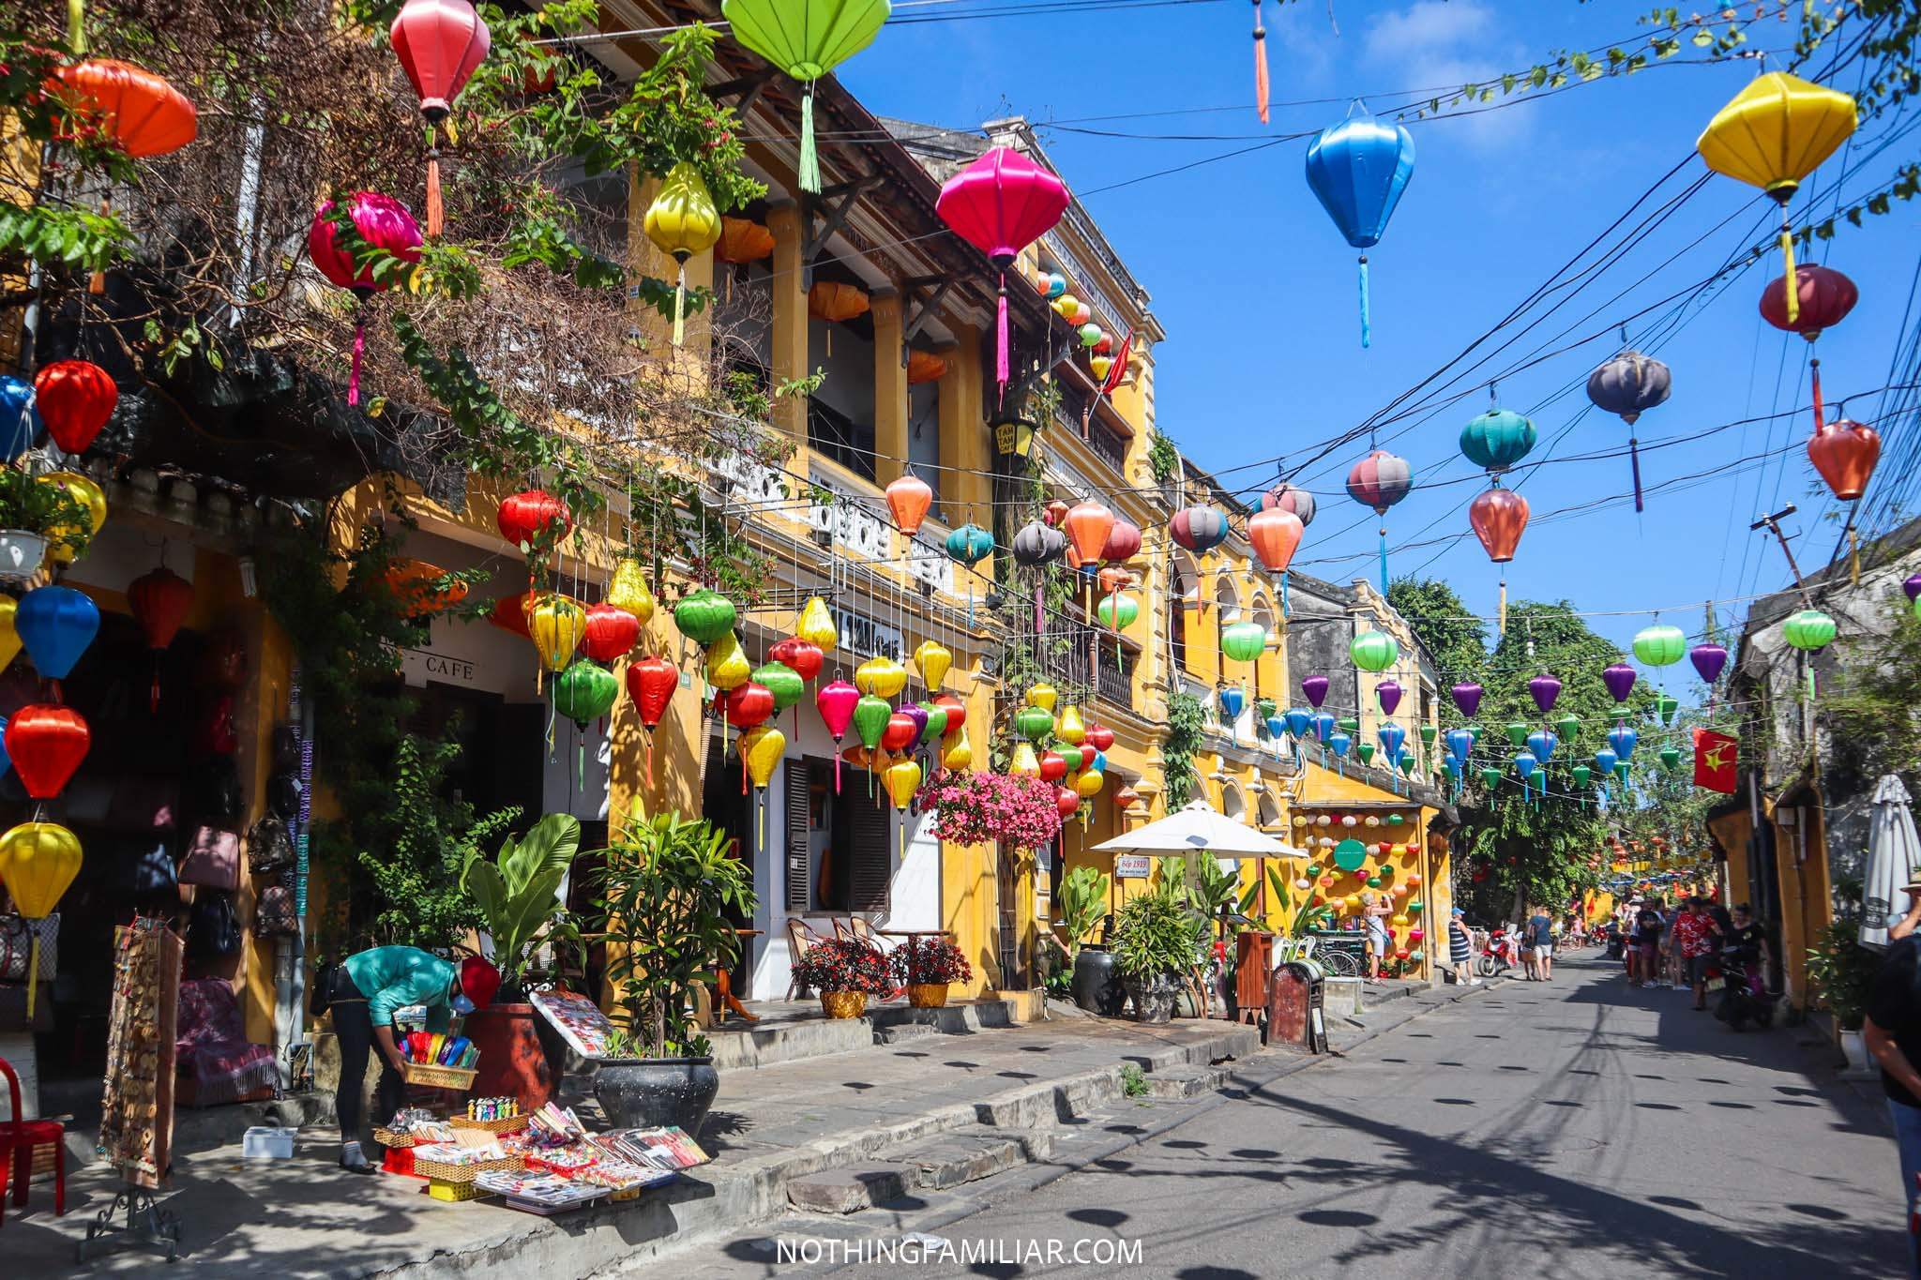
WARM-UP

Slide 8

WARM-UP

Slide 9

EVERYDAY ENGLISH
1
1
Listen and read the conversation
A: Excuse me. Could you tell me the way to the cinema, please?
B: Go along this street. It’s on your left.
A: Excuse me. Where’s the nearest post office, please?
B: Go out of the station. Take the first turning on the right.

Slide 10
EVERYDAY ENGLISH
Ask for directions:
- Could you tell me the way to …?
- Where’s the nearest …?
Give directions:
- Go along this street.
- Go straight ahead.
- Take the first turning on the right.
- It’s on your left.

Slide 11



EVERYDAY ENGLISH
2
Work in pairs. Make similar conversations to ask for and give directions to places near your school.
Work in pairs.
3 mins
Choose a place around your school
Ask for and give directions to the place
Student A
Ask
switch turns
Student B
Give directions

Slide 12

AN AUDIO GUIDE TO A PLACE
3
Listen and fill the blanks.
Let's start our tour in Hoi An. We are in Tran Phu Street now. First, go to Ong Pagoda. To get there, go (1) ___________along the street for five minutes. It's on your left. Next, go to the Museum of Sa Huynh Culture. Take the (2) __________ turning on your left. Turn (3) ________ and it's on your right. Finally, go to Hoa Nhap Workshop to buy some presents. Turn left and then right. It's (4) ___________Tan Ky House.
straight
second
right
next to

Slide 13
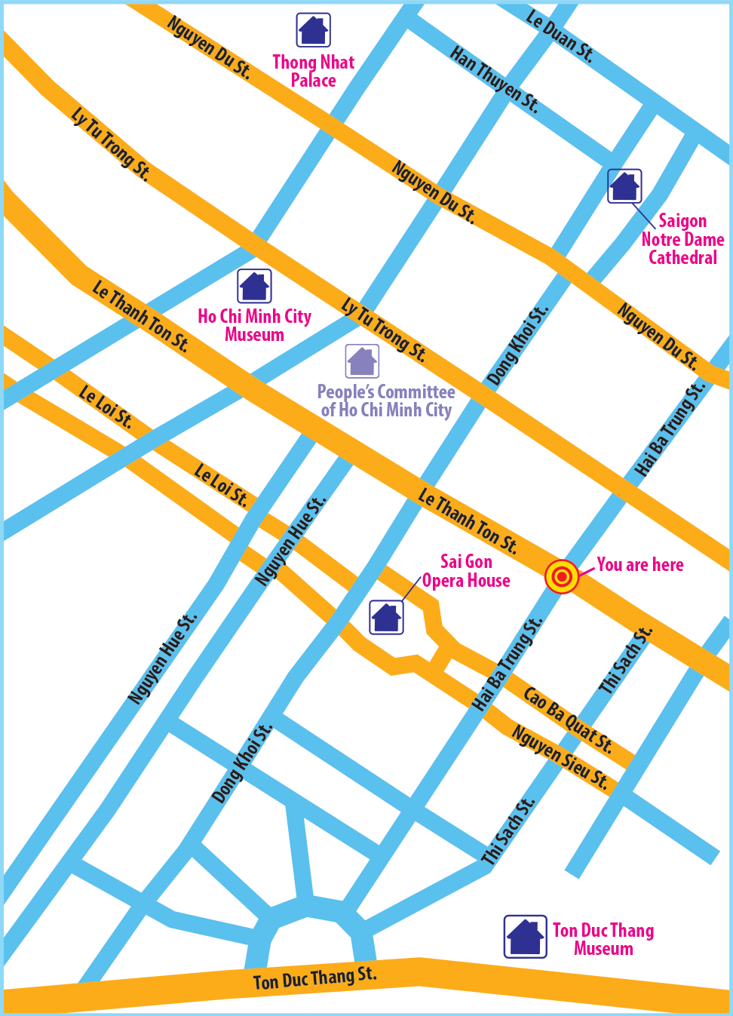
AN AUDIO GUIDE TO A PLACE
4
Look at the map and create an audio guide for District 1 of Ho Chi Minh City.
1. Where exactly are you in Ho Chi Minh City?
2. Are there any beautiful places and restaurants near you?
3. Can you give directions to these places?

Slide 14

AN AUDIO GUIDE TO A PLACE
5
Present your audio guide to your class
Let’s start our tour in Ho Chi Minh City. We are in Hai Ba Trung street now. First, go to

Slide 15

CONSOLIDATION
1
Wrap-up
What have we learnt in this lesson?
Everyday English: asking for and giving directions in a neighbourhood
Making an audio guide of directions

Slide 16

CONSOLIDATION
2
Homework
Do exercises in the workbook.

Slide 17






Website: hoclieu.vn
Fanpage: facebook.com/www.tienganhglobalsuccess.vn/

