Slide 2



Unit
7
TELEVISION
LESSON 5: SKILLS 1
1

Slide 3
LESSON 5: SKILLS 1
LESSON 1: GETTING STARTED
WARM-UP
Guessing game: TV channels
Vocabulary
Task 1: Read the first two columns of the TV guide and answer the questions.
Task 2: Read the TV guide in Task 1 and write the programmes that these people may choose to watch.
READING
Task 3: Work in groups. Share your table in Task 2 with your group and see if they agree with you.
Task 4: Work in groups. Tell your group about your favourite TV programme.
SPEAKING
CONSOLIDATION
Wrap-up
Homework

Slide 4

WARM-UP
GUESSING GAME
WHAT IS THIS TV CHANNEL?

Slide 5

WARM-UP
DISCOVERY CHANNEL

Slide 6

WARM-UP
DISNEY CHANNEL

Slide 7

WARM-UP
CARTOON NETWORK

Slide 8

WARM-UP
CNN

Slide 9
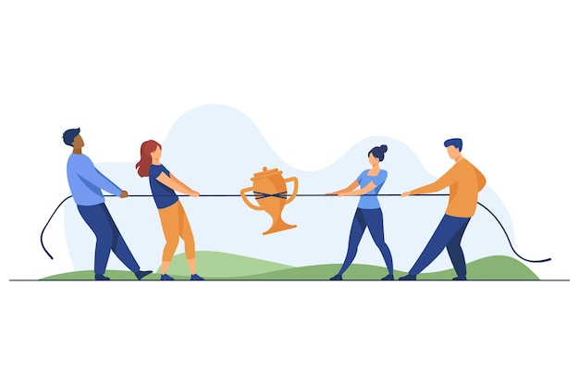

READING
compete (v)
/kəmˈpiːt/
cạnh tranh, thi đấu

Slide 10
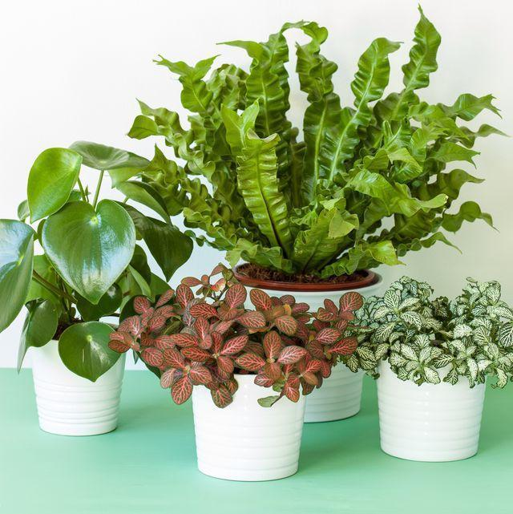
READING
plant (n)
/plɑːnt/
cây xanh

Slide 11
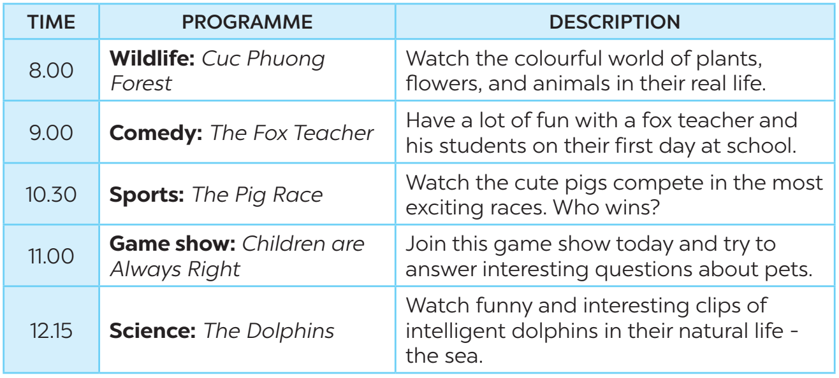
READING
1
Read the first two columns of the TV guide and answer the questions.

Slide 12
READING
1
Read the first two columns of the TV guide and answer the questions.
1. What's in the Wildlife programme?
2. Is The Fox Teacher a comedy?
3. What time is the Sports programme?
→ It's Cuc Phuong Forest.
→ Yes, it is.
→ It's on at 10.30.

Slide 13
READING
1
Read the first two columns of the TV guide and answer the questions.
4. Can we watch a game show at 10.30?
5. What is the topic of the Science programme?
→ No, we can’t.
→ It's about dolphins.

Slide 14
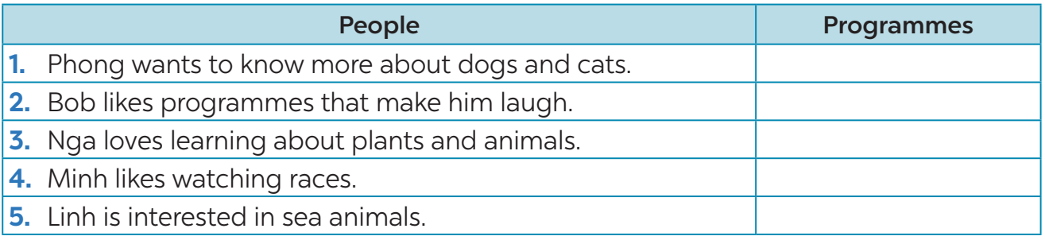
READING
2
Read the TV guide in Task 1 and write the programmes that these people may choose to watch.
Children are always right.
The Fox teacher
Cuc Phuong forest
The Pig race
The Dolphins

Slide 15
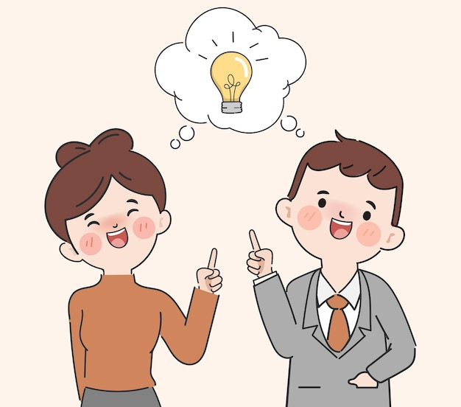
SPEAKING
3
Work in groups. Share your table in Task 2 with your group and see if they agree with you.
﻿Example:
A: I think the best programme for Phong is the game show Children are Always Right.
B: I agree. He wants to know more about pets.

Slide 16
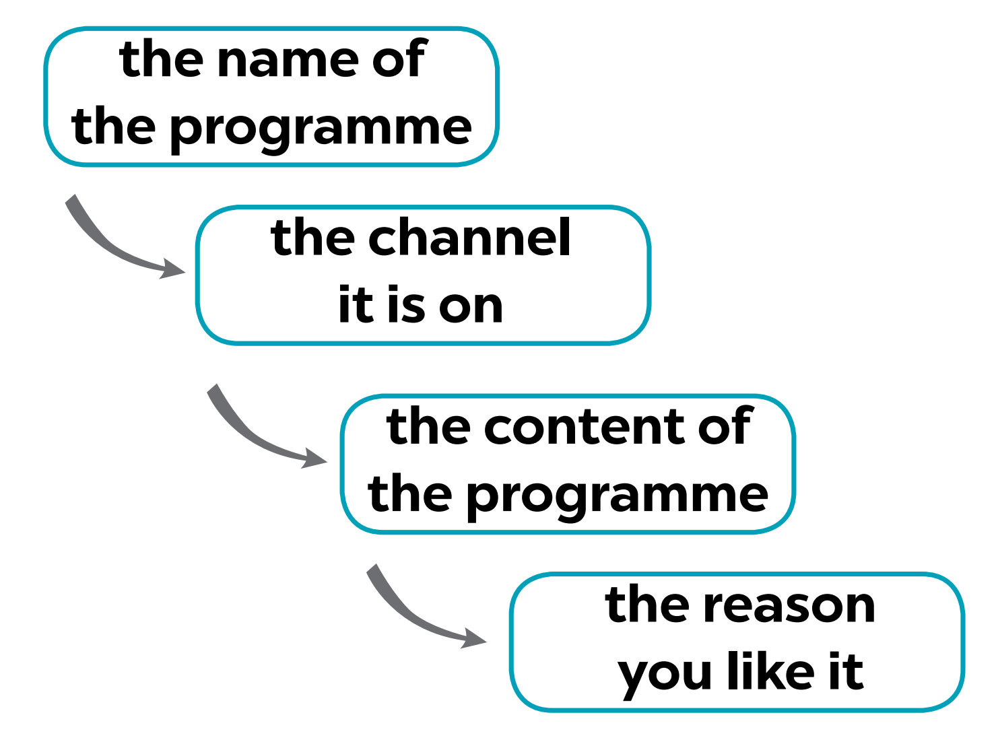
SPEAKING
4
Work in groups. Tell your group about your favourite TV programme.
Suggestions:
- My favourite programme is...
- It’s on ...
- It’s about ...
- I like it because it ...

Slide 17

CONSOLIDATION
1
Wrap-up
What have we learnt in this lesson?
Reading
Speaking

Slide 18

CONSOLIDATION
2
Homework
- Do exercises in the workbook
- Prepare for the next lesson: Skills 2.

Slide 19






Website: hoclieu.vn
Fanpage: facebook.com/www.tienganhglobalsuccess.vn/

