Slide 2



Unit
7
TELEVISION
LESSON 6: SKILLS 2
1

Slide 3
LESSON 6: SKILLS 2
LESSON 1: GETTING STARTED
WARM-UP
Kim’s game
Task 1: Listen and tick the correct channel for each programme.
Task 2: Listen again and tick T (True) or F (False).
LISTENING
Task 3: Read the questions and circle the right answers for yourself.
Task 4: Write a paragraph of about 50 words about your TV-viewing habits. Use your answers in Task 3.
WRITING
CONSOLIDATION
Wrap-up
Homework

Slide 4

WARM-UP
KIM’S GAME!!!

Slide 5
WARM-UP
5 pictures on the slides
Look closely
Call out the name of the TV shows
KIM’S GAME!!!

Slide 6





WARM-UP

Slide 7
WARM-UP
1. Year-end Meeting
2. News
3. Who is the Millionaire?
4. Rap Viet
5. Who is Single?

Slide 8

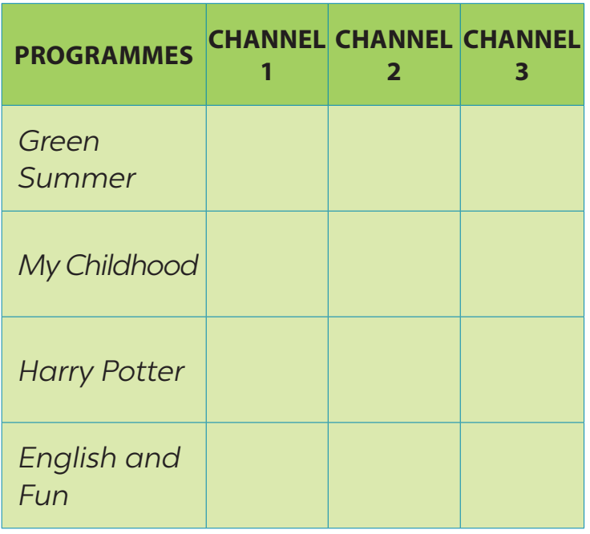

LISTENING
1
Listen and tick the correct channel for each programme.

Slide 9
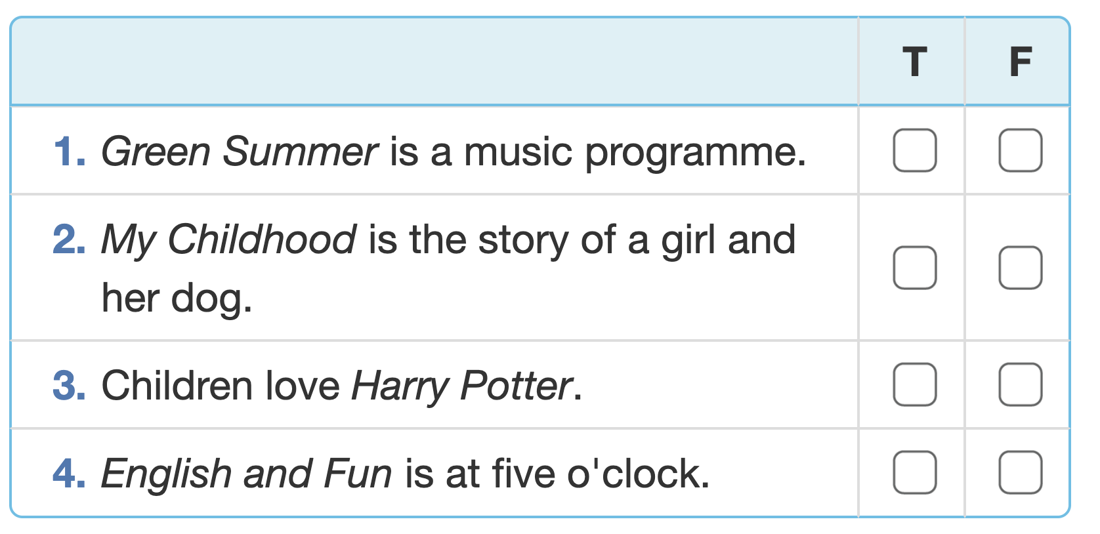
LISTENING
2
Listen again and tick T (True) or F (False).

Slide 10
WRITING
3
Read the questions and circle the right answers for yourself.
﻿1. How much do you like watching TV?
A. A lot. B. So so. C. Not much.
2. How many hours a day do you watch tv?
A. 1 hour. B. 2–3 hours. C. Less than one hour.
3. When do you watch tv the most?
A. In the morning. B. In the afternoon. C. In the evening.
4. Do you watch tv when you are eating?
A. Always. B. Sometimes. C. Never.
5. What tv programme do you watch the most?
A. Cartoons. B. Sports. C. Science.

Slide 11
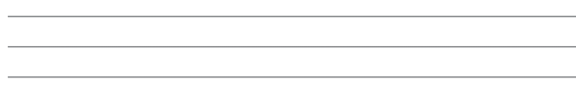
WRITING
4
Write a paragraph of about 50 words about your TV-viewing habits. Use your answers in Task 3.

Slide 12

CONSOLIDATION
1
Wrap-up
What have we learnt in this lesson?
Listening
Writing

Slide 13

CONSOLIDATION
2
Homework
- Rewrite the paragraph in the notebook.
- Do exercises in the workbook.

Slide 14






Website: hoclieu.vn
Fanpage: facebook.com/www.tienganhglobalsuccess.vn/

