Slide 2


Unit
7
TELEVISION
LESSON 2: A CLOSER LOOK 1
VOCABULARY
PRONUNCIATION
TV shows and adjectives to describe
/θ/ and /ð/
1

Slide 3
LESSON 2: A CLOSER LOOK 1
LESSON 1: GETTING STARTED
WARM-UP
Matching
Vocabulary
Task 1: Write the words/ phrases in the box next to the definition.
Task 2: Complete the sentences with the words/ phrases in the box.
Task 3: Complete the sentences with the adjectives in the box.
VOCABULARY
PRONUNCIATION
Task 4: Listen and repeat the words.
Task 5: Tongue Twister.
CONSOLIDATION
Wrap-up
Homework

Slide 4

WARM-UP
MATCHING
6 sets of pictures
Work in groups, match the names with the pictures
Say ‘Bingo’ and stick the work on board

Slide 5
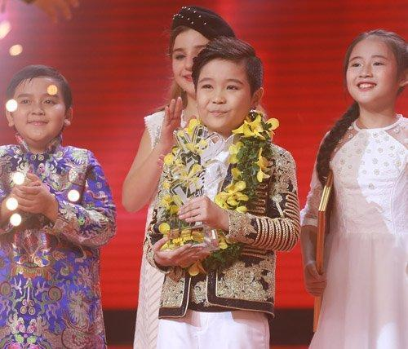
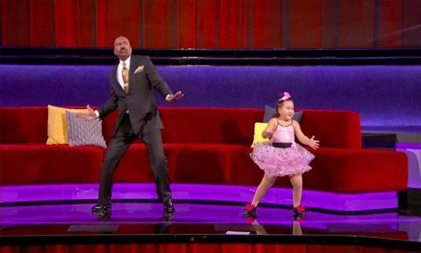
TALENT SHOWS
WARM-UP
Little Big Shots
The Voice Kids

Slide 6
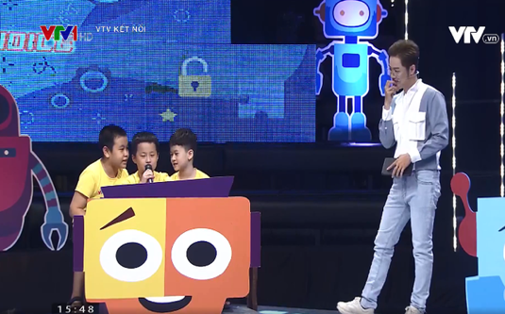
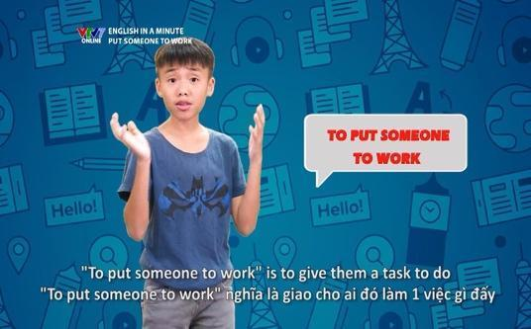
EDUCATIONAL SHOWS
WARM-UP
English in a minute
Alo English

Slide 7
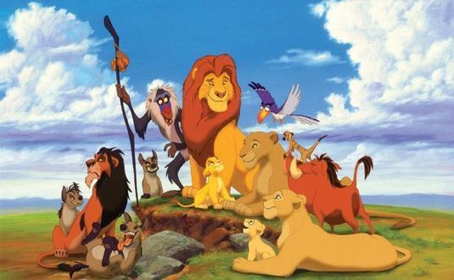

ANIMATED FILMS
WARM-UP
The Lion King
Moana

Slide 8
01
New words

Slide 9
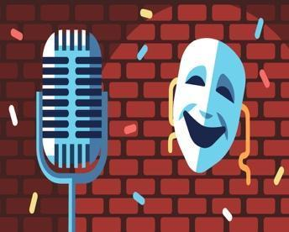

VOCABULARY
comedy (n)
/ˈkɒmədi/
hài kịch

Slide 10
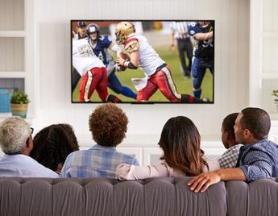
VOCABULARY
viewer (n)
/ˈvjuːə(r)/
người xem

Slide 11
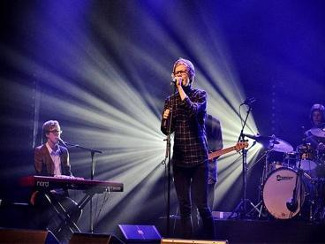
VOCABULARY
performer (n)
/pəˈfɔːmə(r)/
người biểu diễn

Slide 12

VOCABULARY
popular (adj)
/ˈpɒpjələ(r)/
phổ biến, được nhiều người biết đến

Slide 13
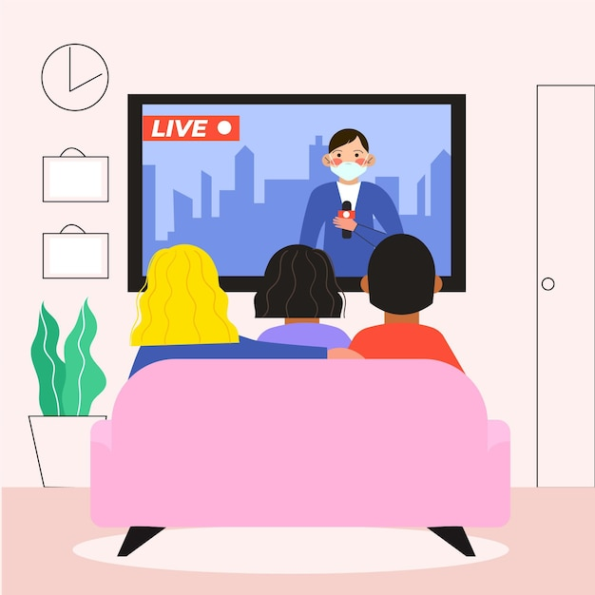
VOCABULARY
live (adj)
/laɪv/
(phát sóng) trực tiếp

Slide 14

VOCABULARY
boring (adj)
/ˈbɔːrɪŋ/
buồn chán

Slide 15
VOCABULARY
New words | Pronunciation | Meaning
1. comedy (n) | /ˈkɒmədi/ | hài kịch
2. viewer (n) | /ˈvjuːə(r)/ | người xem
3. performer (n) | /pəˈfɔːmə(r)/ | người biểu diễn
4. popular (adj) | /ˈpɒpjələ(r)/ | phổ biến
5. live (adj) | /laɪv/ | (phát sóng) trực tiếp
6. boring (adj) | /ˈbɔːrɪŋ/ | buồn chán

Slide 16
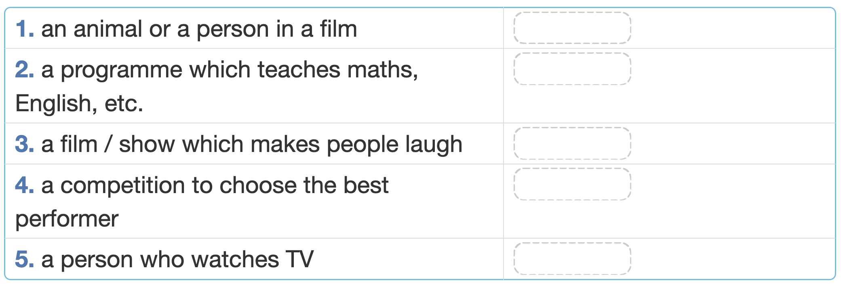
VOCABULARY
1
Write the words/ phrases in the box next to the definition.
Talent show
Educational programme
Viewer
Comedy
Character

Slide 17
VOCABULARY
1
Write the words/ phrases in the box next to the definition.
Talent show
Educational programme
Viewer
Comedy
Character

Slide 18
VOCABULARY
1
Write the words/ phrases in the box next to the definition.
Talent show
Viewer
Comedy
Character
Educational programme

Slide 19
VOCABULARY
1
Write the words/ phrases in the box next to the definition.
Talent show
Viewer
Character
Educational programme
Comedy

Slide 20
VOCABULARY
1
Write the words/ phrases in the box next to the definition.
Viewer
Character
Educational programme
Comedy
Talent show

Slide 21
VOCABULARY
1
Write the words/ phrases in the box next to the definition.
Character
Educational programme
Comedy
Talent show
Viewer

Slide 22
VOCABULARY
2
Complete the sentences with the words/ phrases in the box.
character animated films viewers
comedies game show channel
1. Do you watch Bibi, the popular ____________ for children?
2. Which ____________ do you prefer: Jerry the mouse or Tom the cat?
3. I love _________________ like Happy Feet and Coco.
4. I love Children are Always Right, a ____________ for kids.
5. My father often watches ____________. They're so funny.
6. A popular programme has a lot of ____________.

Slide 23
VOCABULARY
2
Complete the sentences with the words/ phrases in the box.
character animated films viewers
comedies game show
1. Do you watch Bibi, the popular channel for children?
2. Which ____________ do you prefer: Jerry the mouse or Tom the cat?
3. I love _________________ like Happy Feet and Coco.
4. I love Children are Always Right, a ____________ for kids.
5. My father often watches ____________. They're so funny.
6. A popular programme has a lot of ____________.

Slide 24
VOCABULARY
2
Complete the sentences with the words/ phrases in the box.
animated films viewers
comedies game show
1. Do you watch Bibi, the popular channel for children?
2. Which character do you prefer: Jerry the mouse or Tom the cat?
3. I love _________________ like Happy Feet and Coco.
4. I love Children are Always Right, a ____________ for kids.
5. My father often watches ____________. They're so funny.
6. A popular programme has a lot of ____________.

Slide 25
VOCABULARY
2
Complete the sentences with the words/ phrases in the box.
viewers
comedies game show
1. Do you watch Bibi, the popular channel for children?
2. Which character do you prefer: Jerry the mouse or Tom the cat?
3. I love animated films like Happy Feet and Coco.
4. I love Children are Always Right, a ____________ for kids.
5. My father often watches ____________. They're so funny.
6. A popular programme has a lot of ____________.

Slide 26
VOCABULARY
2
Complete the sentences with the words/ phrases in the box.
viewers
comedies
1. Do you watch Bibi, the popular channel for children?
2. Which character do you prefer: Jerry the mouse or Tom the cat?
3. I love animated films like Happy Feet and Coco.
4. I love Children are Always Right, a game show for kids.
5. My father often watches ____________. They're so funny.
6. A popular programme has a lot of ____________.

Slide 27
VOCABULARY
2
Complete the sentences with the words/ phrases in the box.
viewers
1. Do you watch Bibi, the popular channel for children?
2. Which character do you prefer: Jerry the mouse or Tom the cat?
3. I love animated films like Happy Feet and Coco.
4. I love Children are Always Right, a game show for kids.
5. My father often watches comedies. They're so funny.
6. A popular programme has a lot of ____________.

Slide 28
VOCABULARY
2
Complete the sentences with the words/ phrases in the box.
1. Do you watch Bibi, the popular channel for children?
2. Which character do you prefer: Jerry the mouse or Tom the cat?
3. I love animated films like Happy Feet and Coco.
4. I love Children are Always Right, a game show for kids.
5. My father often watches comedies. They're so funny.
6. A popular programme has a lot of viewers.

Slide 29
VOCABULARY
3
Complete the sentences with the adjectives in the box.
popular cute live
educational boring funny
1. The most _______ channel for children is the Cartoon Network.
2. This film is very ________. I don't want to watch it.
3. Cat Kitty is a very ________ character. Children love her.
4. You can watch this programme at the same time it happens. It’s ___.
5. Comedies are ______. People laugh a lot when they watch them.
6. We learn a lot from Discovery Channel. This channel is ______.

Slide 30
VOCABULARY
3
Complete the sentences with the adjectives in the box.
cute live
educational boring funny
1. The most popular channel for children is the Cartoon Network.
2. This film is very ________. I don't want to watch it.
3. Cat Kitty is a very ________ character. Children love her.
4. You can watch this programme at the same time it happens. It’s ___.
5. Comedies are ______. People laugh a lot when they watch them.
6. We learn a lot from Discovery Channel. This channel is ______.

Slide 31
VOCABULARY
3
Complete the sentences with the adjectives in the box.
cute live
educational funny
1. The most popular channel for children is the Cartoon Network.
2. This film is very boring. I don't want to watch it.
3. Cat Kitty is a very ________ character. Children love her.
4. You can watch this programme at the same time it happens. It’s ___.
5. Comedies are ______. People laugh a lot when they watch them.
6. We learn a lot from Discovery Channel. This channel is ______.

Slide 32
VOCABULARY
3
Complete the sentences with the adjectives in the box.
live
educational funny
1. The most popular channel for children is the Cartoon Network.
2. This film is very boring. I don't want to watch it.
3. Cat Kitty is a very cute character. Children love her.
4. You can watch this programme at the same time it happens. It’s ___.
5. Comedies are ______. People laugh a lot when they watch them.
6. We learn a lot from Discovery Channel. This channel is ______.

Slide 33
VOCABULARY
3
Complete the sentences with the adjectives in the box.
educational funny
1. The most popular channel for children is the Cartoon Network.
2. This film is very boring. I don't want to watch it.
3. Cat Kitty is a very cute character. Children love her.
4. You can watch this programme at the same time it happens. It’s live.
5. Comedies are ______. People laugh a lot when they watch them.
6. We learn a lot from Discovery Channel. This channel is ______.

Slide 34
VOCABULARY
3
Complete the sentences with the adjectives in the box.
educational
1. The most popular channel for children is the Cartoon Network.
2. This film is very boring. I don't want to watch it.
3. Cat Kitty is a very cute character. Children love her.
4. You can watch this programme at the same time it happens. It’s live.
5. Comedies are funny. People laugh a lot when they watch them.
6. We learn a lot from Discovery Channel. This channel is ______.

Slide 35
VOCABULARY
3
Complete the sentences with the adjectives in the box.
1. The most popular channel for children is the Cartoon Network.
2. This film is very boring. I don't want to watch it.
3. Cat Kitty is a very cute character. Children love her.
4. You can watch this programme at the same time it happens. It’s live.
5. Comedies are funny. People laugh a lot when they watch them.
6. We learn a lot from Discovery Channel. This channel is educational.

Slide 36

PRONUNCIATION
/θ/ and /ð/

Slide 37
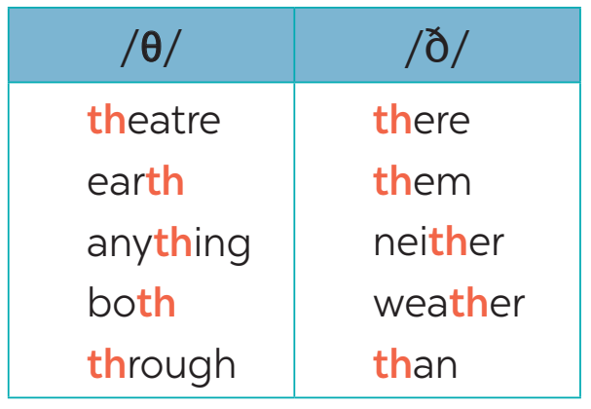
PRONUNCIATION
4
Listen and repeat the words.

Slide 38


Slide 39
PRONUNCIATION
5
Read out loud these sentences.
They are thinking about the weather there.
The new theatre opens on Thursday the third.

Slide 40

CONSOLIDATION
1
Wrap-up
What have we learnt in this lesson?
Vocabulary: TV shows and adjectives
Pronunciation: /θ/ and /ð/

Slide 41

CONSOLIDATION
2
Homework
- Do exercises in the workbook.
- Find 5 more words with /θ/ and 5 more words with /ð/.

Slide 42






Website: hoclieu.vn
Fanpage: facebook.com/www.tienganhglobalsuccess.vn/

