Slide 1


Slide 2

Unit
6
OUR TET HOLIDAY
LESSON 2: A CLOSER LOOK 1

Slide 3




LESSON 2: A CLOSER LOOK 1
LESSON 2: A CLOSER LOOK 1
WARM-UP
Task 1: Hidden pictures
Vocabulary
Task 2: Match the verbs with the nouns.
Task 3: Complete the sentences.
VOCABULARY
PRONUNCIATION
Task 4: Listen and repeat.
Task 5: Listen and repeat the poem.
PRODUCTION
Tongue Twisters
CONSOLIDATION
Wrap-up
Homework

Slide 4
WARM-UP
HIDDEN PICTURES

Slide 5

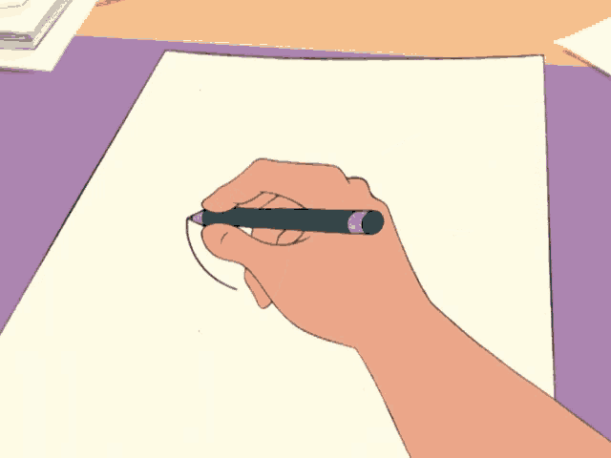
WARM-UP
HOW TO PLAY

Slide 6
WARM-UP
- Work in groups
- The teacher slowly removes the squares while you take turns guessing what picture is hidden behind them.
- If you have right answer, your team will have points.

Slide 7
WARM-UP
LET’S PLAY

Slide 8


fireworks
/ˈfaɪrwɜːks/
SHOW

Slide 9


furniture
/ˈfɜːnɪtʃə(r)/
SHOW

Slide 10
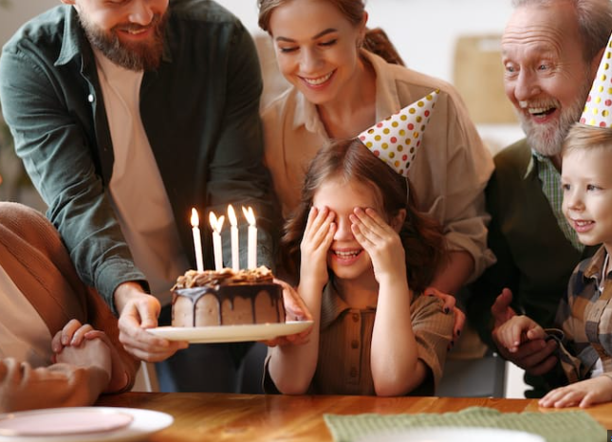
wish
/wɪʃ/
SHOW

Slide 11
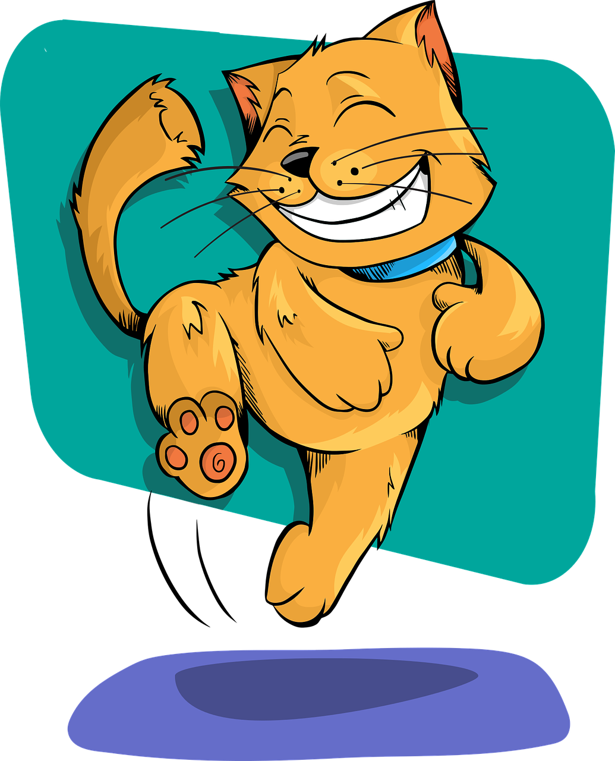
fun
/fʌn/
SHOW

Slide 12
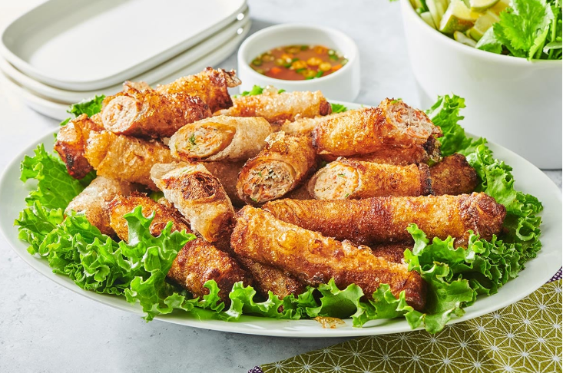
special food
/ˈspeʃl fuːd/
SHOW

Slide 13

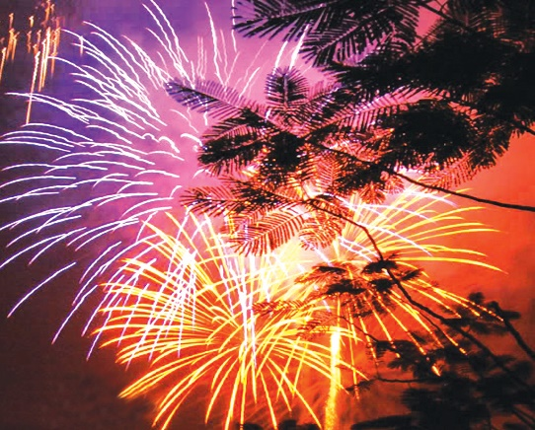
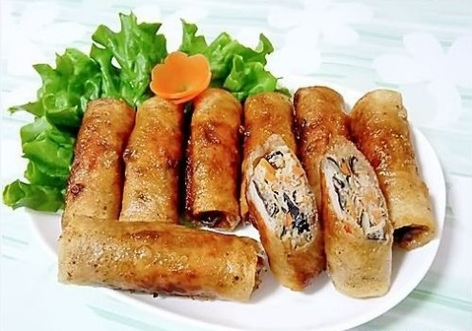

WARM-UP
Write the words / phrases in the box under the pictures.
wish
fun
fireworks
special food
furniture
2. special food
1. fireworks
2.
3. fun
1.
3.

Slide 14
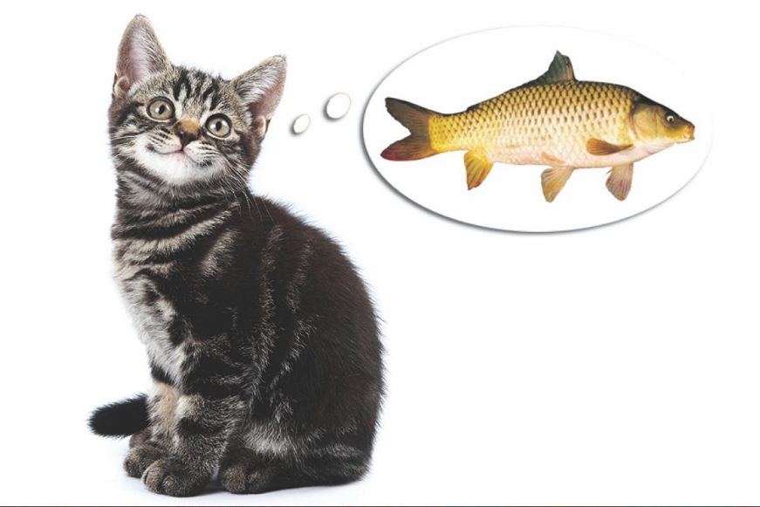
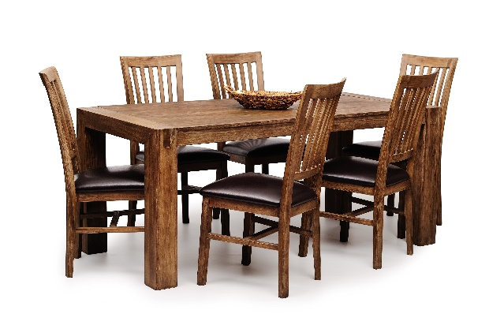
WARM-UP
Write the words / phrases in the box under the pictures.
wish
fun
fireworks
special food
furniture
4. wish
5. furniture
4.
5.

Slide 15

VOCABULARY
Match the verbs with the nouns.
Verbs | Nouns
1. have | a. a wish
2. visit | b. fireworks
3. give | c. the furniture
4. make | d. lucky money
5. clean | e. relatives
6. watch | f. fun
1.
2.
3.
4.
5.
6.
f
e
d
a
c
b

Slide 16
VOCABULARY
3
Complete the sentences with the words in the box.
shopping
celebrate
clean
food
peach
1. In Viet Nam, we ________ Tet in January or February.
2. At Tet, we decorate our houses with _______ flowers.
3. Children should help their parents to _______ their houses.
4. People do a lot of ________ before Tet.
5. My mother usually cooks special _______ during Tet.

Slide 17




PRONUNCIATION
4
Listen and repeat the words.
shopping
special
rice
spring
wish
celebrate

Slide 18

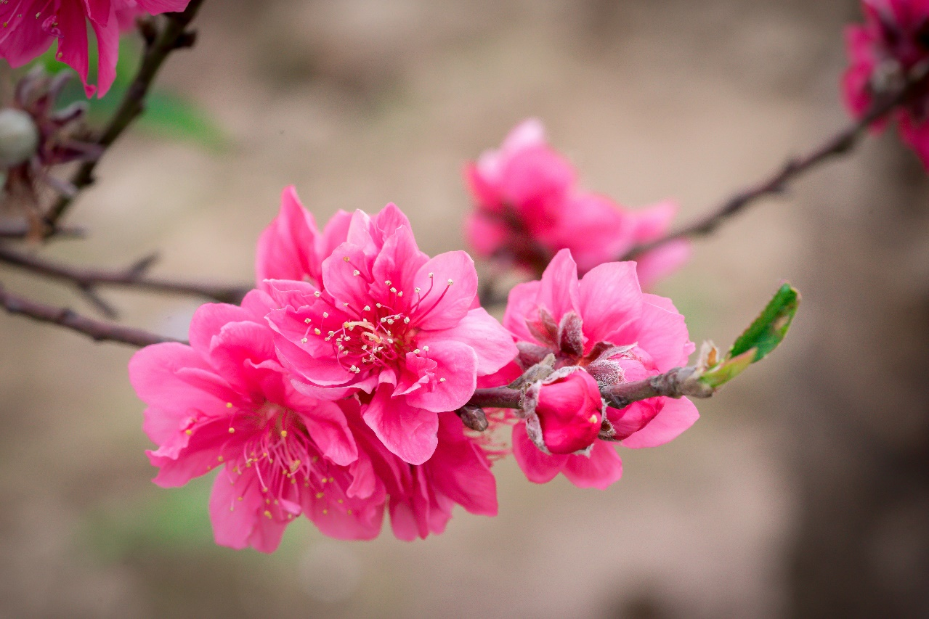
PRONUNCIATION
5
Listen and repeat the poem.
Spring is coming!
Tet is coming!
She sells peach flowers.
Her cheeks shine.
Her eyes smile.
Her smile is shy.
She sells peach flowers.

Slide 19



PRODUCTION
Tounge Twisters

Slide 20

PRODUCTION
- Work in pairs/groups
- Create tongue twisters that include words with the /s/ and /∫/ sounds related to Tet holiday in 5 miutes
Example:
“Sally sent sweet spring wishes during Tet”

Slide 21
PRODUCTION
5 MINUTES

Slide 22

CONSOLIDATION
1
Wrap-up
What have we learnt in this lesson?
Extend and practice vocabulary related to "Tet": things, activities and practices
Pronounce the sounds /s/ and /∫/ correctly

Slide 23

CONSOLIDATION
2
Homework
- Learn new words by heart.
- Practice pronouncing the sound /s/ and /∫/.

Slide 24






Website: hoclieu.vn
Fanpage: facebook.com/www.tienganhglobalsuccess.vn/

