Slide 2



Unit
6
OUR TET HOLIDAY
LESSON 5: SKILLS 1

Slide 3



LESSON 5: SKILLS 1
LESSON 1: GETTING STARTED
WARM-UP
Resolution Race
Vocabulary
Task 1: Read the passages and decide who says sentences.
Task 2: Test your memory!
READING
SPEAKING
Task 3: Discussion.
Task 4: Discussion.
CONSOLIDATION
Wrap-up
Homework

Slide 4
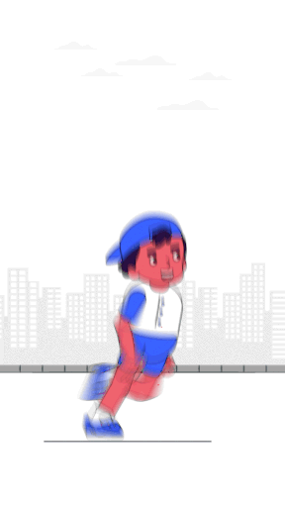
WARM-UP
Resolution
Race

Slide 5
WARM-UP
HOW TO PLAY

Slide 6
WARM-UP
- There is a short list of common New Year's resolutions
- Work in groups
- Write as many resolutions as you can in miniboard (or A0 paper) in 5 minutes
- After the time is up, each group shares your resolutions with the rest of the class.
- The group with the most unique resolutions wins.

Slide 7
WARM-UP
SOME RESOLUTIONS:
- Exercising more
- Reading more books
- Learning new skills

Slide 8
WARM-UP
LET’S START
5 MINUTES

Slide 9



VOCABULARY
cheer (v)
/tʃɪr/
give a loud shout of approval or encouragement

Slide 10
VOCABULARY
strike (v)
/straɪk/
to hit something

Slide 11
VOCABULARY
custom (n)
/ˈkʌstəm/
a way of behaving or a belief that has been stablished for a long time

Slide 12
VOCABULARY
New words | Pronunciation | Meaning
1. cheer (v) | /tʃɪər/ | cổ vũ
2. strike (v) | /straɪk/ | đánh/ điểm (đồng hồ)
3. custom (n) | /ˈkʌstəm/ | phong tục, tập quán

Slide 13

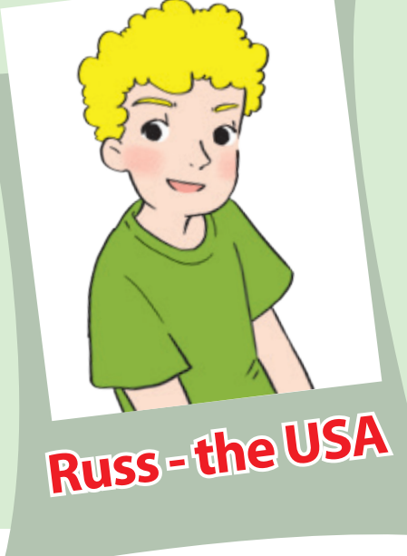
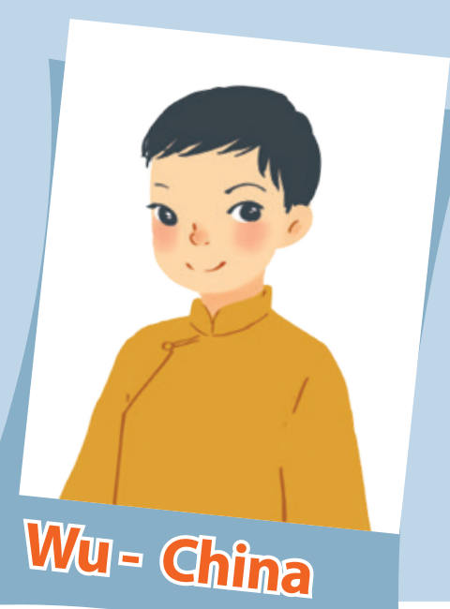
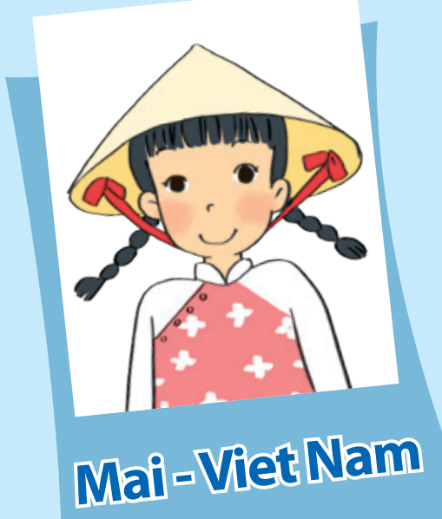
READING
Read the passages and decide who says sentences.

Slide 14
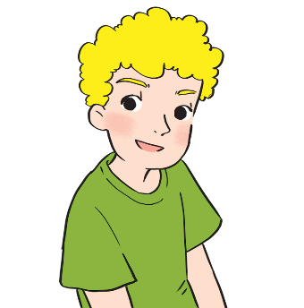
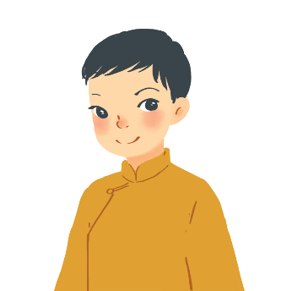
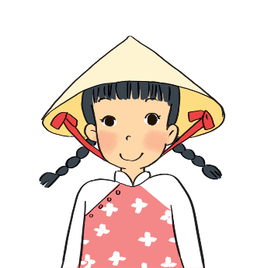
READING
A
I often go to Times Square with my parents to welcome the New Year. When the clock strikes midnight, colourful fireworks light up the sky. Everybody cheers and sings.
Russ – the USA
B
On New Year’s Day, we dress beautifully and go to our grandparents’ houses. We wish them Happy New Year and they give us lucky money. Then we go out and have a day full of fun.
Wu - China
c
I learn some customs about Tet from my parents. People give rice to wish for enough food and buy salt to wish for good luck. Dogs are lucky animals but cats are not. A cat’s cry sounds like "poor" in Vietnamese.
Mai – Viet Nam

Slide 15
READING
A. Russ
B. Wu
C. Mai
Statements | Who
1. Dogs are lucky animals. | C
2. We welcome the New Year at Times Square.
3. Children get lucky money.
4. We give rice to wish for enough food.
5. Children dress beautifully.
A
B
C
B

Slide 16
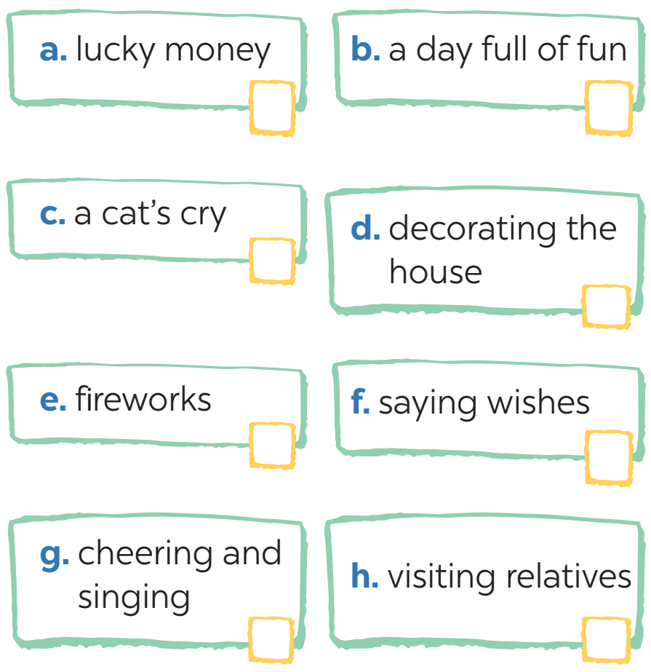


READING
2
Test your memory!
Tick the things which appear in the passages and cross the ones which don’t.

Slide 17

SPEAKING
These are some activities from the reading passages in 1. Tell your group if you do them during Tet.
1. watch fireworks on New Year’s Eve
2. sing when the New Year comes
3. get lucky money
4. go out and have fun
5. dress beautifully
6. buy salt for happiness
Example:
go to Times Square to welcome the New Year
→ I don’t go to Times Square to welcome the New Year.

Slide 18

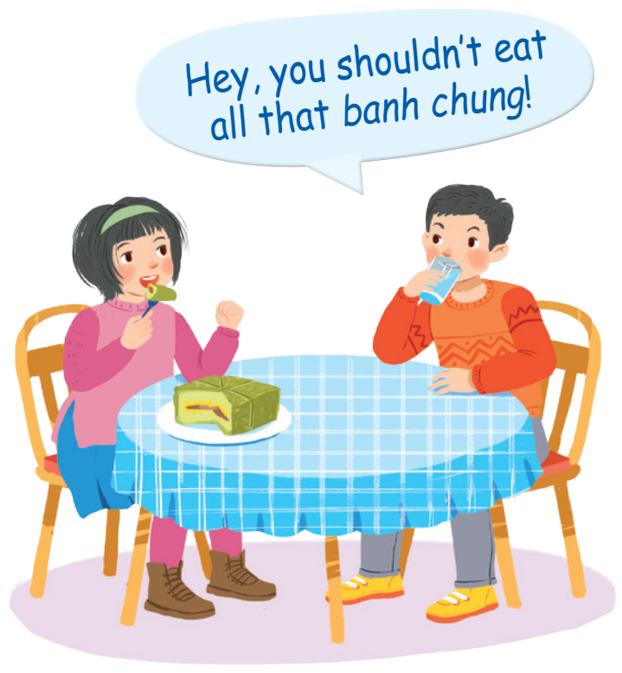
SPEAKING
Read the list and discuss what you should or shouldn’t do at Tet.
– break things
– make a wish
– dress beautifully
– say “Have fun!” to friends
– help decorate our houses
– play games all night
– invite friends home
– ask for lucky money
– play loud music

Slide 19

CONSOLIDATION
1
Wrap-up
What have we learnt in this lesson?
Develop reading skill for general and specific information about the topic
Express judgement about the what children should/ shouldn’t do at Tet

Slide 20

CONSOLIDATION
2
Homework
- Do exercise in workbook
- Search for information about what children should/ shouldn’t do during New Year days in the China, Thailand, Japan or India.

Slide 21






Website: hoclieu.vn
Fanpage: facebook.com/www.tienganhglobalsuccess.vn/

