Slide 1


Slide 2
WARM-UP
Flying car
Hyperloop
Powership
solowheel
MEANS OF TRANSPORT
bus
Bamboo -copter
plane
Car
Driverless car
trains

Slide 3
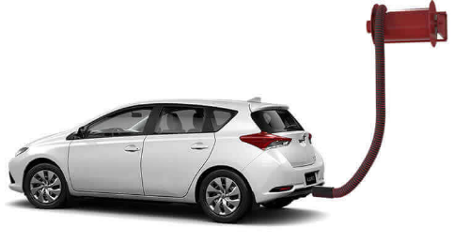
READING: VOCABULARY
run on (phr.v.)
/rʌn ɒn/
chạy bằng
(nhiên liệu nào)

Slide 4



Unit
11
TRAVELLING IN THE FUTURE
LESSON 5: SKILLS 1
READING
SPEAKING
Unit

Slide 5
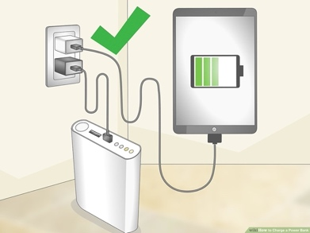
READING: VOCABULARY
charge (v)
/tʃɑːdʒ/
sạc pin

Slide 6
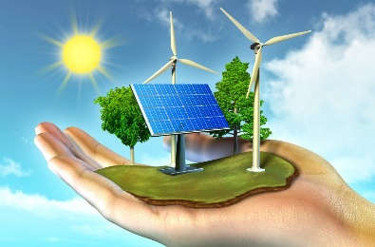
I. READING: VOCABULARY
economical (adj)
/ˌiːkəˈnɒmɪkəl/
tiết kiệm nhiên liệu

Slide 7
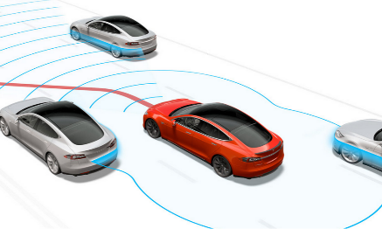
READING: VOCABULARY
autopilot (adj, n)
/ˈɔːtəʊˌpaɪlət/
lái tự động

Slide 8
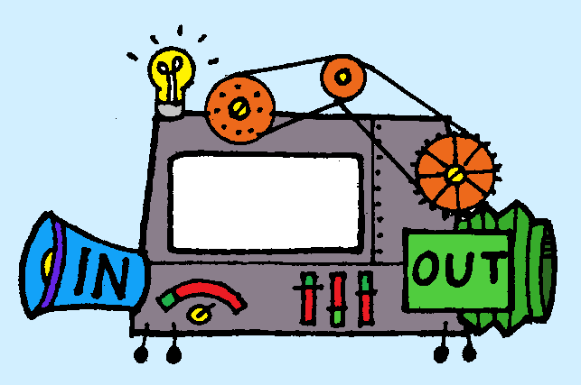
READING: VOCABULARY
function (n)
/ˈfʌŋkʃən/
chức năng

Slide 9
I. READING: VOCABULARY
New words | Pronunciation | Meaning
1. charge (v) | /tʃɑːdʒ/ | sạc pin
2. economical (a) | /ˌiːkəˈnɒmɪkəl/ | tiết kiệm nhiên liệu
3. autopilot (adj, n) | /ˈɔːtəʊˌpaɪlət/ | lái tự động
4. function (n) | /ˈfʌŋkʃən/ | chức năng
5. run on (phr.v.) | /rʌn ɒn/ | chạy bằng (nhiên liệu nào)

Slide 10

I. READING
1
Brainstorming: Look at the picture and find the words or phrases to describe it.
Suggested answer:
The car: convenient, safe, comfortable, modern, automatic, automated, autopilot, etc.
The driver: relaxing / isn’t driving, etc.

Slide 11

II. WHILE-READING
2
Read the passage and answer the question. Roadrunner
Roadrunner is a car company that makes electric cars. The company introduced the first model in 2015 and they named it Speed. Speed soon became a success. Speed is safe, fast, comfortable, and not very expensive. It has four seats. The car can travel over 350 kilometres per hour. You only have to charge the battery every 700 kilometres. It even has a gaming screen inside. The company will introduce a new model next year called Safety. This model will become the largest and safest electric car you can buy. It will be able to carry seven passengers. The new model will also be more economical.Both models have an autopilot function, so they are driverless. Passengers can read, play games, or even sleep while they travel.

Slide 12
II. WHILE-READING
2
Read the passage and answer the question.
﻿What is its main idea?
A. Roadrunner is a success.
B. Roadrunner is a car company.
C. Roadrunner’s cars have an autopilot function.

Slide 13
III. READING
3
Read the passage again and complete the fact file with no more than two words or a number.
Fact file
﻿Name of the company | Roadrunner
Speed was introduced in | (1) ________________
Safety will be the | (2) ________________ and (3) ________________ electric car
Both models have | a gaming screen and an (4) _________________
Both models run on | (5) ________________
Passengers can | read, sleep, play games
2015
safest / largest
largest / safest
autopilot function
electricity

Slide 14
III. READING
3
Retelling.
Tell the class again about the Roadrunner company.

Slide 15

IV. SPEAKING
4
Look at the fact file in 3 then ask and answer questions about it.
Suggested questions:
- When was Speed introduced? / When did they introduce Speed?
- What do you know about Safety? / What is special about Safety?
- What functions do these models have?
- What do these models run on?
- What can passengers do when they are travelling in the car?

Slide 16
IV. SPEAKING
4
Look at the fact file in 3 then ask and answer questions about it.
Suggested questions:
A: What will Safety be?
B: It will be the largest and safest electric car.
A: What will both models have?
B: They will have a gaming screen and an autopilot function.
A: What will both models run on?
B: Electricity.
A: What can passengers do?
B: Read, sleep, play games.

Slide 17

IV. SPEAKING
5
Discuss why Roadrunner’s cars will or won’t become popular in the near future. Report your reasons to the class.
Why Roadrunner’s cars will or won’t become popular in the near future?

Slide 18
IV. SPEAKING
5
Discuss why Roadrunner’s cars will or won’t become popular in the near future. Report your reasons to the class.
Why Roadrunner’s cars will or won’t become popular in the near future?
-We think Roadrunner’s car will become popular in the near future because they are are eco-friendly and canallow passengers read, sleep, play games.
-We think Roadrunner’s car won’t become popular in the near future because they might be dependent on battery.

Slide 19
V. CONSOLIDATION
1
WRAP-UP
READING
SPEAKING

Slide 20
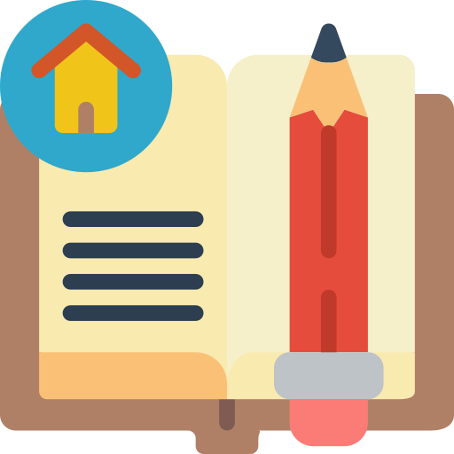
CONSOLIDATION
2
HOMEWORK
Do exercises in the workbook.
Prepare for the next lesson: Skills 2

